Slide 1

Offensive Language Detection: Predicting type and target
TEAM 16

Slide 2
TEAM MEMBERS
NAME | ROLL NUMBER
DINESH KUMAR M. R. | CB.EN.U4AIE20011
K. S. PAVAL | CB.EN.U4AIE20047
SHREYA SANGHAMITRA | CB.EN.U4AIE20066
N. T. SHRISH SURYA | CB.EN.U4AIE20067

Slide 3
Problem Statement
Identifying and categorizing offensive messages.
Sort of offensive language used
The target of the offending content.

Slide 4
Dataset Description
A Hierarchical dataset called OLID is used to pinpoint the nature and audience of inflammatory texts on social media. The Twitter data was gathered and is openly accessible. There are 14,100 total tweets, of which 860 are in the test set and 13,240 are in the training set.

Slide 5
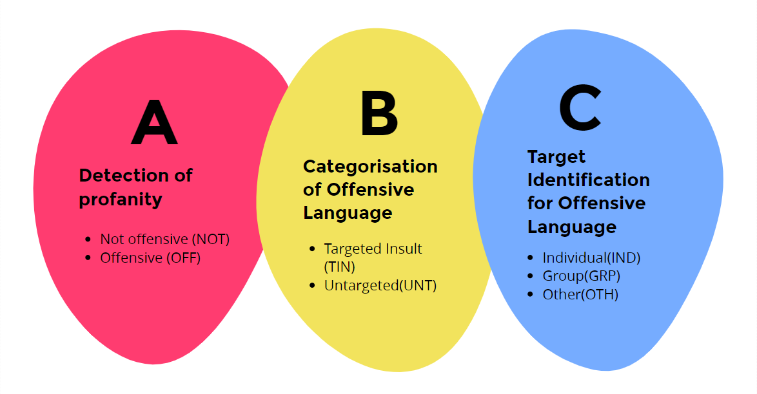
Levels of dataset

Slide 6
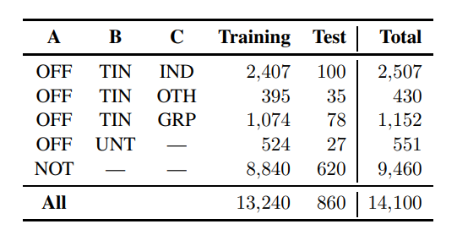
DATA DISTRIBUTION

Slide 7
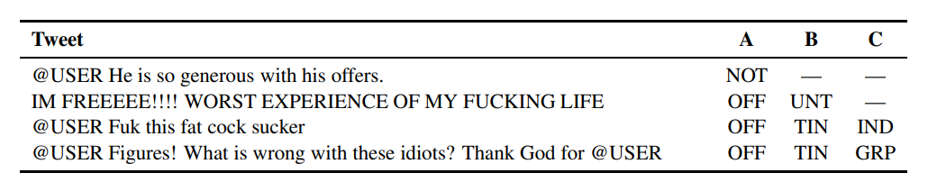
Snippet of Dataset
Four tweets from the dataset, with their labels for each level of the annotation schema.

Slide 8
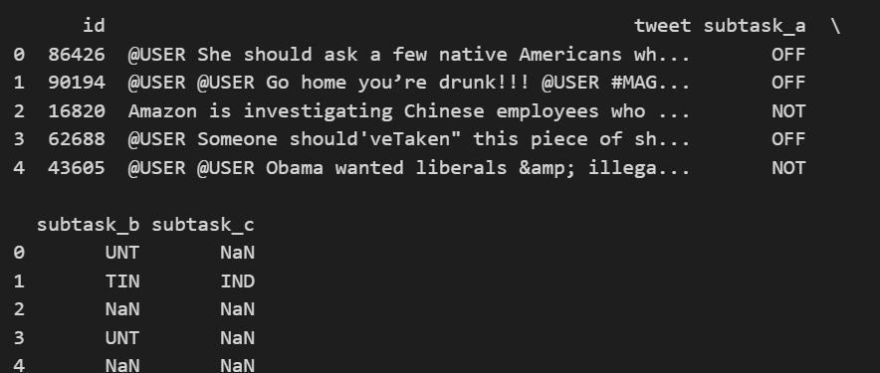
Snippet of Dataset

Slide 9
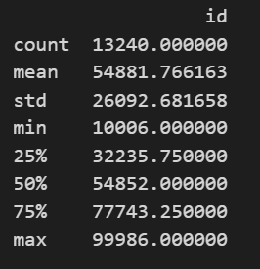
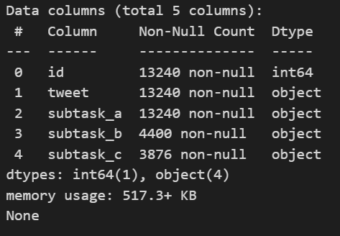
Data Count

Slide 10
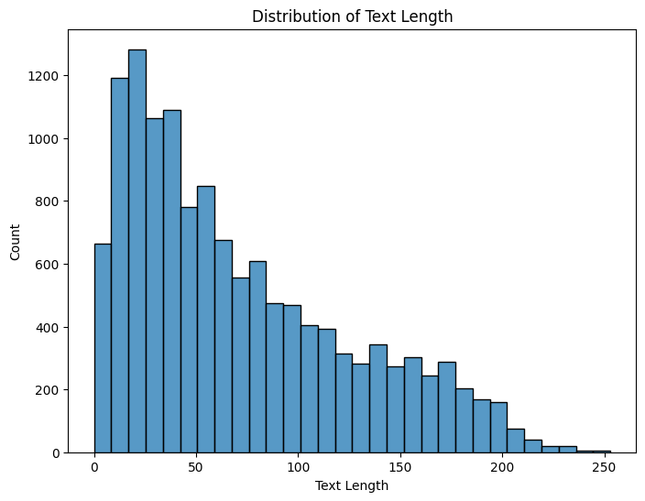
Distribution of text length

Slide 11
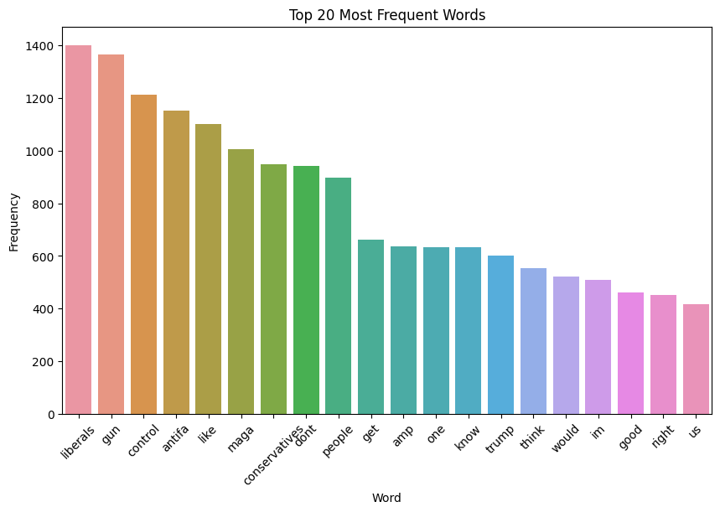
2o most frequent words

Slide 12
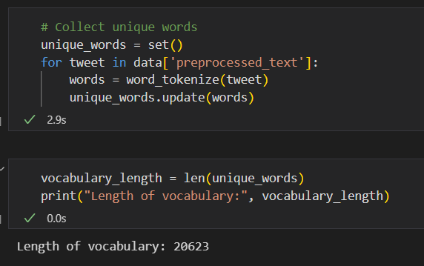
Vocabulary size

Slide 13

METHODOLOGY
SVM
Bi-LSTM
RNN
Meta Learning

Slide 14
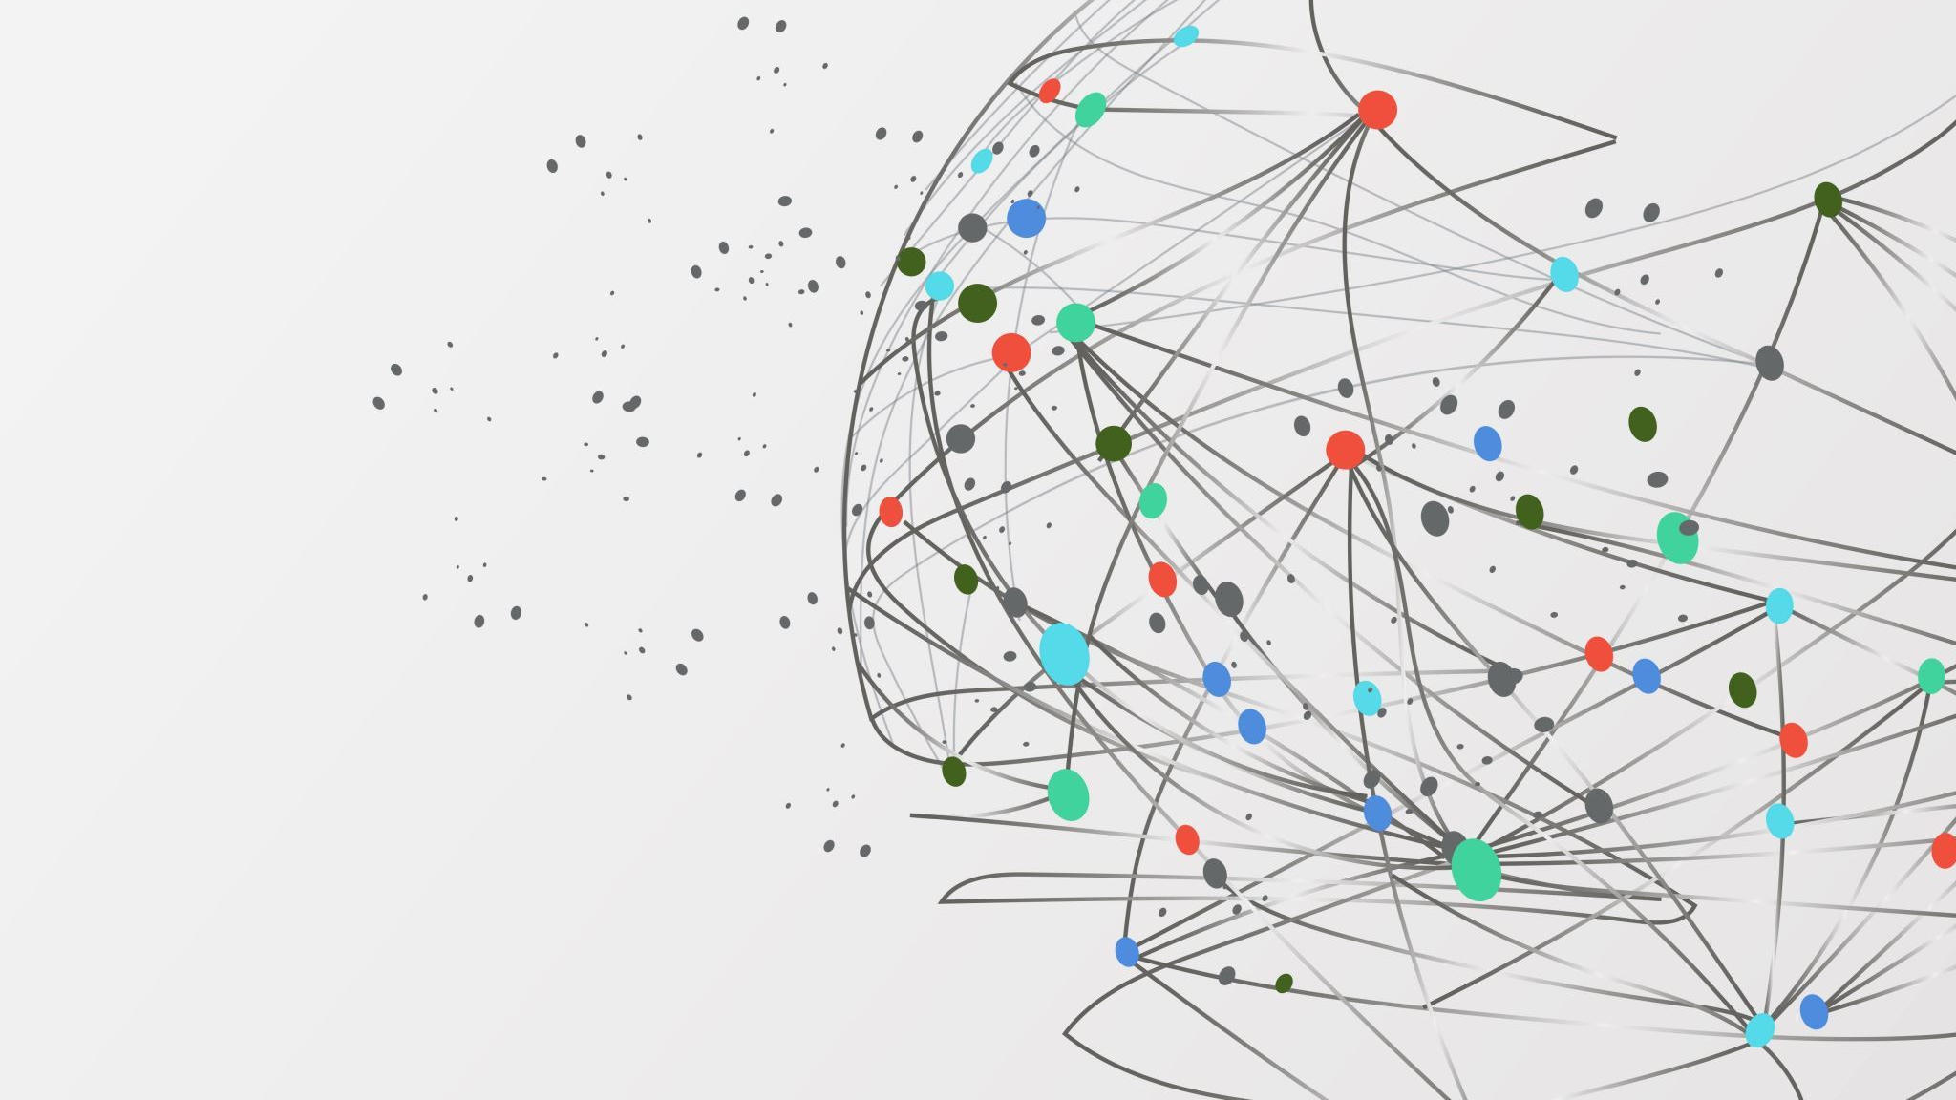
Support vector machines

Slide 15

Support Vector Machines (SVM) is a popular Supervised Learning algorithm used primarily in classification tasks.
The goal of the algorithm is to find an optimal hyperplane that separates the data points of different classes in a binary classification problem.

Slide 16
Pipeline
Load the Data
Data Pre - processing
Join processed data
Split the Data
TF - IDF
Predictions
Vectorize test data
Train the model
Initialize SVM Models

Slide 17
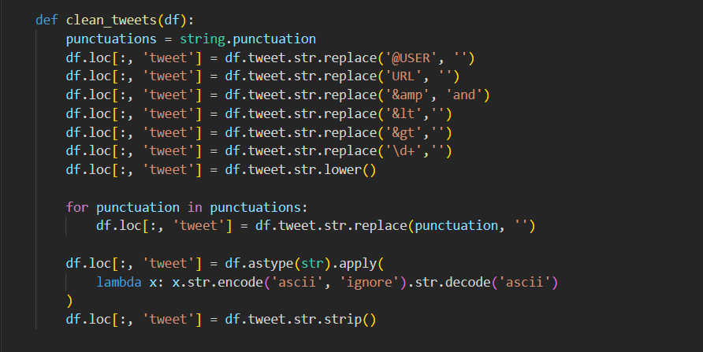
Data preprocessing
Remove punctuations, emojis, numbers and urls from the text, Convert text to lowercase
Drop missing values

Slide 18
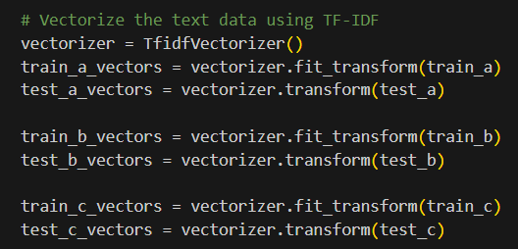
Converting tweets to TF-IDF Representation

Slide 19
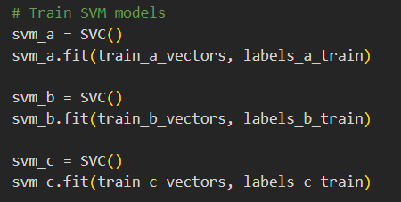
MODEL ARCHITECTURE
This code snippet creates three instances of the Support Vector Machine (SVM) classifier using the 'SVC()' class. Each instance is assigned to a variable named 'svm_a', 'svm_b', and 'svm_c'.
The 'fit()' method is used to train the 3 SVM models

Slide 20
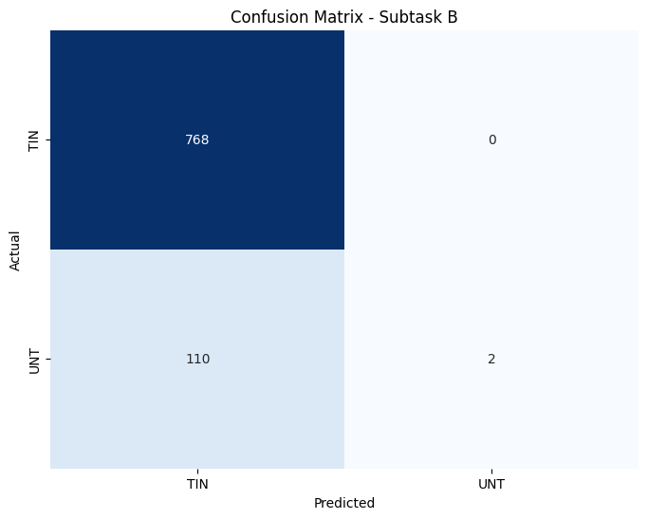
CONFUSION MATRIX

Slide 21
BiLSTM (BiDirectional LSTM)

Slide 22
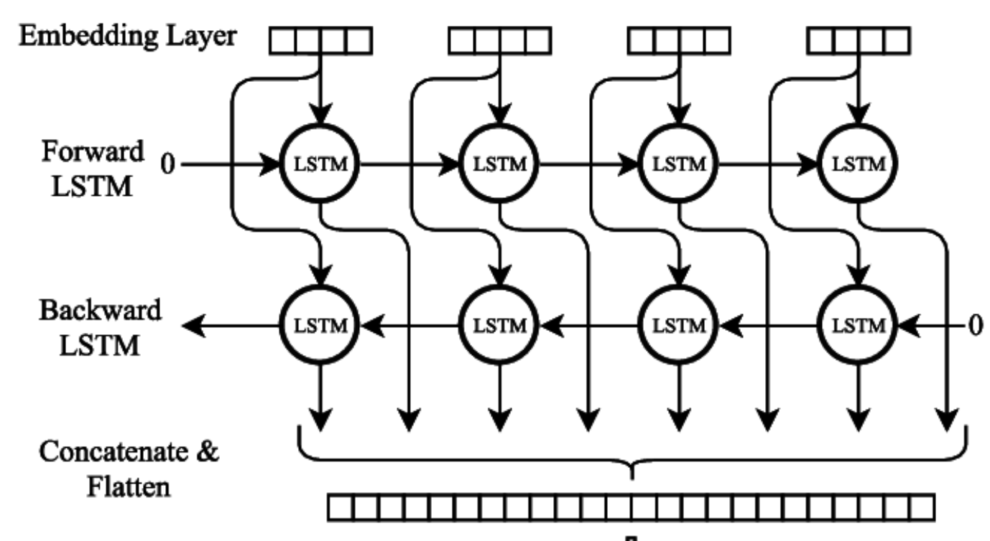

Slide 23
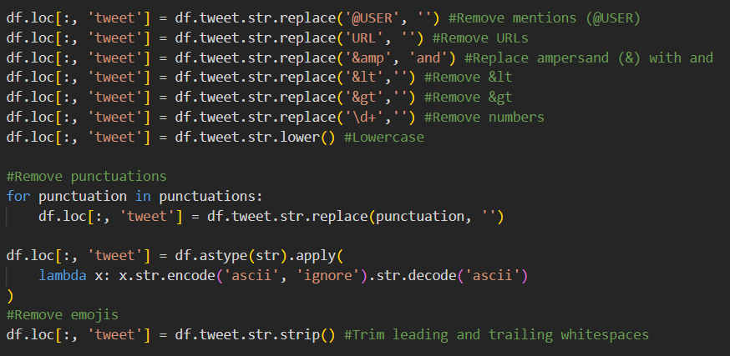
Data preprocessing
Remove punctuations, emojis, numbers and URLs from the text, Convert text to lowercase
Drop missing values

Slide 24
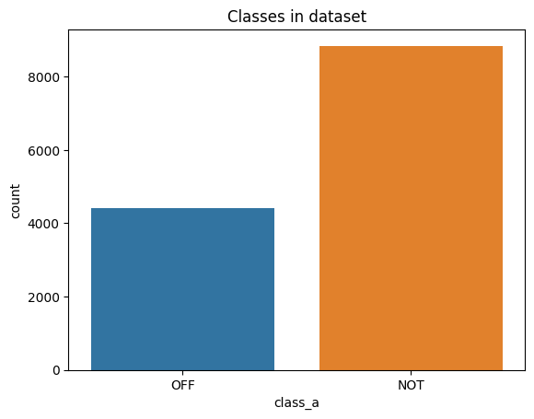
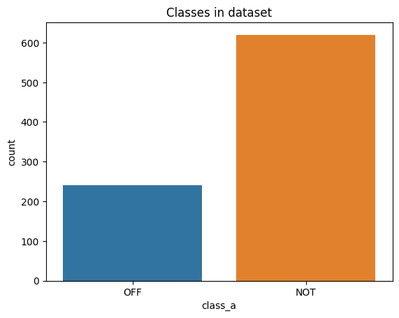
Task a: training and testing dataset (Offensive / not offensive)
TRAINING DATA TESTING DATA

Slide 25
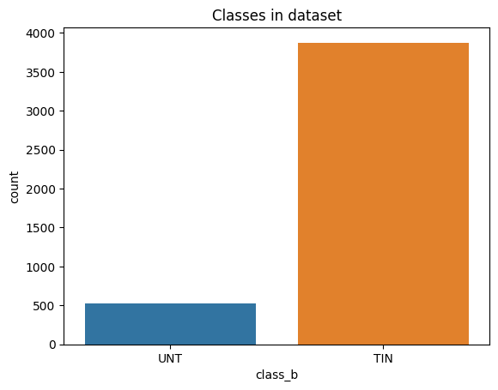
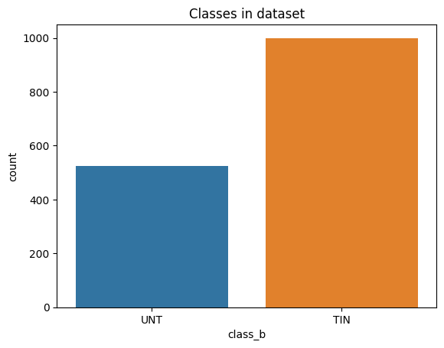
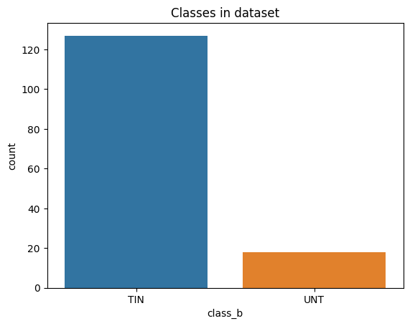
Task b: training and testing dataset: (Targeted / untargeteD)
TRAINING DATA TRAINING DATA TESTING DATA
AFTER UNDERSAMPLING

Slide 26
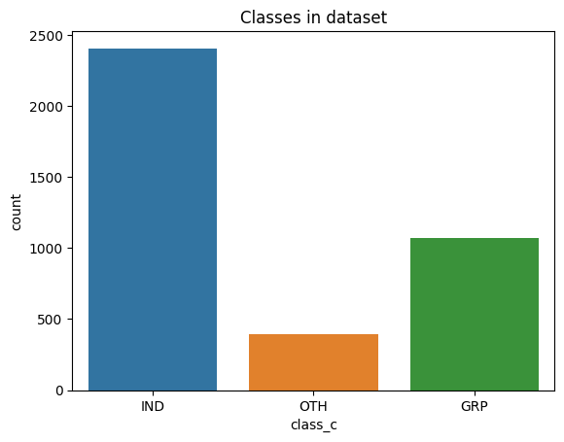
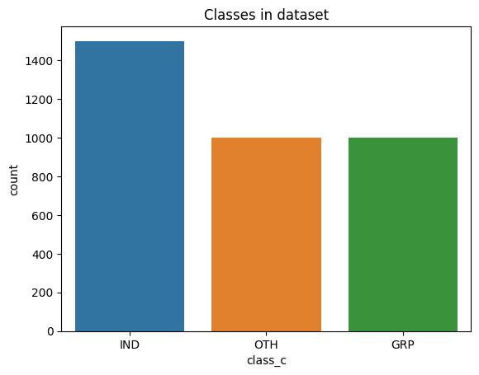
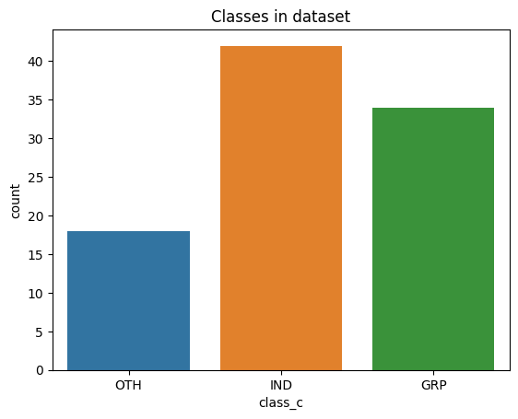
Task c: training and testing dataset: (individual / other / group)
TRAINING DATA TRAINING DATA TESTING DATA
AFTER UNDERSAMPLING

Slide 27
Label Encoding
Used to convert string labels into numerical values
Labelling the data
The tweets and labels are assigned new values after preprocessing and label encoding
Tokenization
Converting text data into numerical sequences
Tokenizer fitted on xtrain tweets to build vocabulary
Preprocessing the data
Text in Training, Validation and Testing datasets are tokenized.
Sequences are padded to a fixed length (uniform input dimensions)

Slide 28
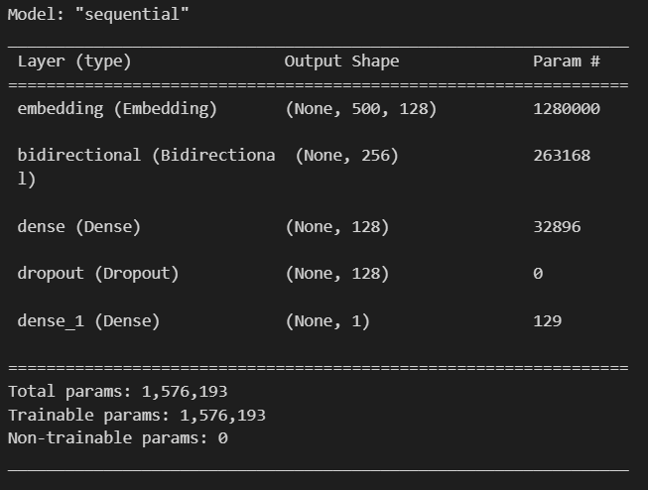
Model architecture
Layer 1: Embedding
Layer 2: BiLSTM: Captures context from both directions
Layer 3: Dense layer (ReLU): allows model to learn complex patterns.
Layer 4: Dropout: To avoid overfitting
Layer 5: Dense layer (Sigmoid): For classification

Slide 29
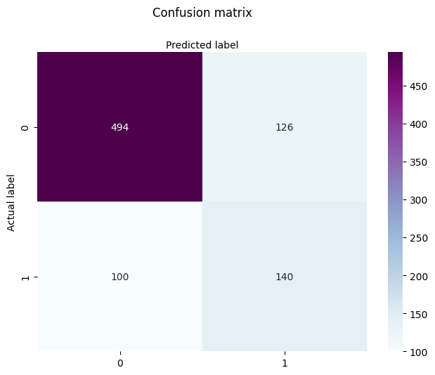
Task a

Slide 30
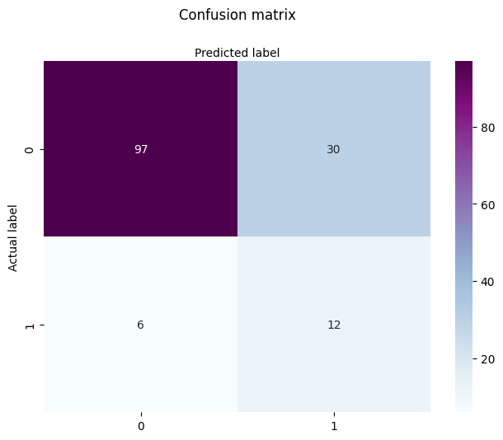
Task B

Slide 31
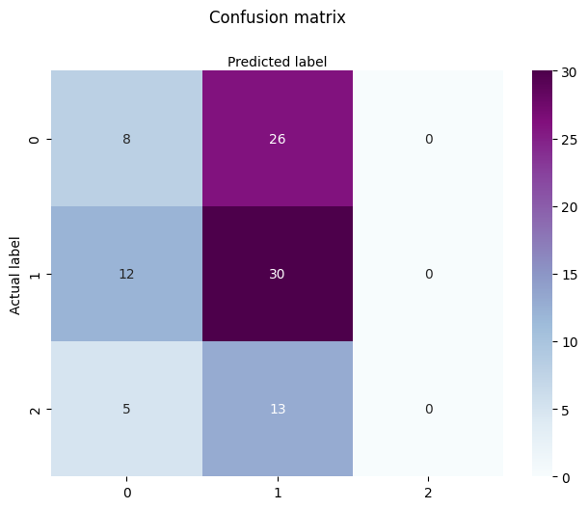
Task c

Slide 32
RECURRENT NEURAL NETWORK (RNN)

Slide 33
Data preprocessing
Remove punctuations, emojis, numbers and urls from the text, Convert text to lowercase
Drop missing values

Slide 34
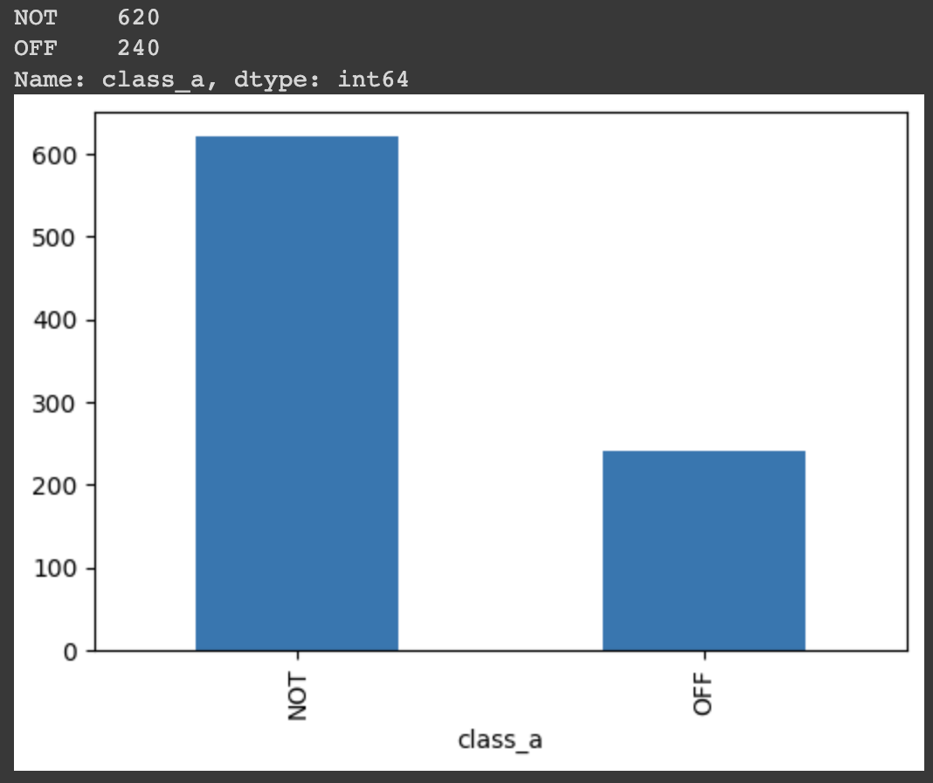
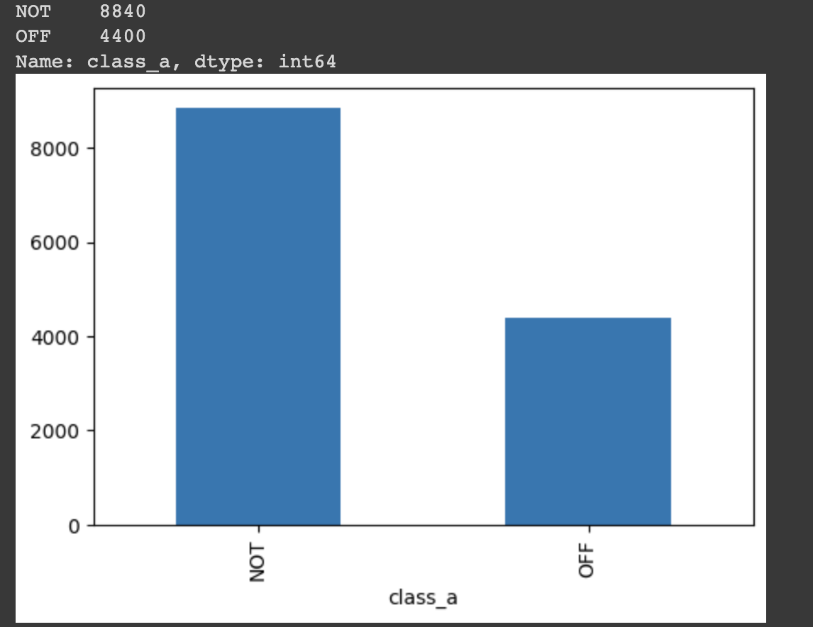
Task a: training and testing dataset (Offensive / not offensive)
TRAINING DATA TESTING DATA

Slide 35
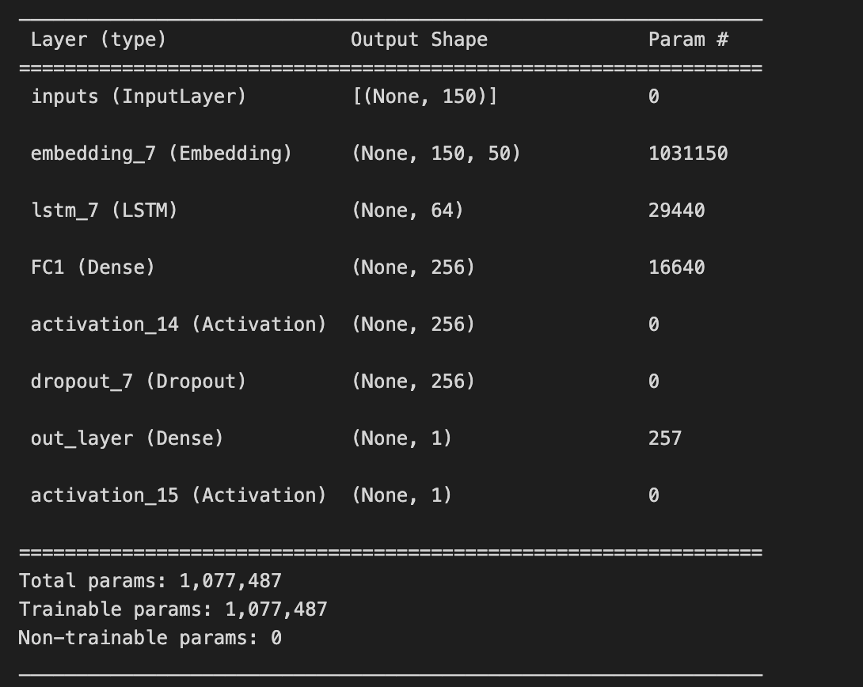
Model Architecture
Layer 1: Input Layer
Layer 2: Embedding
Layer 3: LSTM Layer:
Layer 4: Dense Layer(Fully Connected Layer): Takes the output of the LSTM Layer and applies linear transformation to it.
Layer 5: Activation(ReLU)
Layer 6: Dropout (0.5)
Layer 7: Dense Layer(output layer)
Layer 8: Activation(Sigmoid)

Slide 36
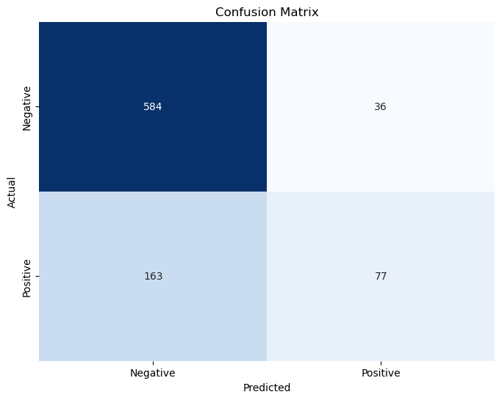
Confusion matrix

Slide 37
META LEARNING

Slide 38
Pre-trained BERT model
Train the meta learner model
Evaluation and Prediction

Slide 39
Approach
Leveraging pre-trained knowledge
Adaptation to specific task
Learning to learn
Optimization for the task
Transfer of knowledge

Slide 40
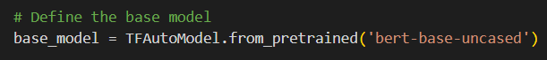
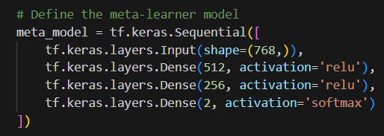
THE BASE BERT MODEL
It consists of an input layer, 2 dense layer with 512 and 256 units and reLU activation, and a dense layer with 2 units and softmax activation.

Slide 41
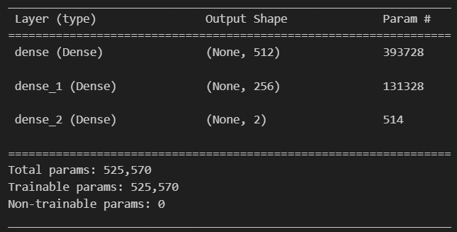
MODEL ARCHITECTURE

Slide 42
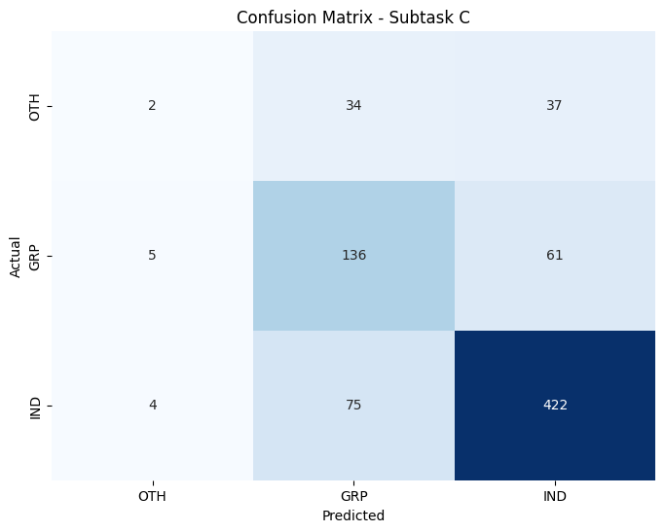
Confusion matrix

Slide 43

RESULTS

Slide 44
FOR TASK A
Model | NOT |  |  | OFF |  |  | Weighted Avg |  |  | Accuracy
 | P | R | F1 | P | R | F1 | P | R | F1
SVM | 0.73 | 0.97 | 0.84 | 0.85 | 0.34 | 0.48 | 0.78 | 0.75 | 0.71 | 0.74
Bi-LSTM | 0.83 | 0.80 | 0.81 | 0.53 | 0.58 | 0.55 | 0.75 | 0.74 | 0.74 | 0.75
RNN | 0.80 | 0.90 | 0.85 | 0.63 | 0.43 | 0.51 | 0.76 | 0.77 | 0.76 | 0.77
BERT | 0.77 | 0.90 | 0.83 | 0.71 | 0.48 | 0.58 | 0.75 | 0.75 | 0.74 | 0.77

Slide 45
FOR TASK B
Model | TIN |  |  | UNT |  |  | Weighted Avg |  |  | Accuracy
 | P | R | F1 | P | R | F1 | P | R | F1
SVM | 0.87 | 1.00 | 0.93 | 1.00 | 0.02 | 0.04 | 0.89 | 0.88 | 0.82 | 0.88
Bi-LSTM | 0.94 | 0.76 | 0.84 | 0.29 | 0.67 | 0.40 | 0.86 | 0.75 | 0.79 | 0.75
RNN | 0.94 | 0.90 | 0.92 | 0.32 | 0.63 | 0.42 | 0.88 | 0.86 | 0.87 | 0.89
BERT | 0.87 | 1.00 | 0.93 | 0.42 | 0.50 | 0.64 | 0.86 | 0.87 | 0.91 | 0.90

Slide 46
FOR TASK C
Model | GRP |  |  | IND |  |  | OTH |  |  | Weighted Avg |  |  | Accuracy
 | P | R | F1 | P | R | F1 | P | R | F1 | P | R | F1
SVM | 0.73 | 0.97 | 0.84 | 0.85 | 0.34 | 0.48 | 0.00 | 0.00 | 0.00 | 0.78 | 0.75 | 0.71 | 0.74
Bi-LSTM | 0.83 | 0.80 | 0.81 | 0.53 | 0.58 | 0.55 | 0.00 | 0.00 | 0.00 | 0.75 | 0.74 | 0.74 | 0.75
RNN | 0.80 | 0.90 | 0.85 | 0.63 | 0.43 | 0.51 | 0.00 | 0.00 | 0.00 | 0.76 | 0.77 | 0.76 | 0.77
BERT | 0.77 | 0.90 | 0.83 | 0.71 | 0.48 | 0.58 | 0.21 | 0.04 | 0.07 | 0.75 | 0.75 | 0.74 | 0.77

Slide 47

Future work

Slide 48
Exploring different meta-learning algorithm.
Investigating different base models
Handling imbalanced datasets
Applying the approach to other text classification tasks
Interpretability and explainability

Slide 49

THANK YOU

