Slide 1

19AIE105_Object Oriented Programming
PROJECT TOPIC: SCIENTIFIC CALCULATOR
GROUP : 7

Slide 2
Team members:
AIEA.12026 | [Dinesh Kumar M R]
AIEB.29621 | [Divi Eswar Chowdary]
AIEB.35658 | [Dabbara Harsha]
AIEB.23682 | [B.E. Pranav Kumar]

Slide 3

Acknowledgement
We would like to express our special thanks of gratitude to our teacher Dr. Sachin Kumar who gave us the golden opportunity to do this wonderful project on the topic (Scientific Calculator), which also helped us in doing a lot of Research and we came to know about so many new things. We are thankful for the opportunity given.

Slide 4
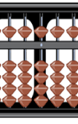
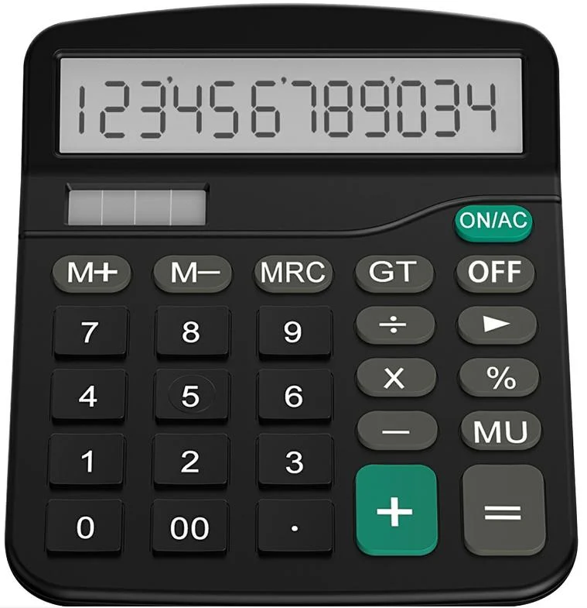
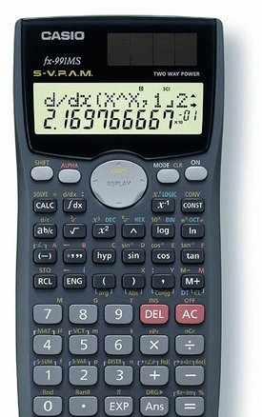
Introduction
Humans naturally use tools and devices to make our work easier, same follows in the field of mathematics. As long back as 2nd century B.C we created basic devices like abacus which made interpretation and memory of intermediate steps in arithmetic calculations easier. With time our understanding of surrounding objects grew and so their creative applications enabled creation of new and better technologies. During the 1960s the first solid-state electronic calculator was created. An electronic calculator is typically a portable electronic device used to perform calculations, ranging from basic arithmetic to complex mathematics. Today, these kinds of calculators are available to the general public from vendors to accountants who perform basic mathematics in their day-to-day life, but the scientific and academic communities require a higher degree of mathematical computations to better aid them, to accommodate for their need additional features were added to them and they were termed as scientific calculators. Some of the features distinct to scientific calculators are logarithms, trigonometric functions, exponential functions. Extra features are unique to the need of customers or the company.

Slide 5
Aim
We intend to create a digital scientific calculator with a GUI (graphical user interphase) which is coded based on the object-oriented programing concepts in java.

Slide 6
Materials required:
Eclipse (IDE latest version)
Window builder package - we have used this to simplify our code to make it easier to interpret and create the GUI

Slide 7
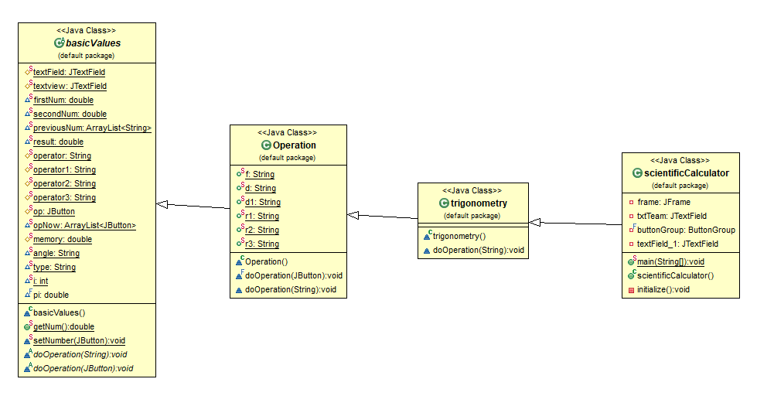
Approach
The following UML diagram shows the relationship between the classes we have used.

Slide 8

Algorithm and Code
Functionalities in our calculator

Slide 9
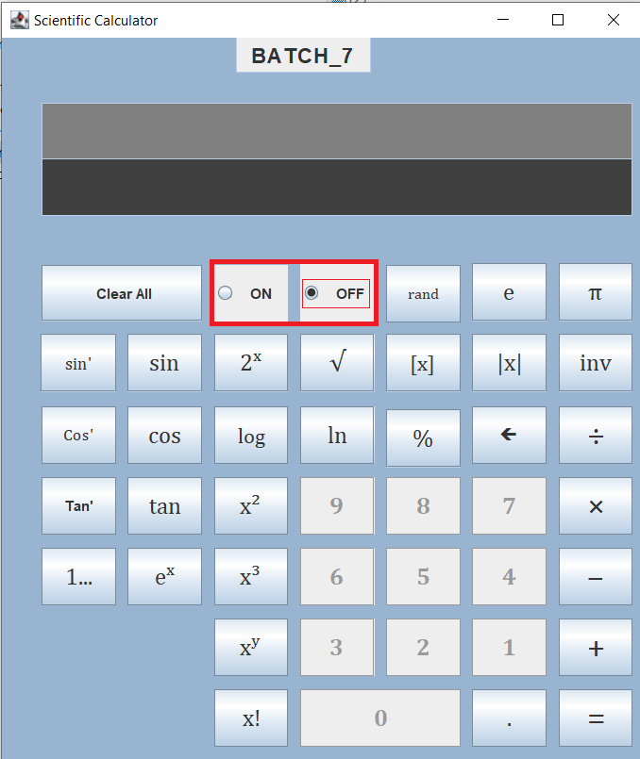
1.On/Off: we can control the state of the device with these two buttons.The calculator cannot exhibit two states at the same time and this functionality is achieve by using a pair of grouped radio buttons. These kinds of buttons are group complimentary I.e., only one given button of the group can be active at a given time.

Slide 10
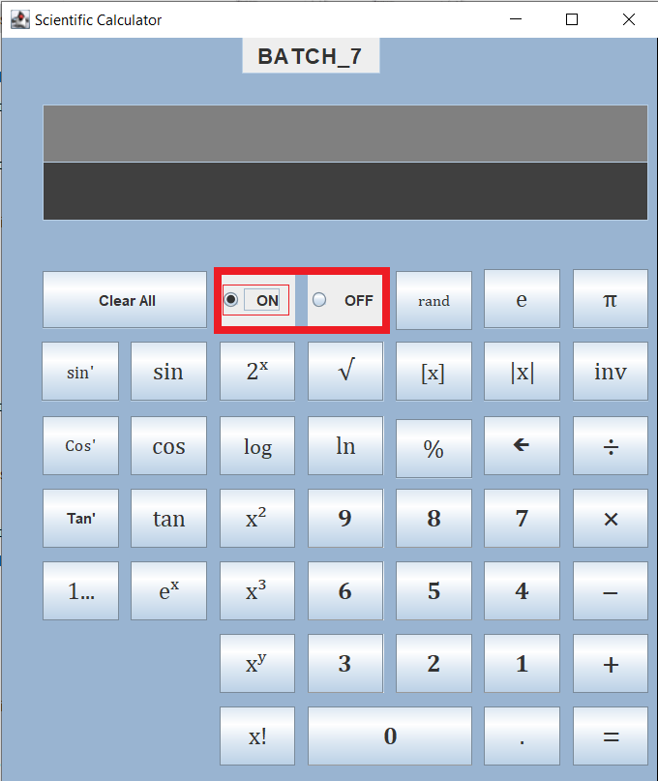
We can see from the above image that when the off button is selected the on button is automatically unselected. We can also see that the state of the input buttons (0 to 9) is inactive. Vise-versa when on button is selected.

Slide 11
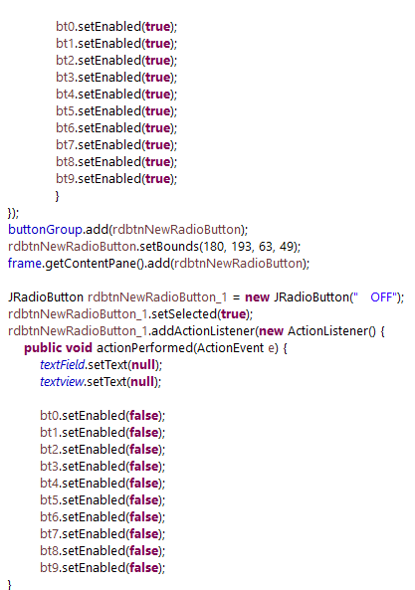

Java code:

Slide 12
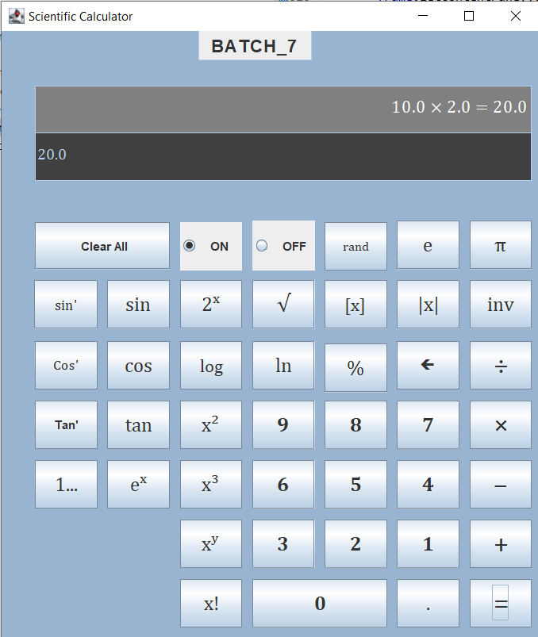
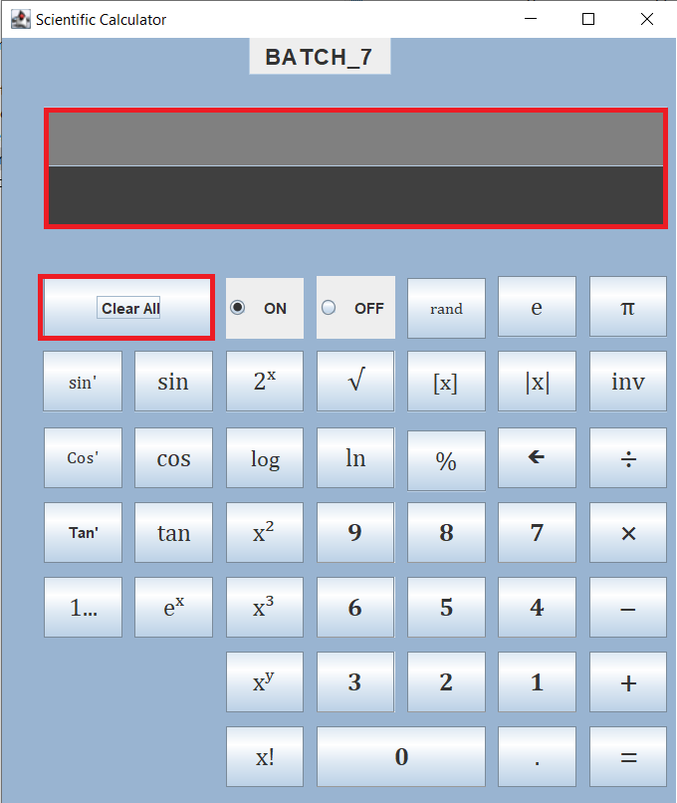
2.clear all: this button is used to clear the previous input if any was given and if not to ensure that previous commands won't affect the current calculation.

Slide 13

Java code:

Slide 14
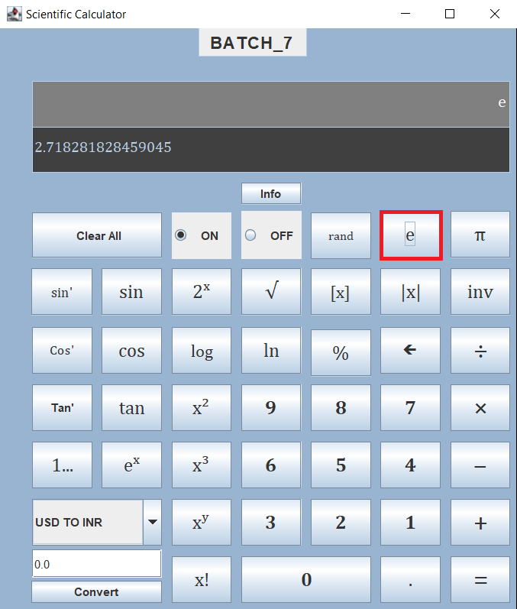
3.e and π: these buttons are used for some essential constant values that are most commonly used in calculations. Adding these as buttons allows the user to be faster in calculations.

Slide 15
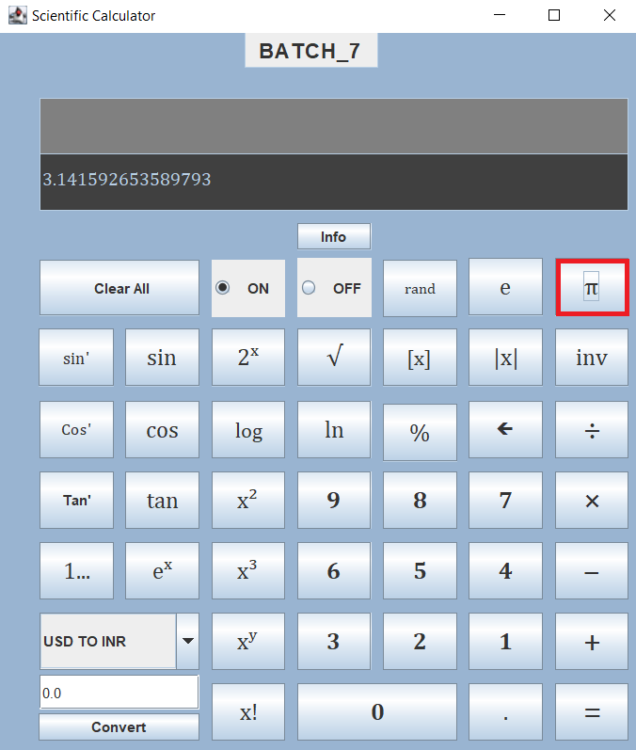


Java code

Slide 16
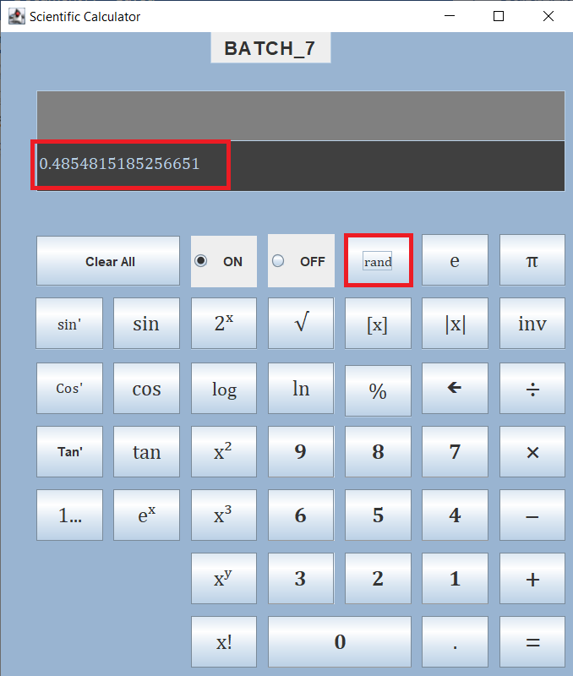
4.rand: this button is used to randomly generate real number values between 0 and 1. This can be used when we required to factor random possibilities during calculations.

Slide 17

Java code:

Slide 18
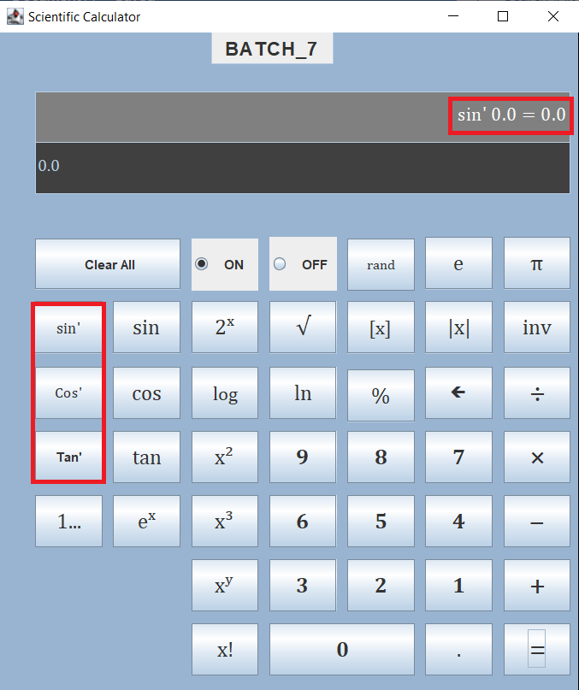
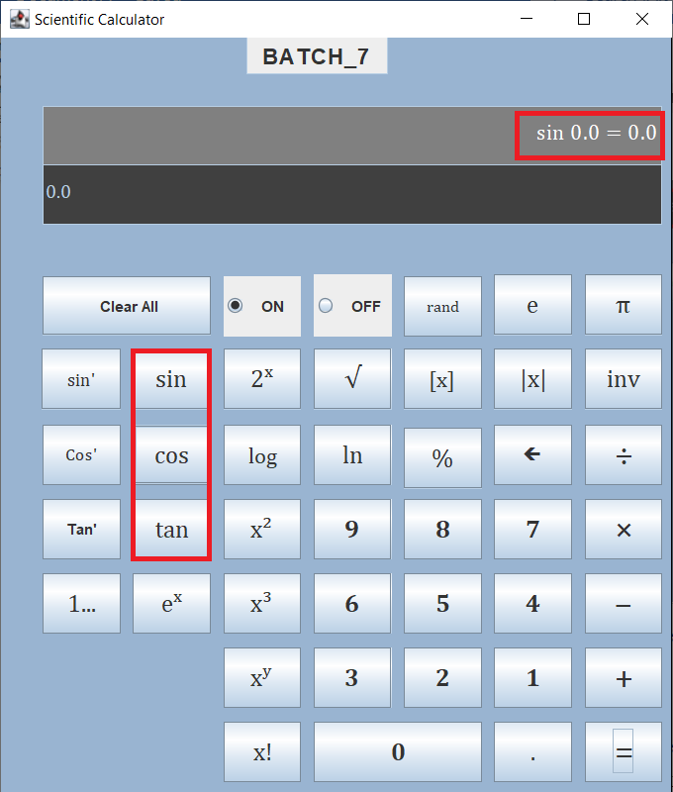
5.sin, cos and tan: these three buttons are used to perform basic trigonometric functions. The values given for calculating are considered in degrees.
6.sini, Cosi and tani: these three buttons are corresponding inverse functions of the trigonometric functions

Slide 19
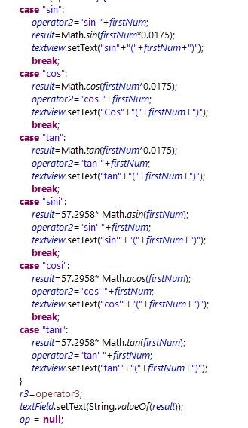
Java code:

Slide 20
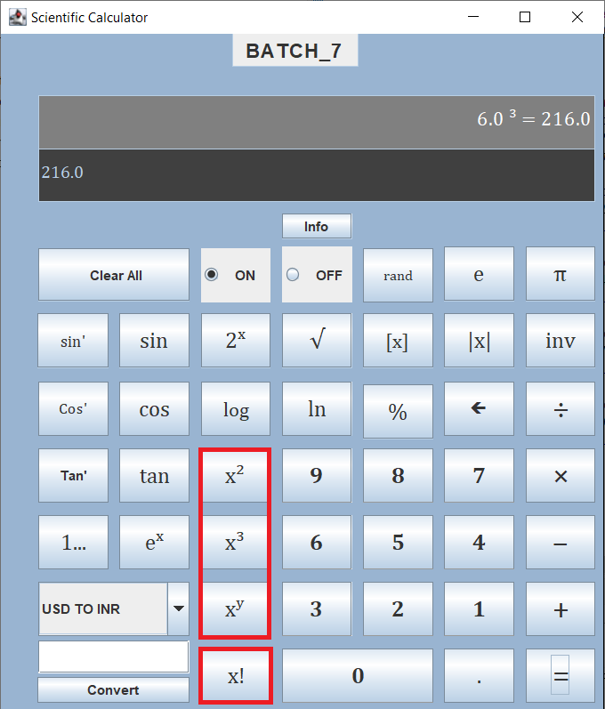
7.power functions: square root, x^2 square, x^3cube ,x^y power value y, factorial. are certain other common functions.

Slide 21
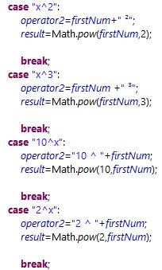

Slide 22
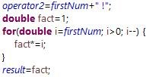


Slide 23
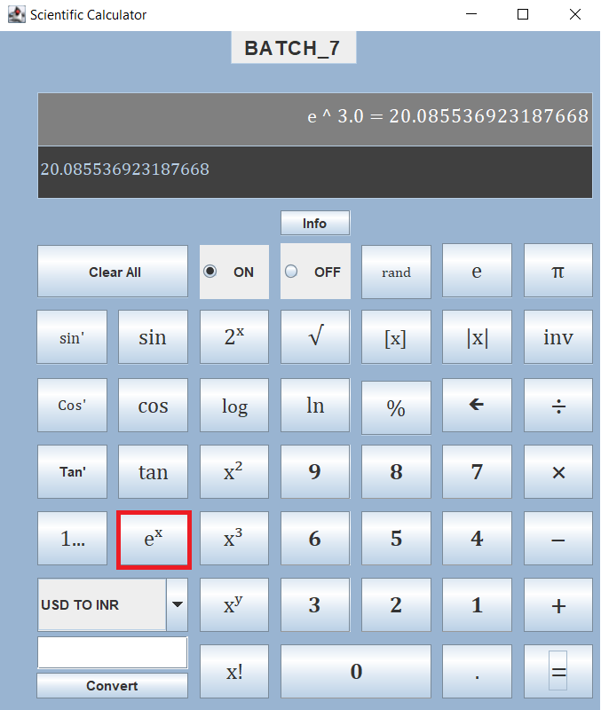
8.exponential functions: this is another common function.

Slide 24

Java code:

Slide 25
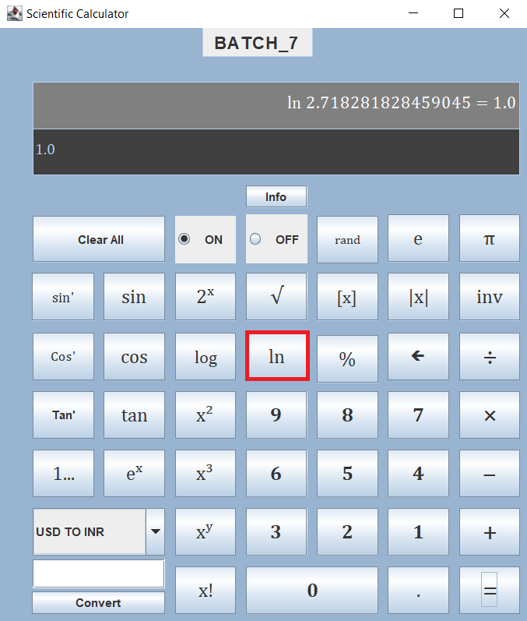
9. logarithms: two buttons ln and log are logarithmic functions with bases e and 10 respectively.

Slide 26
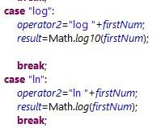
Java code:

Slide 27
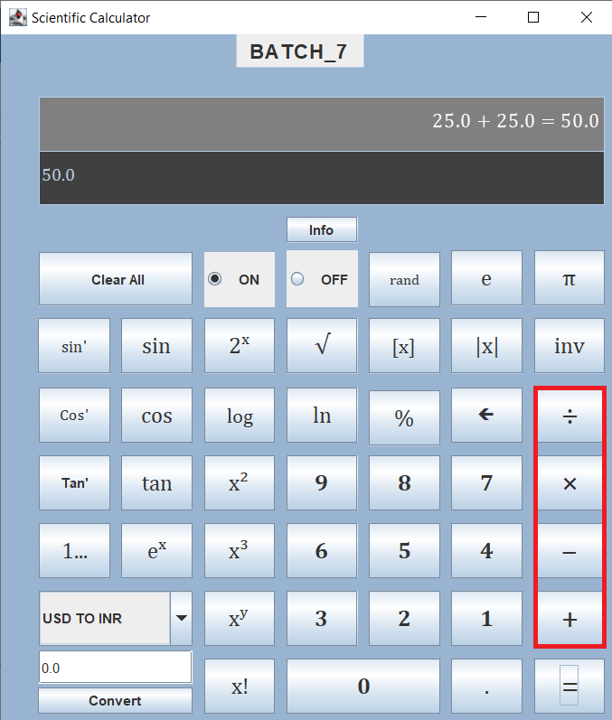
10.arithmetic functions: these are basic functions that are present in every calculator.

Slide 28
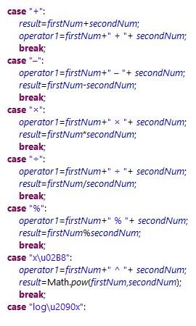
Java code:

Slide 29
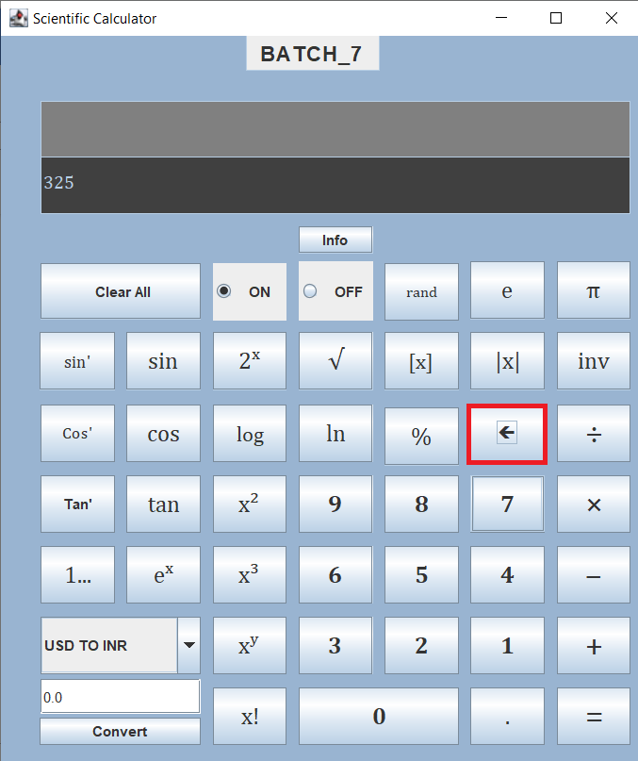
11. Backspace: removes the last entered digit.

Slide 30

Java code:

Slide 31
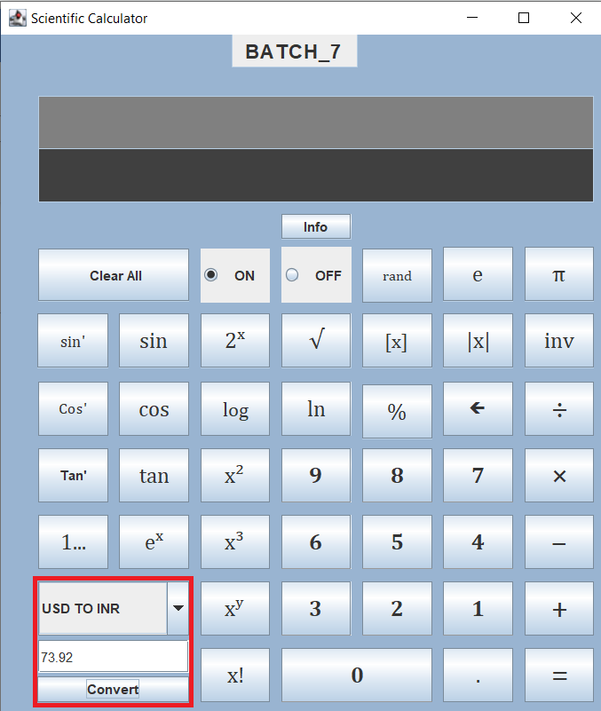
12. Converter: this section contains a drop box with which we can select some basic conversions.

Slide 32
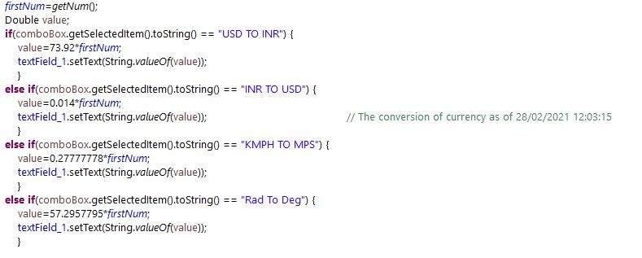
Java code:

Slide 33
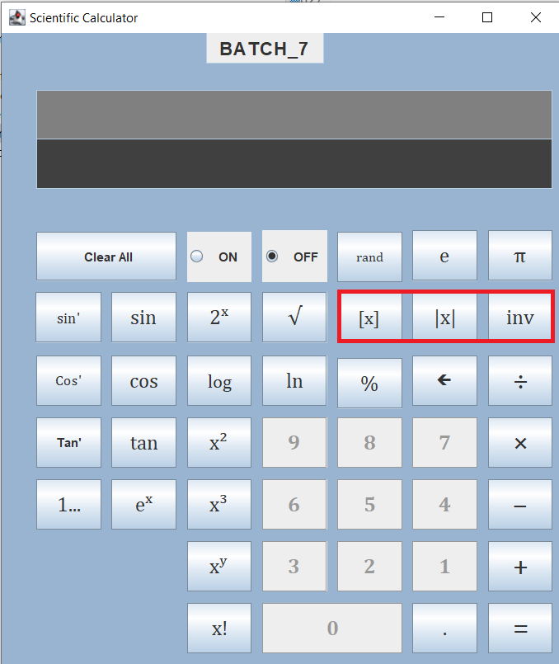
13.step, modulus and inverse: predefined functions

Slide 34
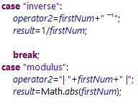
Java code:

Slide 35
Some observations:
This calculator contains two display outputs rather than one, the first text box is used to show the process undertaken to find the output and the second text box displays the result alone.
We have divided the calculator into different zones and each zone contains a separate set of related functions. This makes it more user friendly.
When the calculator is in off state only the input buttons are switched off not all operations.

Slide 36
OOPS concepts used:
Inheritance: this can be realized by looking at UML diagram or the division and extension of classes.
Polymorphism: we are overloading two methods repeatedly to achieve all functionalities.

Slide 37
Conclusion:
Java offers the real possibility that most programs can be written in a type-safe language. However, for Java to be broadly useful, it needs to have more expressive power than it does at present.
This project addresses one of the areas where more power is needed. It extends Java with a mechanism for parametric polymorphism, which allows the definition and implementation of generic abstractions. This gives a complete design for the extended language. The proposed extension is small and conservative and the project discusses the rationale for many of our decisions. The extension does have some impact on other parts of Java, especially Java arrays, OOPS concepts and the Java class library.

Slide 38
For project Related Files/Code
https://amritavishwavidyapeetham-my.sharepoint.com/:f:/g/personal/aieb_29621_cb_students_amrita_edu/EhbpmkwYhPxGigrjqXp-j08BoEX5bmtVkJamb32OUrc_JA?e=rpkWK5

Slide 39

Thank you

