Slide 1
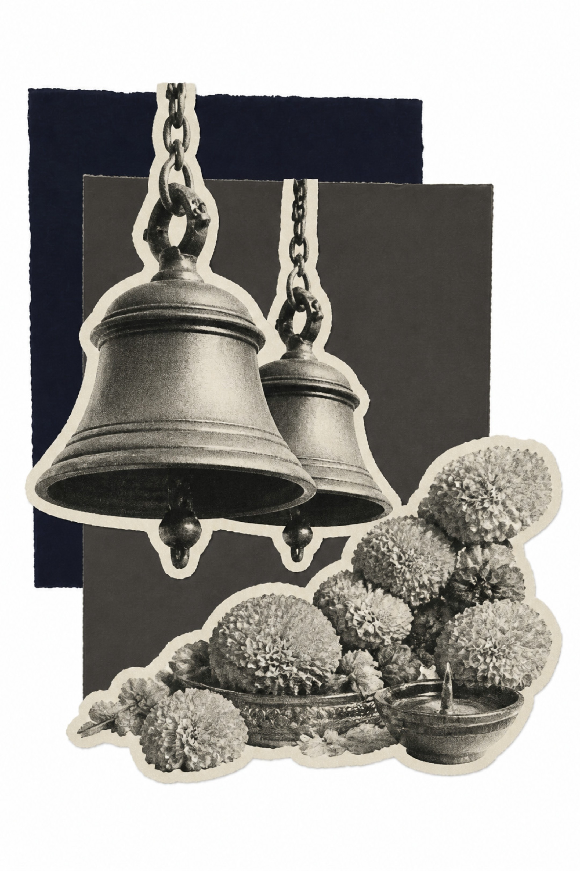
Sur-Mauli
सुर-माऊली — The Melody Mother
A digital home for Marathi songs, compositions, devotion, and cultural memory.

Slide 2
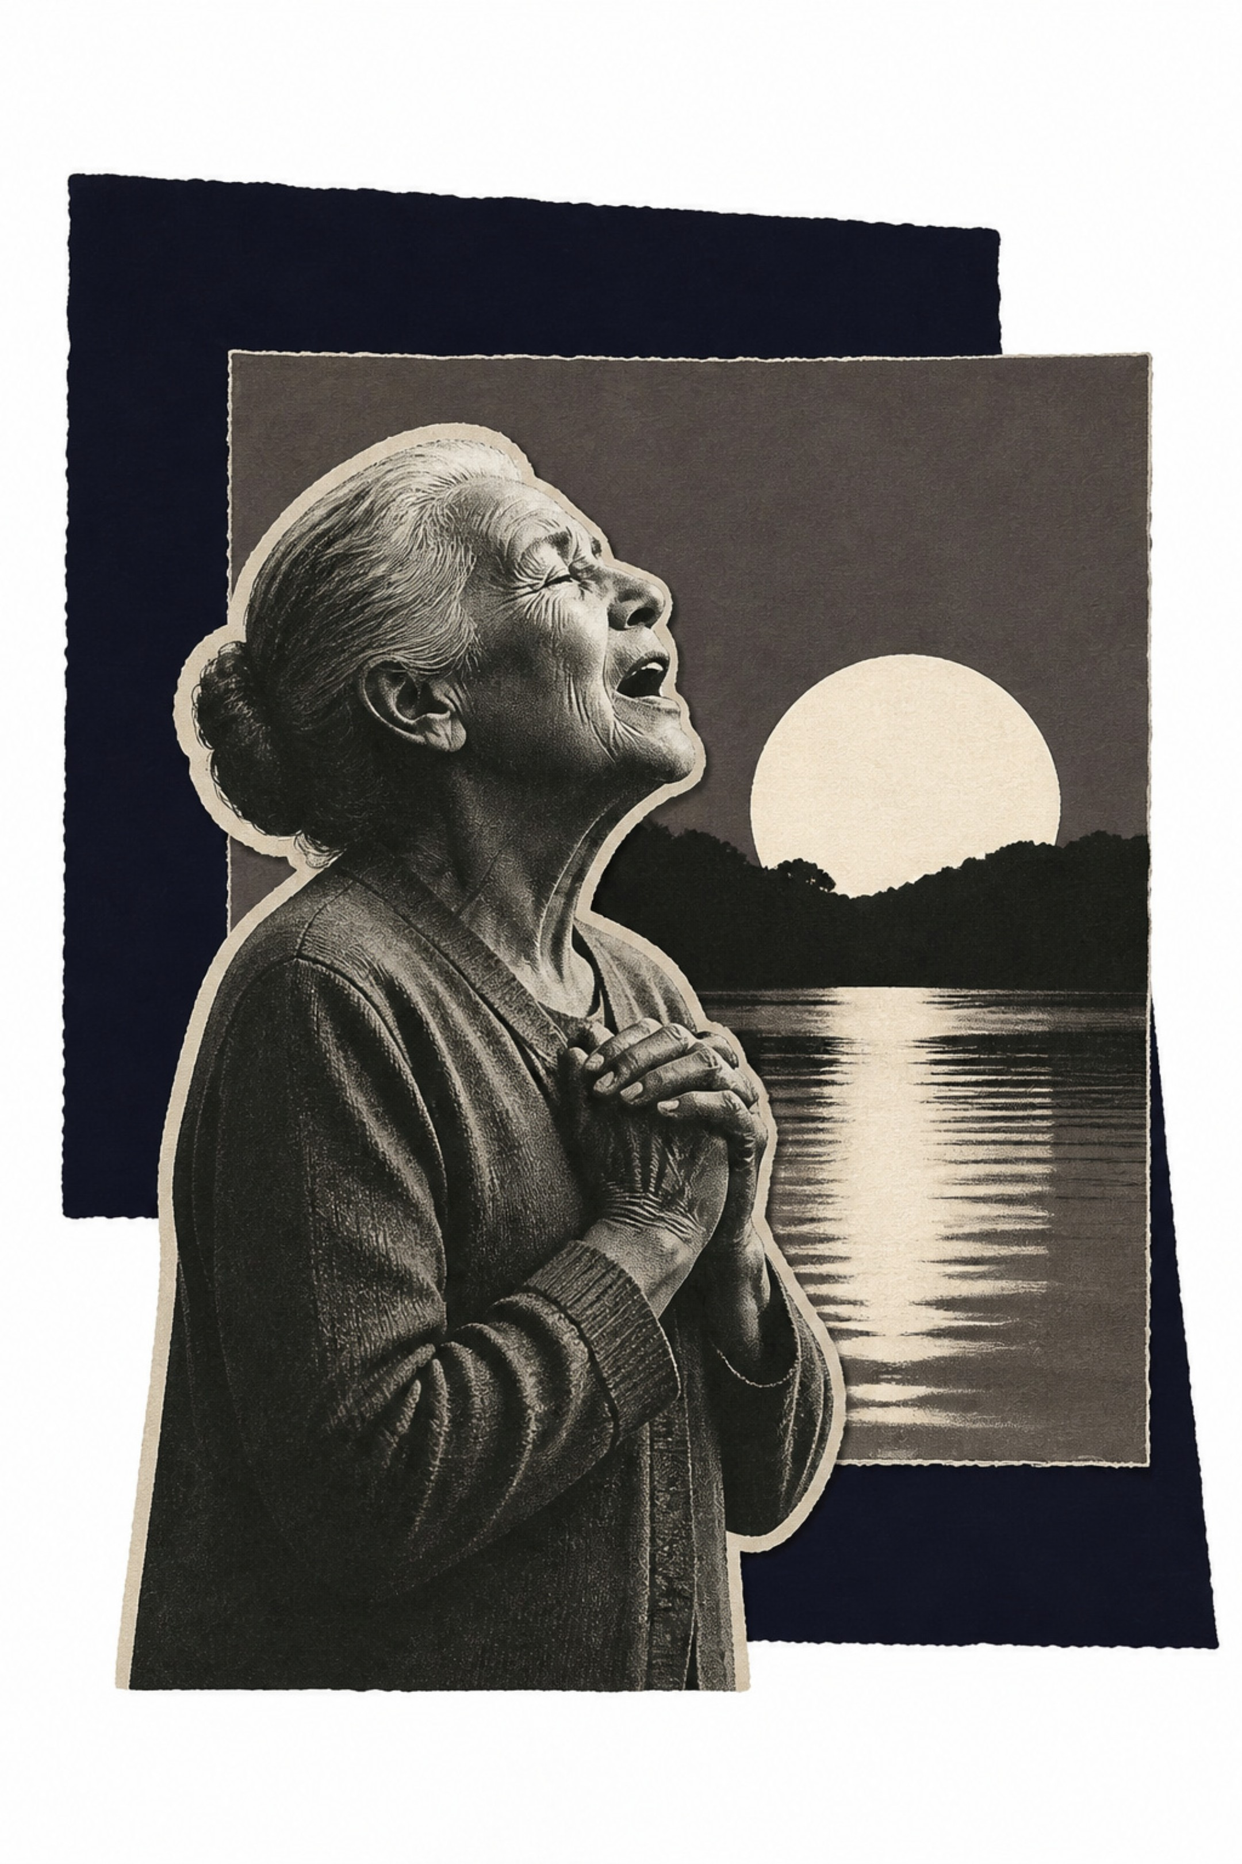
What if every song you hear could become part of your personal musical heritage?
🎵 The Warkari's Bhajan
👵 A Grandmother's Legacy
A devotee records a sacred song during pilgrimage — preserved forever.
Her composition lives on for generations — not lost with time.
📱 Tradition in Your Pocket
Ancient devotional art meets modern technology, seamlessly.

Slide 3
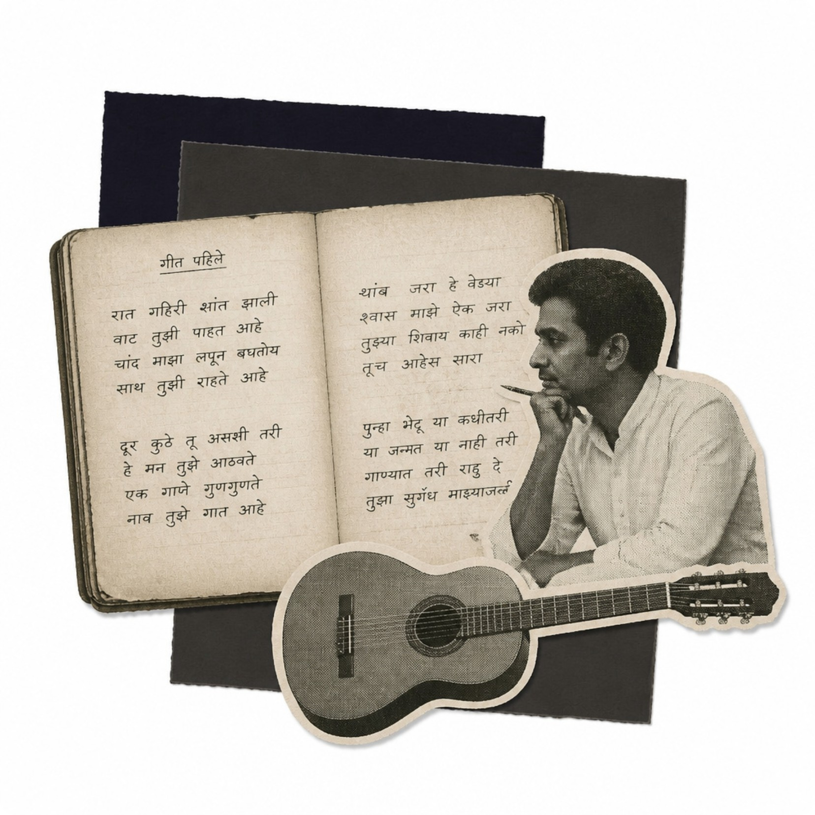

The Cultural Problem
A Heritage Slipping Away
Beautiful bhajans and abhangs are heard once — then forgotten forever
Lyrics scattered across old notebooks, WhatsApp messages, and poor-quality recordings
Regional variations vanish as generations change and migrate
Younger people are disconnecting from their local musical traditions
Every year without a solution, irreplaceable compositions disappear.

Slide 4
The Big Idea
Preserve → Discover → Connect
Record Instantly
Organize Intelligently
Capture songs anywhere — in temples, on pilgrimages, at family gatherings.
AI-powered lyrics, metadata, and smart tagging — all user-editable.
Discover Regionally
Connect Authentically
Thousands of compositions searchable by district, deity, and tradition.
Communities of singers, devotees, and learners united by shared culture.

Slide 5
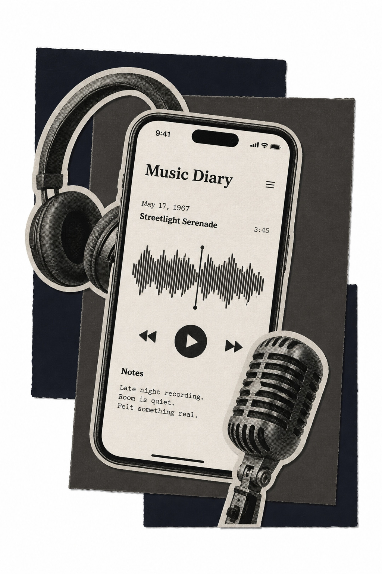
My Composition Diary — The Hero Feature
Your personal lifetime archive — every song you've ever loved, learned, or created.
Rich Metadata per Entry
Audio, lyrics, composer, deity, location, occasion, raga, and instruments — all in one place.
Living Version History
Track how the same song transforms and evolves across regions and generations.
Your Legacy, Your Control
Private or public — you decide what to keep intimate and what to share with the world.

Slide 6
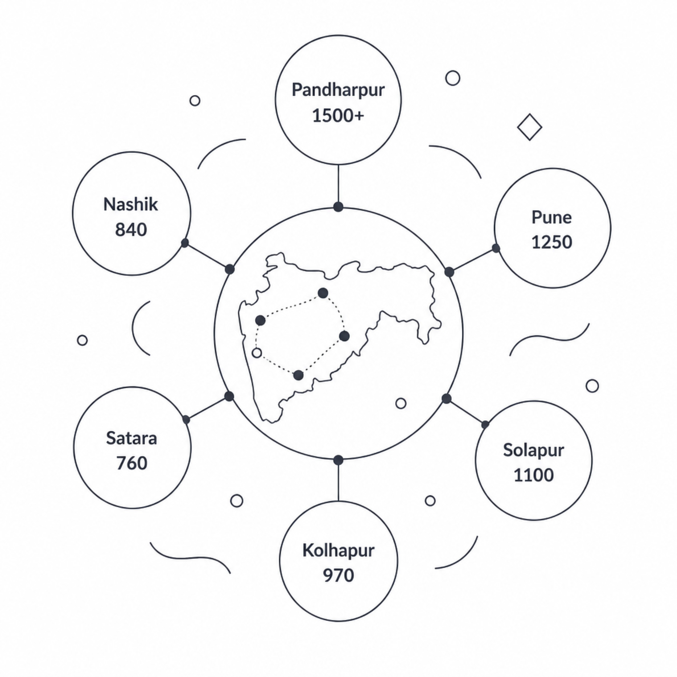

The 10,000 Compositions Discovery Engine
A Living Musical Map of Maharashtra
Pandharpur: 1,500+ compositions — the spiritual heart
Pune: 1,250 compositions — classical and devotional tradition
Solapur: 1,100 | Kolhapur: 970
Nashik: 840 | Satara: 760
These figures represent our product vision — the scale of cultural content to be catalogued.
"Songs Near Me" recommends regional treasures as you travel across Maharashtra.

Slide 7
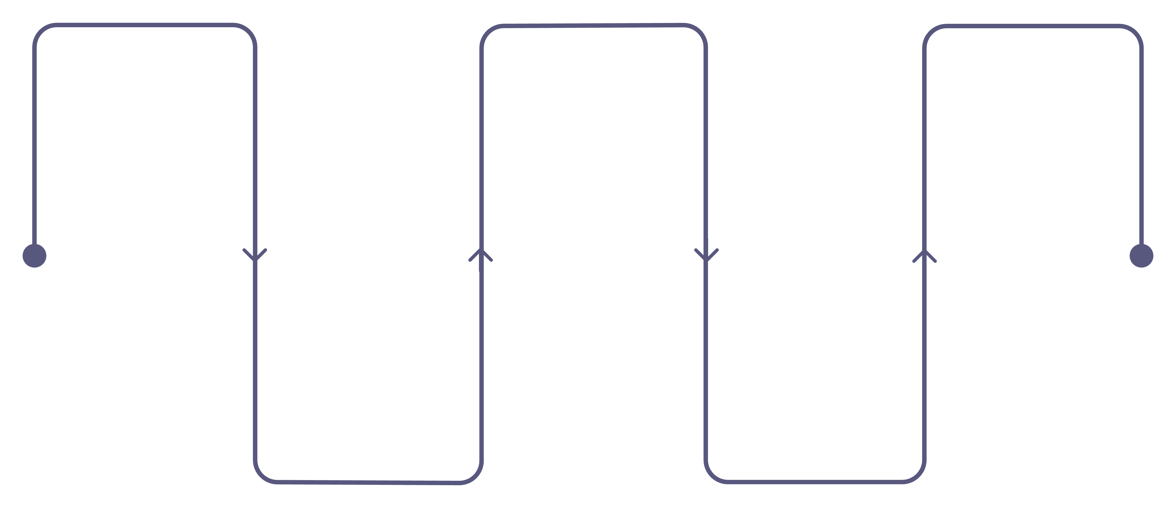
AI-Powered Song Capture
Record
Edit
Save
Capture melody or humming
Refine lyrics, melody, and tags
Store searchable cultural artifact
Transcribe
Tag
Auto-generate notation and lyrics
Assign genre, deity, dialect
From a hummed melody to a fully catalogued cultural artifact — in minutes. AI suggests lyrics, genre, deity, and location — all user-editable. Detects Marathi dialects, traditional terminology, and identifies similar compositions across regions.

Slide 8
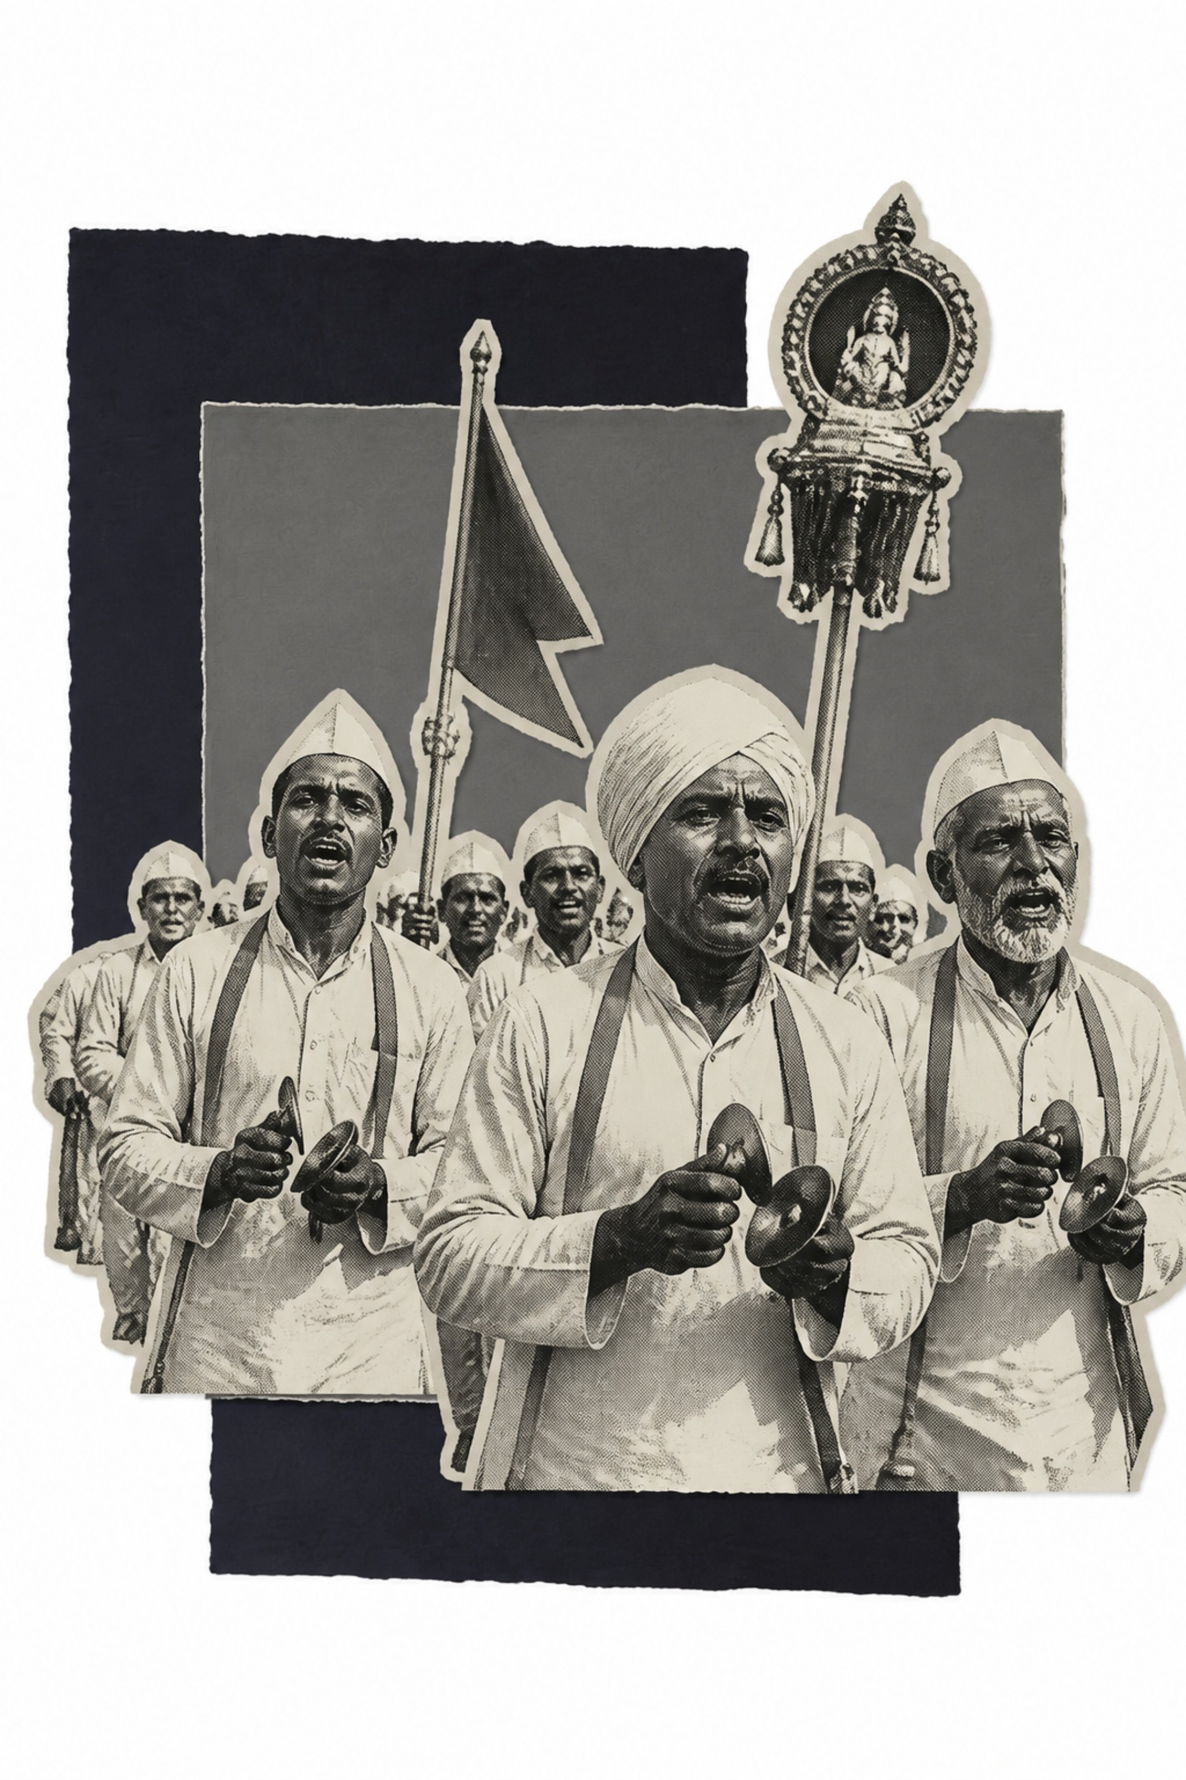
Community & Social Layer
Find your people through your music.
Bhajan Mandals & Warkari Groups
Follow, Share & Collaborate
Join established communities of devotees and kirtankars.
Follow singers, share compositions, co-create arrangements.
Live Sessions & Circles
Live bhajan sessions, local music circles, and group learning events.

Slide 9
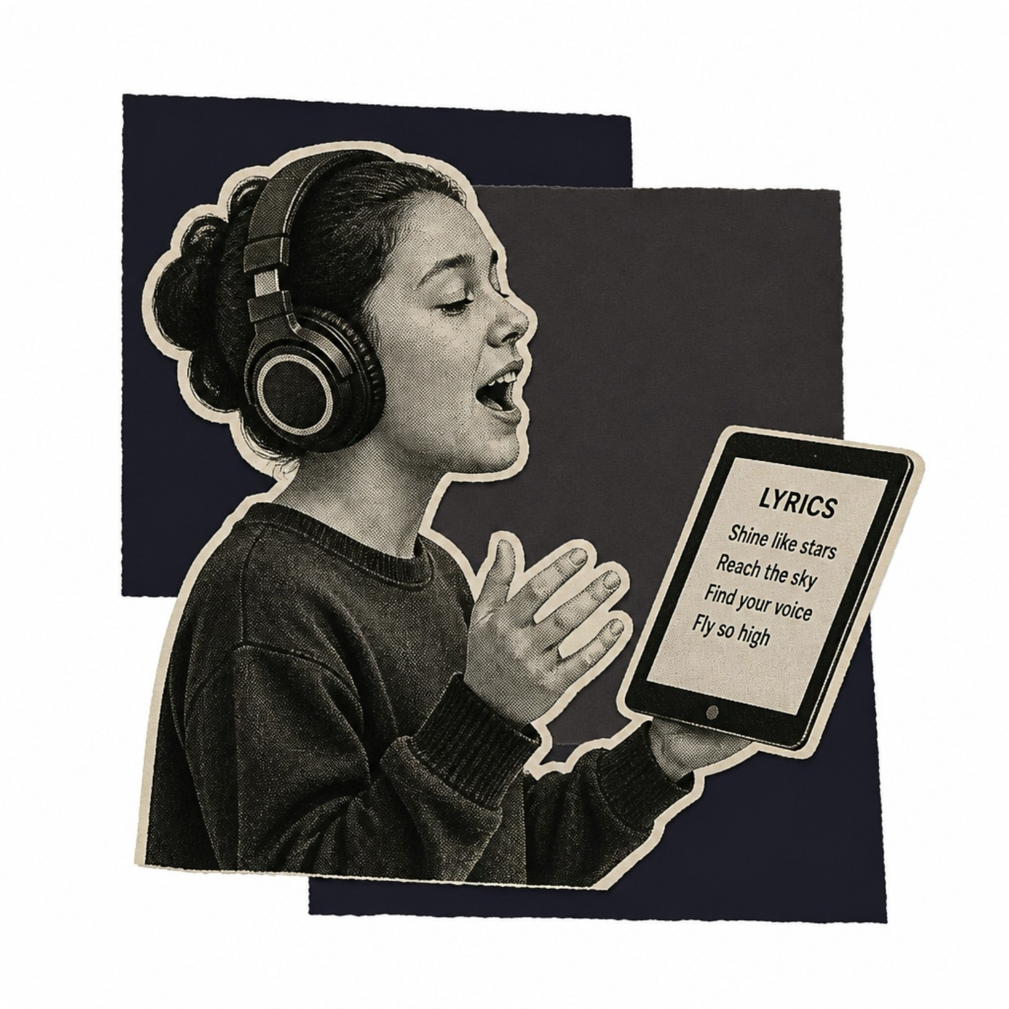

Learn & Practice Ecosystem
From Beginner to Devotional Master
Master abhang, bhajan, aarti, bharud, and folk traditions
Synchronized lyrics, slow playback, practice mode, and karaoke
Record yourself, compare with masters, receive community feedback
Structured beginner-to-advanced progression paths
Learning rooted in tradition, powered by technology.

Slide 10
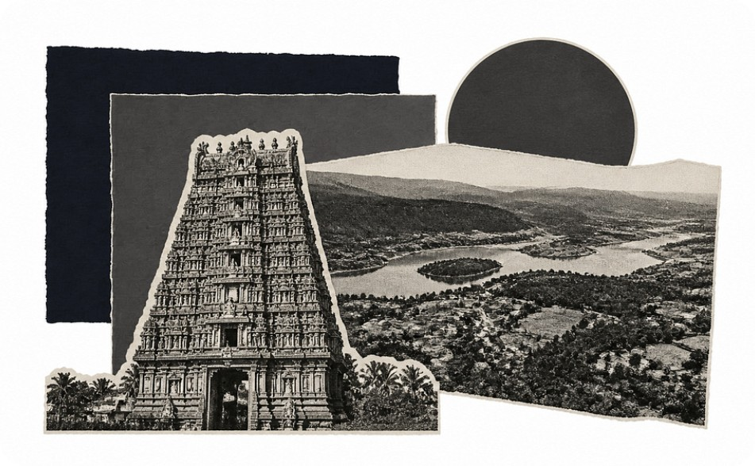
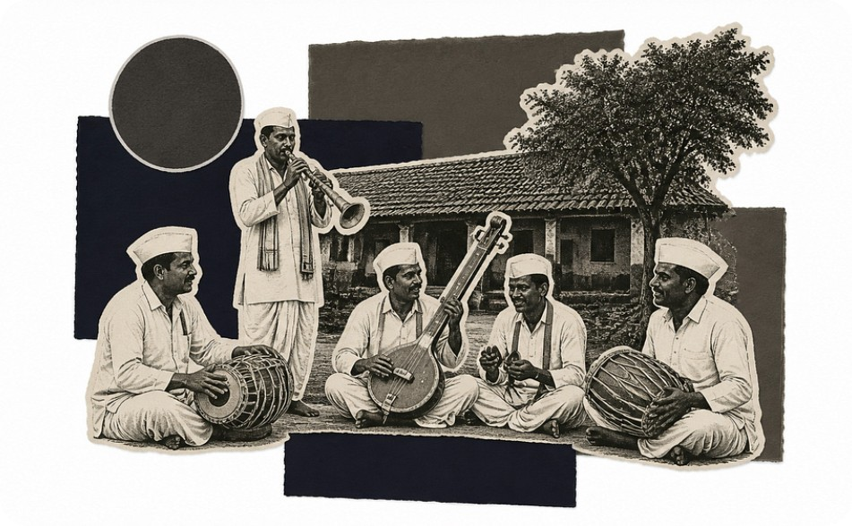
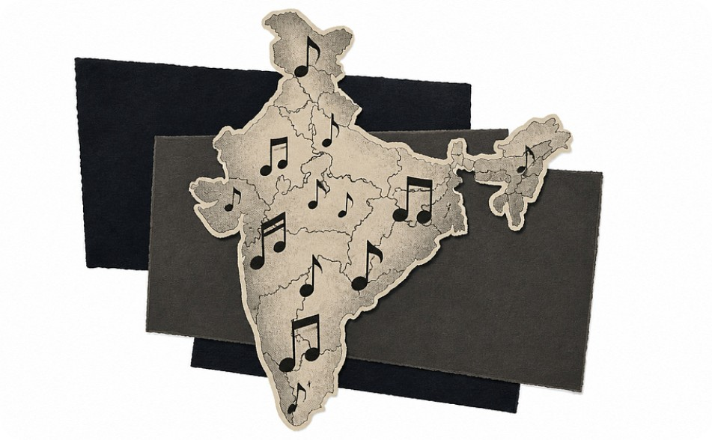
The Cultural Map — "What Does Maharashtra Sound Like?"
Explore by District
Deep Cultural Context
How Songs Transform
Tap any district to discover local devotional songs, dialects, and master singers.
Uncover temple music, folk traditions, and historical compositions with rich heritage notes.
Witness how the same bhajan evolves across villages — and soon across all of India.

Slide 11
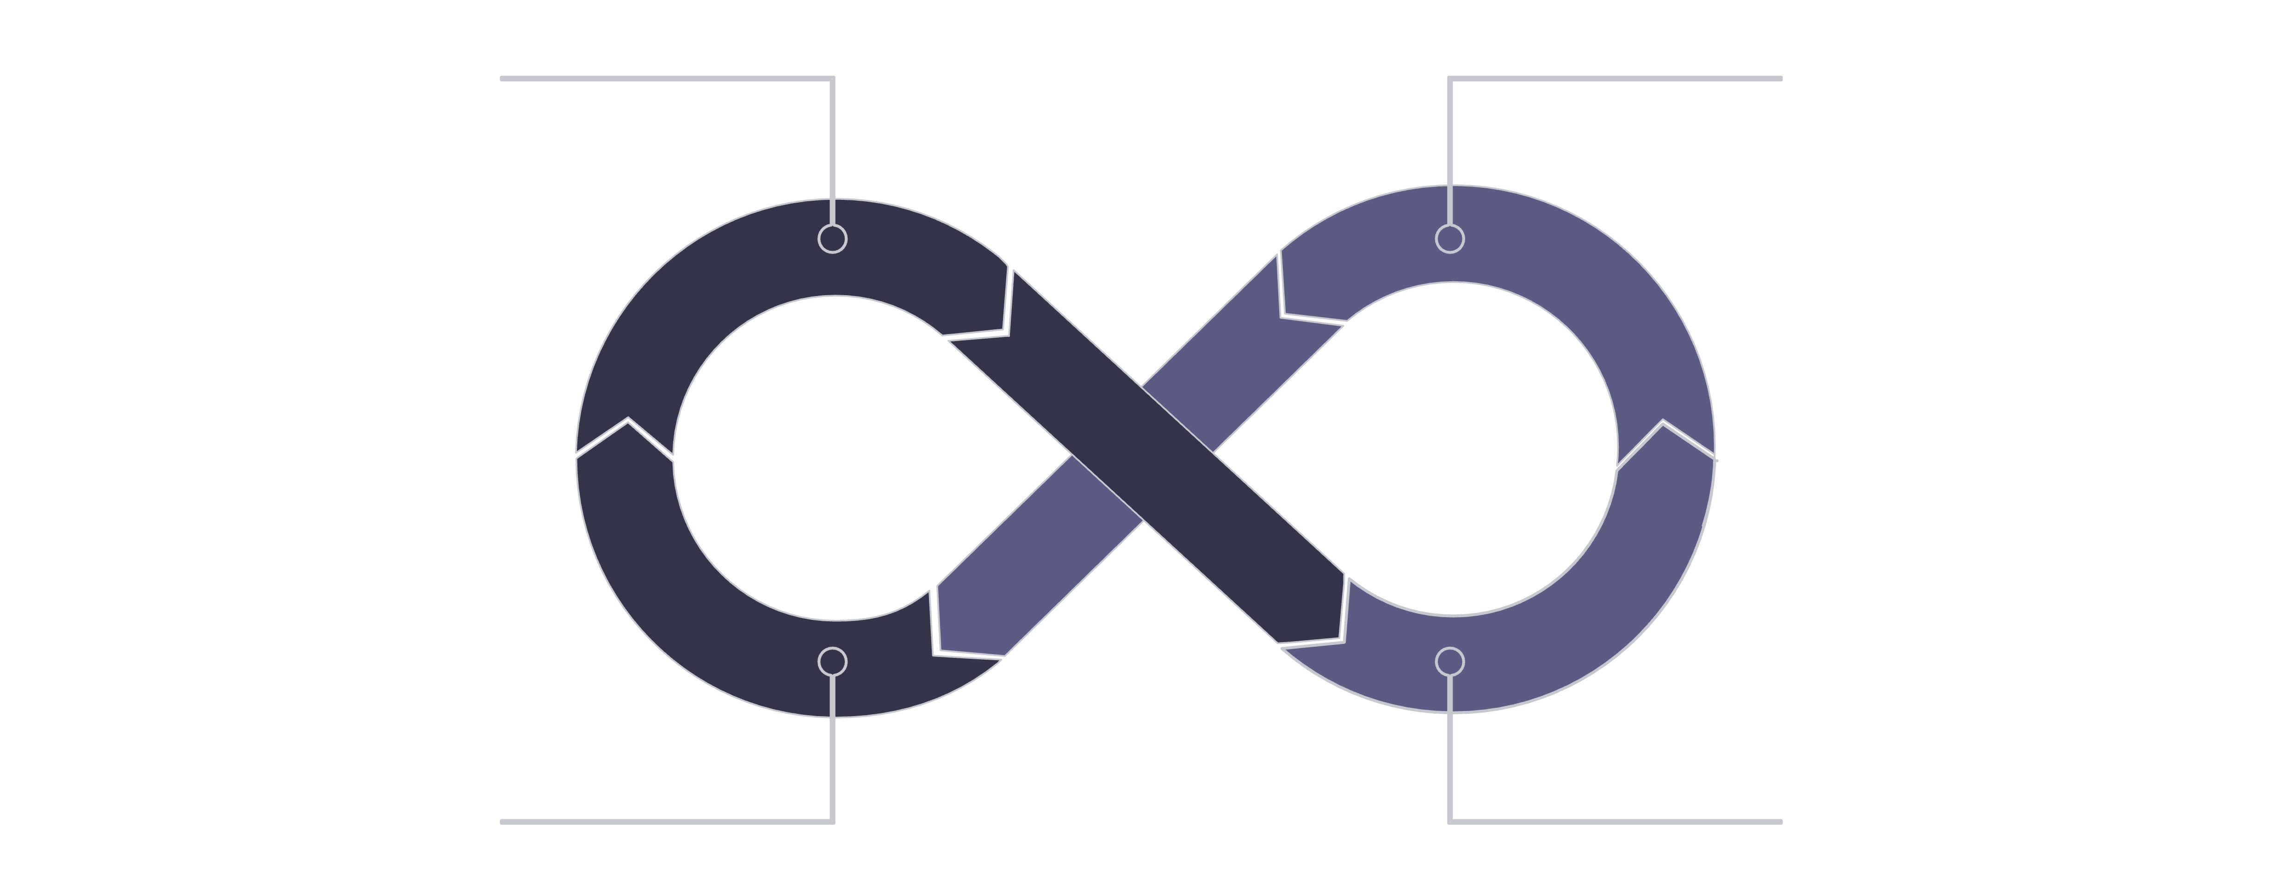
Engagement Without Addiction
आजची रेकॉर्डिंग, उद्याचा वारसा — Today's Recording, Tomorrow's Legacy
Discover Culture
Record Moments
Share & Learn
Save Archive
🏆 Achievements
🌱 Positive Habit Loop
🚫 No Infinite Scroll
"100 Songs Saved" · "10 Districts Explored" · "First Composition"
Centered on learning, preservation, and cultural contribution.
Cultural growth — not addictive mechanics. Depth over distraction.

