Slide 1
虛擬化技術 Virtualization Technique
System Virtualization
Introduction

Slide 2
Agenda
Isomorphism
Emulation
Virtualization
Full-virtualization and Para-virtualization
Categories of virtual machine

Slide 3
Isomorphism

Slide 4
Virtualization is an isomorphism
State mapping
e(Si)
Sj
Si
Guest
V(Si)
V(Sj)
Si’
e’(Si’)
Sj’
Host
Emulation

Slide 5
Virtual Machine
A virtual machine (VM) is a software implementation of a machine (i.e. a computer) that executes programs like a physical machine, i.e., add Virtualizing Software to a Host platform and support Guest process or system

Slide 6
OS VMs: Key Issue – ISA Virtualizability
What if privileged instruction no-ops in user mode? (rather than trapping)
Then… VMM can’t intercept when Guest OS attempts the privileged instruction
What if user can access memory with real address?
Then… a guest OS may see that the real memory it really has is different from the memory it thinks it has
What if user can read system control registers?
Then… guest OS may not read the same state value that it thinks it wrote

Slide 7
Virtual Machine Monitor
Virtual Machine Monitor (VMM), a.k.a. Hypervisor, is a virtualizing software to manage hardware resource and arrange resource sharing among different Guest OS.
The role of VMM to Guest OS in a virtualized environment is similar to the role of OS to user space programs in a non-virtualized environment.
Essential VMM characteristics
Identical
Provide an environment essentially identical to the real machine
With the possible exception of differences caused by timing dependency and availability of resources
Efficiency
Programs show only minor decreases in speed
Mostly native instruction execution
Control
Fully control of system resources

Slide 8
Emulation

Slide 9
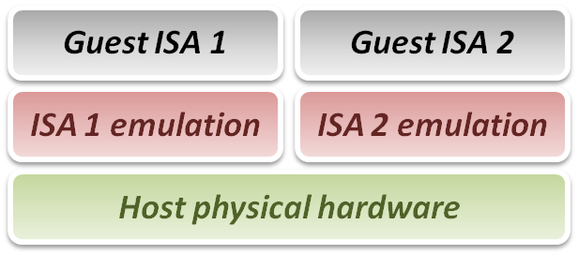
Emulation Technique
Why do we talk about emulation
In fact, virtualization technique can be treated as a special case of emulation technique.
Many virtualization techniques were developed in or inherited from emulation technique.
Goal of emulation
Provide a method for enabling a (sub)system to present the same interface and characteristics as another.

Slide 10
Emulation Technique
Three emulation implementations
Interpretation
Emulator interprets only one instruction at a time.
Static Binary Translation
Emulator translates a block of guest binary at a time and further optimizes for repeated instruction executions.
Dynamic Binary Translation
This is a hybrid approach of emulator, which mix two approaches above.
Design challenges and issues :
Register mapping problem
Performance improvement

Slide 11
Interpretation
Interpreter execution flow
Fetch one guest instruction from guest memory image.
Decode and dispatch to corresponding emulation unit.
Execute the functionality of that instruction and modify some related system states, such as simulated register values.
Increase the guest PC (Program Counter register) and then repeat this process again.
Pros & Cons
Pros
Easy to implement
Cons
Poor performance

Slide 12
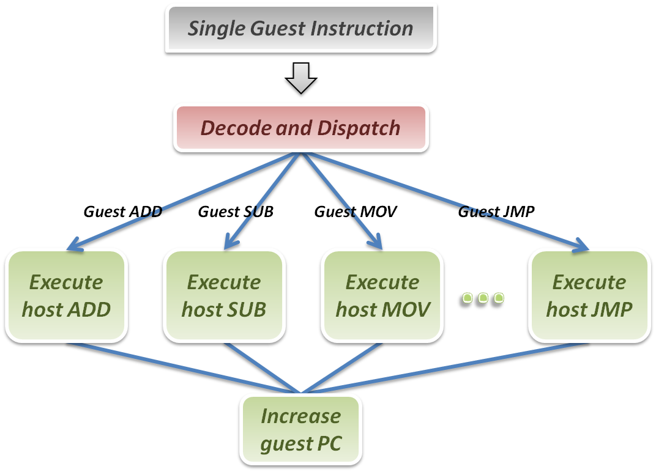
Interpretation
Interpreter

Slide 13
Binary Translation
A technique to optimize binary code blocks, and translate binaries from guest ISA to host ISA.
Static approach vs. Dynamic approach :
Static binary translation
The entire executable file is translated into an executable of the target architecture.
This is very difficult to do correctly, since not all the code can be discovered by the translator.
Dynamic binary translation
Looks at a short sequence of code, typically on the order of a single basic block, translates it and caches the resulting sequence.
Code is only translated as it is discovered and when possible, branch instructions are made to point to already translated and saved code.

Slide 14
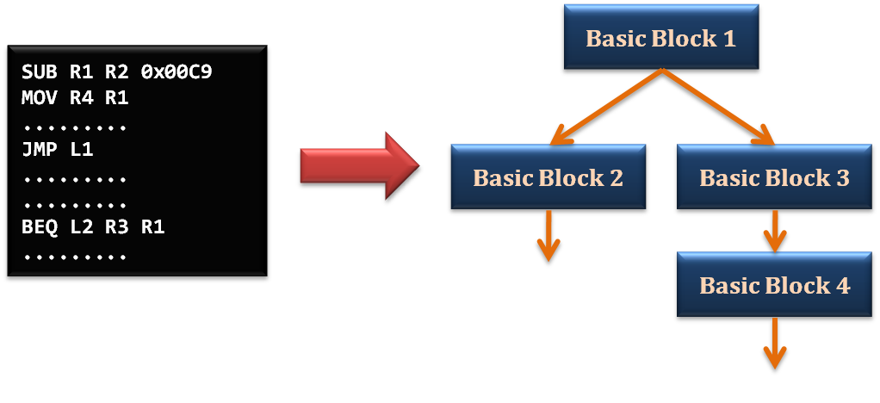
Static Binary Translation
Using the concept of basic block which comes from compiler optimization technique.
A basic block is a portion of the code within a program with certain desirable properties that make it highly amenable to analysis.
A basic block has only one entry point, meaning no code within it is the destination of a jump instruction anywhere in the program.
A basic block has only one exit point, meaning only the last instruction can cause the program to begin executing code in a different basic block.

Slide 15
Static Binary Translation
Static binary translation flow :
Fetch one block of guest instructions from guest memory image.
Decode and dispatch each instruction to the corresponding translation unit.
Translate guest instruction to host instructions.
Write the translated host instructions to code cache.
Execute the translated host instruction block in code cache.
Pros & Cons
Pros
Emulator can reuse the translated host code.
Emulator can apply more optimization when translating guest blocks.
Cons
Implementation complexity will increase.

Slide 16
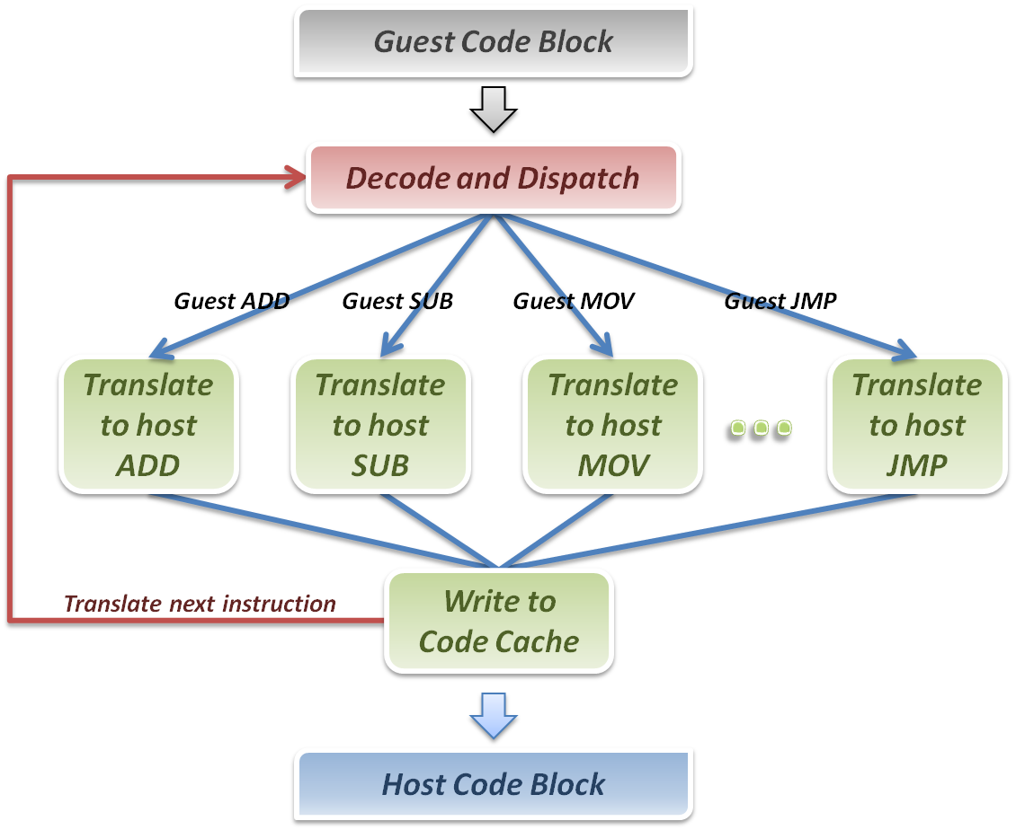
Static Binary Translation
Binary Translator

Slide 17
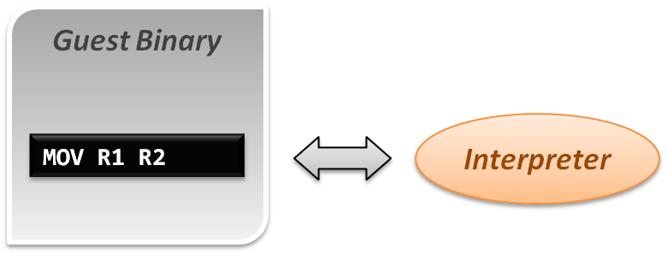
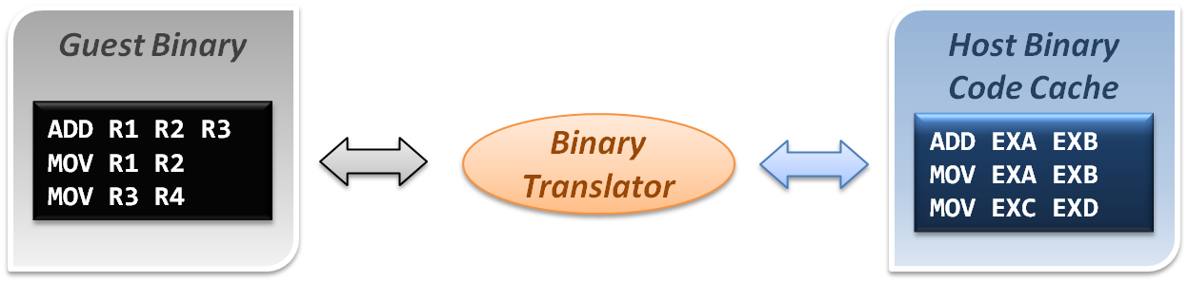
Comparison
Interpretation implementation
Static binary translation implementation

Slide 18
Dynamic Binary Translation
A hybrid implementation
For the first discovered codes, directly interpret by interpreter and record these codes as discovered.
As the guest codes discovered, trigger the binary translation module to translate the guest code blocks to host code blocks, and place them into code cache.
When execute the translated block of guest code next time, jump to the code cache and execute the translated host binary code.
Pros & Cons
Pros
Transparently implement binary translation.
Cons
Hard to implement.

Slide 19
Dynamic Binary Translation
First time execution, no translated code in code cache.
Miss code cache matching, then directly interpret the guest instruction.
As a code block discovered, trigger the binary translation module.
Translate guest code block to host binary, and place it in the code cache.
Next time execution, run the translated code clock in the code cache.
Binary Translator
Guest Binary
trigger
Host Binary Code Cache
Emulation Manager
hit
exit
return
miss
Interpreter

Slide 20
Design challenges and issues
Register mapping problem
Performance improvement

Slide 21
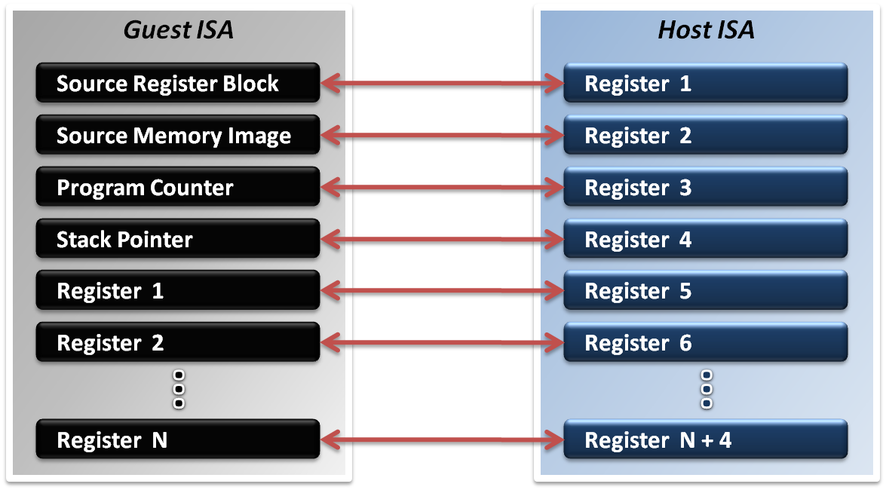
Register Mapping Problem
Why should we map registers ?
Different ISA will define different number of registers.
Sometimes guest ISA even require some special purpose register which host ISA does not defined.

Slide 22
Register Mapping Problem
If number of host registers is larger the guest
That will be an easier case for implementation.
Directly map one register of guest to one of host, and make use of the rest registers for optimization.
Example :
Translating RISC binary to x86
If number of host registers is not enough
That should involve more effort.
Emulator may only map some frequently used guest registers to host, and left the unmapped registers in memory.
Mapping decision will be critical in this case.

Slide 23
Performance Improvement
What introduces the performance hit ?
Control flow problem
Highly frequent context switches between code caches and emulation manager will degrade performance.
Target code optimization
Translate guest code block in instruction-wise (translate one instruction at a time) will miss many optimization opportunities.
Solutions :
Translation Chaining
Dynamic Optimization

Slide 24
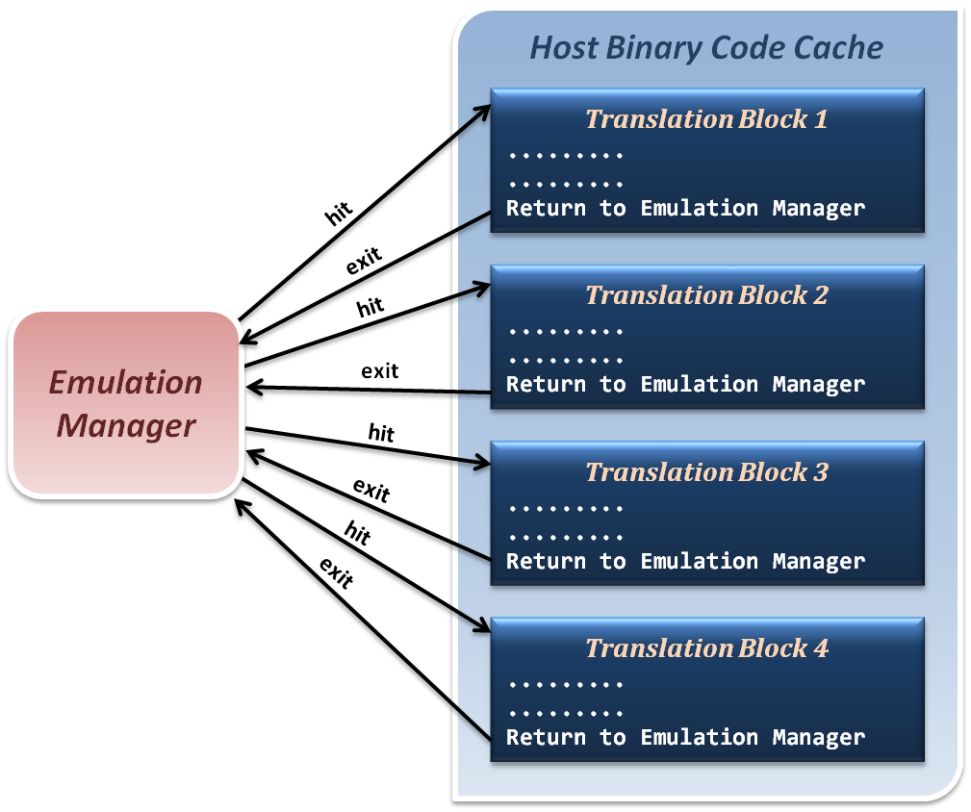
Translation Chaining
Non-optimized control flow between translated blocks and emulation manager.
Context Switches

Slide 25
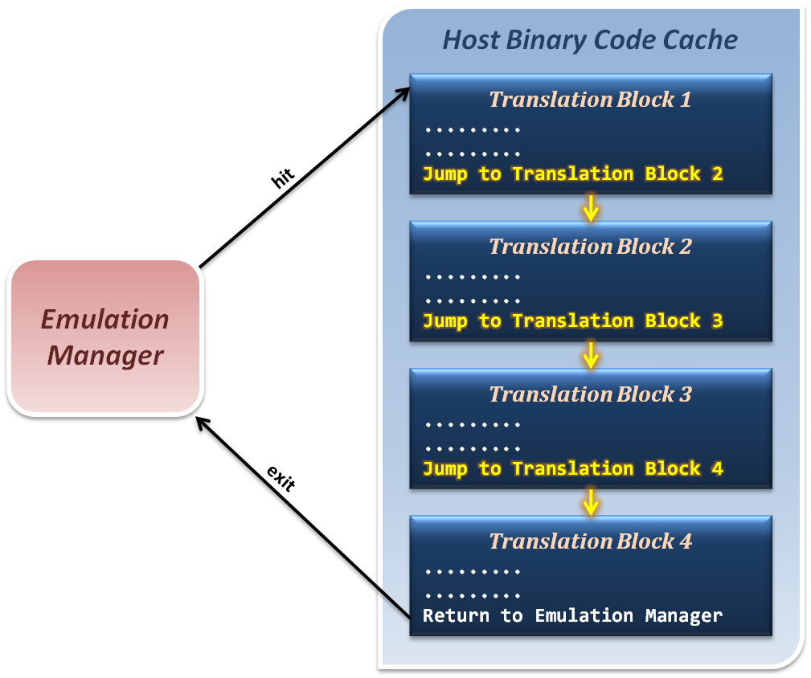
Translation Chaining
Jump from one translation directly to next, which avoid switching back to emulation manager.

Slide 26
Dynamic Optimization
How to optimize binary codes ?
Static optimization (compiling time optimization)
Optimization techniques apply to generate binary code base on the semantic information in source code.
Dynamic optimization (run time optimization)
Optimization techniques apply to generated binary code base on the run time information which relate to program input data.
Why we use dynamic optimization technique ?
Advantages :
It can benefit from dynamic profiling.
It is not constrained by a compilation unit.
It knows the exact execution environment.

Slide 27
Dynamic Optimization
How to implement dynamic optimization ?
Analysis program behavior in run time.
Collect run time profiling information based on the input data and host hardware characteristics.
Dynamically translate or modify the binary code by reordering instructions or other techniques.
Write back the optimized binary into code cache for next execution.

Slide 28
Dynamic Optimization
How to analyze program behavior and profile ?
Collect statistics about a program as it runs
Branches (taken, not taken)
Jump targets
Data values
Cache misses
Predictability allows these statistics to be used for optimizations to be used in the future
Profiling in a VM differs from traditional profiling used for compiler feedback.

Slide 29
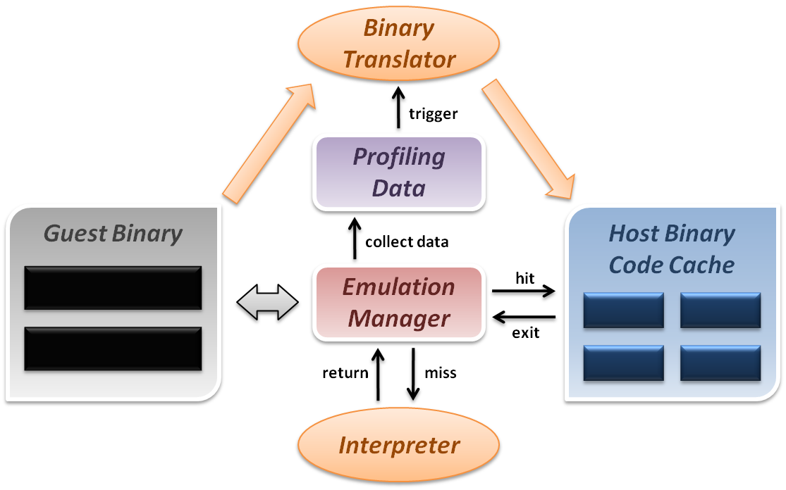
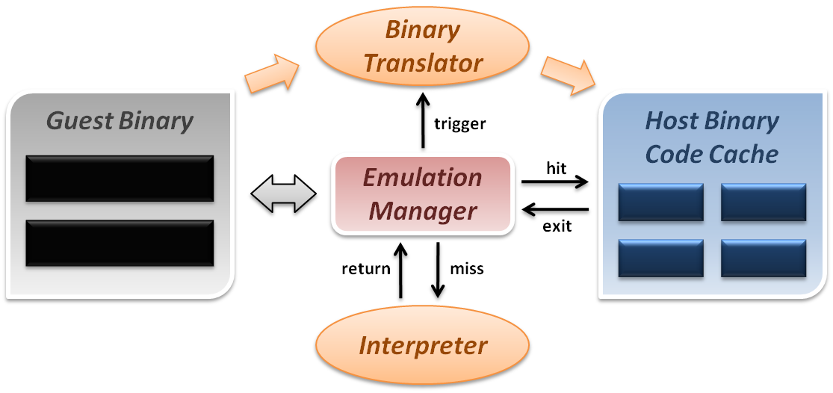
Dynamic Optimization
Dynamic binary translation and optimization :

Slide 30
VIRTUALIZATION

Slide 31
System Virtual Machine
System virtual machines are capable of virtualizing a full set of hardware resources, including a processor (or processors), memory and storage resources and peripheral devices.
Constructed at ISA level
Allow multiple OS environments, or support time sharing.
Examples
IBM VM/360
VMware
Xen
KVM
OKL4
Android
Windows Phone
App
App
App
App
App
App
App
App
Linux kernel
Windows Phone 8’s kernel
Virtual Machine Monitor
Hardware

Slide 32
Virtual Machine Monitor: Main Theorem
A virtual machine monitor can be constructed if the set of sensitive instructions is a subset of the set of privileged instructions
Proof shows
Equivalence
by interpreting privileged instructions and executing remaining instructions natively
Resource control
by having all instructions that change resources trap to the VMM
Efficiency
by executing all non-privileged instructions directly on hardware
A key aspect of the theorem is that it is easy to check

Slide 33
Emulation & Virtualization
Emulation seems a good way to implement VMM.
We can run Guest OS above emulator.
Emulator can manage all hardware resource and arrange sharing resource to Guest OS
However, there are rarely people using emulator as VMM.
WHY?
Because emulation is quite SLOW!
It’s not Efficient!
How to let it faster?
Don’t emulate everything. Just emulate some sensitive instruction which will directly access hardware resource.
Execute all non-privileged instructions directly on hardware

Slide 34
full-virtualization & Para-virtualization

Slide 35
Full-Virtualization
Definition:
We run the Guest OS without modified.
The Guest OS doesn’t realize that it is running above VM rather than physical machine.
Pro:
User can use any OS what he/she wants to install as Guest OS
For those OS which is hard to patch (ex: Windows, because it’s hard to get its source code), user can only install them in full-virtualization environment
Con:
For non-virtualizable CPU, running Guest OS without patched critical instruction need use Dynamic Binary Translation in the hypervisor. It costs a lot.
Even for the virtualizable or hardware assistant CPU, running an OS which doesn’t find out its in VM rather in physical machine is still lots of computing resource. Using patched guest OS can avoid these resource wasting. And using full-virtualization environment cannot gain the performance optimization.

Slide 36
Para-Virtualization
Definition:
Run the Guest OS which is patched for virtualization.
The Guest OS realizes that it is running above VM rather than physical machine.
Pro:
For non-virtualizable CPU, running Guest OS with patched critical instruction can reduce lots of work for hypervisor. Let guest OS run faster.
Even for the virtualizable or hardware assistant CPU, running an OS which doesn’t find out its in VM rather in physical machine is still lots of computing resource. Using patched guest OS can avoid these resource wasting.
Con:
User cannot use any OS what he/she wants to install as Guest OS
For those OS which is hard to patch(ex: Windows, because it’s hard to get its source code), user cannot install them as guest OS.

Slide 37
categories of virtual machine

Slide 38
Several Types of VMM
According to the category from Popek and Goldberg in 1974, virtual machine monitor can be separate into two major type which are majorly category from where the hypervisor is.
Type 1
a.k.a. “Bare-metal VMM”
Type 2
a.k.a. “Hosted VMM”

Slide 39
Type-1: Bare-Metal VMM

Slide 40
Bare-Metal VMM
Android
Windows Phone
App
App
App
App
App
App
App
App
Linux kernel
Windows Phone 8’s kernel
Bare-Metal VMM
Hardware: ARM Cortex-A15 and beyond

Slide 41
Bare-Metal VMM
VMM is responsible for scheduling and managing the allocation of HW resources
Example:
Xen
Hyper-V
VMware workstation

Slide 42
Type-2: Hosted VM

Slide 43
Hosted VMM
Android
App
App
App
App
Windows
Windows
App
App
App
App
App
App
App
App
Windows 8’s kernel
Windows 8’s kernel
Hosted VMM
Linux kernel
Hardware: ARM Cortex-A15 and beyond

Slide 44
Hosted VMM
VMM is built on top of an existing OS
Installation process is similar to the installation of an APP
Let the host OS to provide device drivers and other low-level services
Can patch privileged instructions to VMM calls (traps), or using DBT techniques
Example:
VMware player
KVM
Parallels

Slide 45
Comparison with Native and Hosted VMs
Virtual
Virtual
Machine
Machine
Applications
Virtual
Non-privileged
Machine
modes
VMM
VMM
OS
VMM
Host OS
Host OS
Privileged
Mode
Hardware
Hardware
Hardware
Hardware
Traditional
Native
User-mode
Dual-mode
uniprocessor
VM system
Hosted
Hosted
system
VM system
VM system

Slide 46
References
Books :
James E. Smith & Ravi Nair, Virtual Machines, Elsevier Inc., 2005
英特爾開源軟件技術中心 & 復旦大學並行處理研究所, 系統虛擬化 – 原理與實現, 北京 : 清華大學出版社, 2009.03
Other resources :
Lecture slides of “Virtual Machine” course (5200) in NCTU
Lecture slides of “Cloud Computing” course (CS5421) in NTHU

