Slide 1
虛擬化技術 Virtualization Techniques
Hardware Support Virtualization
SR-IOV

Slide 2
Agenda
Overview
Introduction
Memory Virtualization
Storage Virtualization
Servers Virtualization
I/O Virtualization
PCIe Virtualization
Motivation
Directed I/O
PCIe Architecture
SR-IOV
Architecture Supporting SR-IOV Capability
ARI – Alternative Routing ID Interpretation
ACS Access Control Services
ATS - Address Translation Service
Theory of Operations

Slide 3
Overview
Memory Virtualization
Storage Virtualization
Servers Virtualization
I/O Virtualization

Slide 4
Overview
Memory Virtualization
Uses memory more effectively
Was revolutionary, but now is assumed
Storage Virtualization
Presents storage resources in ways not bound to the underlying hardware characteristics
Fairly common now
Servers Virtualization
Increases typically under-utilized CPU resources
Becoming more common

Slide 5
Overview
I/O Virtualization
Virtualizing the I/O path between a server and an external device
Can apply to anything that uses an adapter in a server, such as:
Ethernet Network Interface Cards (NICs)
Disk Controllers (including RAID controllers)
Fibre Channel Host Bus Adapters (HBAs)
Graphics/Video cards or co-processors
SSDs mounted on internal cards

Slide 6
PCIe I/O Virtualization
Motivation
Directed I/O
PCIe Architecuture

Slide 7
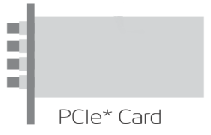


Motivation
I/O Virtualization Solutions
A - Software only
B - Directed I/O (enhance performance)
C – Directed I/O and Device Sharing (resource saving)
Virtual Machine
Virtual Machine
Virtual Machine
Virtual Machine
Virtual Machine
Virtual Machine
Virtual Machine
I/O Driver
I/O Driver
I/O Driver
I/O Driver
I/O Driver
I/O Driver
Virtual Machine Monitor
Virtual Machine Monitor
Virtual Machine Monitor
Virtual Function
Physical Function
C – Directed I/O & Device Sharing
A – Software only
B – Directed I/O

Slide 8
PCIe I/O Virtualization
Motivation
Directed I/O
PCIe Architecture

Slide 9
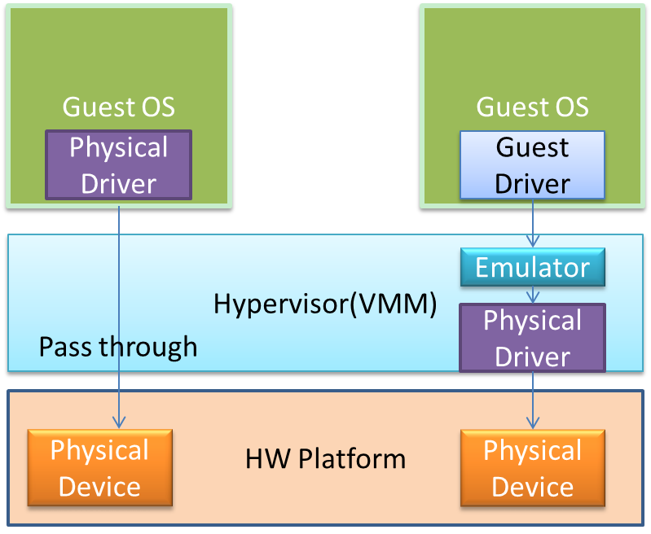
Directed I/O
Software-based sharing adds overhead to each I/O due to emulation layer
This indirection has the additional affect of eliminating the use of hardware acceleration that may be available in the physical device.
Directed I/O has added enhancements to facilitate memory translation and ensure protection of memory that enables a device to directly DMA to/form host memory.
Bypass the VMM’s I/O emulation layer
Throughput improvement for the VMs

Slide 10
Drawbacks to Directed I/O
One concern with direct assignment is that it has limited scalability
A physical device can only be assigned to one VM.
For example, a dual port NIC allows for direct assignment to two VMs. (one port per VM)
Consider for a moment a fairly substantial server of the very near future
4 physical CPU’s
12 cores per CPU
If we use the rule that one VM per core, it would need 48 physical ports.

Slide 11
Terminology relating to Directed I/O
Acronym | Expansion | Defined By | What is it?
I/O MMU | I/O Memory Management Unit | Common parlance | Translation mechanism in the system memory controller (North Bridge) that allows a device or set of devices to use translated addresses when accessing main memory. In many cases, it also translates interrupts coming from the devices as messages.
ATPT | Address Translation and Protection Table | PCI SIG | I/O MMU
VT-d, VT-d2 | Virtualization Technology for Directed I/O | Intel | I/O MMU
DMAr | DMA Remapping | Intel, Microsoft | I/O MMU
IOMMU | I/O Memory Management Unit | AMD | I/O MMU

Slide 12
PCIe I/O Virtualization
Motivation
Directed I/O
PCIe Architecture

Slide 13
Generic Platform
System Image (SI)
System Image (SI)
System Image (SI)
System Image (SI)
Virtualization Intermediary
Processor
System Image(SI)
SI, e.g., a guest OS, to which virtual and physical devices can be assigned
Memory
Root Complex (RC)
Root
Port (RP)
Root
Port (RP)
Switch
PCIe Device
PCIe Device
PCIe Device
PCIe Device

Slide 14
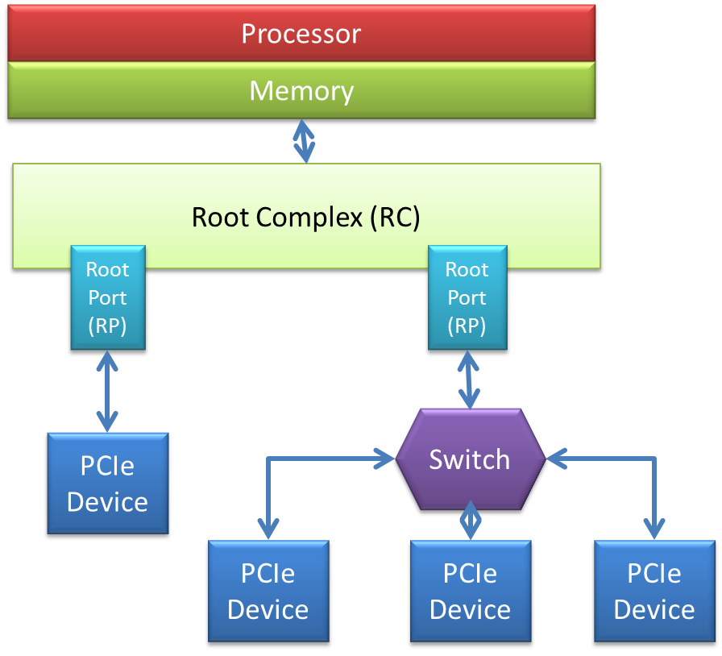
PCIe components
Root Complex
A root complex connects the processor and memory subsystem to the PCIe switch fabric composed of one or more switch devices
Similar to a host bridge in a PCI system
Generate transaction requests on
behalf of the processor, which is
interconnected through a local bus.
May contain more than one PCIe port
and multiple switch devices.

Slide 15
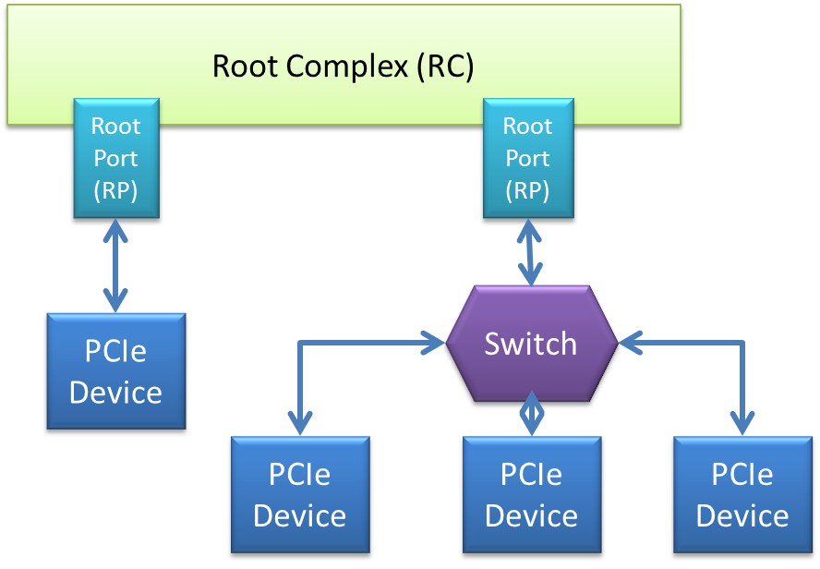
PCIe components
Root Port (RP)
The portion of the motherboard that contains the host bridge. The host bridge allows the PCIe ports to talk to the rest of the computer

Slide 16
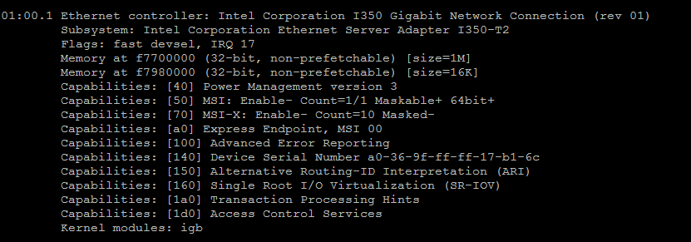
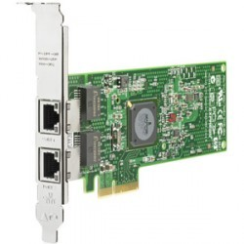
PCIe Device
PCIe Device
Unique PCI Function Address
Bus / Dev / Function
Command, lspci -v, can get PCI device information on linux
Device
Function2
Function1

Slide 17
Example: Multi-Function Device
The link and PCIe functionality shared by all functions is managed through Function 0
All functions use a single Bus Number captured through the PCI enumeration process
Each function can be assigned to an SI
Configuration Resources
Function 0
ATC1
Physical Resources1
PCIe
Port
Internal Routing
Function 1
ATC2
Physical Resources2
PCIe
Port
Function 2
ATC3
Physical Resources3
PCIe
Port
PCIe Device

Slide 18
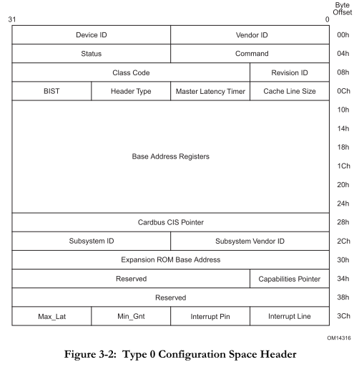
Components in PCIe Device
Configuration Resources
Configuration Space
Devices will allocate resource such as memory and record the address into this configuration space
Reference:
PCI Local Bus Specification ver.2.3 Chap 6

Slide 19
Components in PCIe Device
ARI – Alternative Routing Id Interpretation
Alternative Routing ID Interpretation as per the PCIe Base Specification
Physical Resources
Memory which allocated from physical memory
ATC - Address Translation Cache
A hardware stores recently
used address translations.
This term is used instead of
TLB buffer
To differentiate the TLB used
for I/O from the TLB used by
the CPU
Function 0
ATC1
Physical Resources1
Internal Routing
Function 1
ATC2
Physical Resources2
Function 2
ATC3
Physical Resources3

Slide 20
Physical V.S. Virtual
Configuration Resources
Function 0
ATC1
Physical Resources1
PCIe
Port
Internal Routing
Function 1
ATC2
Physical Resources2
PCIe
Port
Function 2
ATC3
Physical Resources3
PCIe
Port
PCIe Device
Physical
PF 0
Configuration Resources
ATC1
Physical Resources
PCIe
Port
Internal Routing
VF 0,1
Physical Resources
PCIe SR-IOV
Capable Device
VF 0,2
Physical Resources
Virtual

Slide 21
PCIe SR-IOV Capable Device
SR-IOV
A technique performs and manages PCIe Virtualization.
PF – physical Function
Provide full PCIe functionality, including the SR-IOV capabilities
Discover the page sizes supported by a PF and its associated VF
VF – virtual Function
A “light-weight” PCIe function that
is directly accessible by an SI,
including an isolated memory
space, a work queue, interrupts
and command processing.
For data movement
Can be optionally migrated form
one PF to another PF
Can be serially shared by different
SI
PCIe SR-IOV
Capable Device
PF 0
Configuration Resources
ATC1
Physical Resources
PCIe
Port
Internal Routing
VF 0,1
Physical Resources
VF 0,2
Physical Resources

Slide 22
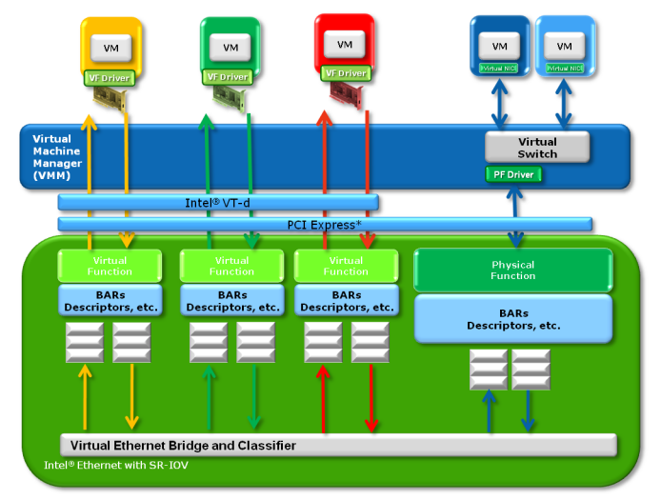
Directly and Software Shared
Figure from Inter PCI-SIG SR-IOV Primer

Slide 23
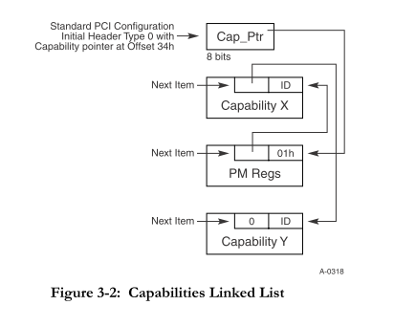
Extended Capabilities

Slide 24
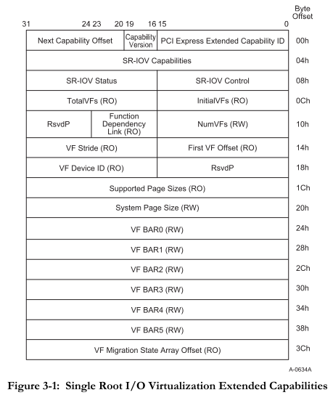
SR-IOV Extended Capabilities

Slide 25
SR-IOV
Architecture Supporting SR-IOV Capability
ARI – Alternative Routing ID Interpretation
ACS – Access Control Services
ATS – Address Translation Service
Data Path for Incoming Packets

Slide 26
Platform with SR-IOV
System Image (SI)
System Image (SI)
System Image (SI)
System Image (SI)
Virtualization Intermediary
SR-PCIM
SR-PCIM
Configure SR-IOV Capability
Management of PFs and VFs
Processing of error events
Device controls
Power management
Hot-plug
SR-PCIM
Processor
Memory
Translation Agent (TA)
Address Translation and Protection Table (ATPT)
Root Complex (RC)
Root
Port (RP)
Root
Port (RP)
Switch
PCIe Device
PCIe Device
PCIe Device
PCIe Device

Slide 27
Components of SR-IOV
TA – Translation Agent
Translate address within a PCIe transaction into the associated platform physical address.
Hardware or combination of hardware and software
A TA may also support to enable a PCIe function to obtain address translations a priori to DMA access to the associated memory.
Translation Agent (TA)
Address Translation and Protection Table (ATPT)

Slide 28
Components of SR-IOV
ATPT – Address Translation and Protection Table
Contain the set of address translations accessed by a TA to Process PCEe requests
DMA Read/Write
Interrupt requests
DMA Read/Write requests are translated through a combination of the Routing ID and the address contained within a PCIe transaction
In PCIe, interrupts are treated as memory write operations.
Though the combination of the Routing ID and the address contained within a PCIe transaction as well
Translation Agent (TA)
Address Translation and Protection Table (ATPT)

Slide 29
SR-IOV
Architecture Supporting SR-IOV Capability
ARI – Alternative Routing ID Interpretation
ACS – Access Control Services
ATS – Address Translation Service
Data Path for Incoming Packets

Slide 30
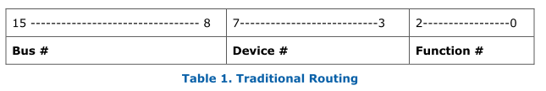
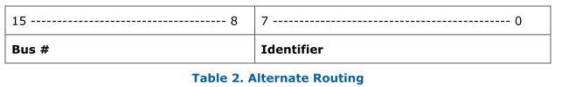
ARI – Alternative Routing ID Interpretation
Routing ID is used to forward requests to the corresponding PFs and VFs
All VFs and PFs must have distinct Routing IDs
ARI provides a mechanism to allow single PCIe component to support up to 256 functions.
Originally there are 8 functions at most in a PCIe.
Figure from Intel PCI-SIG SR_IOV prim

Slide 31
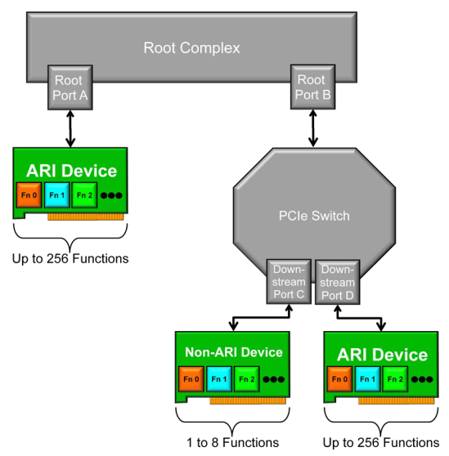
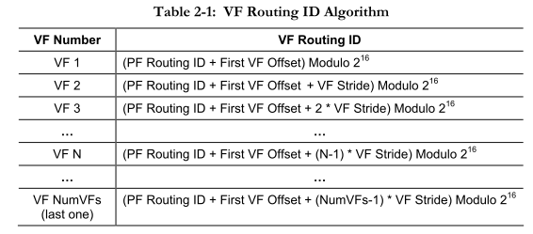
ARI – Alternative Routing ID Interpretation
Figure from SR-IOV Specification revision 1.1
Figure from Intel PCI-SIG SR_IOV prim

Slide 32
SR-IOV
Architecture Supporting SR-IOV Capability
ARI – Alternative Routing ID Interpretation
ACS – Access Control Services
ATS – Address Translation Service
Data Path for Incoming Packets

Slide 33
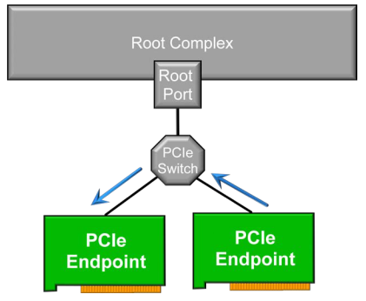
ACS – Access Control Services
The PCIe specification allows for P2P transactions.
This means that it is possible and even desirable in some cases for one PCIe endpoint to send data directly to another endpoint without having to go through the Root Complex.
However, in a virtualized environment it is generally not desirable to have P2P transactions.
With both direct assignment and SR-IOV, the PCIe transactions should go through the Root Complex in order for the ATS to be utilized.
ACS provides a mechanism by
which a P2P PCIe transaction
can be forced to go up through
the RC
Figure from Intel PCI-SIG SR_IOV prim

Slide 34
SR-IOV
Architecture Supporting SR-IOV Capability
ARI – Alternative Routing ID Interpretation
ACS – Access Control Services
ATS – Address Translation Service
Data Path for Incoming Packets

Slide 35
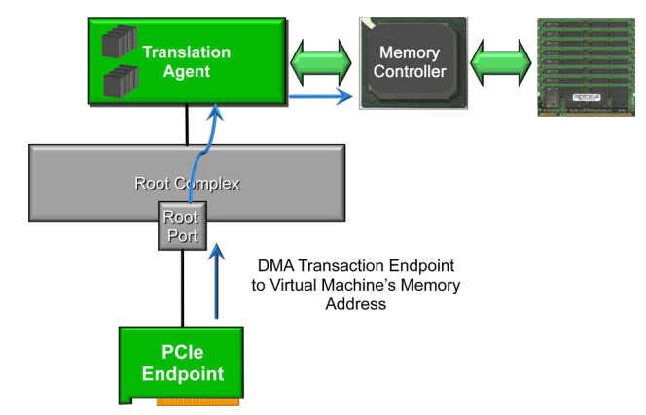

ATS – Address Translation Services
ATS provides a mechanism allowing a virtual machine to perform DMA transaction directly to and from a PCIe endpoint.

Slide 36
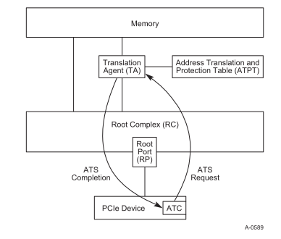
ATS – Address Translation Services
ATS uses a request-completion protocol between a Device and a Root Complex (RC)

Slide 37
ATS – Address Translation Services
Upon receipt of an ATS Translation Request, the TA performs the following Requests
Validates that the Function has been configured to issue ATS Translation Requests.
Determines whether the Function may access the memory indicated by the ATS Translation Request and has the associated access rights.
Determines whether a translation can be provided to the Function. If yes, the TA issues a translation to the Function.
The TA communicates the success or failure of the request to the RC which generates an ATS Translation Completion and transmits via a Response TLP through a RP to the Function.
Path
Function(Request)=>TA=>RC(Completion)=>Function

Slide 38
ATS – Address Translation Services
When the Function receives the ATS Translation Completion
Either updates its ATC to reflect the translation
Or notes that a translation does not exist.
The Function generates subsequent requests using
Either a translated address
Or an un-translated address based on the results of the Completion.

Slide 39
SR-IOV
Architecture Supporting SR-IOV Capability
ARI – Alternative Routing ID Interpretation
ACS – Access Control Services
ATS – Address Translation Service
Data Path for Incoming Packets

Slide 40
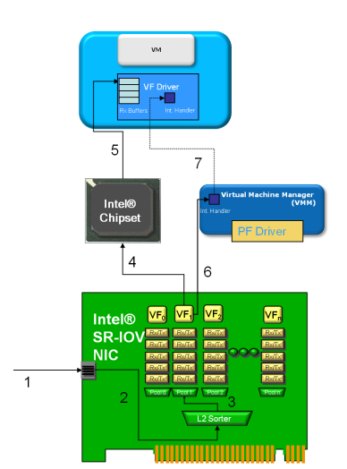
Data Path for incoming packets
The Ethernet packet arrives at the Ethernet NIC
The packet is sent to the Layer 2 sorter/switch/classifier
This Layer 2 sorter is configured by the Master Driver. When either the MD or the VF Driver configure a MAC address or VLAN, this Layer 2 sorter is configured.

Slide 41
Data Path for incoming packets
3. After being sorted by the
Layer 2 Switch, the packet is
placed into a receive queue
dedicated to the target VF.
4. The DMA operation is
initiated. The target memory
address for the DMA operation
is defined within the
descriptors in the VF, which
have been configured by the VF
driver within the VM.

Slide 42
Data Path for incoming packets
5. The DMA Operation has
reached the chipset. Intel VT-d,
which has been configured by
the VMM then remaps the target
DMA address from a virtual host
address to a physical host address.
The DMA operation is completed;
the Ethernet packet is now in the
memory space of the VM
6. The NIC fires interrupt,
indicating a packet has
arrived. This interrupt
is handled by the VMM

Slide 43
Data Path for incoming packets
7. The VMM fires a virtual
interrupt to the VM, so
that it is informed that
the packet has arrived

Slide 44
Summary
SR-IOV creates Virtual Function, which records the information of the virtual PCIe device and be directly mapped to a system image.
Virtual Function is a “light weight” function just for data movement. The management is controlled by Physical Function.
ATC, a hardware stores recently used address translations
ARI, a mechanism to allow single PCIe component to support up to 256 functions. And Routing ID is used to forward requests to the corresponding PFs and VFs.
ATS, a mechanism allowing a virtual machine to perform DMA transaction directly to and from a PCIe endpoint
In the end, a example show up the data path for the incoming packets.

Slide 45
虛擬化技術 Virtualization Techniques
Hardware Support Virtualization
MR-IOV

Slide 46
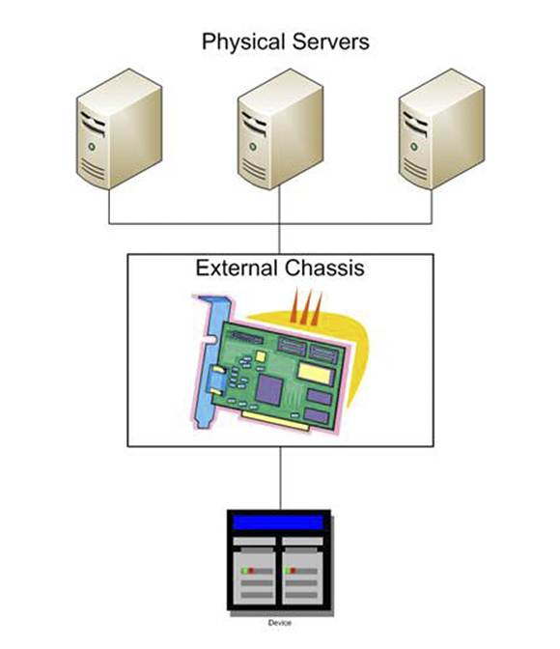
MR-IOV Introduction
Multiple servers & VMs sharing one I/O adapter
Bandwidth of the I/O adapter is shared among the servers
The I/O adapter is placed into a separate chassis
Bus extender cards are placed into the servers

Slide 47
MR-IOV Topology
MR components group to create Virtual Hierarchies (VH)
Virtual Hierarchy = a logical PCIe hierarchy within a MR topology.
Each VH typically contains at least one PCIe Switch.
Extends from a RP to all its EPs
Each VH may contain any mix of Multi-Root Aware (MRA) Devices, SR-IOV Devices, Non-IOV Devices, or PCIe to PCI/PCI-X Bridges.
The MR-IOV topology typically contains at least one MRA Switch

Slide 48
MR-IOV Topology
Root Complex (RC)
Root Complex (RC)
Root Complex (RC)
Root Complex (RC)
Root
Port (RP)
Root
Port (RP)
Root
Port (RP)
Root
Port (RP)
MRA
Switch
MRA
Switch
PCIe
Switch
PCIe to PCI Bridge
MRA PCIe
Device
SR-IOV PCIe
Device
PCIe
Device
PCI/PCI-X
Device

Slide 49
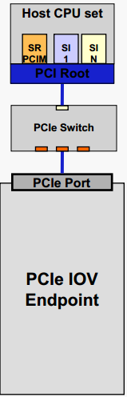
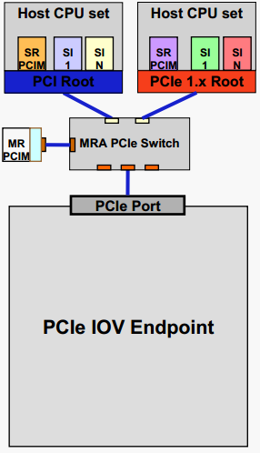
Topology Overview and Terms
SR Topology | Multi-Root Topology | Terms
 |  | Single Root (SR) IOV Overview, Only has one Root. Switches only need to support PCIe base functionality. To make full use of IOV, EP must support SR-IOV capabilities. SR-PCIM configures the EP. Multi-Root (MR) IOV Overview, One or more Roots. Switches with Multi-Root Aware (MRA) functionality are needed. To make full use of IOV, EP must support SR & MR-IOV capabilities. MR-PCIM assigns Virtual Endpoints (VEs) to RCs and manages PCIe components. SR-PCIM configures its VEs.

Slide 50
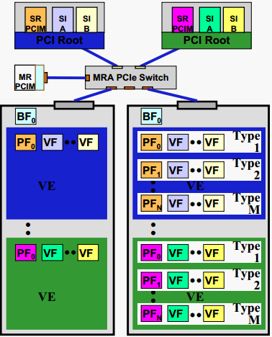
Multi-Root IOV function Types and Terms
MR Topology | MR Topology Terms
 | Virtual Endpoint (VE) is the set of physical and virtual functions assigned to an RC. Each VE is assigned to a Virtual Hierarchy (VH). Virtual Hierarchy (VH) is a fully functional PCIe hierarchy that is assigned to an RC or MR-PCIM. Note, all PFs and VFs in a VE are assigned the same VH. Base Function (BF) only 1 per EP and is used by MR-PCIM to manage an MR aware EP (e.g. assigning functions to Virtual Endpoints).

Slide 51
MRA Components
Multi-Root Aware Device(MRA Device)
It is composed of a set of Functions in each VH.
There are a variety of Function types:
BF (Base Function)
Function used to manage the MR features of an MR Device.
PF
VF
Non-IOV Function

Slide 52
MRA Components
A BF is a function compliant with this specification that includes the MR-IOV Capability. A BF shall not contain an SR-IOV Capability.
A PF is a Function compliant with the PCI Express Base Specification that includes the SR-IOV Extended Capability. Every PF is associated with a BF. The Function Offset fields in a BF’s Function Table point to the PFs.

Slide 53
MRA Components
A VF is a Function associated with a PF and is described in the Single-Root I/O Virtualization and Sharing Specification. VFs are associated with a PF and are thus indirectly as associated with a BF.
A Non-IOV Function is a Function that is not a BF, PF, or VF. Non-IOV Functions may or may not be associated with a BF.

Slide 54
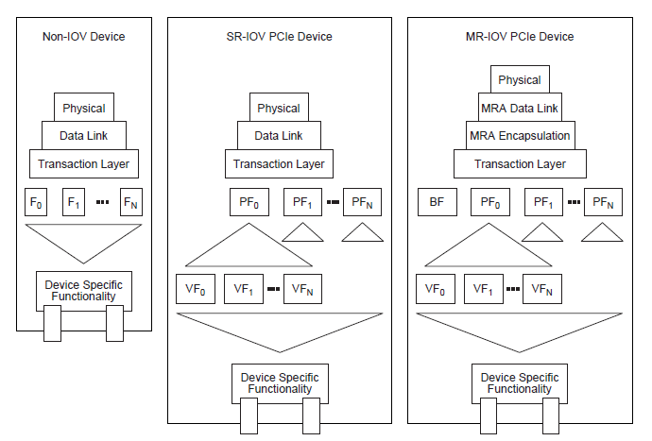
MRA Components
Non-IOV, SR-IOV, and MRA Device Functional Block Comparison

Slide 55
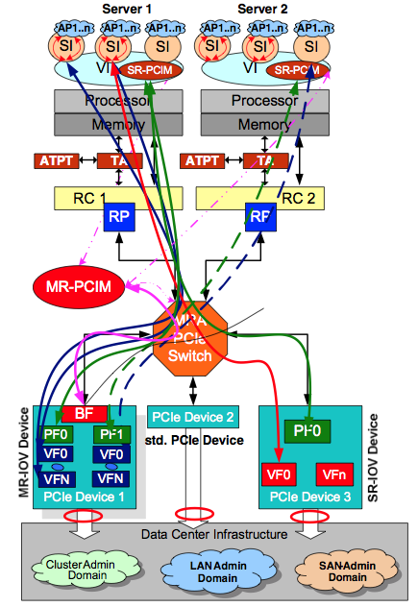
Multi Root I/O Virtualization
Enables sharing of PCIe device resources between different physical servers.
PCIe devices on each server not required consolidation of costs, power and space.
PCIe interface of server exposed to external PCIe fabric devices.
Reference to FSC TEC Team,Fujitsu Siemens Computers 2008.

Slide 56
Multi Root I/O Virtualization
Single Root PCI Manager (SR-PCIM) as part of VI has to allocate VFs from PCIe devices to individual SI’s
Management of I/O hierarchy resources done by a Multi Root PCI Manager (MR-PCIM).
Reference to FSC TEC Team,Fujitsu Siemens Computers 2008.

Slide 57
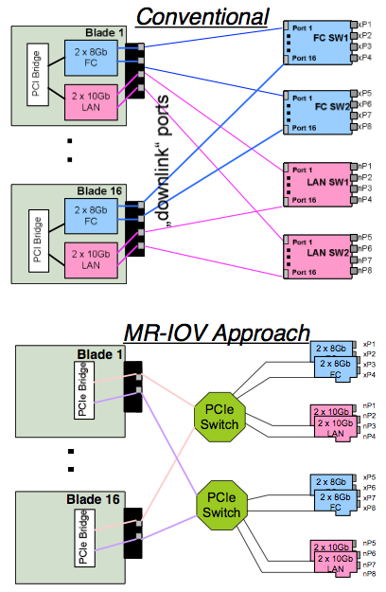
MR-IOV Adoption to Blade Systems
MR-IOV approach might fit with Blade Server Systems enclosing multiple hosts at high density.
Example Configuration Requirements:
16 x Blade Server Modules 8 x 10 Gb Ethernet uplink Ports 8x 8Gb FC uplink Ports
Redundant Fabric Infrastructure
Reference to FSC TEC Team,Fujitsu Siemens Computers 2008.

Slide 58
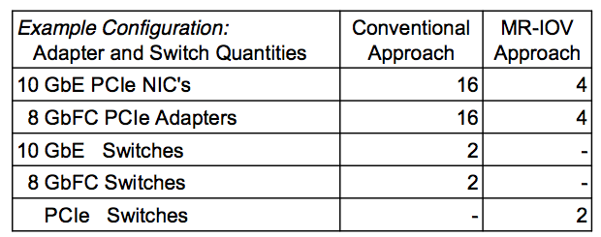
MR-IOV Adoption to Blade Systems
The functional alike MR-IOV approach will require reduced adapter and switch quantities:
Reference to FSC TEC Team,Fujitsu Siemens Computers 2008.

Slide 59
MR-IOV Approach Implications
Hardware cost reductions
Less number of switches- and switch-types required
Sharing of I/O devices will allow to avoid costly over-provisioning
Performance
Conventional approach alike latencies expected
I/O throughput can be setup per blade
max. throughput limitated by PCIe Fabric implementation details

Slide 60
MR-IOV Approach Implications
Power savings
Reduced number of switching chip devices
Flexibility in configuring I/O Devices
I/O device pool provides VF resources for server individual assignments
Online reconfiguration capability for I/O devices due to various reasons
HW problems, service, performance, virtual configuration management
Less dependency on proprietary PCIe card implementations

Slide 61
Reference
Intel PCI-SIG SR-IOV Primer
“SR-IOV Networking in Xen: Architecture, Design and Implementation” Yaozu Dong, Zhao Yu and Greg Rose
Single Root I/O Virtualization and Sharing Specification Revision 1.1
Address Translation Services Revision 1.1
“Implementing PCI I/O Virtualization Standards”, Mike Krause and Renato Recio
PCI SIG IOV Work Group Co-chairs
Multi-Root I/O Virtualization and Sharing Specification Revision 1.0
Dennis Martin, “Innovations in storage networking: Next-gen storage networks for next-gen data centers,” in Storage Decisions Chincago presentation titled, 2012.
http://www.mindshare.com/files/ebooks/PCI%20System%20Architecture%20(4th%20Edition).pdf
http://www.pcisig.com/developers/main/training_materials/get_document?doc_id=4717c70ea2fe2f92dcbc4560a39cba8129af32c1
http://www.intel.com/content/dam/doc/application-note/pci-sig-sr-iov-primer-sr-iov-technology-paper.pdf
http://ieeexplore.ieee.org/xpls/abs_all.jsp?arnumber=5416637&tag=1

Slide 62
Reference
http://www.pcisig.com/developers/main/training_materials/get_document?doc_id=e3da4046eb5314826343d9df18b60f083880bf7b
http://www.pcisig.com/developers/main/training_materials/get_document?doc_id=ee6c699074c0b2440bfac3abdecb74b3d89821a8
http://www.pcisig.com/developers/main/training_materials/get_document?doc_id=656dc1d4f27b8fdca34f583bdc9437627bc3249f

Slide 63
Q & A

