Slide 1

Applied CyberInfrastructure Concepts ISTA 420/520 Fall 2012
Will Computers Crash Genomics? Science Vol 331 Feb 2011
Nirav Merchant (nirav@email.arizona.edu)
Bio Computing & iPlant Collaborative
Eric Lyons (ericlyons@email.arizona.edu) Plant Sciences & iPlant Collaborative
University of Arizona
http://goo.gl/p4j3m or https://sites.google.com/site/appliedciconcepts/
1

Slide 2
Topic Coverage
Resource and Job Management systems (RJMS)
Overview of UA HPC systems
Submit your first job
Make sure you get your futuregrid account application in !!!!

Slide 3
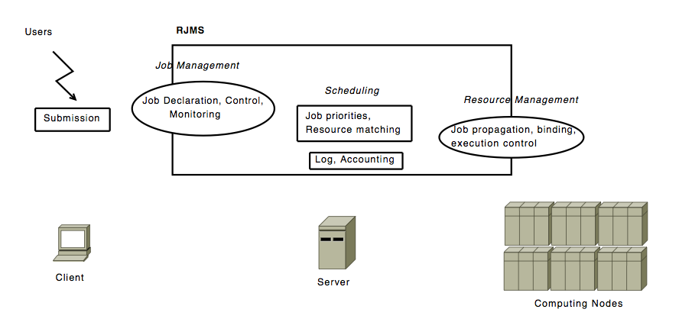
General Architecture
CONTRIBUTIONS FOR RESOURCE AND JOB MANAGEMENT IN HIGH PERFORMANCE COMPUTING - Yiannis Georgiou 2010 (thesis)

Slide 4
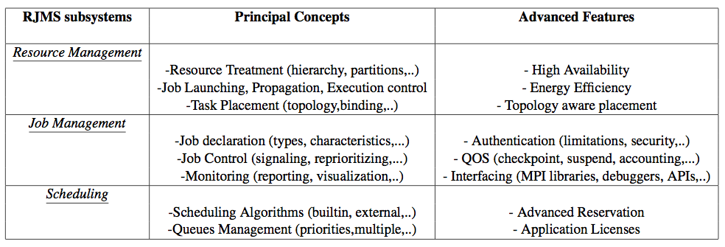
Resource & Job Mgmt System
CONTRIBUTIONS FOR RESOURCE AND JOB MANAGEMENT IN HIGH PERFORMANCE COMPUTING - Yiannis Georgiou 2010 (thesis)

Slide 5
Why are you torturing us
This is absolutely boring
I have no use for it
I own my HPC, HTC (and it does what I tell it)
I <3 Amazon and this is never needed on the cloud
Etc etc.
Notes:
Knowing the RJMS is the key to expoiting the full potential of ANY computing system

Slide 6
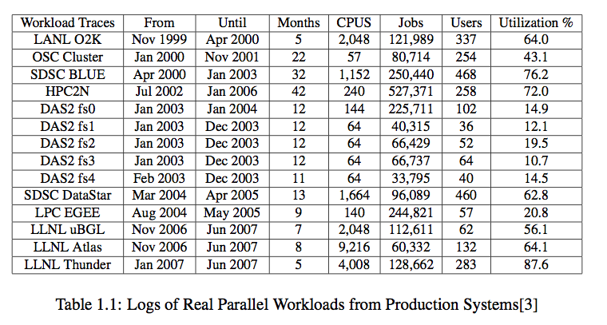
Resource utilization on HPC systems per parallel job
CONTRIBUTIONS FOR RESOURCE AND JOB MANAGEMENT IN HIGH PERFORMANCE COMPUTING - Yiannis Georgiou 2010 (thesis)
Notes:
Not to be confused with occupancy

Slide 7
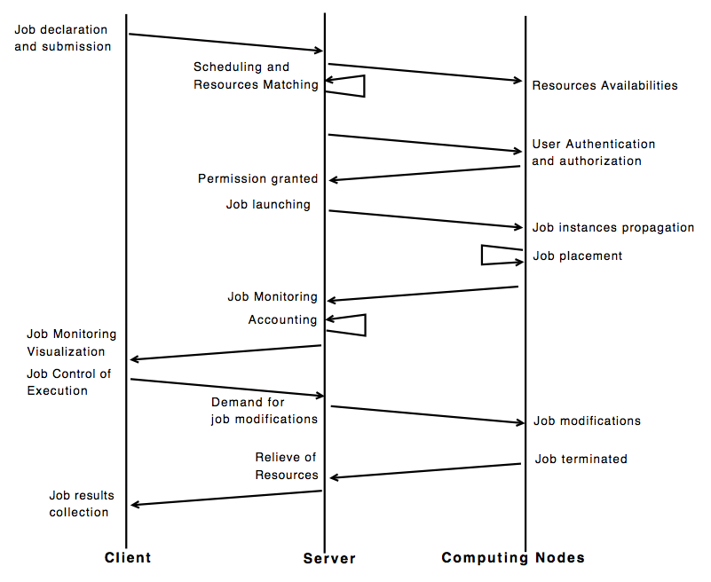
Principal tasks (sequence dia.)

Slide 8
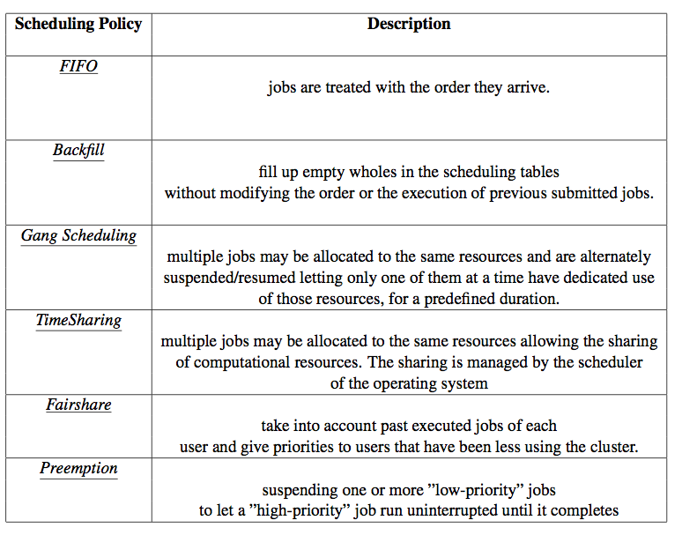
Scheduling Policy

Slide 9
Popular Options (commercial and opensource)
SLURM
CONDOR
TORQUE
OAR
SGE
MAUI
MOAB
LSF
PBSPro
LoadLeveler
Notes:
Highlighted ones we will use in class
Talk of starcluster -> open grid scheduler

Slide 10
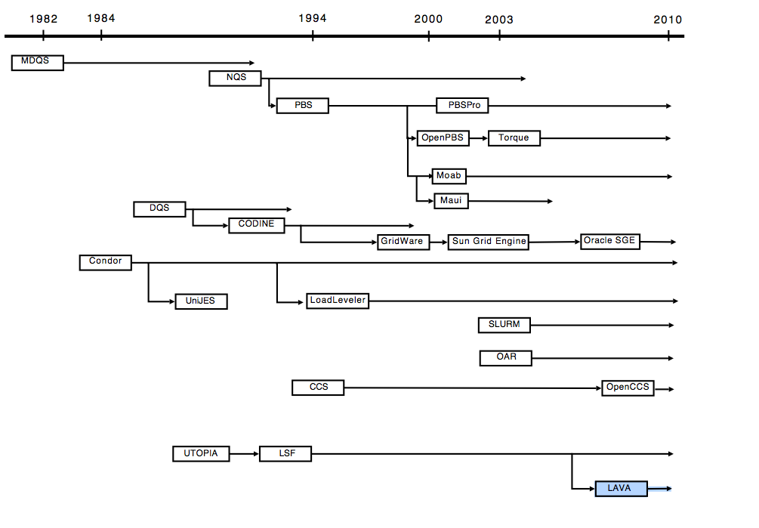
Resource and Job Mangement
CONTRIBUTIONS FOR RESOURCE AND JOB MANAGEMENT IN HIGH PERFORMANCE COMPUTING - Yiannis Georgiou 2010 (thesis)

Slide 11
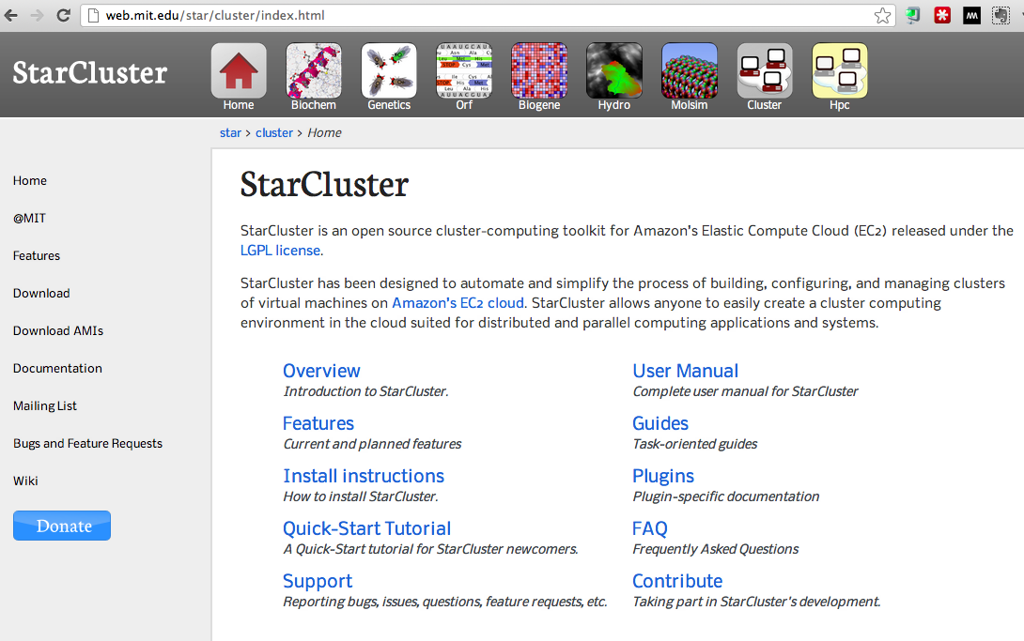
Cloud is no different for RJMS
Notes:
Tell me what queing , load balancing system they are using ?

Slide 12
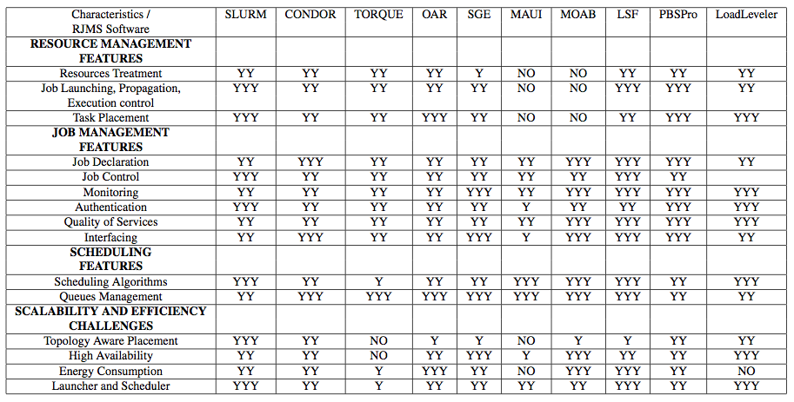

Comparison of RJMS

Slide 13
Popular RJMS Options (commercial and open-source)
SLURM (0): Simple Linux Utility for Resource Management
HTCONDOR (0): Used on iPlant’s AZ grid
TORQUE (0): Terascale Open-Source Resource and QUEue Manager
OAR (0): French software.
SGE/OGE ($): Sun Grid Engine (Oracle Grid Engine)
MAUI (0): Develment has slowed
MOAB ($): Commercial implementation of MAUI. Greatly expanded features
LSF ($): Load Sharing Facility
PBSPro ($): Portable Batch System
LoadLeveler ($): IBM Tivoli Workload Scheduler

Slide 14
Some common concepts & Right of Passage !
Login nodes
Compute nodes
Storage systems
Time: CPU, Wall etc
RJMS systems
Understanding queues
Understanding scheduling
Understanding monitoring
Clever tricks specific to RJMS !
Notes:
Some tricks like pbsdsh and job array

Slide 15
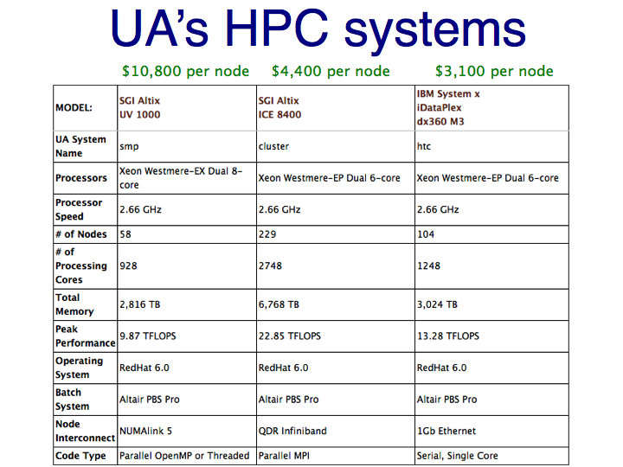

Slide 16
Which Queue do you go to ?
In order to utilize the systems most effectively each user needs to know four things about their jobs:
type of software (serial, parallel MPI, parallel threaded/OpenMP)
hardware system designed for the type of job (htc, cluster, smp)
UA HPC/HTC keywords or PBS resource requests used to match user jobs to the appropriate HPC/HTC system
the queue where the job should run (windfall, standard, high)
memory required of your program
time you need to run

Slide 17
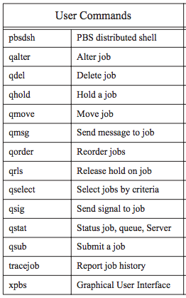
PBSpro

Slide 18
Lets examine a qsub file
http://rc2.webhost.uits.arizona.edu/hpc-htc/using-systems/pbs-example
Scroll towards the bottom
Copy example script 1 “Script to run a serial job using one core”.
Modify it to run:
/usr/bin/time echo "This is a test. Only a test. Do not panic"
Submit to pbs (how will you do it ?)

