Slide 1

Assignment
Submitted by Dinesh Kumar

Slide 2
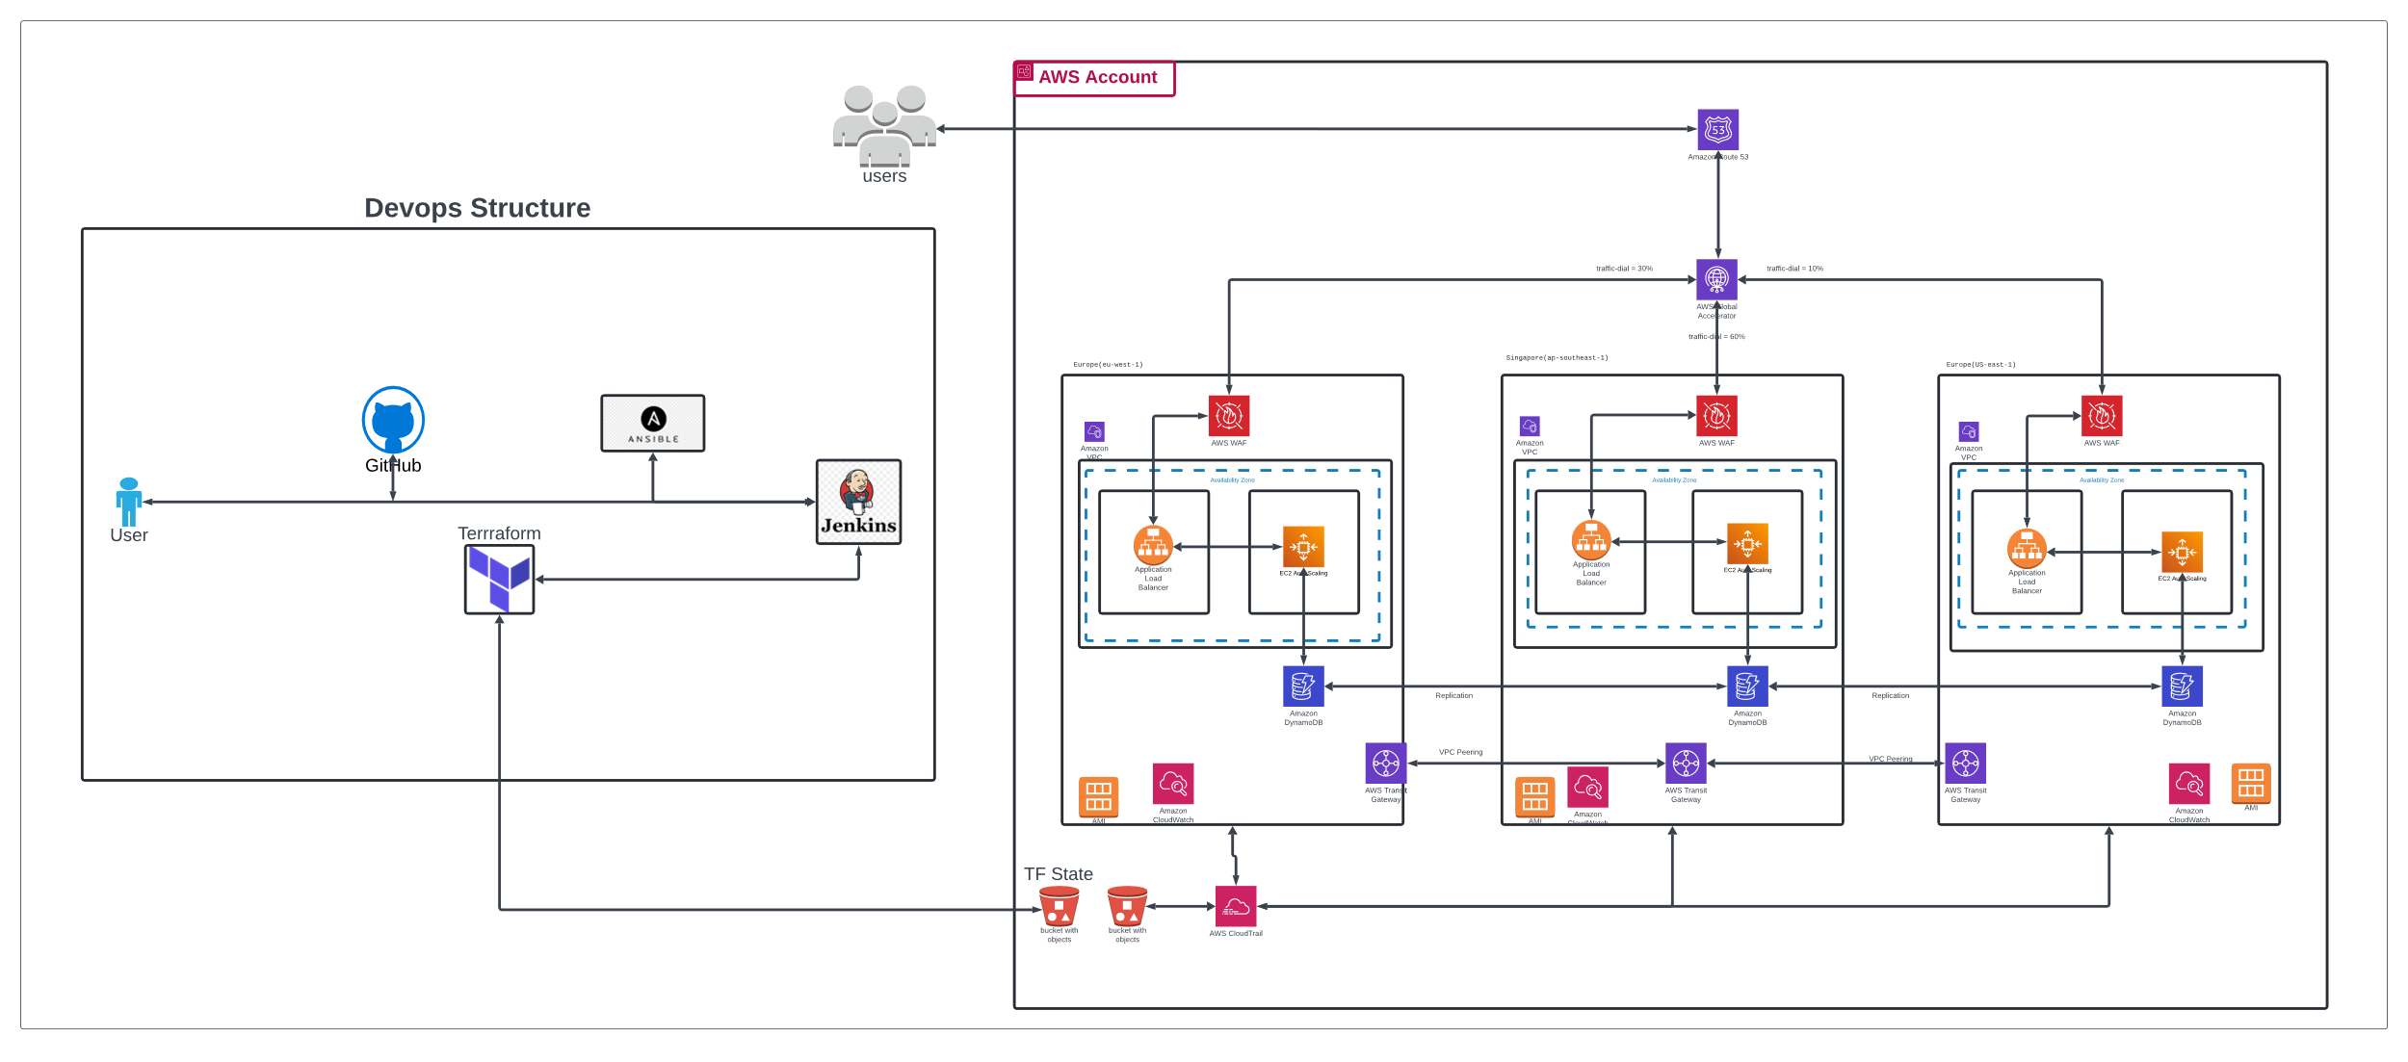
Architecture Diagram
Click on the Link for Lucidchard diagram…..

Slide 3
List of services used for the assignment
EC2 Autoscaling → For Scalability and optimization depends on the load
2
Application load balancers → Load sharing across the vm’s and high availability within region
3
4
5
6
7
8
9
10
VPC → For Subnets, Transit gateway, VPC peering, Application configuration, administration and BAU activities etc.
S3 buckets → Storing Terraform State file, Audit logs and log storage
WAF → Secure from the threats like DDOS attack, SLQ injection etc.
Global accelerator → Share the traffic load based on the condition across region
Route 53 → DNS management
DynamoDB → Database with multi region replication, each Database have the capability to write operation and replicate to the other database
Cloud Trail → For audit purpose, capturing and storing in the S3
Cloud Watch → For infra and application monitoring and log management
1

