Slide 1


Team Delta
Case-study team
AI FDE CAPSTONE · EXECUTIVE PRESENTATION
One quality estate.
One version of
the truth.
Dinesh Naik
PRESENTER
Dinesh.Naik@Birlasoft.Com
Rama Vedula
Rama.Vedula@Birlasoft.Com
Nachiket Bordekar
Nachiket.Bordekar@Birlasoft.Com
Sudhir Kulkarni
Transforming a legacy GxP quality estate with a deterministic hub, a governed semantic layer and an advisory AI that never decides
Sudhir.Kulkarni@Birlasoft.Com
Hardik Trivedi
Presented by Dinesh Naik
Senior GenAI Solution Architect · Birlasoft · October 2026
Hardik.Trivedi@Birlasoft.Com
All figures come from a synthetic, seeded dataset (seed 4100): they validate the method, not a production outcome.
Notes:
Introduce Team Delta: Dinesh Naik (presenter), Rama Vedula, Nachiket Bordekar, Sudhir Kulkarni and Hardik Trivedi. Then say what this is: a capstone transformation of a synthetic but realistic GxP quality estate. Everything shown is real code running on synthetic data. The honest headline comes on the next slide.

Slide 2




THE ANSWER FIRST
WHAT WE DID, WHAT IS PROVEN, WHAT WE NEED
Executive summary
What we built
Proven in the sandbox
A deterministic, standard-library hub beside the untouched legacy code
A semantic layer: 34 entities, 56 vocabularies, tested
A running Command Centre UI with an advisory OpenAI assistant
Month-end defect found and fixed: +19.3 % inflation removed
Replay of 8,567 feed rows changes nothing (Δ 0)
134 / 134 legacy behaviours preserved; 15 / 15 mutants killed
Not proven yet
The ask
No users, no after-window: no time or cost saving can be claimed
Release gate NO-GO: 0 of 40 human approvals
AI assistant not yet evaluated on real documents
Five decisions: closure definition, Zone H holders, pilot window, owners, AI scope
A 90-day gated pilot on one site
A second reviewer for separation of duties
Notes:
Pyramid: give the CTO the conclusion before the story. Four quadrants: what we built, what is proven in the sandbox, what is not proven, and the ask.

Slide 3
THE ESTATE CANNOT AGREE
ON ITS OWN NUMBERS
Why · Problem statement
MONTH-END INFLATION
FEED ROWS UNMATCHED
MEANINGS OF CLOSED
OPEN CASES (D-OPS)
+19.3%
97.98%
4
89 / 125
742,956.61 legacy vs 622,826.44 one-source
8,394 of 8,567 reference no case
across case, batch, deviation and enterprise vocabularies
median age 565 days; 31 older than two years
WHAT THIS MEANS FOR THE BUSINESS
Finance and operations report different month-ends
and nobody owns the definition (OPD-08)
A 2025 partner replay inflated the exception queue
and forced a rollback: intake was destructive
Quality decisions leave no record of who decided and why
a GxP audit cannot be answered from the data
Notes:
Start with the KPI. The same month-end total is 742,956.61 in the legacy report and 622,826.44 when read once from one table. 98 percent of partner-feed rows point at cases that do not exist. 'Closed' means four different things. 89 of 125 cases are open with a median age of 565 days. These are synthetic numbers, but each defect is real in the code.

Slide 4






WHO FEELS IT,
AND WHO MUST DECIDE
Who · Stakeholders
Quality reviewer
Quality lead
Compliance
Works the exception queue; needs to know why an item is there and what to check
Owns case work; needs one backlog number per definition, not one per report
Needs every decision traceable to a person, a reason and evidence
Finance (read)
Integration owner
Dispositioner
Needs a month-end total that reconciles, with a stated cut-off
Needs replays and partner revisions to be safe, never destructive
The only human who may release or reject a batch: Zone H, holder required
Sponsor: CTO · Delivery: AI Forward Deployed Engineer · In this capstone the accountable roles are vacant (0 of 28 assets have an accepted owner)
Notes:
Six roles from the hub's own role model. Be honest: in this engagement every owner field is Dinesh; the roles exist in the design and are vacant in reality. The dispositioner is the only role that can ever hold a Zone H action, and the holder list ships empty.

Slide 5
EIGHT ROOT CAUSES,
CONFIRMED IN CODE AND SCHEMA
Why · Diagnosis
RC-1
RC-2
RC-3
RC-4
No recorded decision step
Mutable case state
No owned definition of 'closed'
Three unsynchronised approval rules
RC-5
RC-6
RC-7
RC-8
Manual, unrecorded execution
Destructive intake
No shared identity model
No shared month-end definition
Source: docs/06-root-cause/confirmed-root-causes.md · Every root cause is an absence of design or ownership, not of language understanding
Notes:
Each root cause is an absence: of a record, an owner, a key or a definition. None of them is a language problem. This is why the core fix is engineering and governance, and why AI is an advisory layer, not the engine.

Slide 6
What we built, and how it works
02
Solution approach · functional flow · technical implementation · engineering decisions
Notes:
Transition into the solution. Three things were built: the hub, the semantic layer and the Command Centre with its assistant.

Slide 7




FIVE PRINCIPLES
THAT SHAPED EVERY LINE OF CODE
What · Solution approach
Deterministic core
Humans decide
Meaning before metrics
Shadow, not cutover
AI as advisor
Counting, classifying and recording are rules, not models. Exact decimals, fixed precedence, one query path.
Ten Zone H actions are human-only. The holder list ships empty, so nothing consequential can happen by accident.
A semantic layer defines every entity, status and metric. Figures carry their definition tag and are never mixed.
The hub runs beside the untouched legacy code, reads a checksum-verified copy and proves parity first.
OpenAI explains cases, exceptions and rules with citations. Autonomy A1: it suggests; a human acts.
Notes:
Walk through the five principles. The key message for a CTO: we separated what must be deterministic (counting, deciding, recording) from what AI is good at (explaining, finding, summarising), and put a human gate on every consequential action.

Slide 8


FROM PARTNER FEED
TO A DEFENSIBLE DECISION
How · Functional flow
Receive
Validate
Route
Explain
Review
Gate
Raw row kept verbatim; natural key (partner, kind, ref, source_ts)
15 reason codes, fixed precedence, no silent fixes
5 queues: quarantine, revision, unmatched, ambiguous, flagged
AI assistant cites the rule, definition and record (A1)
Reviewer acts with a reason; event appended, hash-chained
Zone H: named human holder only; AI and services refused
Metrics read the same events. Backlog, time-to-close and month-end are computed once, each tagged D-OPS, D-EVID or D-FIN. Where a definition is undecided the figure is reported as unavailable rather than guessed.
Notes:
Follow one feed row left to right. It is stored raw, keyed by its natural key, validated against 15 reason codes in a fixed precedence, routed to one of five queues, explained to a reviewer by the advisory AI, and any consequential action stops at the Zone H gate. Metrics read the same events and carry their definition tag.

Slide 9
BEFORE: WHAT THE REPO HAD
FIVE CODEBASES, THREE RULE COPIES
How · Technical baseline
SOURCES
LEGACY CODE (as imported)
DATA
Partner feeds
8,567 rows · replays
RC-8
RC-6
RC-2
app/ JSON API
Python · 18 files · 552 lines · Docker 0.0.0.0:8080 · no login
services/source_gateway
Python HTTP service :8090 · pulls partner data
SQLite: legacy.sqlite3
cases · events · partner_feeds · policy_exceptions · mutable status column
Gateway inbox
MES / LIMS / QMS
RC-5
RC-8
legacy_batch/
night-shift reconciliation · treats REVIEW as open
legacy_java/
ReconcileLegacy.java · month-end in floating point
Vendor CSV
2,400 rows
enterprise_legacy.sqlite3 + lake
finance / reference stores
RC-4
RC-4
legacy_js/
front-end approval threshold · 999,999 default · ×1.05
app/legacy_logic.py
server priority + manual-review rule
Documents
1,200 archive items
Missing entirely
decision record · audit trail · login and roles · shared identity keys · owned definitions · UI
Baseline commit a6eb4e8 (17 Oct 2026): 7 test files (121 lines), 1 CI workflow, shipped suite kills 1 of 15 mutants
Notes:
This is the repository as imported on 17 Oct (baseline commit a6eb4e8, unmodified). A JSON-only Python API in Docker on 0.0.0.0, a source gateway service, a night-shift batch job, a Java month-end reconciliation using floating point, and a JavaScript approval threshold with a 999,999 default. Three copies of the approval rule disagree (RC-4). Everything writes straight into SQLite with no audit, no login and no decision record. Seven test files.

Slide 10
NOW: ONE GOVERNED HUB
BESIDE THE UNTOUCHED ESTATE
How · Target architecture
LEGACY ESTATE (unchanged, shadow)
GxP QUALITY HUB · Python stdlib · 204 files · 24 packages
EXPERIENCE
Hub reviewer UI
127.0.0.1:8081 · login · queue · trace · disposition
app/ API + rules
read-only
adapters
read-only legacy access
intake
15 reasons · 5 queues
crosswalk
7 id types · exact keys
Java / JS / batch
decision
append-only events
policy
definition tags · rules
gate (Zone H)
ZH-01..10 · holders []
Quality Command Centre
127.0.0.1:8090 · 9 views · 6 personas · read-only
legacy.sqlite3
metrics
one query path · Decimal
runs · review
idempotent jobs · queue
security · obs
48 routes · audit · counters
AI assistant (A1)
guard · retrieve · wrap · generate · log
feeds · gateway · vendor · docs
hub.sqlite3 · migrations M001-M006 · hash-chained audit anchor
checksum gate on data (OD-03a) · backup / restore · release evaluator · golden compare
Semantic layer
YAML · schema · tests
OpenAI / Azure
only with a key
Notes:
Read left to right. Sources are read through read-only adapters; the legacy estate keeps running unchanged in shadow. The hub owns intake, identity, decisions, policy, the Zone H gate and metrics, all over its own SQLite store with forward-only migrations M001 to M006 and a hash-chained audit anchor. Two experiences sit on top: the hub's reviewer UI for actions, and the Command Centre for insight with the advisory assistant. The assistant is the only component that can call out, to OpenAI or Azure OpenAI, and only with a configured key.

Slide 11
A MODULAR MONOLITH
BESIDE THE LEGACY ESTATE
How · Technical implementation
GxP Quality Command Centre (9 views, 6 personas)
Advisory AI assistant: OpenAI / Azure OpenAI, one config file
Hub reviewer UI (login, queue, trace, evidence pack)
CONTROLS ACROSS LAYERS
Experience
Loopback only (127.0.0.1)
Checksum gate on data (OD-03a)
Deny-by-default routes and roles
Zone H human gate, empty holders
Untrusted text wrapped, never obeyed
API key: env or local file, never logged
No writes to the repository
Semantic layer: 34 entities, 56 vocabularies, 48 spec rules
JSON Schema + 17 tests + generated JSON for any model
Open-decision register: OPD-01..16, OD-S12, RQ-1..4
Knowledge
intake · crosswalk · decision · gate · policy · metrics · runs · audit
Python standard library only; 204 files, 17,247 lines
48 API operations, deny-by-default, hash-chained audit
Hub core
SQLite case store, partner feeds, gateway, vendor files
Untouched; read through a checksum-verified snapshot
Legacy rules kept for side-by-side comparison
Legacy estate
Notes:
Four layers. The legacy estate is untouched. The hub is a standard-library Python modular monolith: 204 files, 17,247 lines, 48 API operations, deny-by-default. The semantic layer is YAML plus a JSON Schema plus tests. The Command Centre imports only pure hub modules, and the assistant is the only component that can make an outbound call, only with a key.

Slide 12
INSIDE THE HUB:
24 PACKAGES, ONE RESPONSIBILITY EACH
How · Code structure
INGEST
DECIDE
MEASURE
intake
1,157
policy
1,415
r2 reports
974
search
778
decision
1,196
metrics
913
adapters
364
gate
813
obs
876
crosswalk
361
review
501
golden
464
OPERATE
PROTECT
SERVE
runs
1,119
security
1,501
web
1,893
control
549
guards
420
store
266
resilience
291
admin
309
core
190
release
277
coexistence
64
ops
236
Python lines per package (git ls-files, current main). Total hub: 204 Python files; plus 11 JSON contracts and 9 SQL migrations.
Notes:
The hub is organised by capability. Lines are Python lines per package at the current main. The largest packages are web, security, policy, decision, intake and runs: that is where the root causes were fixed. Nothing in the hub imports a third-party package.

Slide 13
WHAT CHANGED
IN THE ENGINEERING
How · Before vs now
Dimension | Before (baseline a6eb4e8) | Now (main b4b7393 + Delevarables)
Code | app/ 18 Python files, 552 lines; Java, JS and batch copies | hub: 204 Python files in 24 packages; Command Centre UI
Business rules | 3 approval rules (Python, Java, JS) that disagree | One rule service; as-found rules loaded inactive; 48 spec rules
Arithmetic | Floating point; month-end SQL join fans out (+19.3 %) | Exact Decimal, one table, ROUND_HALF_EVEN, cut-off required
Intake | Destructive; replays inflate the queue | Raw store, natural key, 15 reason codes, 5 queues, replay Δ 0
Decisions | Mutable status column, no actor, no reason | Append-only, hash-chained events; Zone H human gate
Access | No login; Docker binds 0.0.0.0 | Login, 6 roles, 48 routes deny-by-default, loopback only
Testing | 7 test files (121 lines); kills 1 of 15 mutants | 140 Python test modules (31,102 lines in tests/); 134/134 characterisation; 15/15 mutants
Operations | 1 CI workflow, Docker compose | Runbook, backup/restore, rollback L1-L3, SLO candidates, release evaluator
Knowledge and AI | Tribal knowledge; docs drift; no AI | Semantic layer (YAML, schema, tests); advisory OpenAI assistant, A1
Notes:
One row per engineering dimension. Left is the repository as imported; right is what exists now. Every 'now' cell is built and tested in the sandbox; none is in production.

Slide 14

OPENAI, BEHIND
FIVE GUARDRAILS
How · AI assistant design
Guard Action request? Refuse before any call; log as Zone H attempt
config/settings.json (one place for every AI parameter)
"ai": {
"enabled": true,
"provider": "openai", // or "azure_openai"
"openai": {
"api_key_env": "OPENAI_API_KEY",
"base_url": "https://api.openai.com/v1",
"model": "gpt-4.1-mini" },
"generation": { "temperature": 0.1,
"max_output_tokens": 700, "timeout_seconds": 30 },
"guardrails": { "autonomy_level": "A1",
"block_action_requests": true }
}
Retrieve Semantic layer + selected case or feed item, top-k with ids
Wrap Untrusted text tagged; instruction-like text flagged; e-mails redacted
Generate OpenAI / Azure OpenAI chat completion, low temperature
Label and log Advisory label, citations, acted-claim check, JSONL log without key
Key resolution: UI session key → environment variable → settings.local.json. No key = retrieval-only, zero model calls.
Notes:
The assistant is a pipeline, not a chatbot bolted on. Every question is checked for action intent first; action requests are refused before any model call. Context is retrieved from the semantic layer and the selected record, untrusted text is wrapped, then OpenAI or Azure OpenAI writes an answer that must cite its sources. Every parameter, including the API key, is set in one place.

Slide 15
SIX DECISIONS
AND WHAT EACH ONE COST
How · Engineering decisions
Decision | Why | Trade-off accepted
Standard library only (ADR-018) | No supply-chain risk in a GxP core; runs anywhere Python runs | No frameworks: more hand-written code, thin UI
Shadow mode, no cutover | Prove parity before anyone depends on it | No production value until a pilot
Append-only, hash-chained events | Every decision has an actor, a basis and a history | Corrections are new events; storage grows
Definition tags, never a winner | The business has not decided what 'closed' means | Some KPIs report 'unavailable' instead of a number
Zone H ships with no holders | Nothing consequential can happen by accident | The human gate cannot be exercised until named
AI advisory only, A1 | Root causes are absences; AI cannot supply an owner | AI explains and suggests; it does not automate decisions
Notes:
Show that the trade-offs were deliberate. Each row is an ADR or orchestrator decision. The cost column matters to a CTO: every one of these choices gave something up.

Slide 16
THE 42-STAGE FDE SPINE,
ADAPTED, NOT FOLLOWED BLINDLY
How · Delivery method
Stages 0-4
Stages 5-8
Stages 9-14
Stages 15-22
Stages 23-29
Stages 30-37
Stages 38-43
1
2
3
4
5
6
7
Discover
Diagnose
Specify
Build
Harden
Release
Sustain
context, stakeholders, value, baseline
current state, root causes, AI qualification
PRD, architecture, data, specs, traceability
modernise, validate, deliver, integrate
human control, security, TEVV, resilience
release, observability, FinOps, measure
handover, drift, scale, defence, as-built PRD
46 stage prompts executed
0A to 43, with pre-flight stages added
2 not applicable, by decision
19 Intelligence and 22 Agentic (No-AI core)
4 blocked on humans
30 release, 38 handover, 41 retirement, 43 final
Notes:
The engagement ran the AI FDE spine end to end. Two stages were deliberately not applicable (19 Intelligence, 22 Agentic) because qualification ruled AI out of the decision path; that is now revisited with the advisory assistant. Four stages are blocked on human decisions, not engineering.

Slide 17
Show, don't tell
03
Live demonstration of the GxP Quality Command Centre on Python 3.14 · every number recomputed by the built hub code
Notes:
Switch to the live app now (py -3.14 run.py). If the network or machine fails, the next four slides are the recorded fallback.

Slide 18
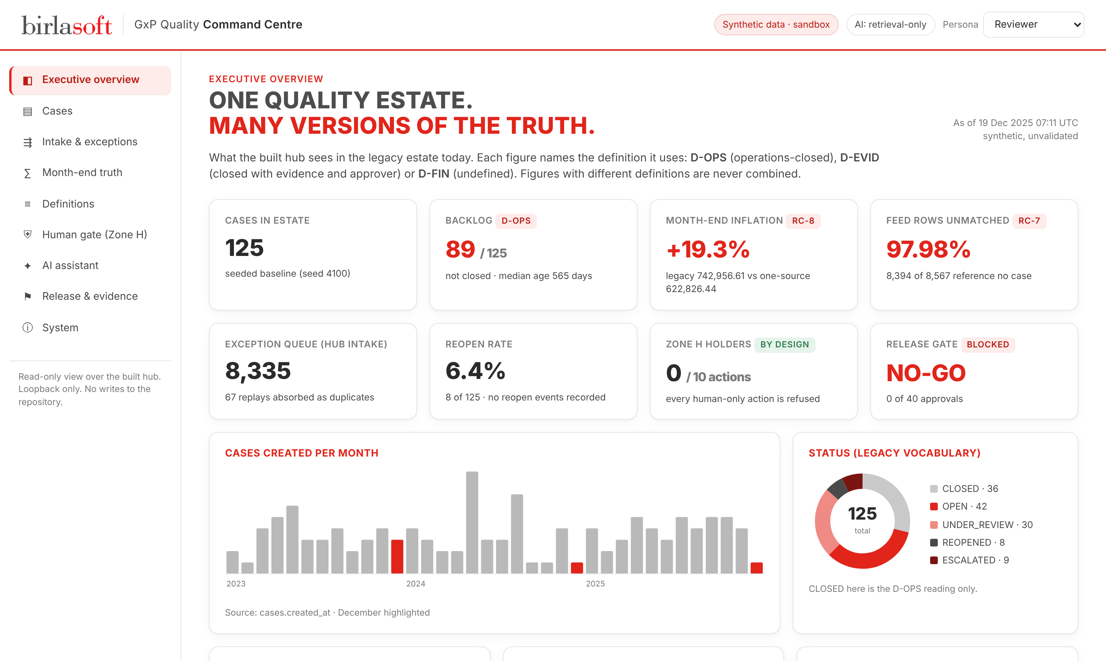
THE COMMAND CENTRE:
ONE VIEW, EVERY DEFINITION VISIBLE
Evidence · Running system
Runs locally
Python 3.14, standard library, loopback only
Built hub code
intake, reasons, canon, metrics imported directly
Nine views
overview, cases, intake, month-end, definitions, Zone H, AI, release, system
Six personas
deny-by-default, hub role names
Read-only
checksum-verified snapshot; no repository writes
Notes:
The executive overview. Point at the D-OPS tag on the backlog, and the 'what cannot be counted yet' panel. This is what definition transparency looks like: the system refuses to show a number it cannot define.

Slide 19
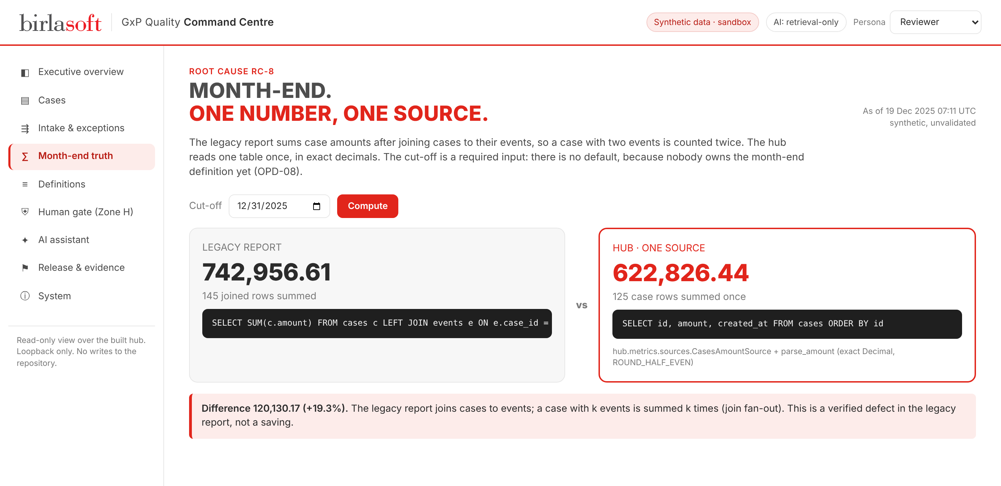
ONE NUMBER,
ONE SOURCE
Evidence · RC-8 month-end
LEGACY REPORT
742,956.61
SUM after LEFT JOIN events: 145 rows for 125 cases
HUB, ONE SOURCE
622,826.44
125 rows summed once, Decimal, ROUND_HALF_EVEN
Difference 120,130.17 (+19.3 %). Reproduced live from hub.metrics.sources.
Notes:
The legacy report joins cases to events, so a case with two events is summed twice. The hub reads one table once in exact decimals. The cut-off is a required input because nobody owns the month-end definition yet. This is a verified defect fix, not a saving.

Slide 20
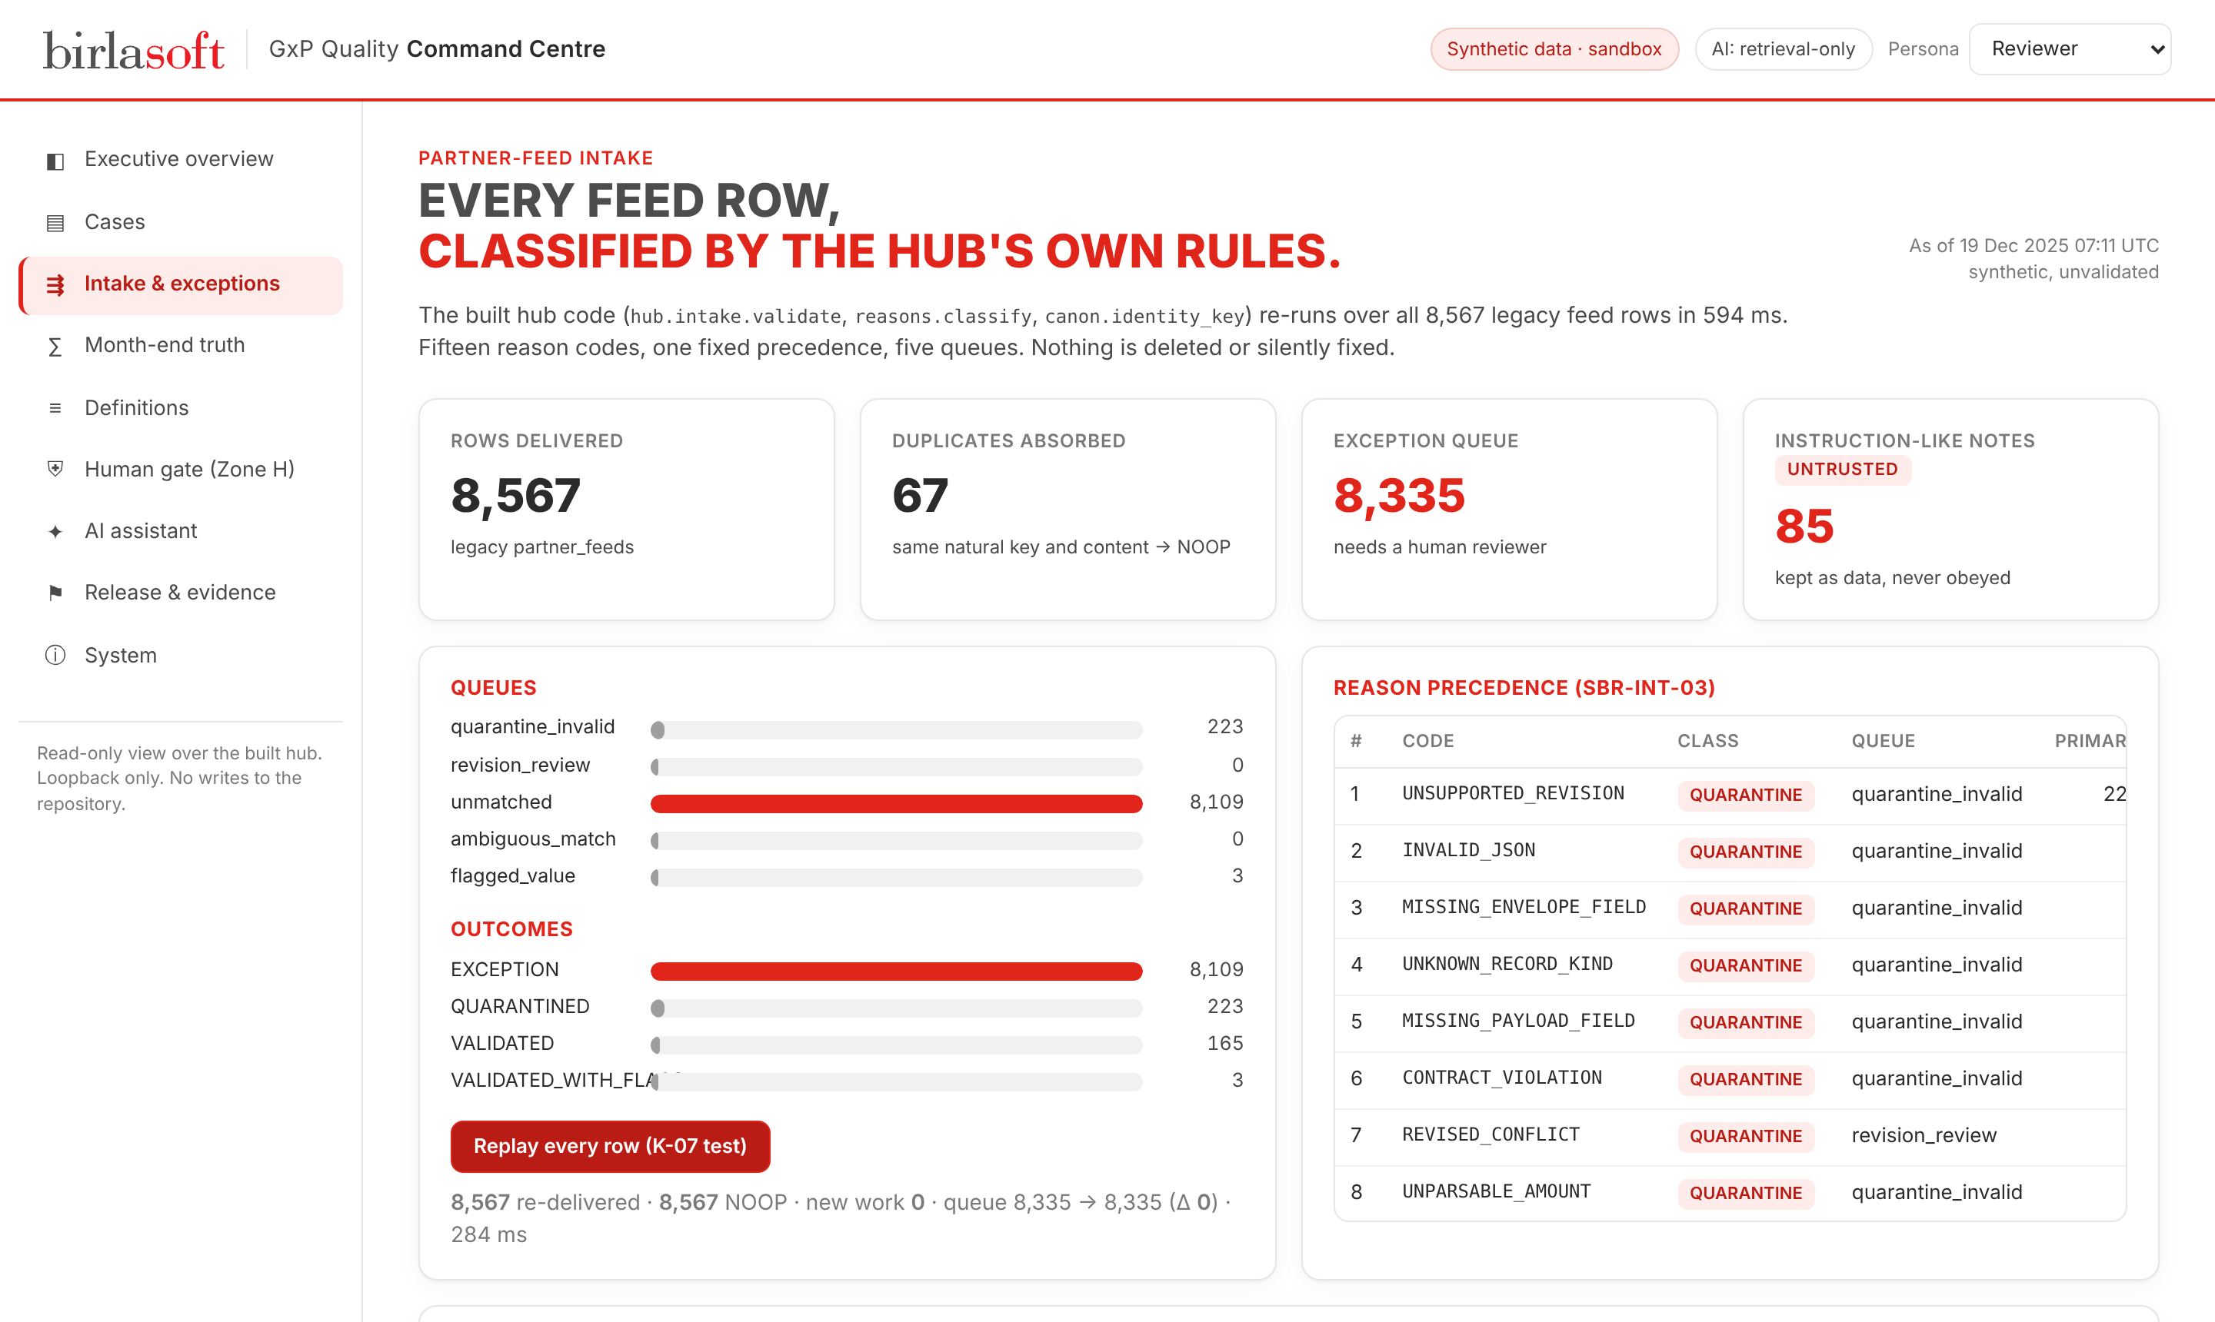
8,567 FEED ROWS,
CLASSIFIED BY THE HUB'S OWN RULES
Evidence · RC-6 / RC-7 intake
Replay test (K-07)
8,567 re-delivered · 8,567 NOOP · 0 new work · queue 8,335 → 8,335 (Δ 0)
Notes:
Every legacy feed row re-runs through hub.intake.validate and reasons.classify. 8,335 land in an exception queue, 67 replays are absorbed as duplicates. Press Replay: every row is re-delivered, all 8,567 are no-ops and the queue does not move. The 2025 replay incident cannot recur.

Slide 21
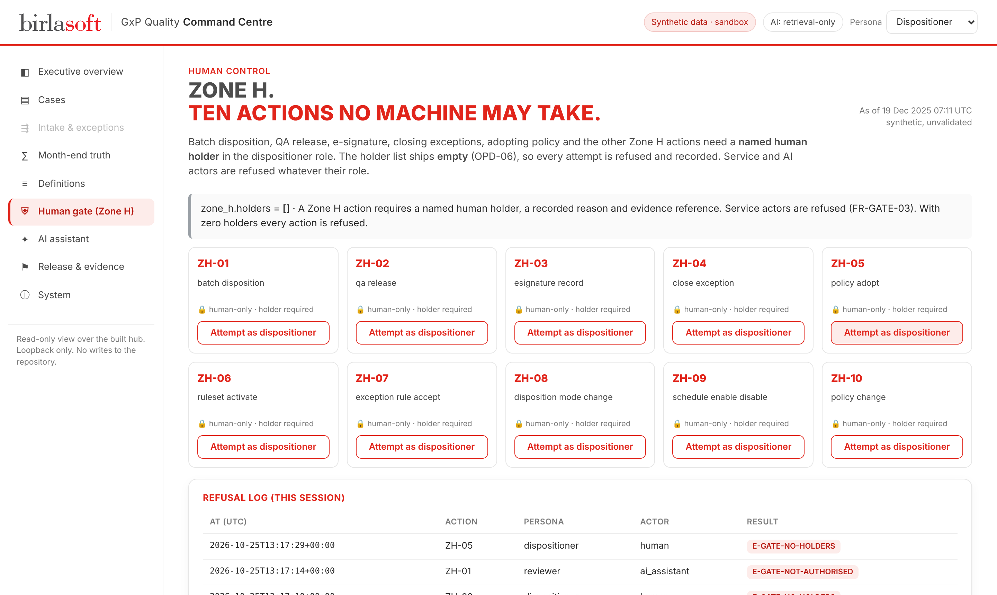
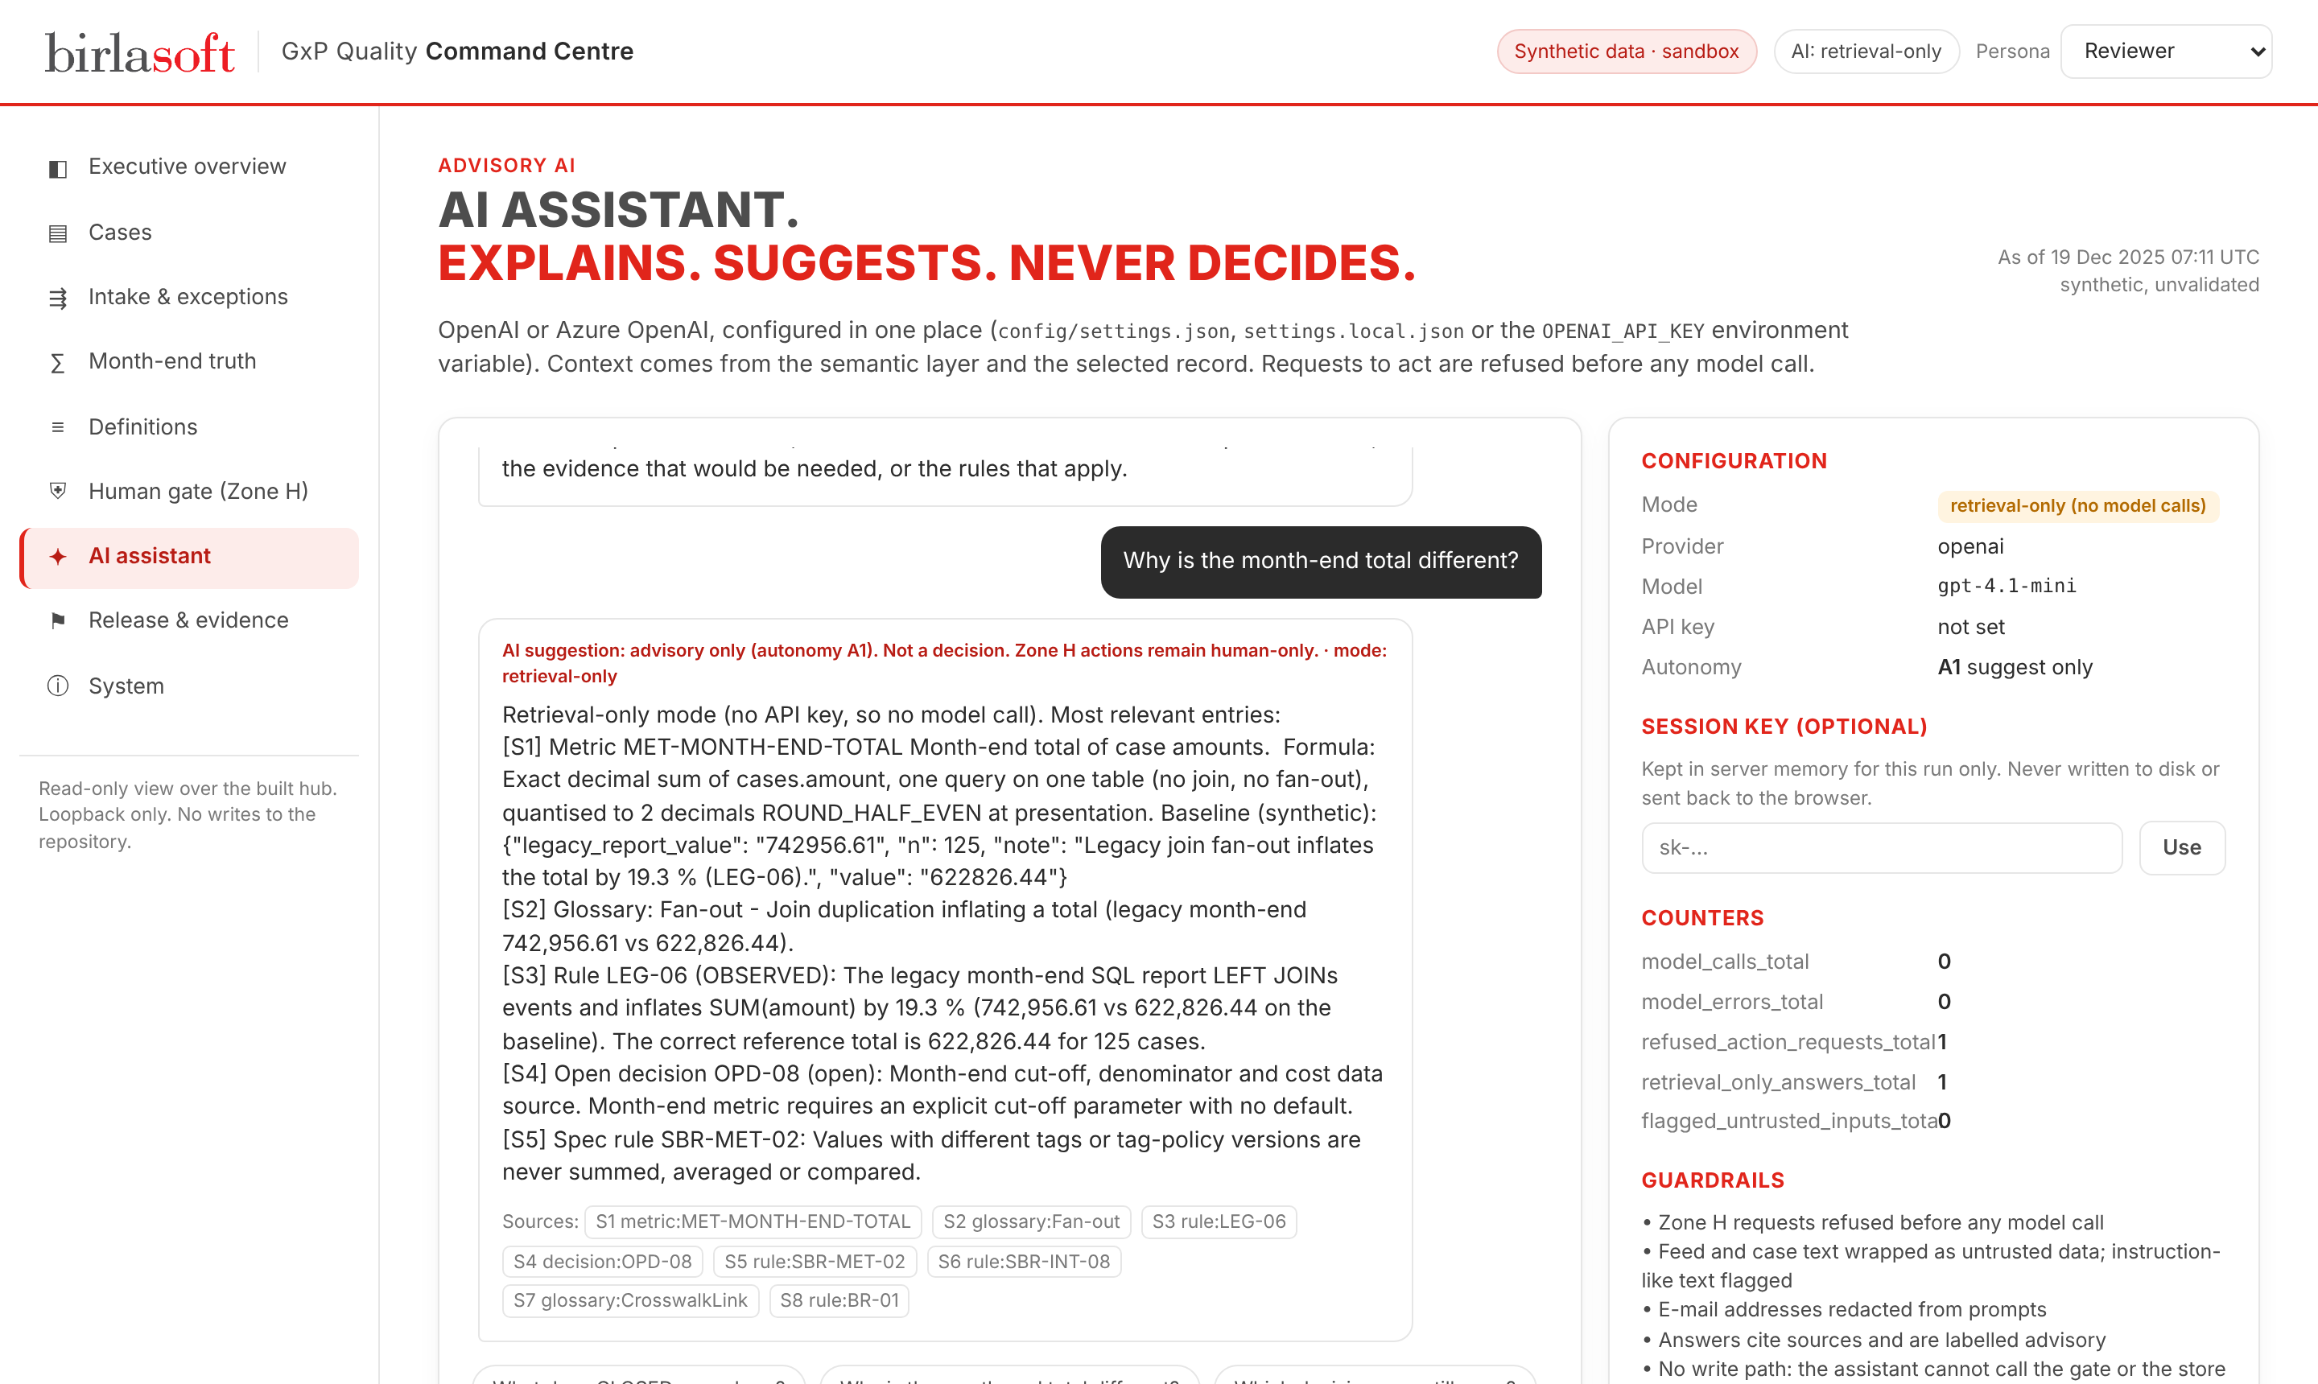
TEN ACTIONS
NO MACHINE MAY TAKE
Evidence · Human control and AI guardrails
Every attempt is refused and logged: E-GATE-NO-HOLDERS for humans, E-GATE-NOT-AUTHORISED for AI
The assistant answers with citations, and refuses requests to act before any model call
Notes:
Switch persona to dispositioner and attempt a batch disposition: refused with E-GATE-NO-HOLDERS because nobody has been named. Then ask the assistant to approve a batch release: it refuses before any model call and the refusal is logged as a Zone H attempt by an AI actor.

Slide 22
TESTED LIKE
IT WILL BE AUDITED
Evidence · Engineering quality
134 / 134
241
legacy characterisation checks pass
hub acceptance tests green (sandbox)
11 · 0 · 1
17 + 15
TEVV findings · critical · high (fixed)
new tests: semantic layer + Command Centre
Sources: docs/16-repo-validation, docs/26-tevv, docs/27-hardening; Delevarables/semantic-layer/tests; 04_Quality_Command_Centre/tests
Notes:
The shipped legacy test suite kills one of fifteen deliberate bugs; the hub's mutation gate kills all fifteen. Legacy behaviour is preserved where checked: 134 of 134. The red team found 11 findings, none critical, one high which was fixed. The new Command Centre adds 15 tests and the semantic layer 17.

Slide 23
WHAT MOVED,
AND WHAT WE REFUSE TO CLAIM
Value · Before vs after
KPI | Before (legacy) | After (hub, sandbox) | Reading
Month-end total (RC-8) | 742,956.61 (inflated) | 622,826.44 | Defect fixed
Replay safety K-07 | 2025 replay inflated queue, rollback | Δ 0 on 8,567 re-delivered rows | Proven in sandbox
Definition transparency K-03 | 0 of 6 figures tagged | 4 of 4 figures tagged | Not like-for-like
Decisions recorded K-11 | 0 of 2 | 2 of 2 as 'accepted open' | Record, not resolution
Backlog K-09-OPS | 89 of 125 | 89 of 125 | Parity
Reopen rate K-15 | 6.4 % | 6.4 % | Parity
Time to close / evidence / rework | Unknown | Unknown | Not measurable
Adoption K-21 | 0 of 125 | 0 of 125 | No users yet
Notes:
Only like-for-like pairs are shown as movement. Month-end, replay safety and definition transparency are real changes in the sandbox. Backlog and reopen rate are parity: the hub reproduces legacy, it does not improve it. Time and effort are unknown because the data never recorded them.

Slide 24

WHICH GAINS CAME FROM AI,
AND WHICH FROM ENGINEERING
Value · Attribution
Traditional engineering
GenAI in the product
GenAI in delivery
Month-end defect fixed (+19.3 % removed)
Replay-safe intake (Δ 0)
15 reason codes, 5 queues, no silent fixes
Hash-chained decision record
Zone H human gate
Explains a case under each definition
Explains why an item is in a queue
Answers rule and metric questions with citations
Refuses action requests before any call
Ran the 42-stage FDE spine with agents
Captured the semantic layer for model portability
Generated specs, tests and evidence
4 defects caught only by independent regression
All measured improvements
New; not yet evaluated (RQ-1)
Effort saving not recorded (LL-14)
Notes:
Be precise about attribution. Every measured improvement in the sandbox came from traditional engineering: keys, definitions, idempotency, exact arithmetic. GenAI contributed in two other places: it accelerated building the system under an evidence discipline, and it now gives reviewers explanations grounded in the semantic layer. Neither AI contribution is measured yet.

Slide 25
WHAT AI CAN DO HERE,
AND WHAT IT MUST NEVER DO
Value · Why GenAI, and its limits
AI CAN
AI CANNOT, BY DESIGN
Explain a case under D-OPS, D-EVID and D-FIN
Explain why a feed item is in a queue, and what to check
Find the rule, metric or open decision behind a number
Flag instruction-like text in partner data
Help regenerate the app from the semantic layer on another model
Approve, release, sign, close or disposition anything
Choose what 'closed' means or map one vocabulary onto another
Invent a number, a target or an ROI
Follow instructions hidden in source data
Act without a human: autonomy stays at A1
Notes:
Why was GenAI needed at all? Conventional rules can count and route, but a reviewer facing 8,335 exceptions, 56 vocabularies and 48 rules needs an explanation in plain language, grounded in the governed definitions. That is a language task. Deciding, approving and defining 'closed' are not, and stay human.

Slide 26



WHAT A LEADER
CAN TAKE FROM THIS TODAY
Value · Business implications
Risk removed by design
A reusable semantic layer
Unrecorded decisions, destructive replays and inflated month-ends are structurally refused, not just fixed once.
34 entities, 56 vocabularies and 48 rules in tested YAML: the context any model, or any new team, needs on day one.
A path to measured value
Honest economics
A 90-day gated pilot on one site defines the after-window that ROI, time and effort need.
Model spend is configurable and zero without a key. ROI, NPV and payback stay 'not computable' until the pilot runs.
Notes:
There is no ROI number and we will not invent one: there is no after-window, no volumes and no labour rate. What a CTO can take: a reusable method, a defect class removed by design, and a semantic layer that makes the next client faster and model-independent.

Slide 27
FIVE LESSONS
AND WHAT SURPRISED US
Closing · Lessons learned
Engineering
Independent full regression before merge catches what builders miss: four late defects were found by the orchestrator, not the author.
Business
Value never quantified at framing cannot be computed later. Capture volumes, rate and time from day one.
GenAI limits
Qualify AI against root causes, not fashion. AI built fast, but could not be trusted to check itself.
Unexpected
The baseline was test residue: 97.98 % of feed rows unmatched, so most KPIs ended Unknown.
Future
Wire controls as a gate of the build, and appoint a second reviewer: one approver is a single point of failure.
Notes:
Five lessons, one per theme. The unexpected one: the baseline itself was synthetic residue. 98 percent of feed rows point at cases that do not exist, so most KPIs ended Unknown. That changed what we could claim.

Slide 28
ENGINEERING IS NOT THE CONSTRAINT.
DECISIONS ARE
Closing · Status and decisions
# | Decision needed | Unblocks
1 | Go-ahead for a gated pilot, or stop at the sandbox | Everything
2 | Define 'closed' (D-OPS / D-EVID / D-FIN) and the month-end cut-off | Time and cost KPIs, ROI
3 | Name Zone H holders, or declare Zone H unused for the pilot | Human gate, dispositions
4 | Define the after-window and time capture | Measured improvement
5 | Confirm AI scope: advisory A1 with OpenAI / Azure OpenAI | Assistant in pilot, RQ-1 evaluation
RELEASE GATE
NO-GO
0 of 40 approvals; G1, T-09, T-10 open; T-05 green (3.14 sandbox)
ASSETS WITH AN OWNER
0 / 28
17 of 24 accountable roles vacant
Notes:
The release evaluator says NO-GO with 0 of 40 approvals, by design: nothing consequential has a human owner yet. Engineering evidence is 17 of 20 criteria; the rest needs named human decisions. These five decisions unblock the pilot. Ask for them explicitly.

Slide 29



FROM ONE ESTATE
TO AN ENTERPRISE PATTERN
Closing · Next and moonshots
P0
P1
P2
P3
GxP context lake
One semantic layer per client, reused across Birlasoft life-sciences accounts
Decide
Make fit
Pilot
Evaluate
D+0 to 14
D+15 to 45
D+46 to 75
D+76 to 90
five decisions, owners, second reviewer
wire controls, time capture; 3.14 run done 25 Oct
one site, real reviewers, assistant on
re-run KPIs, ROI if computable
Model-portable apps
Regenerate the PRD and app from the layer on any model; compare and certify
Evidence-pack agent (A2)
Agents draft the disposition evidence pack; a named human reviews and signs
90-DAY GATED PLAN
At D+90 the honest outcome may still be 'ROI not computable' if the window is too short. A neutral result is a valid result.
Audit copilot
Answer an inspector's question from hash-chained events, with citations
Notes:
The 90-day path is gated and modest. The moonshots are where this becomes an organisational capability: the semantic layer as a reusable context lake for every GxP client, apps regenerated from it on any model, and agents that draft evidence packs for a human to sign.

Slide 30
One estate. One truth.
Humans decide.
THANK YOU · QUESTIONS
We diagnosed why a GxP quality estate cannot agree on its own numbers, rebuilt its core so every figure carries its definition and every decision its owner, and added an AI that explains but never decides. The next step is five decisions and a 90-day pilot.
Notes:
End on the ask. Repeat the three-part claim, then the five decisions. Then invite questions; the Q&A bank has 20 prepared answers.

Slide 31
PREPARED ANSWERS
FOR THE Q&A
Appendix · Hard questions
Question | Answer
What is the ROI? | Not computable: no after-window, no volumes, no labour rate. We will not offer a number.
Who is using it? | Nobody yet. It runs in a sandbox; adoption is 0 of 125 cases.
Why not let AI decide? | The root causes are missing owners, keys and records. AI cannot supply an owner, and an LLM reading feed data carries an injection risk (86 rows).
Is it GxP / Part 11 compliant? | We make no compliance claim. Part 11 is framing only.
Is it secure? | For synthetic data on loopback in shadow mode. No TLS, no second factor, no external penetration test yet.
What does the AI cost? | Zero without a key. With a key, one chat call per question; spend is set by the configured model.
Notes:
Backup slide. Use during the 10 minutes of questions. The full 20-question bank is in the Excel tracker.

