Slide 1
"Sentiment Analysis Using Feedforward Neural Network and Word2Vec Embeddings".

Slide 2
Introduction
.
The rise of user-generated content on platforms like social media and e-commerce websites has made sentiment analysis increasingly relevant. This project aims to develop a system for classifying the emotional tone (positive or negative) in textual data through machine learning techniques. Specifically, a Feedforward Neural Network (FNN) integrated with Word2Vec embeddings was designed to fulfill this purpose.
Goal: Classify text data (user reviews) as positive or negative using a Feedforward Neural Network (FNN) and Word2Vec embeddings.

Slide 3
Team Members and Roles:
Dinesh Devisetti: Data preprocessing and Word2Vec embedding generation.
Pattem Jaya Sankar: FNN architecture design, training, and evaluation.
Rohith: Training, evaluation, and report writing.

Slide 4
Dataset
The dataset comprises a collection of user-generated reviews, each annotated with a sentiment label, indicating whether the review expresses a positive or negative opinion. This data serves as the foundation for training and evaluating the sentiment analysis model.
Features:
Text Reviews: User-generated feedback on products/services.
Sentiment Labels: Positive or Negative.
Dataset Characteristics:
Balanced dataset.
Example split:
Positive Reviews: 12,500
Negative Reviews: 12,500

Slide 5
Preprocessing
Steps:Noise Removal: Remove special characters, URLs, and numbers.
Lowercasing: Convert text to lowercase for uniformity.
Tokenization: Split text into individual words.
Stopword Removal: Eliminate common, irrelevant words (e.g., “the”, “and”).
Lemmatization: Convert words to their base forms (e.g., "running" → "run").

Slide 6
Methodology
Word2Vec Embeddings
Purpose: Represent words as dense numerical vectors to capture semantic and syntactic relationships.
Pre-trained (e.g., Google News, 300-dimensions) or trained on the dataset (Skip-Gram method).
FNN Architecture:
Input Layer: 100 dimensions (Word2Vec vectors).
Hidden Layers:
First: 128 units, ReLU activation.
Second: 64 units, ReLU activation.
Output Layer: Softmax (2 classes: Positive/Negative).
Regularization: Dropout layers to prevent overfitting.

Slide 7
Training Process
The dataset was split up into the following subsets in order to efficiently train and assess the model:
80% of the dataset is the training set
Data Split:Training: 80%
Testing: 20%
Validation: Optional (10% of training data).
Optimization:Adam Optimizer (Learning Rate: 0.001).
Early Stopping for efficiency.

Slide 8
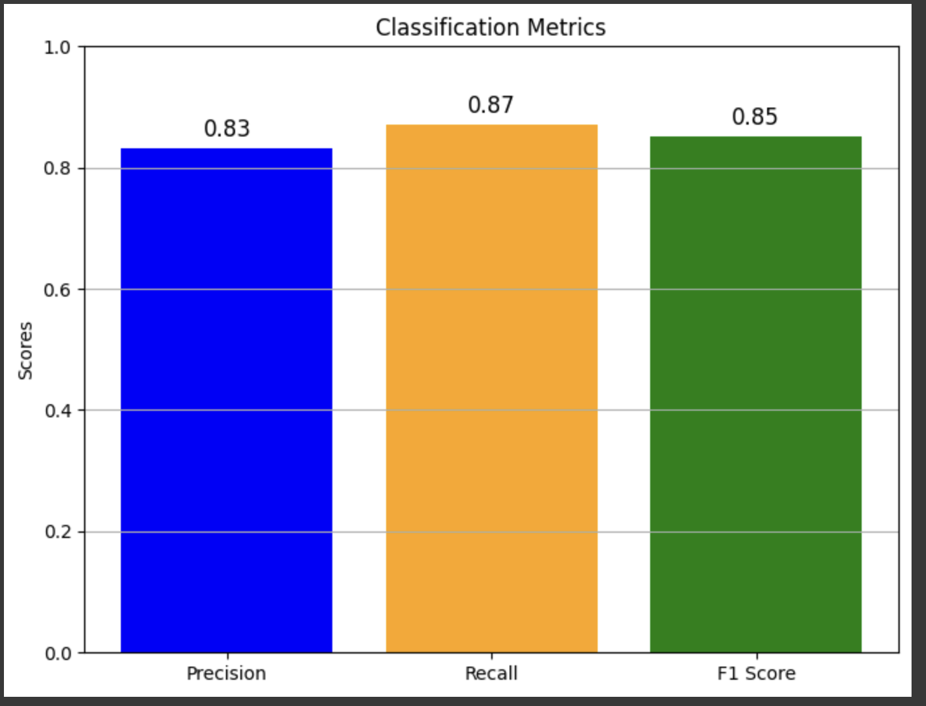
Results
Performance Metrics:Accuracy: 84.57%
Precision: 83%
Recall: 87%
F1-Score: 85%

Slide 9
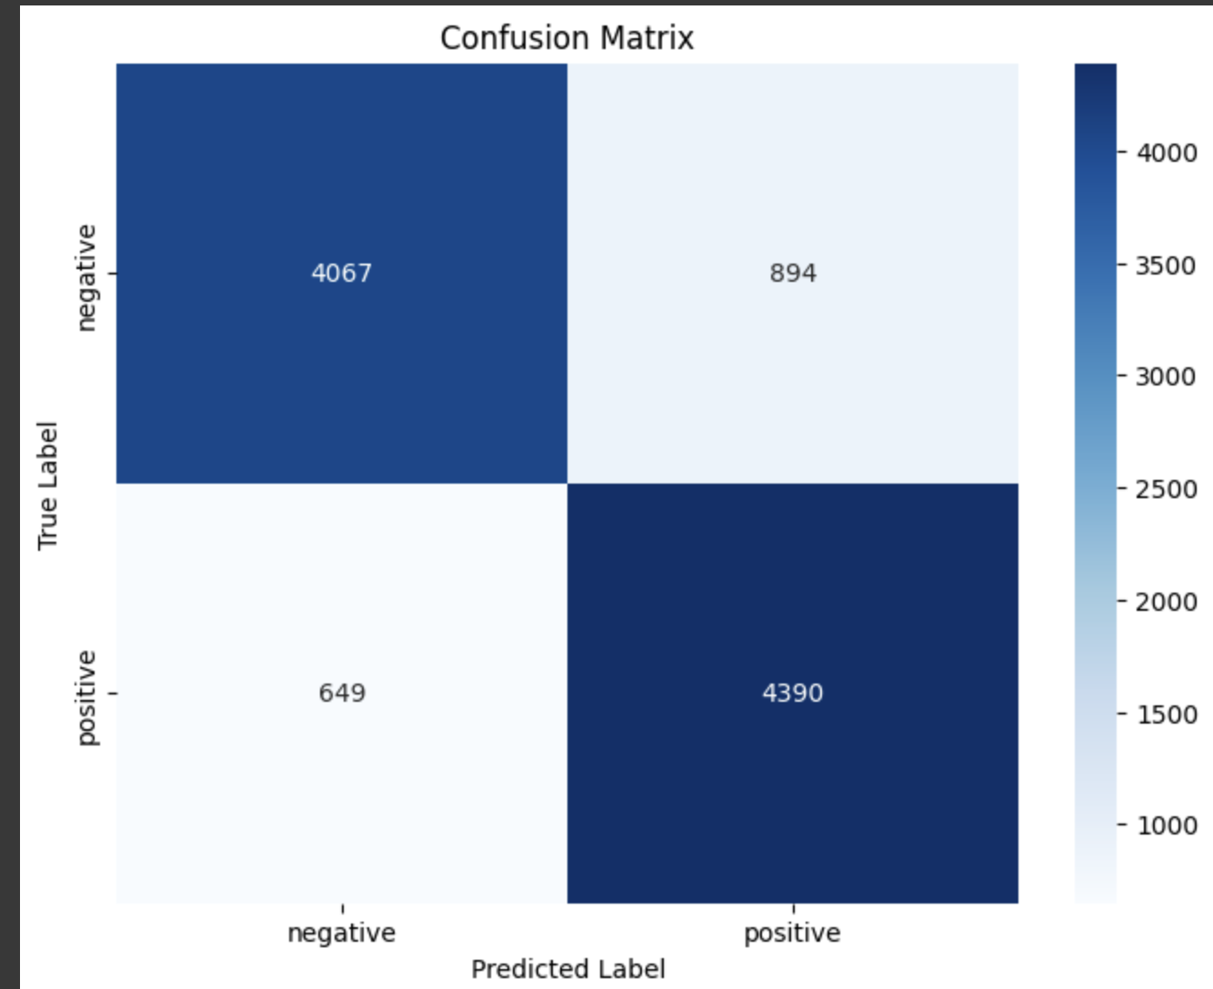
Visualization:
Confusion Matrix Heatmap for detailed insights.

Slide 10
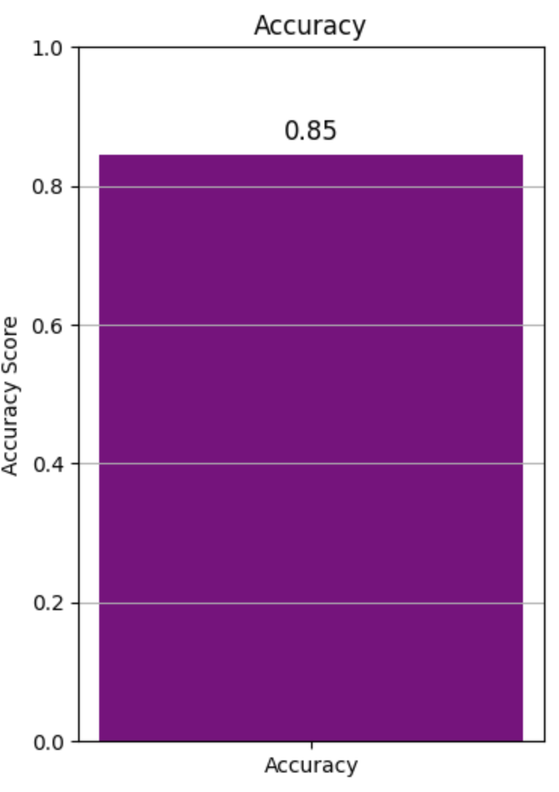
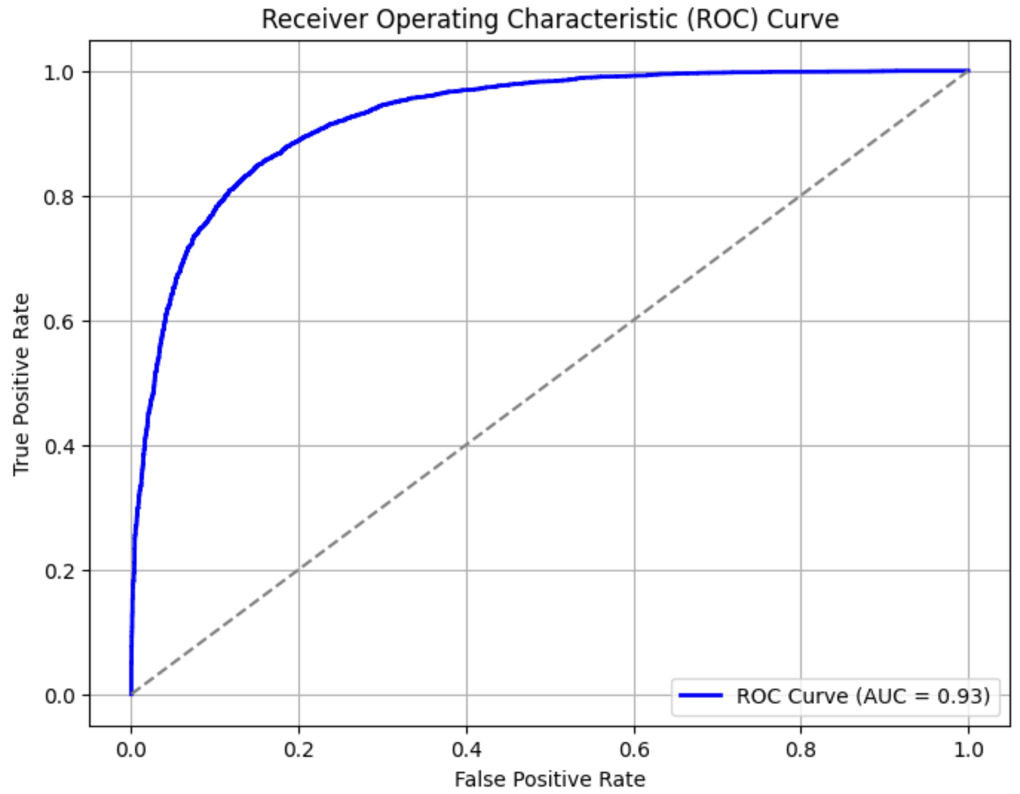
Accuracy & False Positive rate

Slide 11
Discussion
Pros:Efficient, scalable, balanced performance.
Generalization with dropout and early stopping.
Cons:Struggles with Out-of-Vocabulary (OOV) words.
Limited contextual understanding.

Slide 12
Future Improvements
Explore advanced embeddings like BERT or GPT.
Experiment with deeper or recurrent architectures.
Fine-tune hyperparameters and embeddings for domain-specific data.

Slide 13
thankyou

