Slide 1
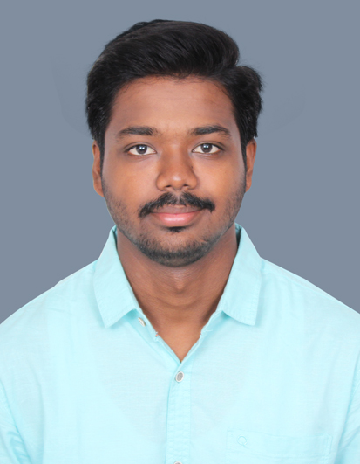
Associate Name: Dinesh B Emp No: 35348579
Profile Summary
Qualification & Skills
Education Qualification: BE ECE | Bosch Mail id : B.Dinesh@in.bosch.com
Total Experience : 0 Yr 10 months | BGSW Experience : 0 Yr 10 months
Current Work Location: COB
Technical /Skills : Embedded C, Flash modules
Certifications if any : Learning Python, Python Object-Oriented Programming (LinkedIn Learning)
Professional Summary
Experienced in working with TI CC2340R5, STM32F405 and NXP S32G2 boards, including hardware understanding and peripheral interface development.
Gaining expertise in the DoIP (Diagnostics over Internet Protocol) and DCM (Diagnostic Communication Manager) modules within AUTOSAR for flashing operations.
Proficient in embedded C/C++ programming for developing applications aimed at microcontroller-based systems.
Familiar with SPI, I2C, UART, and CAN protocols for interfacing flash memory with microcontrollers.
Proficient in version control systems for collaborative firmware development and code management.

