Slide 1
Trackbars
Trackbar is a GUI element that let the user to select a specific value within a range of values by sliding a slider linearly. It’s similar to scrolling but it limits the user to select a specific value with its minimum and maximum limits.
Creating a trackbar
cv2.createTrackbar( trackbarname, winname, ,value, count, onChange )
Reading the position of trackbar
cv2.getTrackbarPos( trackbarname, winname )

Slide 2
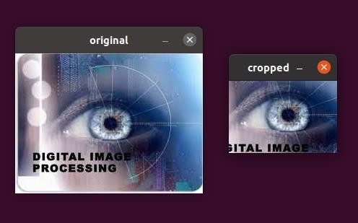
Cropping an image
import cv2
import numpy as np
img = cv2.imread('test.jpeg') print(img.shape) # Print image shape cv2.imshow("original", img)
# Cropping an image
cropped_image = img[50:150, 50:200]
# Display cropped image cv2.imshow("cropped", cropped_image)
# Save the cropped image
cv2.imwrite("Cropped Image.jpg", cropped_image) cv2.waitKey(0)
cv2.destroyAllWindows()

Slide 3
Trackbar
Trackbar is a GUI element that let the user to select a specific value within a range of values by sliding a slider linearly. It’s similar to scrolling but it limits the user to select a specific value with its minimum and maximum limits.
Why we use Trackbar?
There are times when you want to run the program with different value or parameter and experiment to find the optimum value to figure out the best parameter value.
Editing the variable value in source code and running the program, again and again, can be tedious, instead, you can bind trackbars to the output image window.
These trackbars will either call a function or update variable value based on slider position

Slide 4
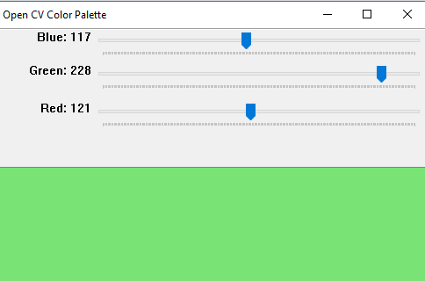
import cv2
import numpy as np
def emptyFunction():
pass
def main():
# blackwindow having 3 color chanels
image = np.zeros((512, 512, 3), np.uint8)
windowName ="Open CV Color Palette"
# window name
cv2.namedWindow(windowName)
# there trackbars which have the name
# of trackbars min and max value
cv2.createTrackbar('Blue', windowName, 0, 255, emptyFunction)
cv2.createTrackbar('Green', windowName, 0, 255, emptyFunction)
cv2.createTrackbar('Red', windowName, 0, 255, emptyFunction)
# Used to open the window
# till press the ESC key
while(True):
cv2.imshow(windowName, image)
if cv2.waitKey(1) == 27:
break
# values of blue, green, red
blue = cv2.getTrackbarPos('Blue', windowName)
green = cv2.getTrackbarPos('Green', windowName)
red = cv2.getTrackbarPos('Red', windowName)
# merge all three color chanels and
# make the image composites image from rgb
image[:] = [blue, green, red]
print(blue, green, red)
cv2.destroyAllWindows()

Slide 5
Example-FIND THE HSV COLOR VALUE FOR DETECTING ANY COLOR USING TRACKBAR IN OPENCV
import cv2
import numpy as np
def nothing(x):
pass
if __name__ == '__main__':
cap = cv2.VideoCapture(1)
cv2.namedWindow("HSV Value")
cv2.createTrackbar("H MIN", "HSV Value", 0, 179, nothing)
cv2.createTrackbar("S MIN", "HSV Value", 0, 255, nothing)
cv2.createTrackbar("V MIN", "HSV Value", 0, 255, nothing)
cv2.createTrackbar("H MAX", "HSV Value", 179, 179, nothing)
cv2.createTrackbar("S MAX", "HSV Value", 255, 255, nothing)
cv2.createTrackbar("V MAX", "HSV Value", 255, 255, nothing)
while True:
_, frame = cap.read()
hsv = cv2.cvtColor(frame, cv2.COLOR_BGR2HSV)
h_min = cv2.getTrackbarPos("H MIN", "HSV Value")
s_min = cv2.getTrackbarPos("S MIN", "HSV Value")
v_min = cv2.getTrackbarPos("V MIN", "HSV Value")
h_max = cv2.getTrackbarPos("H MAX", "HSV Value")
s_max = cv2.getTrackbarPos("S MAX", "HSV Value")
v_max = cv2.getTrackbarPos("V MAX", "HSV Value")
lower_blue = np.array([h_min, s_min, v_min])
upper_blue = np.array([h_max, s_max, v_max])
hsv_min="MIN H:{} S:{} V:{}".format(h_min,s_min,v_min)
hsv_max = "MAX H:{} S:{} V:{}".format(h_max, s_max, v_max)
mask = cv2.inRange(hsv, lower_blue, upper_blue)
result = cv2.bitwise_and(frame, frame, mask=mask)
cv2.putText(frame, hsv_min, (10, 30), cv2.FONT_HERSHEY_SIMPLEX, 1, (0, 0, 255), 2)
cv2.putText(frame, hsv_max, (10, 80), cv2.FONT_HERSHEY_SIMPLEX, 1, (0, 0, 255), 2)
cv2.imshow("HSV Value", frame)
cv2.imshow("Mask", mask)
cv2.imshow("Frame Mask", result)
key = cv2.waitKey(1)
if key == 27:
break
cap.release()
cv2.destroyAllWindows()

Slide 6
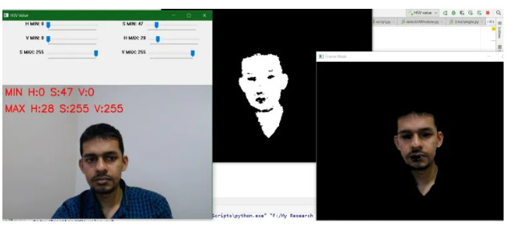
Output

Slide 7
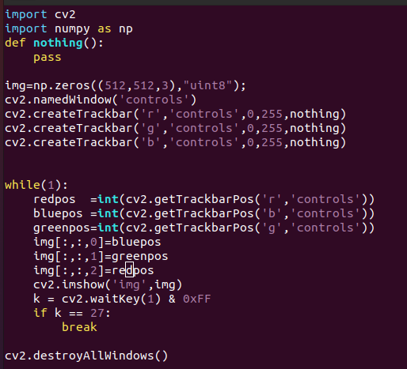
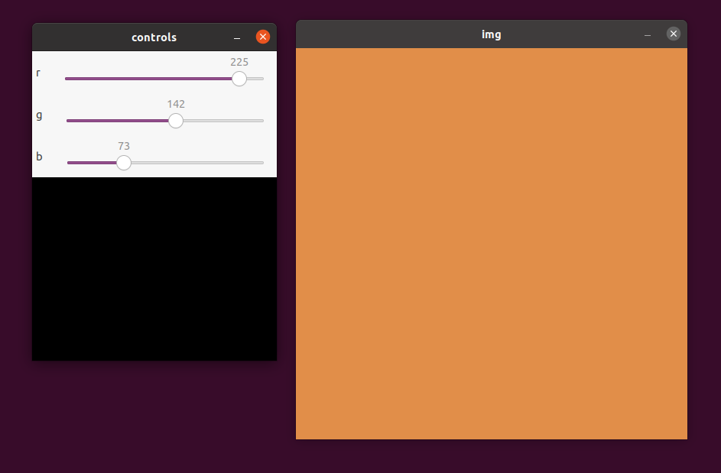
Using Trackbars

Slide 8
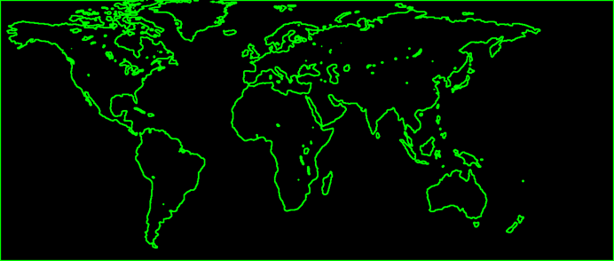
Contours-
Curve joining all the continuous points (along the boundary), having same colour or intensity
The contours are a useful tool for shape analysis and object detection and recognition.

Slide 9
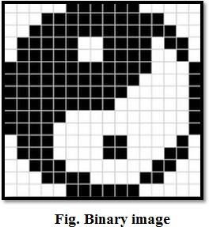
Some tips & tricks
For better accuracy, use binary images. So before ﬁnding contours, apply threshold
Finding contours is like ﬁnding white object from black background. So remember, object to be found should be white and background should be black.
Threshing is important because contour detection algorithm works on finding the pixels of same value, and draw boundary around it, which is easily done on binary image

Slide 10
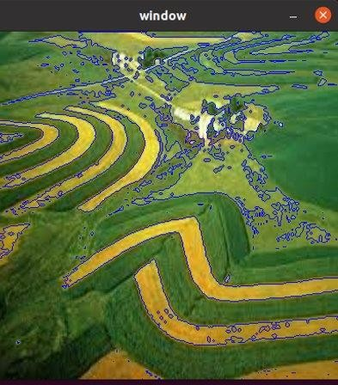
CODE:
import cv2
import numpy as np
img = cv2.imread("Documents/contour.jpeg") dim=(400,400)
img=cv2.resize(img,dim)
img_gray=cv2.cvtColor(img,cv2.COLOR_BGR2GRAY)
ret,thresh = cv2.threshold(img_gray,127,255,cv2.THRESH_BINARY)
contours,hierarchy = cv2.findContours(thresh,cv2.RETR_TREE, cv2.CHAIN_APPROX_NONE)
cv2.drawContours(img,contours,-1,(255,0,0),1) cv2.imshow("window",img)
cv2.waitKey(0)
(source image, contour retrieval mode, contour approximation method)
(source image, contour array, contour select ID,color,width)

Slide 11
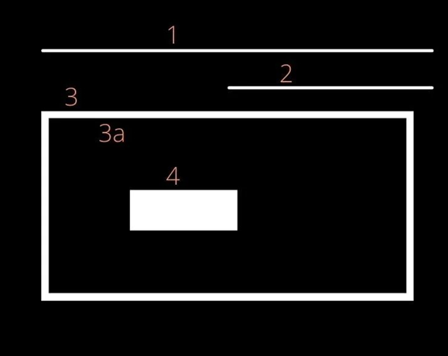
Contour Hierarchy
Hierarchies denote the parent-child relationship between contours. You will see how each contour- retrieval mode affects contour detection in images, and produces hierarchical results.
All the individual numbers, i.e., 1, 2, 3, and 4 are separate objects, according to the contour hierarchy and parent-child relationship.
We can say that the 3a is a child of 3. Note that 3a represents the interior portion of contour 3.
Contours 1, 2, and 4 are all parent shapes, without any associated child, and their numbering is thus arbitrary. In other words, contour 2 could have been labeled as 1 and vice-versa.

Slide 12
Hierarchy Format:
[Next, Previous, First_Child, Parent]
Next: Denotes the next contour in an image, which is at the same hierarchical level. So,
For contour 1, the next contour at the same hierarchical level is 2. Here, Next will be 2.
Accordingly, contour 3 has no contour at the same hierarchical level as itself. So, it’s Next value will be - 1.
Previous: Denotes the previous contour at the same hierarchical level. This means that contour 1 will always have its Previous value as -1.
First_Child: Denotes the first child contour of the contour we are currently considering.
Contours 1 and 2 have no children at all. So, the index values for their First_Child will be -1.
But contour 3 has a child. So, for contour 3, the First_Child position value will be the index position of 3a.
Parent: Denotes the parent contour’s index position for the current contour.
Contours 1 and 2, as is obvious, do not have any Parent contour.
For the contour 3a, its Parent is going to be contour 3
For contour 4, the parent is contour 3a

Slide 13
Different Contour Retrieval Techniques
The RETR_EXTERNAL contour retrieval method only detects the parent contours, and ignores any child contours. So, all the inner contours like 3a and 4 will not have any points drawn on them.
The RETR_LIST contour retrieval method does not create any parent child relationship between the extracted contours. So, for all the contour areas that are detected, the First_Child and Parent index position values are always –1, but the child contours are still stored independently, unlike RETR_EXTERNAL.

Slide 14
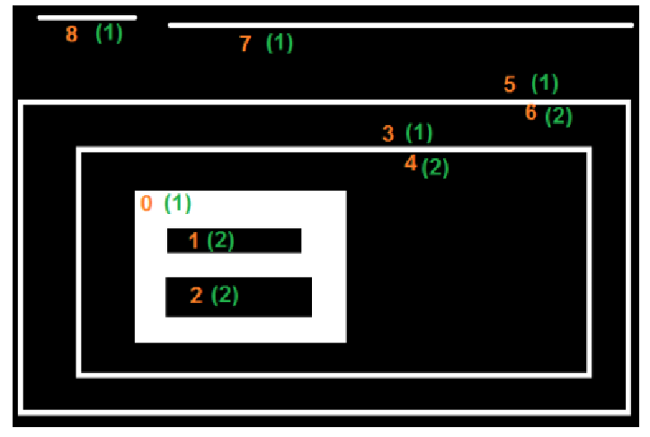
RETR_CCOMP retrieves all the contours in an image. Along with that, it also applies a 2- level hierarchy to all the shapes or objects in the image. All the outer contours will have hierarchy level 1 and all the inner contours will have hierarchy level 2

Slide 15
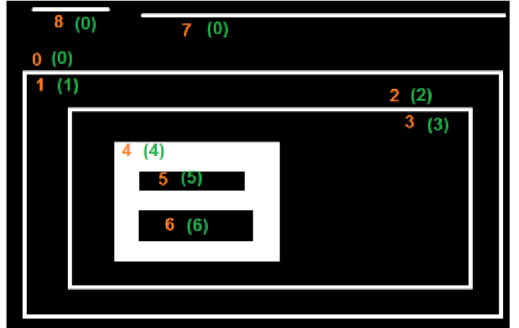
RETR_TREE also retrieves all the contours. It also creates a complete hierarchy, with the levels not restricted to 1 or 2. Each contour can have its own hierarchy, in line with the level it is on, and the corresponding parent-child relationship that it has.

Slide 16
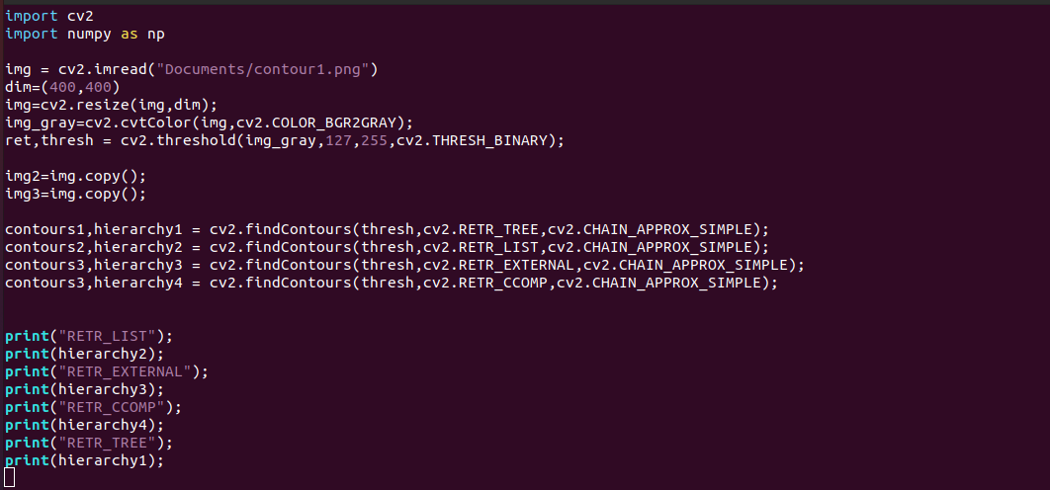
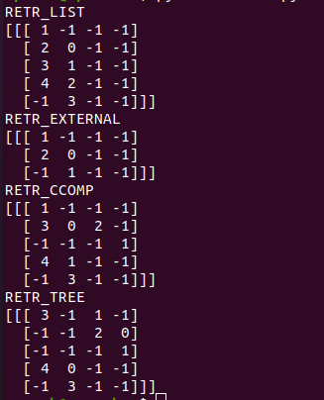
Example

