Slide 1
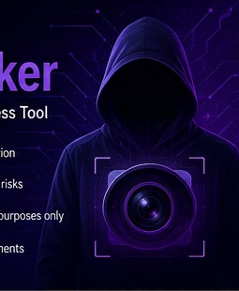
01
CYBERSECURITY PROJECT
CamHacker
Camera Phishing Awareness Tool
• Demonstrates browser camera-permission risks
• Explains how phishing can manipulate user trust
• Designed for awareness and controlled demonstrations
• Use only in authorized environments
PRESENTED BY DINESH S

Slide 2
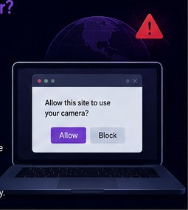
02
CONCEPT
What is CamHacker?
Awareness Tool
A controlled demonstration of camera-phishing and browser permission risks.
Permission Demonstration
Shows how a web page can request camera access and why users must verify the request.
Privacy Focus
Highlights careful links, trusted domains and browser permission controls.

Slide 3
03
TECHNICAL STACK
Tools & Technologies Used
Bash / Shell
PHP
HTML & CSS
Automation
Server-side components
Web interface
JavaScript
cURL
Wget
Browser interaction
Network requests
Downloads
Unzip
Cloudflare / LocalXpose
Docker
File handling
Tunneling
Containers

Slide 4
04
CAPABILITIES
Main Features
✓
Multiple webpage templates
✓
Configurable image-storage directory
✓
Camera-permission demonstration
✓
Tunneling support
✓
IP information collection
✓
Error-diagnosis functionality
✓
Device and browser information
✓
Command-line options
✓
Configurable server port
✓
Automatic dependency checking

Slide 5
05
WORKFLOW
How the Tool Works
01
Run
02
Select
03
Serve
Launch the script.
Choose a web template.
Start the local PHP server.
04
Access
05
Permission
06
Awareness
Open the page in a browser.
Review the camera request.
Discuss privacy and safe browsing.

Slide 6
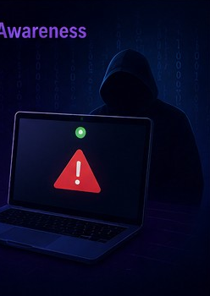
06
AWARENESS
Camera Phishing Risks
01
Familiar-looking pages
Attackers may imitate trusted websites.
02
Urgent requests
Suspicious links can pressure quick decisions.
03
Permission prompts
A permission request does not prove trust.
04
Privacy impact
Unnecessary camera access can expose sensitive information.

Slide 7

07
DEFENSE
Prevention & Safe Browsing
✓
Verify links
✓
Check the domain
Check the destination before opening suspicious messages.
Look for unusual spellings or unexpected domains.
✓
Deny unnecessary permissions
✓
Review browser permissions
Grant camera access only when genuinely needed.
Remove access from sites you no longer trust.
✓
Keep software updated
✓
Report suspicious pages
Use current browsers and security updates.
Tell a trusted administrator or platform.

Slide 8
08
FINAL TAKEAWAY
Conclusion
Awareness + Permission Control = Stronger Privacy
CamHacker demonstrates how a convincing webpage can influence users to trust a camera-permission request. The strongest defense is informed decision-making: verify the source, question unexpected permissions, and keep browser controls under your control.
STAY AWARE
STAY SAFE
PROTECT PRIVACY
Recognize phishing signals.
Grant only necessary permissions.
Review access regularly.
Thank you

