Slide 1


SMART INDIA HACKATHON 2026
TITLE PAGE
Problem Statement ID – SIH25047 Problem Statement Title - Disaster Response Drone For Remote Areas Theme - Disaster Management
PS Category - Hardware
Team ID - 126583
TeamName- (SkyRescue Innovators)

Slide 2

01 • NEED & RESPONSE
Problem statement → solution
THE CHALLENGE
AERORESCUE NEXUS
THE SOLUTION
01
INACCESSIBLE ZONES
D1–D15
Search UAVs
Blocked roads and collapsed structures prevent physical entry.
SEARCH UAVs
Wide-area surveillance • thermal imaging • human detection
02
DELAYED OPERATIONS
R1–R15
Verification Rovers
Slow search and rescue timelines cost lives.
AI
DECISION
ENGINE
Close-range inspection • survivor verification • terrain assessment
03
COMMUNICATION FAILURES
Delivery UAVs
Network outages sever coordination between teams.
D16–D30
Medical kits • food supplies • emergency communication support
VERIFY ROVERS
04
SURVIVOR LOCALIZATION
Difficulty pinpointing survivors in rubble or floodwater.
DELIVERY UAVs
ALWAYS ON
3D + COMMS
Real-time 3D disaster mapping • adaptive communication network
05
PERSONNEL RISK
Unstable terrain puts human rescue responders in danger.
MISSION FLOW
DISASTER
→
SEARCH
→
DETECT
→
VERIFY
→
MAP
→
DELIVER
→
RECOVER
SKYRESCUE INNOVATORS • SMART INDIA HACKATHON 2025

Slide 3
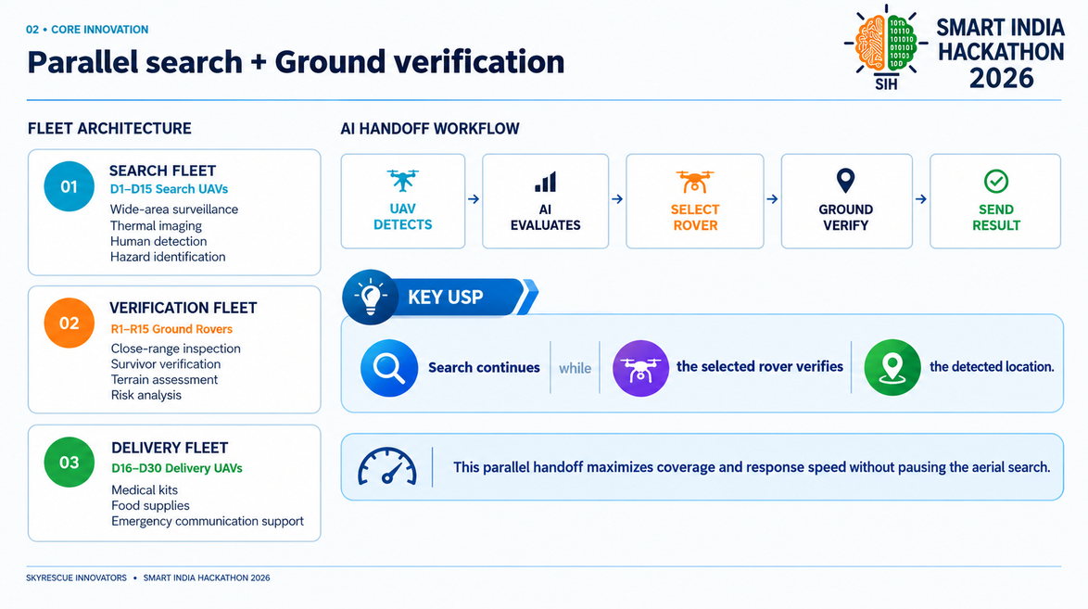

Slide 4
03 • TECHNICAL DESIGN
Hardware, software & operational loop
SYSTEM PIPELINE
SENSORS
01
02
EDGE COMPUTE
03
AI PROCESSING
04
COMMUNICATION
05
COMMAND ENGINE
HARDWARE COMPONENTS
01
02
03
04
RASPBERRY PI /
JETSON NANO
05
UAV PLATFORM
GROUND ROVER
THERMAL CAMERA
LORA MODULE
Multi-rotor airframe for
aerial operations
All-terrain wheeled
verification unit
Infrared survivor
detection sensor
Long-range low-power
communication
Onboard edge
AI compute units
SOFTWARE STACK
Python
OpenCV
YOLO
TensorFlow
FastAPI
GIS & 3D Mapping
Core language
Vision processing
Object detection
AI inference
Backend services
Spatial visualization
OPERATIONAL LOOP • Continuous situational awareness + resource deployment
SKYRESCUE INNOVATORS • SMART INDIA HACKATHON 2025

Slide 5
04 • FEASIBILITY & IMPACT
From prototype to large-scale deployment
FEASIBILITY
SCALABILITY ROADMAP
01
TECHNICAL
02
OPERATIONAL
03
INFRASTRUCTURE
01
02
03
04
Existing AI frameworks
UAV technology
Ground robotics
GPS navigation
LoRa communication
Continuous aerial monitoring
Ground verification support
Real-time coordination
Dashboard monitoring
Onboard computing
Wireless communication
PROTOTYPE
D15 FLEET
D30 FLEET
D50+ FLEET
Large-scale deployment
CHALLENGES → MITIGATION
EXPECTED IMPACT
01
Battery limitation
→
Smart Battery Management
01
Faster rescue operations
Improved survivor localization
Increased rescue efficiency
Reduced risk to responders
SOCIAL
02
Communication loss
→
Adaptive Communication Network
03
GPS errors
→
Multi-Sensor Verification
02
ECONOMIC
Efficient resource utilization
Faster operational decisions
Reduced search effort
04
Weather conditions
→
Adaptive Mission Planning
03
ENVIRONMENTAL
Smart disaster monitoring
Reduced unnecessary deployment
Better situational awareness
05
False detection
→
Rover & Human Verification
SKYRESCUE INNOVATORS • SMART INDIA HACKATHON 2025

Slide 6
05 • FUTURE & CLOSE
A practical roadmap for smarter disaster response
FUTURE SCOPE
01
ADVANCED THERMAL AI
02
MULTI-AGENT COORDINATION
03
IMPROVED 3D MAPPING
Next-generation infrared detection models for improved survivor identification in complex environments
Autonomous fleet coordination and human-in-the-loop control for large-scale multi-agent deployment
Long-endurance UAV systems with enhanced GIS mapping and disaster prediction support capabilities
DEVELOPMENT ROADMAP
01
PROTOTYPE
02
CONTROLLED TESTING
03
FIELD TESTING
04
MULTI-AGENT DEPLOYMENT
Build initial AI thermal prototype
Laboratory trials with safety oversight
Real-world scenarios with operators
Coordinated fleet with human-in-loop
TARGET USERS
Disaster Response Teams • Government Agencies • Emergency Services
AERORESCUE NEXUS
Search & Rescue Organizations • Humanitarian Relief Teams
Search → Detect → Verify → Map → Deliver → Recover
Making Disaster Response Faster • Safer • Smarter
References: NASA Earth Observation & Disaster Management Resources • NDMA • UAV Search & Rescue Research • Robotics & Automation Research • AI-Based Human Detection Research
SKYRESCUE INNOVATORS • SMART INDIA HACKATHON 2025

