Slide 1
INPUT panel

Slide 2


INPUT DATA
Type:
Unit No :
Model :
Rated Motor :
Outlet Size :
Discharge Constant :
Rated Frequency :
Liquid Temperature :
Test Voltage :
kW
mm
Hz
ºC
V
Date :
Observed Frequency :
Correction Head :
Watt Meter Constant :
Duty :
Phases :
Rated Speed :
No. of Stages :
Surface Finish of pump shaft:
Hz
m
rpm
micron
DECLARED VALUES
DESIGN DETAILS
Head :
Discharge :
Efficiency :
Power :
Current :
m
lps
%
kW
A
Core Length
Winding design
Stamping
Casing details
Impeller detail
PRINT DESIGN DATA
YES | NO

Slide 3
S.No. | HEAD (m) | Time for cm Rise (s) | A (amps) | W1 | W2 | Frequency (Hz) | Speed (RPM) | %slip
1.
2
3
4
5
6
7
8
9
10
HOME
Generate Table

Slide 4
TABLE PANEL

Slide 5

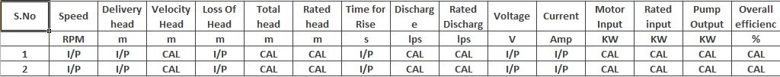

TEST REPORT ON SUBMERSIBLE PUMPSET
Unit | I/P
Model | I/P
No. Of Stages | I/P
Outlet Size | I/P
Rated Speed | I/P
Rated Motor KW | I/P
No. of Phases | I/P
Rated Frequency | I/P
Frequency during test | I/P
rpm
KW
Hz
Hz
Date Of Test | I/P
Head Range | CAL
Liquid Temperature | I/P
Correction Head | I/P
Discharge Constant | I/P
mm
m
ºC
m
Casing Withstood a pressure of ‘CAL’ m of water
Tested by
Verified by
Surface finish of pump shaft = I/P micron
Declared Values :
I/P
I/P
I/P
I/P
I/P
m
lps
%
KW
amp
I/P - Take from Input
CAL- Calculated Value
GENERATE GRAPH

Slide 6
GRAPH

Slide 7
PERFORMANCE CURVE FOR SUBMERSIBLE PUMP SET
Head
Current
Hd, Qd
Efficiency
Current (Amp)
Hd
Efficiency %
HEAD (m)
Hg,max
Head range
Hg,min
Hg, Qg
Head plot
Qd
Discharge (lps)
PUMP STD:- I/P | Type: I/P | Duty Point | Q(lps) | T.Head(m) | O.A.Eff.(%) | “I” max in Head range
Rated Speed : I/P | Sl.No: I/P | Declared | I/P | I/P | I/P | I/P
Head Range : CAL | Outlet Size: I/P | Actual | CAL (from graph) | CAL (from graph) | CAL (from graph) | CAL (from graph)
Date: I/P | Frequency:I/P | Results | PASS/FAIL | PASS/FAIL | PASS/FAIL | PASS/FAIL
PRINT

Slide 8
formulae

Slide 9

$$Discharge \left(lps\right) = \frac{Discharge constant}{Time (s)}$$
$$Velocity Head \left(m\right) = \frac{({Discharge}^{2})\text{ ∗ 82711.17} }{({Outlet size}^{4})}$$
$$Total Head=\left(Delivery head\right)+\left(Velocity Head\right)+\left(Correction head\right)+\left(Loss of Head\right)$$
$$Rated head(m) = \left( {\left(\frac{Rated Frequency}{Actual Frequency}\right)}^{2}\right)∗Total Head$$
$$Rated Discharge (lps) = \left(\frac{Rated Frequency}{Actual Frequncy}\right)∗Discharge$$
$$Motor Input \left(KW\right) = Voltage ∗current ∗\frac{1.5}{1000}$$
$$Rated Input \left(KW\right) = \left( {\left(\frac{Rated Frequency}{Actual Frequency}\right)}^{3}\right)∗Motor Input$$
$$Pump Output \left(KW\right) = \frac{( 9.81∗Rated Head ∗Rated Discharge )}{1000}$$
$$Overall Efficiency \left(Ƞo\right) in \% = \left( \frac{Pump Output}{Motor Input} ∗100 \right)$$

Slide 10
$$Casing withstood a maximum pressure=1.5∗Maximum Rated Head$$
$$Head Range Calculation$$
$$Hg\min{= H_{g}∗0.75}$$
$$Hg\max{= H_{g}∗1.1}$$
If Actual value is greater than Declared value, then pump is passed.

Slide 11
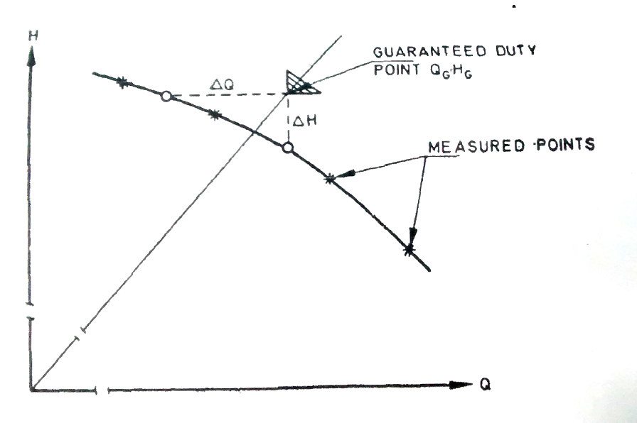
Declared values
Head , H_{G} | I/P
Discharge ,Q_{G} | I/P
Efficiency | I/P
Power | I/P
Current | I/P
m
Declared value
lps
%
Head
KW
Design point
H_{d} , Q_{d}
A
Straight line connecting declared value and origin.
Origin
Discharge

Slide 12
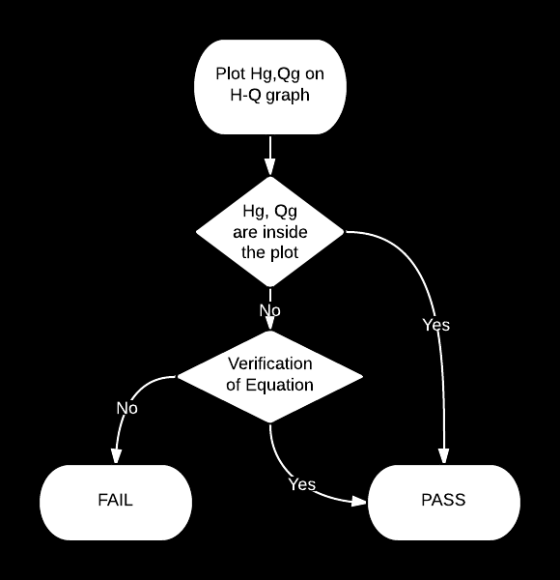

${\left(\frac{H_{G}∗X_{H}}{∆H}\right)}^{2}$+${\left(\frac{Q_{G}∗X_{Q}}{∆Q}\right)}^{2}≥1$
$X_{H}$=0.04; $X_{Q}$=0.07.

Slide 13
Instructions for graph
Approximate the curves to a second degree polynomial only.
Use dynamic scales in graph to get good shape.
Differentiate between head, current, efficiency points by using different type of markers.

