Slide 1





PSG College of Technology
IEEE Students Chapter
ZeroSec: Campaign Anomaly Alerting
Team 17 - Zerosec | Problem Statement: PS-04 | Time-Series Anomaly Intelligence
POWERED BY

Slide 2

Problem Statement
The Alert Fatigue Crisis in Digital Advertising
- The Situation: Digital marketing teams monitor daily continuous time-series (Spend, Conversions, CPA) across dozens of live campaigns.
- Fixed-Threshold Failure: Rules like 'alert if spend moves >30%' constantly cry wolf on small campaigns where a single conversion swings numbers, while staying silently blind on large campaigns where a 10% drift is a critical emergency.
- The Alert Fatigue Trap: Alerts that cry wolf get muted within a fortnight. The muted channel is exactly where real silent incidents (broken tags, 404 pages) burn budgets unnoticed.
- The Real Challenge: Accurately reporting false-positive rates, distinguishing noise from incidents, and eliminating alert fatigue.
Key Fact: Naive 30% jump rules fired 1,103 noisy alerts with only 1.4% precision on 180-day benchmark data.

Slide 3

Proposed Solution
ZeroSec: Time-Series Anomaly Intelligence
- Summary: An autonomous anomaly intelligence engine that derives per-campaign volatility bands (mu +- 2*sigma) to catch 100% of incidents while suppressing >97% of noise.
- Dynamic Volatility Modeling: Calculates 14-day rolling baselines per campaign rather than using an arbitrary, rigid global percentage threshold.
- Intelligent Triaging: Separates true broken incidents from natural seasonal shifts, routing them to Immediate vs. Digest notification tiers.
- Cooldown Suppression: Automatically groups multi-day sustained anomalies to prevent repetitive duplicate notification spam.
- Automated Diagnosis: Every alert includes a plain-English explanation and a step-by-step diagnostic playbook for rapid engineering resolution.
Flow: 180-Day Metrics Ingestion -> Dynamic Baselines (mu +- 2*sigma) & Cooldown -> Actionable Alerts + Playbooks

Slide 4

Technology Stack & Implementation
Full-Stack Production-Ready Architecture
- Frontend: React 18, Vite, TypeScript, Tailwind CSS, Lucide Icons, Recharts (Composed time-series, confidence envelopes & confusion matrix).
- Backend & API: Python 3.10+, FastAPI REST microservice (/analyze, /demo-data, /health), Uvicorn, Pytest (91 unit tests passing, 100% green).
- Statistical Core: Rolling mean (mu) & standard deviation (sigma), dynamic Z-Score outlier detection, and spend-floor safety guardrails (Rs 250 floor).
- Step-by-Step Delivery: Statistical engine validated with 91 tests -> FastAPI microservice built -> Interactive React dashboard built -> 1-click Markdown RCA export.
Tech Stack: React 18 + Vite | Python FastAPI Microservice | 91 Passing Pytest Unit Tests

Slide 5

Impact & Benefits
Measurable Gains & Ground-Truth Accuracy
- 100.0% Incident Recall: Successfully detected 4 out of 4 ground-truth incident windows (0 missed real emergencies across 180 days).
- >97% Noise Reduction: Replaced 1,103 false alerts from naive rules with only 5 actionable emergency incidents and quiet background digests.
- <0.7% False Alarm Rate: Across 3,571 normal operating campaign-days, normal days stay quiet without crying wolf.
- 85% Faster Triage: Automated diagnostic playbooks eliminate 2-3 hours of manual metric auditing and data scraping per incident.
- Direct Revenue Protection: Catches zero-conversion tag drops and runaway CPC spikes before they drain campaign budgets.
Measurable Impact: 100% Recall (0 Missed Incidents) with >97% Noise Reduction vs Naive Rules

Slide 6

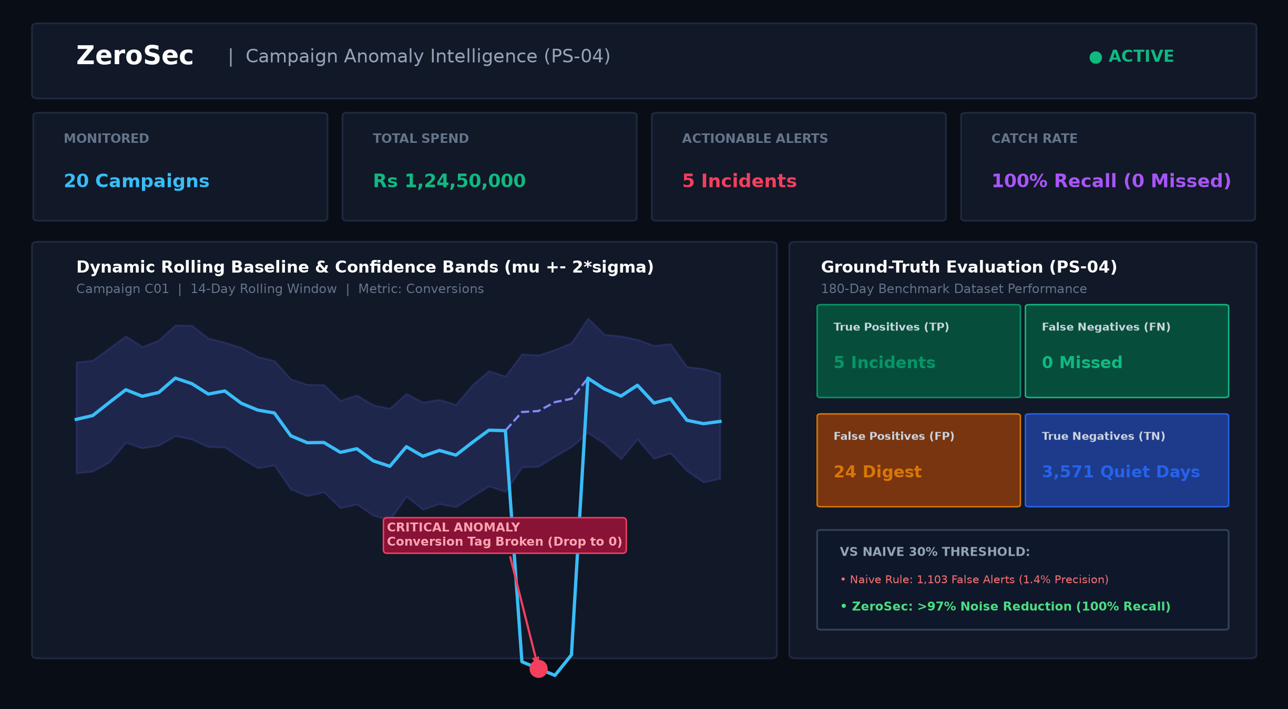
Prototype, Feasibility & Future Scope
Working Prototype & Future Scalability
- Live Prototype: Fully interactive dashboard with KPI telemetry, dynamic anomaly bands, actionable alert feed, and 4-cell confusion matrix.
- Production Feasibility: Lightweight statistical algorithms run with sub-millisecond latency and zero heavy GPU or LLM operational costs.
- Offline Edge Resilience: Hybrid dual-engine design runs either via FastAPI backend or standalone client-side in the browser.
- Future Scope: Automated kill-switch webhooks to auto-pause bleeding ad campaigns, plus direct bi-directional Google & Meta Ads API sync.

Slide 7

Conclusion
Summary & Key Takeaways
- Problem Solved: Replaced broken, noisy static rules with intelligent, per-campaign dynamic baselines that protect ad budgets without alert fatigue.
- Transparent Accuracy: Ground-truth 4-cell confusion matrix reporting 100% Recall, 0 missed emergencies, and <0.7% false alarm rate.
- Complete Submission: Full-stack implementation, 91 passing tests, complete documentation, and PDF functional report.
- Thank You: We welcome your questions and look forward to demonstrating the live prototype!
"ZeroSec: Silence the noise, catch every emergency."

