Slide 1

FILE COMPARATOR
By Dinesh

Slide 2
01 INTRODUCTION
02 OBJECTIVES
03 SCOPE
04 SAMPLE INPUT
05 SAMPLE 0UTPUT
06 DEMO
07 FUTURE ENHANCEMENT
OVERVIEW

Slide 3
INTRODUCTION
A file comparator is an software application that is designed to highlight differences between two files.
FILE COMPARATOR

Slide 4
Objectives
Enable the users to efficiently Compare two files
Support TXT, CSV, or JSON file formats.
Provide a graphical user interface (GUI) for intuitive interaction.
Implement robust file handling functionalities for selecting and displaying file contents.
Utilize indigenous technique to identify and prompt the differences.
Incorporate a highlighting mechanism to visually distinguish discrepancies.
Implement quit functionality for a seamless user experience.
Deploy the software as an executable or installer for widespread accessibility.
FILE COMPARATOR

Slide 5
SCOPE
Software development
Content creation
Legal Document review
FILE COMPARATOR

Slide 6
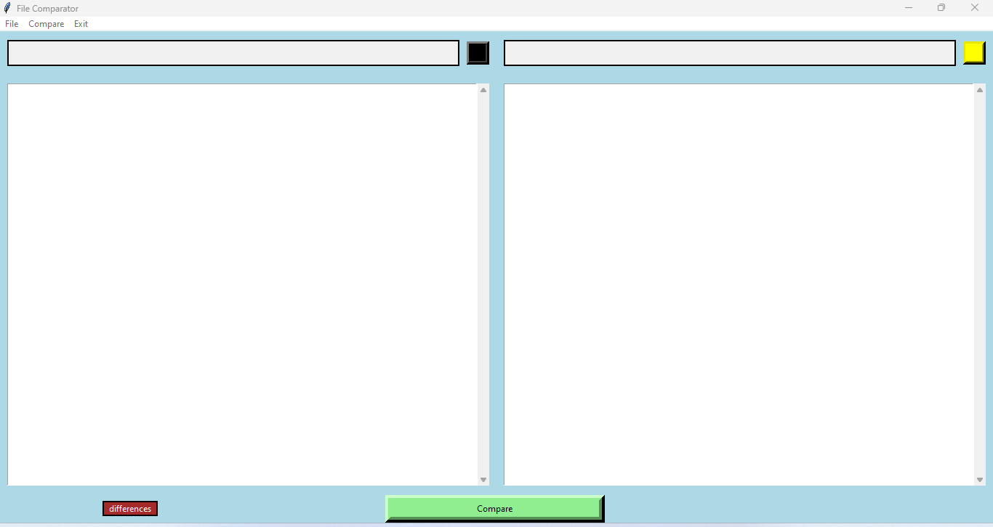
SAMPLE INPUT
FILE COMPARATOR

Slide 7
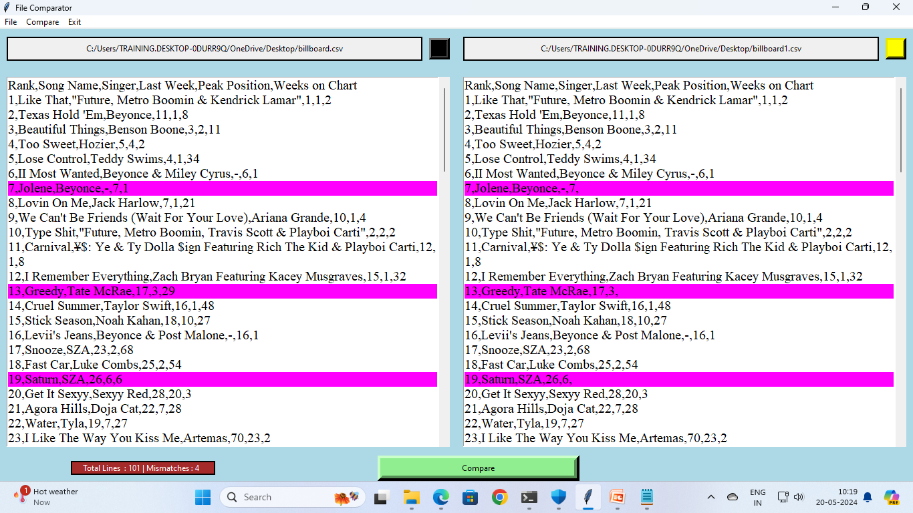
SAMPLE OUTPUT
FILE COMPARATOR

Slide 8
DEMO
FILE COMPARATOR

Slide 9
FUTURE ENHANCEMENT
Enhanced File Type Support.
Highlighting mismatched words.
Save Comparison Results.
Multi-Threaded Processing.
Localization.
FILE COMPARATOR

Slide 10
Thank you
FILE COMPARATOR

