Slide 1
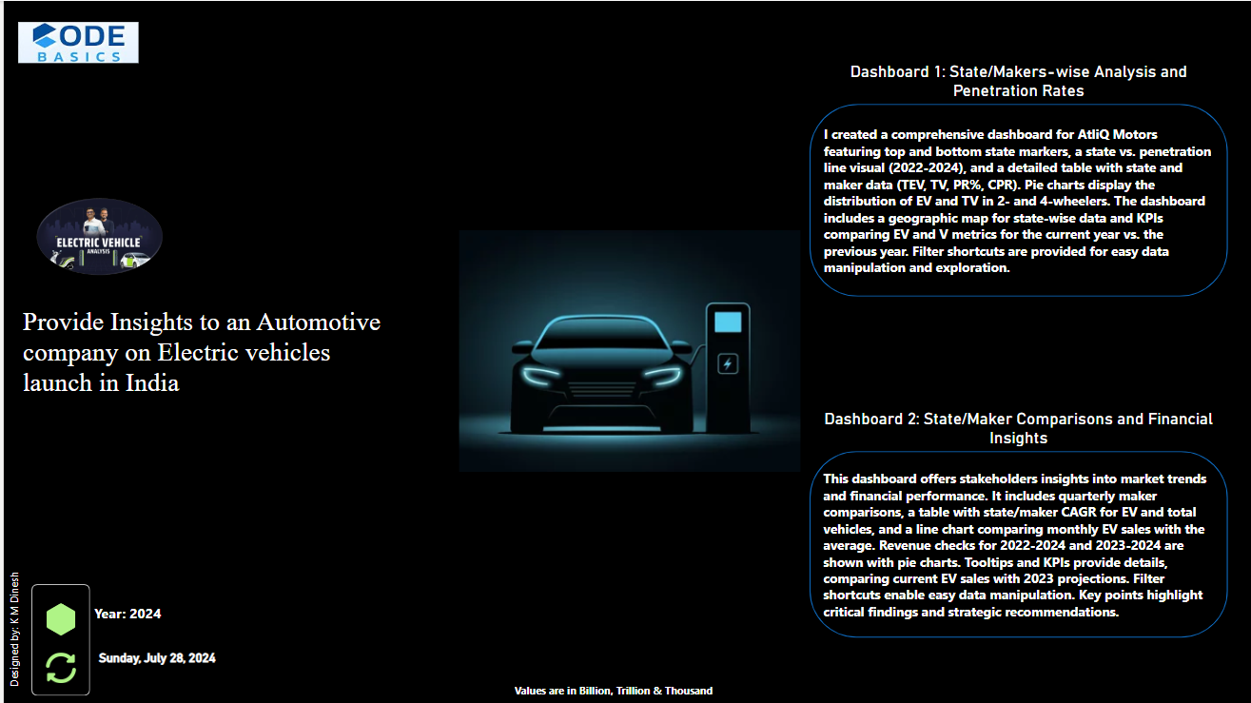

Slide 2
Problem Statement
AtliQ Motors, a leading automotive giant in the USA specializing in electric vehicles (EV), has achieved a significant market share of 25% in the electric and hybrid vehicle segment in North America over the past five years.
As part of their strategic expansion plan, AtliQ Motors aims to introduce their bestselling models in India, where their current market share is less than 2%.

Slide 3
Objectives
Comprehensive Market Study: Conduct an in-depth analysis of the existing EV/Hybrid market in India to understand the competitive landscape, consumer preferences, and growth potential.
Market Entry Strategy: Identify the key opportunities and challenges for AtliQ Motors in the Indian market and develop a data-driven strategy to increase market share.

Slide 4
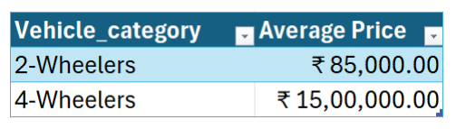
Preliminary Research Questions:
1. List the top 3 and bottom 3 makers for the fiscal years 2023 and 2024 in terms of the number of 2-wheelers sold.
2. Identify the top 5 states with the highest penetration rate in 2-wheeler and 4-wheeler EV sales in FY 2024.
3. List the states with negative penetration (decline) in EV sales from 2022 to 2024?
4. What are the quarterly trends based on sales volume for the top 5 EV makers (4-wheelers) from 2022 to 2024?
5. How do the EV sales and penetration rates in Delhi compare to Karnataka for 2024?
6. List down the compounded annual growth rate (CAGR) in 4-wheeler units for the top 5 makers from 2022 to 2024.
7. List down the top 10 states that had the highest compounded annual growth rate (CAGR) from 2022 to 2024 in total vehicles sold.
8. What are the peak and low season months for EV sales based on the data from 2022 to 2024?
9. What is the projected number of EV sales (including 2-wheelers and 4- wheelers) for the top 10 states by penetration rate in 2030, based on the compounded annual growth rate (CAGR) from previous years?
10. Estimate the revenue growth rate of 4-wheeler and 2-wheelers EVs in India for 2022 vs 2024 and 2023 vs 2024, assuming an average unit price. H

Slide 5
Secondary Research Questions:
1. What are the primary reasons for customers choosing 4-wheeler EVs in 2023 and 2024 (cost savings, environmental concerns, government incentives)?
2. How do government incentives and subsidies impact the adoption rates of 2-wheelers and 4-wheelers? Which states in India provided most subsidies?
3. How does the availability of charging stations infrastructure correlate with the EV sales and penetration rates in the top 5 states?
4. Who should be the brand ambassador if AtliQ Motors launches their EV/Hybrid vehicles in India and why?
5. Which state of India is ideal to start the manufacturing unit? (Based on subsidies provided, ease of doing business, stability in governance etc.)
6. Your top 3 recommendations for AtliQ Motors.

Slide 6

Dashboard Screenshot

Slide 7
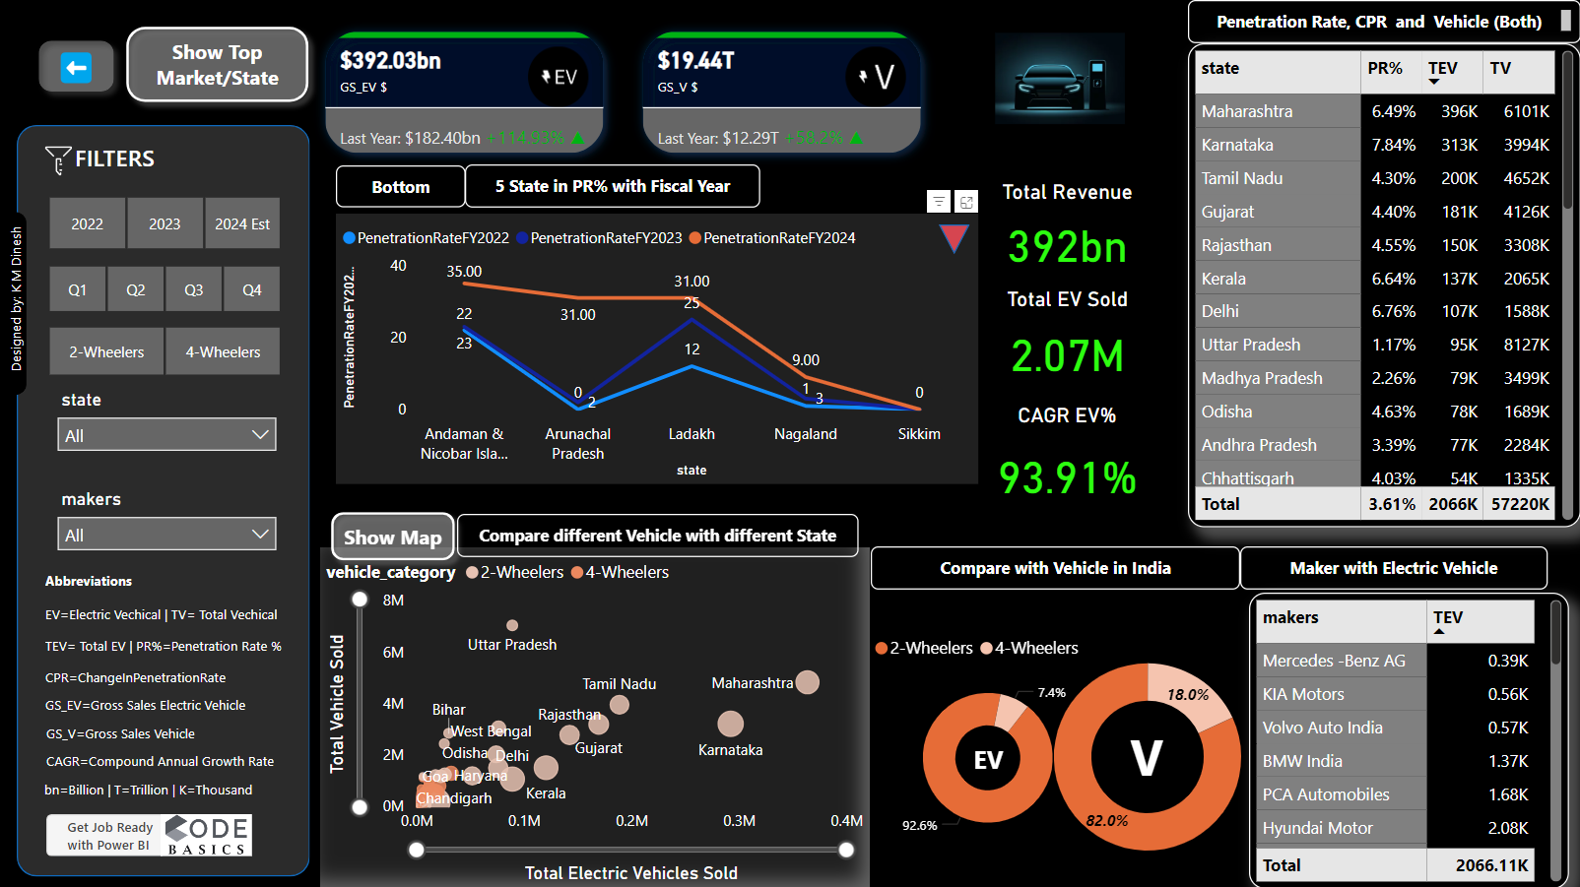
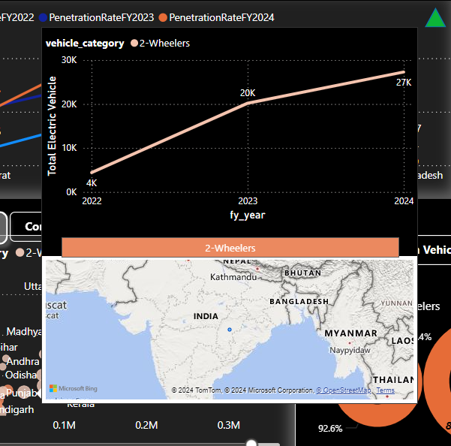
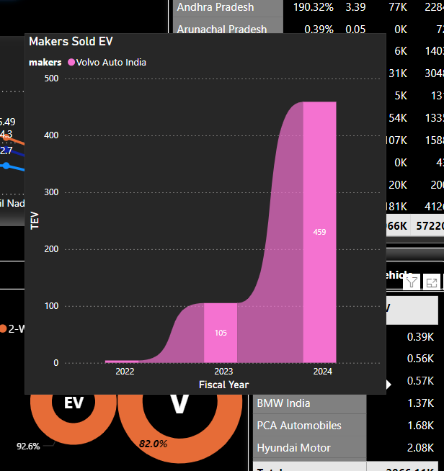
Dashboard 1.1: State/Maker-wise Analysis and Penetration Rates

Slide 8
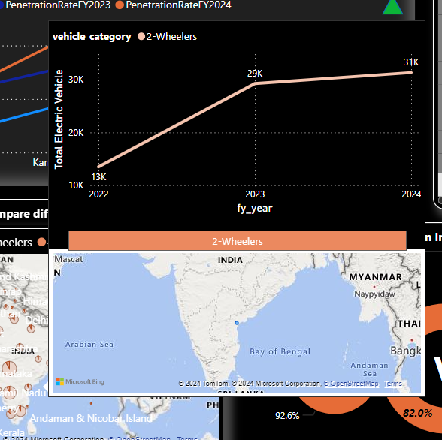
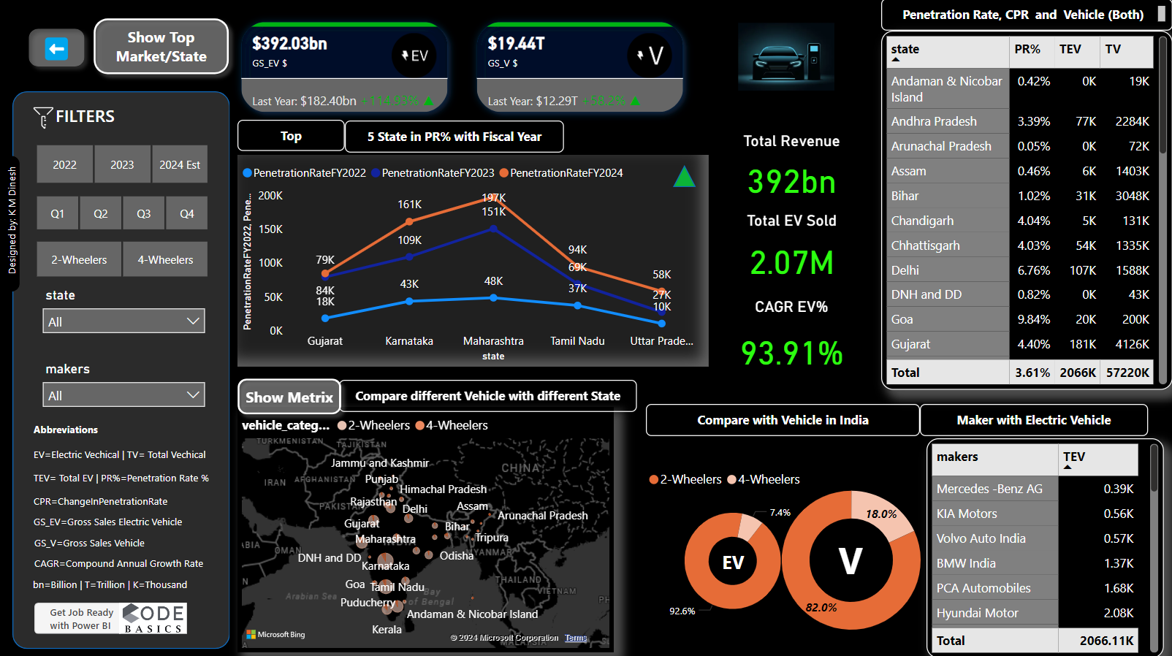
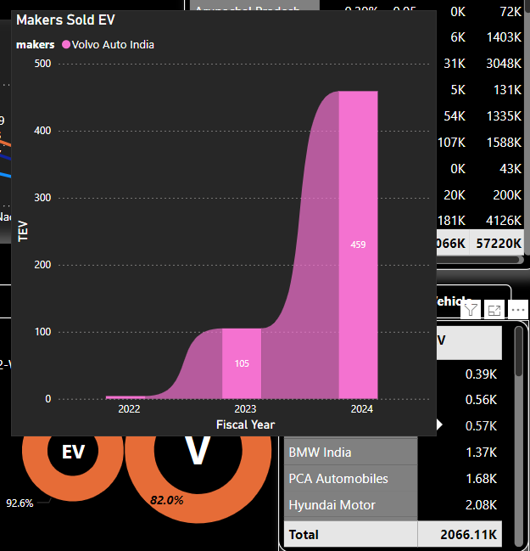
Dashboard 1.2: State/Maker-wise Analysis and Penetration Rates In Map and Tooltip

Slide 9
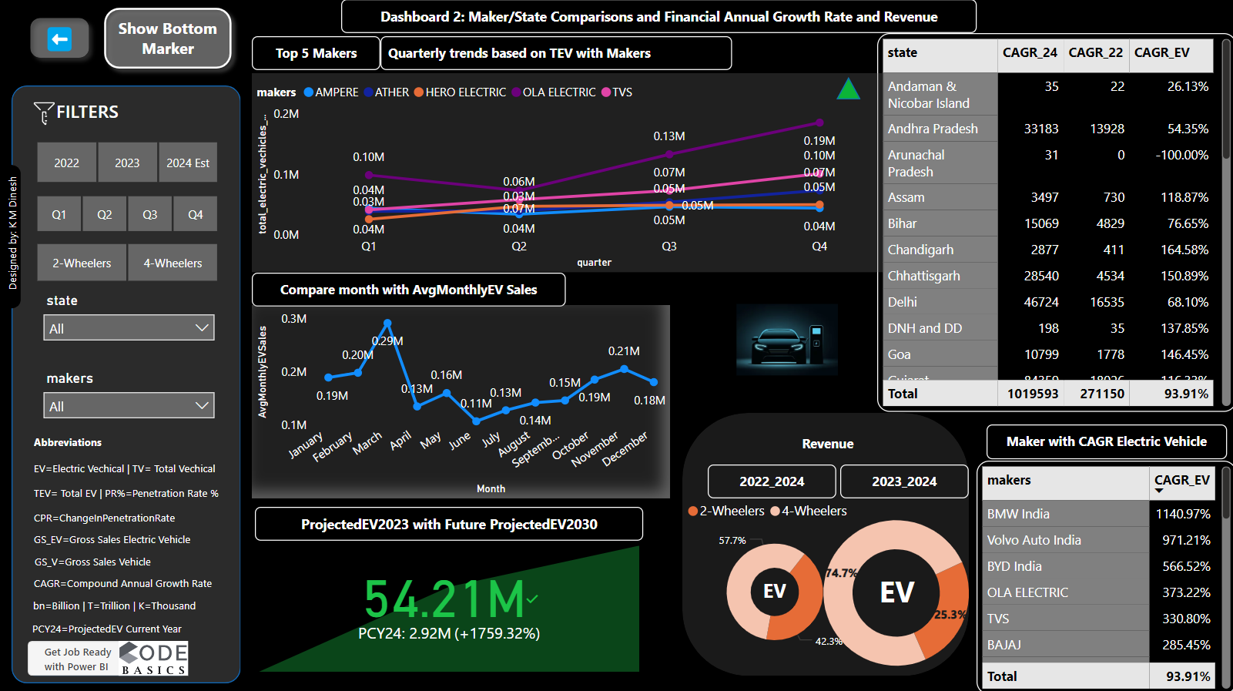
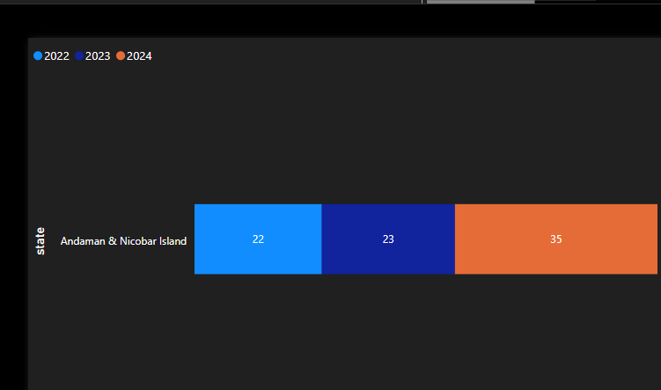
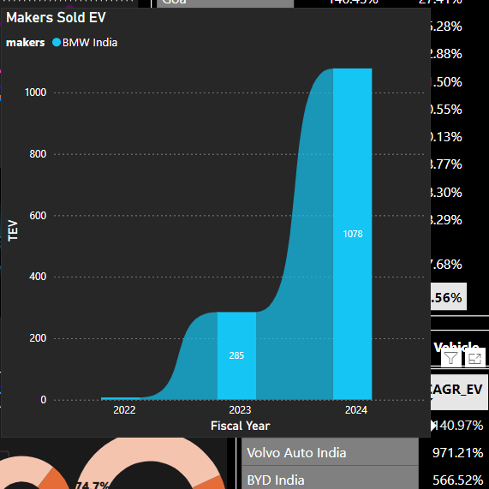
Dashboard 2: Maker/State Comparisons and Financial Annual Growth Rate , Revenue and Future Projected 2030

Slide 10
Q/A

Slide 11
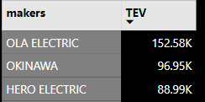
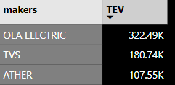
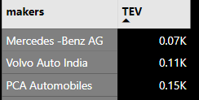
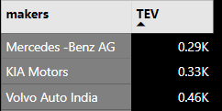
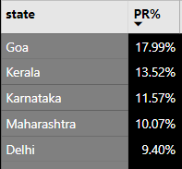
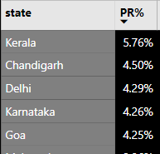
1) List the top 3 and bottom 3 makers for the fiscal years 2023 and 2024 in terms of the number of 2-wheelers sold.
Top 3 Makers Bottom 3 Makers
2) Identify the top 5 states with the highest penetration rate in 2-wheeler and 4-wheeler EV sales in FY 2024.
2023
2024
2023
2024
Top 5 Penetration rate in 2-wheeler
Top 5 Penetration rate in 4-wheeler

Slide 12
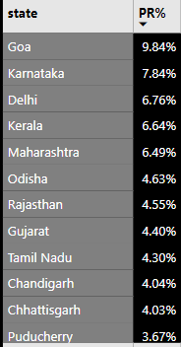
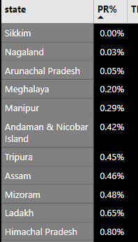
3) . List the states with negative penetration (decline) in EV sales from 2022 to 2024?

Slide 13
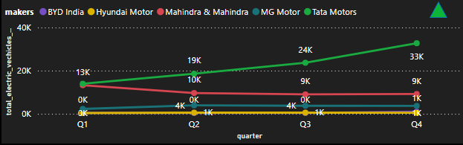

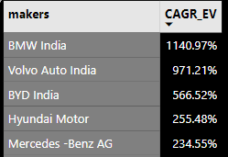
4) What are the quarterly trends based on sales volume for the top 5 EV makers (4-wheelers) from 2022 to 2024?
5) How do the EV sales and penetration rates in Delhi compare to Karnataka for 2024?
6) List down the compounded annual growth rate (CAGR) in 4-wheeler units for the top 5 makers from 2022 to 2024.

Slide 14
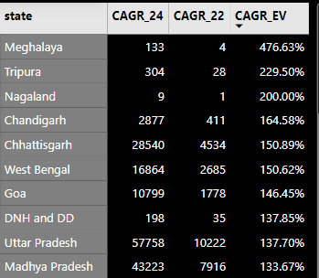
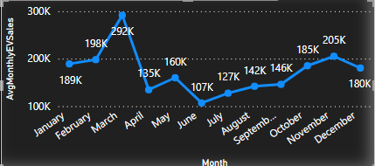
7) . List down the top 10 states that had the highest compounded annual growth rate (CAGR) from 2022 to 2024 in total vehicles sold.
8) What are the peak and low season months for EV sales based on the data from 2022 to 2024?

Slide 15
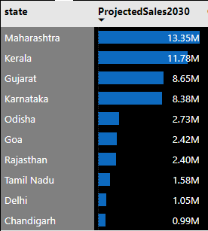
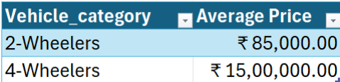
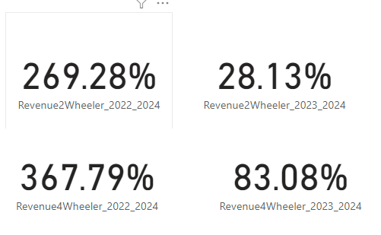
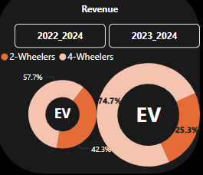
9. What is the projected number of EV sales (including 2-wheelers and 4- wheelers) for the top 10 states by penetration rate in 2030, based on the compounded annual growth rate (CAGR) from previous years?
10) Estimate the revenue growth rate of 4-wheeler and 2-wheelers EVs in India for 2022 vs 2024 and 2023 vs 2024, assuming an average unit price. H
Revenue 2022_24
Revenue 2023_24

Slide 16
Secondary Research Questions:
1) What are the primary reasons for customers choosing 4-wheeler EVs in 2023 and 2024 (cost savings, environmental concerns, government incentives)?
Ans)
Cost Savings:
Lower Operating Costs: EVs generally have lower operating costs compared to traditional internal combustion engine (ICE) vehicles due to cheaper electricity compared to fuel and lower maintenance costs.
Fuel Savings: The cost of electricity is often lower than that of gasoline or diesel, leading to significant savings over time.
Environmental Concerns:
Reduction in Emissions: EVs produce zero tailpipe emissions, contributing to reduced air pollution and greenhouse gas emissions. This is a significant motivator for environmentally conscious consumers.
Sustainability: Increasing awareness about climate change and the need for sustainable practices drives consumers to choose EVs to reduce their carbon footprint.
Government Incentives:
Subsidies and Tax Credits: Many governments offer financial incentives such as subsidies, tax credits, and rebates to reduce the initial purchase price of EVs.
Infrastructure Development: Investment in charging infrastructure and other supportive measures makes EV ownership more convenient and practical.

Slide 17
2) How do government incentives and subsidies impact the adoption rates of 2-wheelers and 4-wheelers? Which states in India provided most subsidies?
Government incentives and subsidies play a crucial role in accelerating the adoption rates of both 2-wheelers and 4-wheelers by reducing the initial purchase cost and making EVs more affordable.
States like Maharashtra, Gujarat, Tamil Nadu, Karnataka and Rajasthan lead in offering substantial financial incentives, including purchase subsidies, tax rebates, and infrastructure development support.
These measures not only lower the overall cost of ownership but also boost consumer confidence and encourage early adoption.
By investing in charging infrastructure and providing consistent support, these states are fostering a favourable environment for the growth of the EV market in India.

Slide 18
3) How does the availability of charging stations infrastructure correlate with the EV sales and penetration rates in the top 5 states?
Convenience: More charging stations make it easier for people to charge their EVs, encouraging more people to buy them.
Government Support: States with lots of charging stations often have strong policies and incentives for EVs, which can help boost sales.
Cost Savings: Charging stations can make using EVs cheaper compared to gas cars, making EVs more attractive to buyers.
Consumer Confidence: Knowing there are many places to charge an EV can make people feel more confident about buying one.
Public Awareness: The presence of many charging stations can make EVs more visible and familiar to the public, leading to higher adoption rates.
States like Maharashtra, Gujarat, Tamil Nadu, Karnataka and Rajasthan

Slide 19
4) Who should be the brand ambassador if AtliQ Motors launches their EV/Hybrid vehicles in India and why?
1. Ratan Tata
Role: Chairman Emeritus, Tata Sons.
Traits: Integrity, innovation, sustainability.
2. PV Sindhu
Role: Olympic badminton medalist.
Traits: Excellence, dedication, performance.
3. Amitabh Kant
Role: Former CEO, NITI Aayog.
Traits: Innovation, sustainable development.
4. Nitin Gadkari
Role: Minister for Road Transport & Highways.
Traits: Policy support, EV infrastructure.
5. Vishwanathan Anand
Role: Former World Chess Champion.
Traits: Strategic thinking, reliability, intelligence.

Slide 20
5. Which state of India is ideal to start the manufacturing unit? (Based on subsidies provided, ease of doing business, stability in governance etc.)
Uttar Pradesh
Maharashtra
Tamil Nadu
Gujarat
Karnataka

Slide 21
6. Your top 3 recommendations for AtliQ Motors.
1. Expand Charging Infrastructure
Invest in a widespread charging network
Partner with governments and private firms
2. Use Data and Analytics
Gain customer insights and preferences
Implement predictive maintenance
3. Strengthen Brand and Marketing
Choose an influential brand ambassador
Highlight sustainability and innovation

Slide 22

Live Dashboard
🫳Click Here

Slide 23

Thank You
Presentation By K M Dinesh
LinkedIn
Github

