Slide 1
WAVECON TELECOM ANALYSIS
K M Dinesh
July 2023

Slide 2

Introduction
Wavecon, a top telecom company, just launched new 5G services, showing its dedication to using the latest tech. But while everyone is excited about this, Wavecon still has to deal with problems and chances in the telecom world

Slide 3
Objectives
What is the impact of the 5G launch on our revenue?
Which KPI is underperforming after the 5G launch?
After the 5G launch, which plans are performing well in terms of revenue? Which plans are not performing well?
Is there any plan affected largely by the 5G launch? Should we continue or discontinue that plan?
Is there any plan that is discontinued after the 5G launch? What is the reason for it?

Slide 4
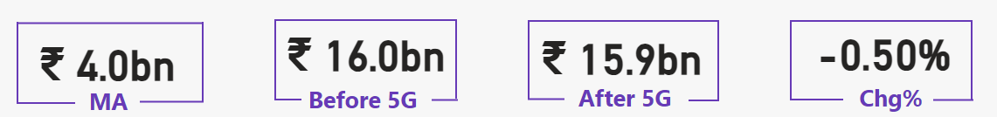
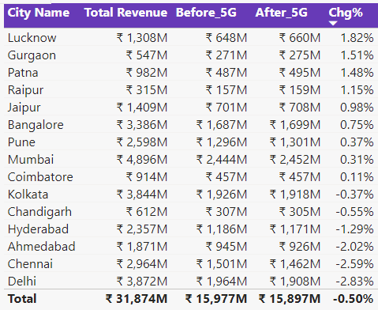
Impact of the 5G launch on our Revenue
Revenue decreased by 0.5% following the implementation of 5G.
Top three cities with nearly 1.5% increase are Lucknow, Gurgaon, and Patna.
Least three cities with the lowest decrease are Ahmedabad, Chennai, and Delhi, with a decrease averaging below 2.48%.

Slide 5
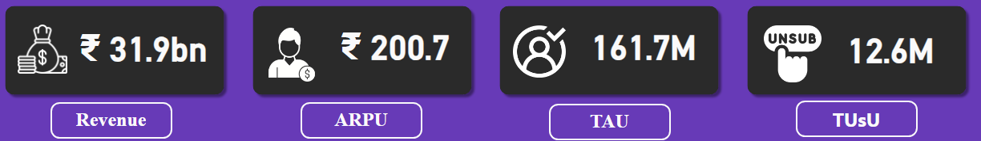
Key Performance Indicator
Total Revenue Generated: Rs. 31.9 billion
ARPU (Average Revenue Per User): Rs. 200
TAU (Total Active Users): 161.7 million
TUSU (Total Unique Subscribers): 12.6 million

Slide 6
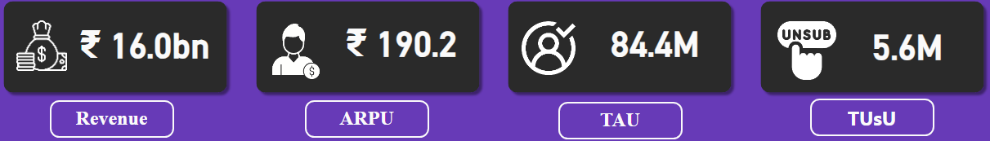
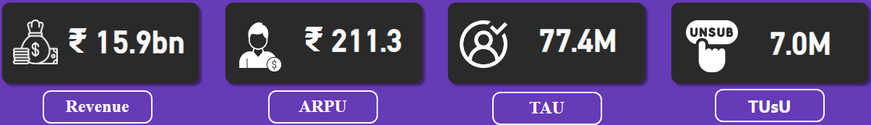
Underperforming KPI after 5G launch
Before 5G
After 5G

Slide 7
Before 5G:
Revenue: Rs. 16 billion
ARPU (Average Revenue Per User): Rs. 190.2
TAU (Total Active Users): 84.4 million
TUSU (Total Unique Subscribers): 5.6 million
After 5G:
Revenue: Rs. 15.9 billion
ARPU (Average Revenue Per User): Rs. 211.3
TAU (Total Active Users): 77.4 million
TUSU (Total Unique Subscribers): 7 million

Slide 8
Revenue Change Percentage: Revenue decreased by approximately 0.63%.
ARPU Change Percentage: ARPU increased by approximately 11.09%.
TAU Change Percentage: TAU decreased by approximately 8.29%.
TUSU Change Percentage: TUSU increased by approximately 25.00%.

Slide 9
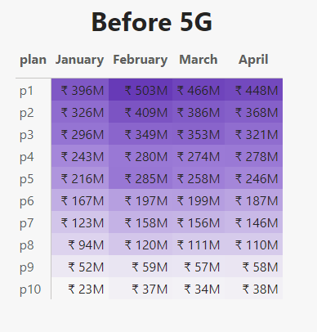
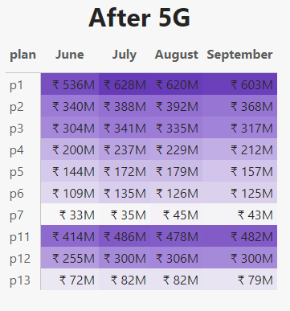
Plan Performance in Revenue after 5G launch

Slide 10
Plans P1, P2, and P3 consistently performed well both before and after the introduction of 5G.
Revenue for plans P4, P5, and P6 declined following the launch of 5G.
The company introduced plans 11, 12, and 13 after the 5G rollout.
Plans P8, P9, and P10 were discontinued after the introduction of 5G.

Slide 11
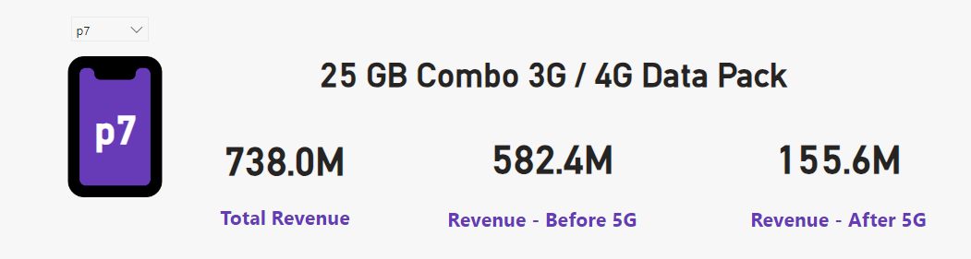
Plan Largely Affected after 5G launch
Plan 7 experienced a significant impact after the launch of 5G, with revenue dropping from 582.4M to 155.6M.

Slide 12
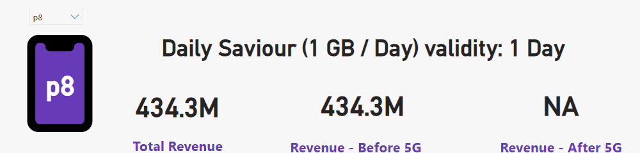
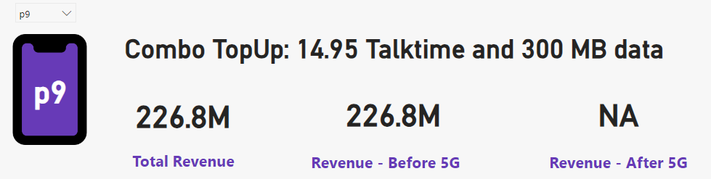
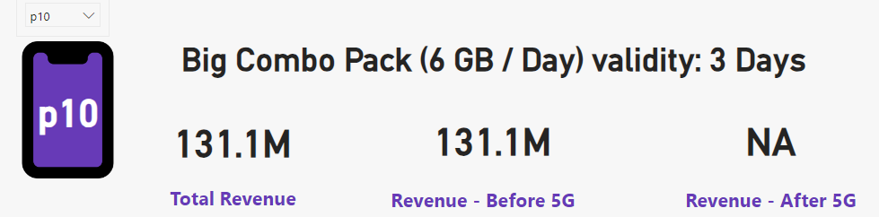
Discontinued Plan after 5G launch

Slide 13
Plans 8, 9, and 10 were discontinued after the introduction of 5G.
New plans 11, 12, and 13 were introduced following the launch of 5G.

Slide 14

Thank You

