Slide 1
Hackathon Project
Identify Car Wash Services

Slide 2
Hackathon Team Information
Team Members
Gorijilli Venkata Naga Sai Dinesh (2421162)
Borigi Pavan (2421317)
Pravallika Cherukuri (2421155)
Ashok Boda (2421374)
Uma Shankar Cherukula (2421228)
K Pavani Teja (2421159)

Slide 3
Project Overview: Identify Car Wash Services
Project Objective To design and implement a robust test automation framework that identifies
and validates top-rated car wash services near the user's location using
real-time data from legitimate service listing platforms (e.g., Justdial).
Website Link: Justdial.com

Slide 4
Modules and Features Automated
Feature | Scenario
category display | Verify all categories are visible
excel reading | Testing core functionality using Excel-based input data
Filter Functionality | Verify filter application for ratings
Free Listing Login | Free listing login with valid phone number,invalid phone number and empty phone number
Validate Filtered List Item Count | Verify filtered item count matches expected
Search Functionality | Successful search and Unsuccessful search
Service Page Query Submission | Successful and Unsucessful query on the service page
Show Number Popup | Verify phone number display in show number popup

Slide 5
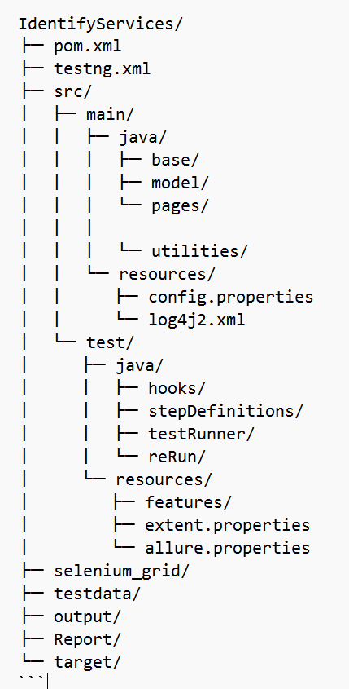
Week 1: Framework Foundation & Feasibility
Goals:
Define scope and automation feasibility for Justdial
Set up Maven/TestNG project structure
Create base classes and reusable utilities
Tasks:
Create base, utilities, and model packages under src/main/java
Configure config.properties, log4j2.xml, and pom.xml
Set up Page Object Model (POM) using Page Factory
Define hooks and test runners using Cucumber

Slide 6
Week 1: Framework Foundation & Feasibility
Build reusable functions for:
Browser actions
Wait mechanisms / Input validations
Define test environment setup via base configuration classes
Deliverables:
Project skeleton with directory structure
Base configuration and reusable functions
Initial feature files and step definitions

Slide 7
Week 2: Feature Automation & Data Integration
Goals:
Automate service search and validation
Implement form submission and error capture
Tasks:
Create feature files under src/test/resources/features
Implement step definitions for:
Car wash service search
Free listing form validation
Integrate Excel/XML data using Apache POI

Slide 8
Week 2: Feature Automation & Data Integration
Implement Retry Mechanism for Failed Scenarios
Use a custom retry analyzer to re-execute failed test cases automatically.
Integrate with TestNG and Cucumber to ensure robustness in flaky environments.
Parameterize Test Execution via TestNG XML
Configure multiple test environments (e.g., browser types, base URLs) using TestNG parameters.
Enable flexible execution across different setups without modifying code.
Deliverables:
Feature files: IdentifyServices.feature, FormValidation.feature, MenuExtraction.feature
Data files: ProjectData.xlsx, TrackOrder.xml, etc.
Updated step definitions and page objects

Slide 9
Week 3: Reporting, Execution & Integration
Goals:
Integrate reporting tools and finalize test suite
Validate cross-browser execution
Perform regression testing
Tasks:
Configure Allure and Extent Reports
Validate execution on Chrome and Edge
Review test failures and optimize scripts

Slide 10
Week 3: Reporting, Execution & Integration
Configure cross-browser execution:
Validate test scripts on Chrome and Edge
Review handling of headless and headed modes
Conduct regression suite run:
Execute all features with final test data
Review failures and fix tracking
Prepare final report:
Summary of features implemented
Data source coverage
Known issues and recommendations

Slide 11
Project Summary & Learnings
Applied all phases of the Software Testing Life Cycle (STLC) through real-world implementation.
Gained hands-on experience in automation testing using Selenium Grid, TestNG, and Cucumber (BDD).
Designed a modular framework using Page Object Model (POM) and Page Factory for maintainability.
Implemented data-driven testing using Excel and XML; runtime configurations handled via .properties files.
Captured and validated error messages from form submissions with invalid inputs.
Extracted and stored menu items dynamically using collections (List, Map).
Integrated Allure and Extent Reports for rich visual reporting with screenshots and metadata.
Strengthened team collaboration and version control using GitHub, with branching and task tracking.
Validated test scripts across multiple browsers and modes (headed/headless).
Enhanced skills in alert handling, form validations, and dynamic navigation paths.

Slide 12
THANK YOU

