Slide 1
CptS 440 / 540
Artificial Intelligence
Search

Slide 2
Search
Search permeates all of AI
What choices are we searching through?
  Problem solving
  Action combinations (move 1, then move 3, then move 2...)
  Natural language
  Ways to map words to parts of speech
  Computer vision
  Ways to map features to object model
  Machine learning
  Possible concepts that fit examples seen so far
  Motion planning
  Sequence of moves to reach goal destination
An intelligent agent is trying to find a set or sequence of actions to achieve a goal
This is a goal-based agent

Slide 3
Problem-solving Agent
SimpleProblemSolvingAgent(percept)
state = UpdateState(state, percept)
if sequence is empty then
goal = FormulateGoal(state)
problem = FormulateProblem(state, g)
sequence = Search(problem)
action = First(sequence)
sequence = Rest(sequence)
Return action

Slide 4
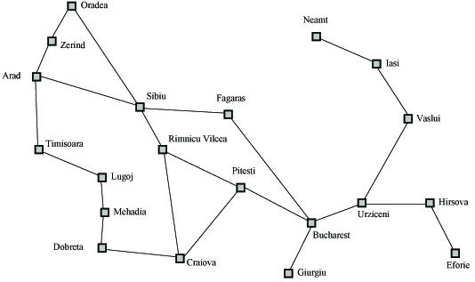
Search Example
Formulate goal: Be in Bucharest.
Formulate problem: states are cities, operators drive between pairs of cities
Find solution: Find a sequence of cities (e.g., Arad, Sibiu, Fagaras, Bucharest) that leads from the current state to a state meeting the goal condition

Slide 5
Search Space Definitions
State
  A description of a possible state of the world
  Includes all features of the world that are pertinent to the problem
Initial state
  Description of all pertinent aspects of the state in which the agent starts the search
Goal test
  Conditions the agent is trying to meet (e.g., have $1M)
Goal state
  Any state which meets the goal condition
  Thursday, have $1M, live in NYC
  Friday, have $1M, live in Valparaiso
Action
  Function that maps (transitions) from one state to another

Slide 6
Search Space Definitions
Problem formulation
  Describe a general problem as a search problem
Solution
  Sequence of actions that transitions the world from the initial state to a goal state
Solution cost (additive)
  Sum of the cost of operators
  Alternative: sum of distances, number of steps, etc.
Search
  Process of looking for a solution
  Search algorithm takes problem as input and returns solution
  We are searching through a space of possible states
Execution
  Process of executing sequence of actions (solution)

