Slide 1
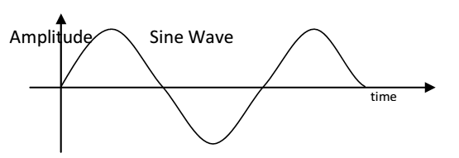
UNIT-I
SIGNAL ANALYSIS
Signal: Signal is one that carries information and is defined as a physical quantity that varies with one or more independent variable. Example: Music, speech
Classification of signals
Analog and Digital signal
Analog signal: A signal that is defined for every instants of time is known as analog signal. Analog signals are continuous in amplitude and continuous in time. It is denoted by x(t). It is also called as Continuous time signal. Example for Continuous time signal is shown in Fig

Slide 2
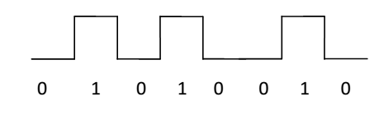
Digital signal: The signals that are discrete in time and quantized in amplitude is called digital signal
Continuous time and discrete time signal
Continuous time signal: A signal that is defined for every instants of time is known as continuous time signal. Continuous time signals are continuous in amplitude and continuous in time. It is denoted by x(t) and shown in Fig

Slide 3
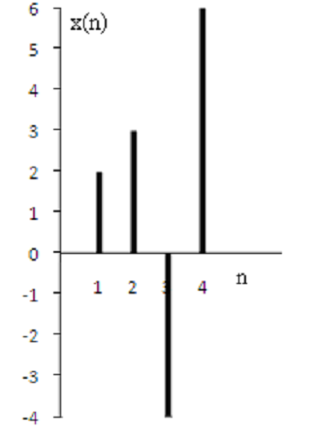
Discrete time signal: A signal that is defined for discrete instants of time is known as discrete time signal. Discrete time signals are continuous in amplitude and discrete in time. It is also obtained by sampling a continuous time signal. It is denoted by x(n) and shown in Fig

Slide 4
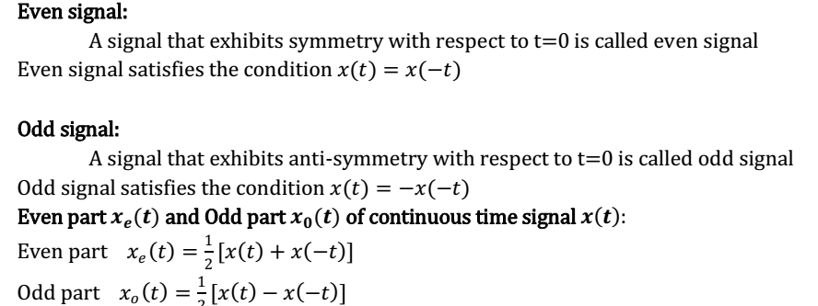
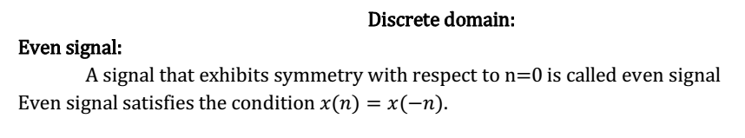
Even (symmetric) and Odd (Anti-symmetric) signal Continuous domain

Slide 5
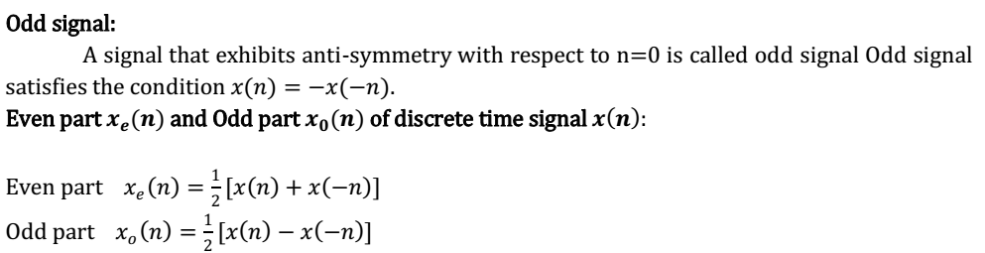
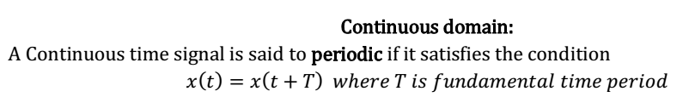
Periodic and Aperiodic signal Periodic signal: A signal is said to periodic if it repeats again and again over a certain period of time. Aperiodic signal: A signal that does not repeat at a definite interval of time is called aperiodic signal.

Slide 6
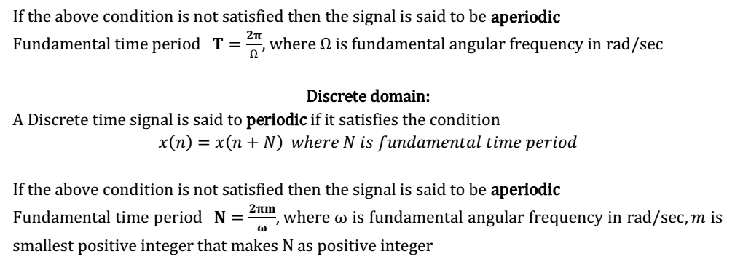
Energy and Power signal Energy signal: The signal which has finite energy and zero average power is called energy signal. The non periodic signals like exponential signals will have constant energy and so non periodic signals are energy signals.

Slide 7
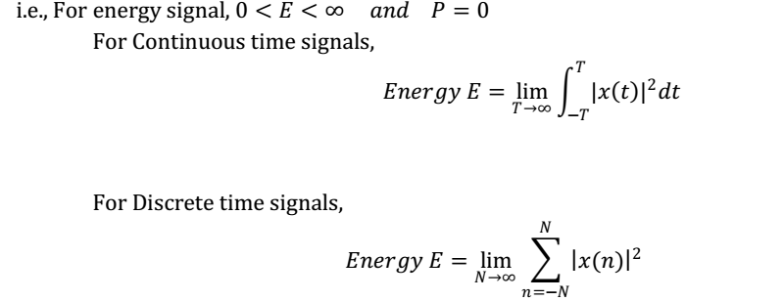
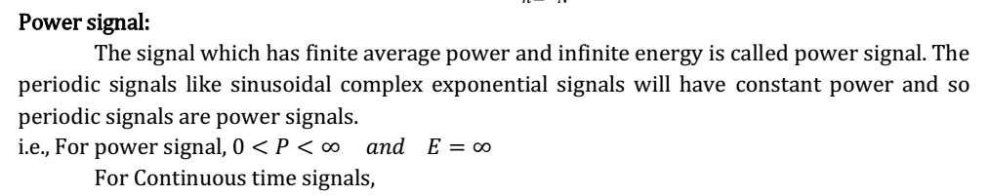

Slide 8
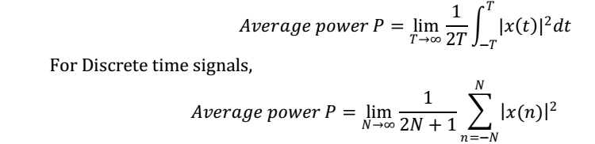
Deterministic and Random signals Deterministic signal: A signal is said to be deterministic if there is no uncertainty over the signal at any instant of time i.e., its instantaneous value can be predicted. It can be represented by mathematical equation.
Example: sinusoidal signal Random signal (Non-Deterministic signal):
A signal is said to be random if there is uncertainty over the signal at any instant of time i.e., its instantaneous value cannot be predicted. It cannot be represented by mathematical equation.

Slide 9
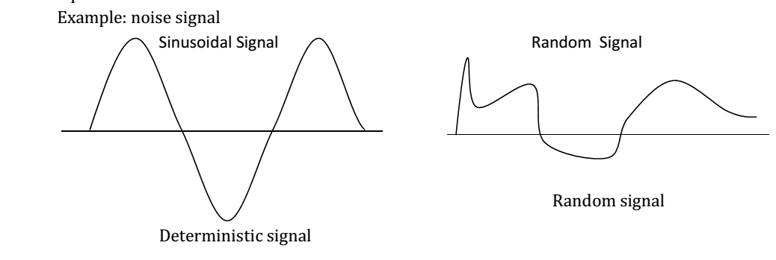

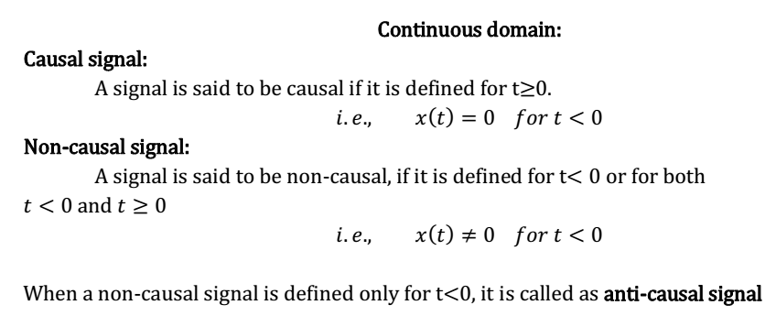

Slide 10
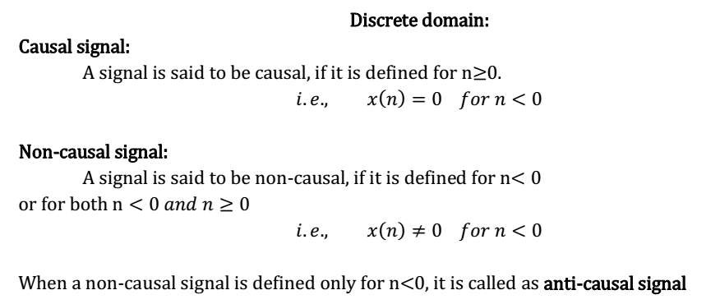

Slide 11
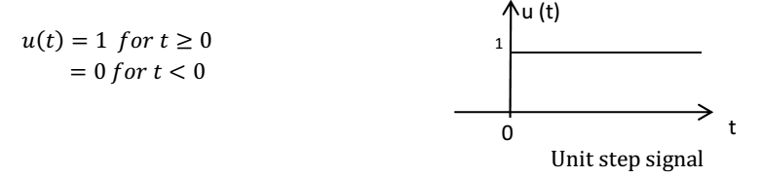
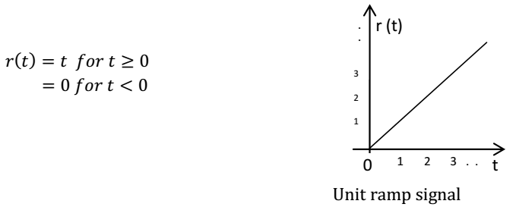
Basic(Elementary or Standard) continuous time signals
Step signal Unit Step signal is defined as
Ramp signal Unit ramp signal is defined as

Slide 12
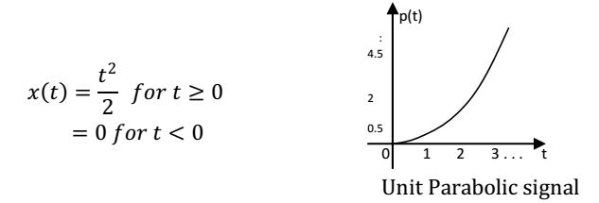
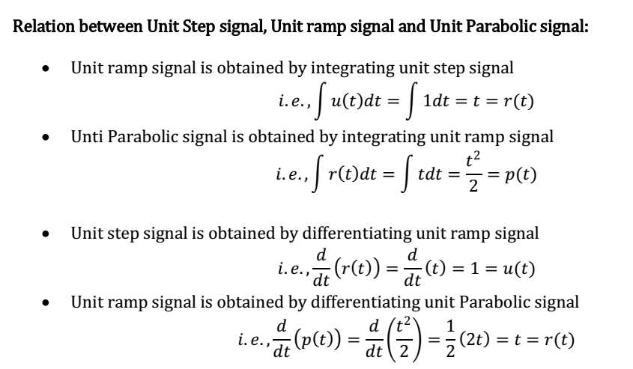
Parabolic signal Unit Parabolic signal is defined as

Slide 13
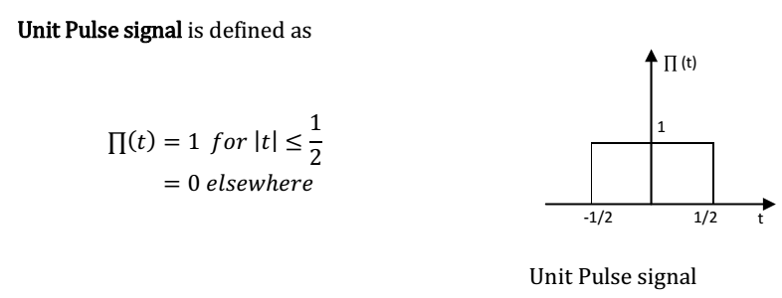
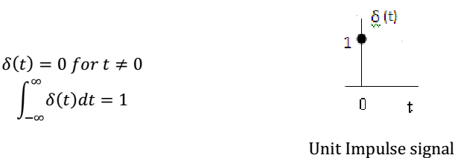
Impulse signal Unit Impulse signal is defined as

Slide 14
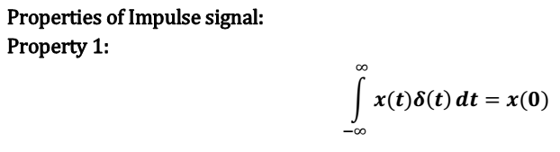
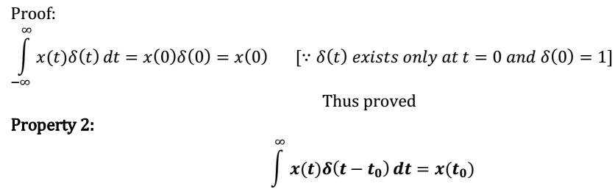
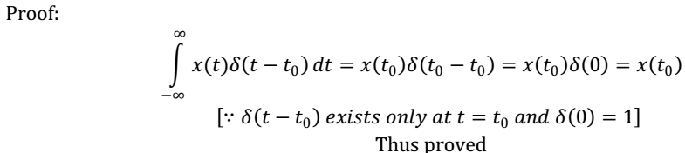

Slide 15


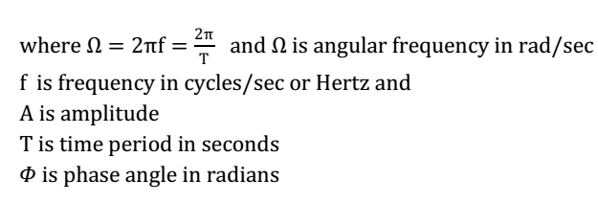
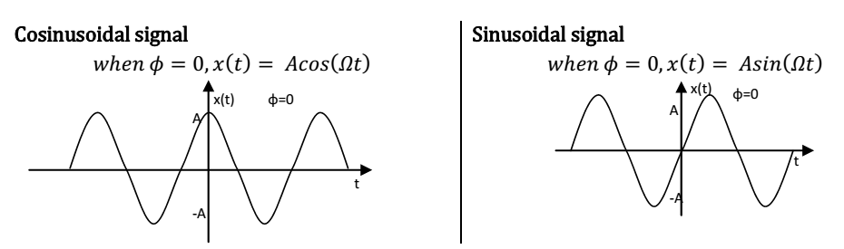
Sinusoidal signal Cosinusoidal signal is defined as
Sinusoidal signal is defined as

Slide 16

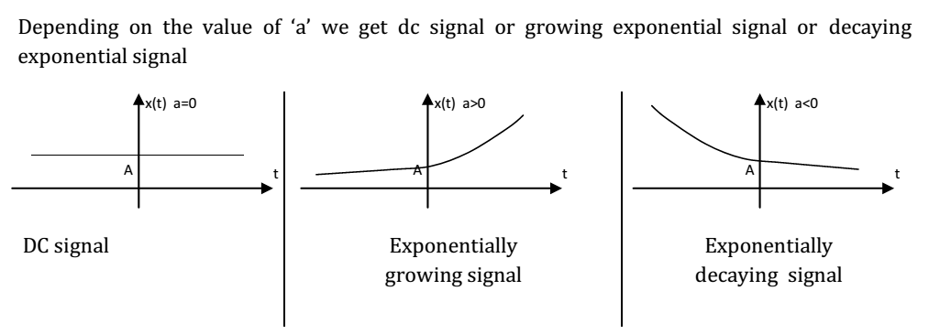
Exponential signal Real Exponential signal is defined as

Slide 17
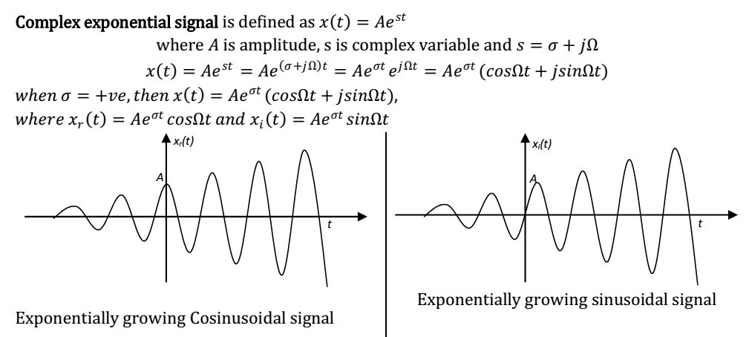
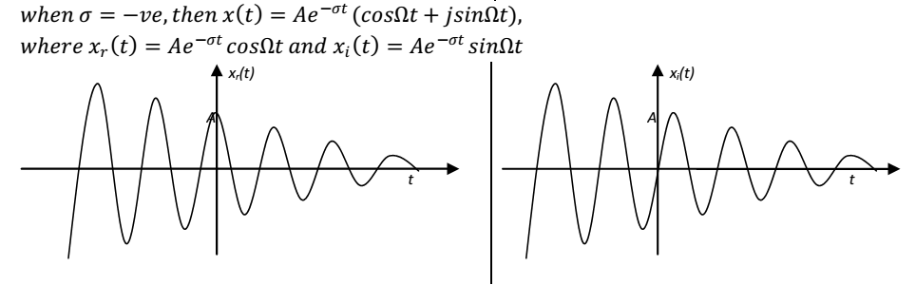

Slide 18
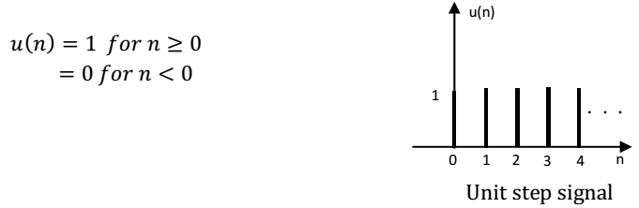
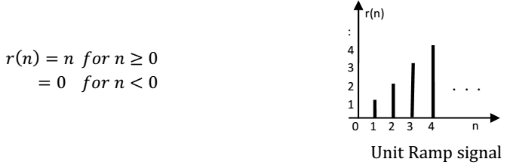
Basic(Elementary or Standard) Discrete time signals
Step signal Unit Step signal is defined as
Unit Ramp signal Unit Ramp signal is defined as

Slide 19
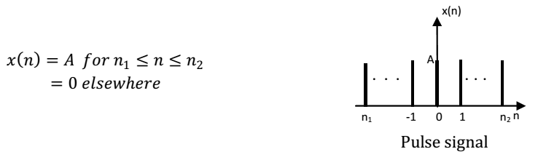
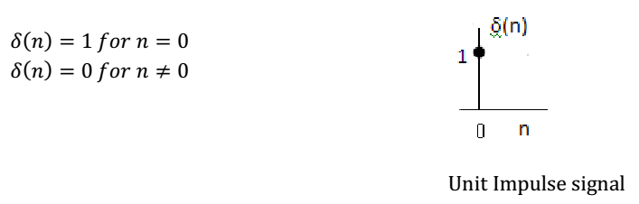
Pulse signal (Rectangular pulse function) Pulse signal is defined as
Unit Impulse signal Unit Impulse signal is defined as

Slide 20
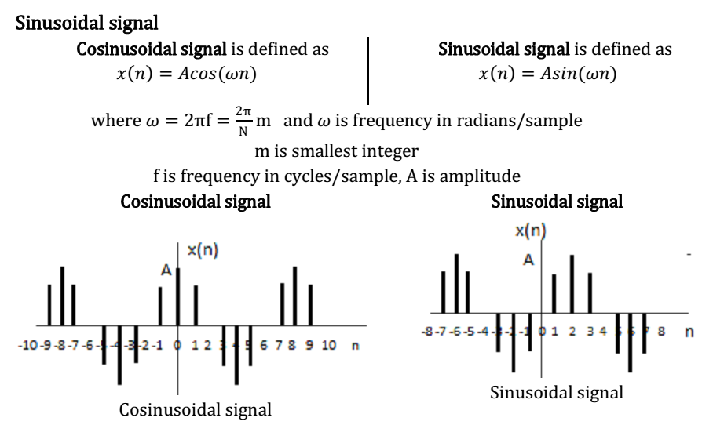

Slide 21

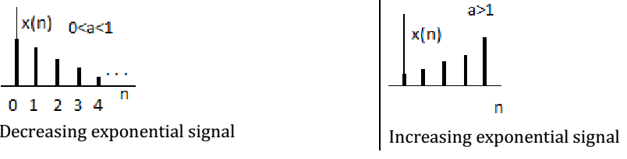
Exponential signal Real Exponential signal is defined as

Slide 22
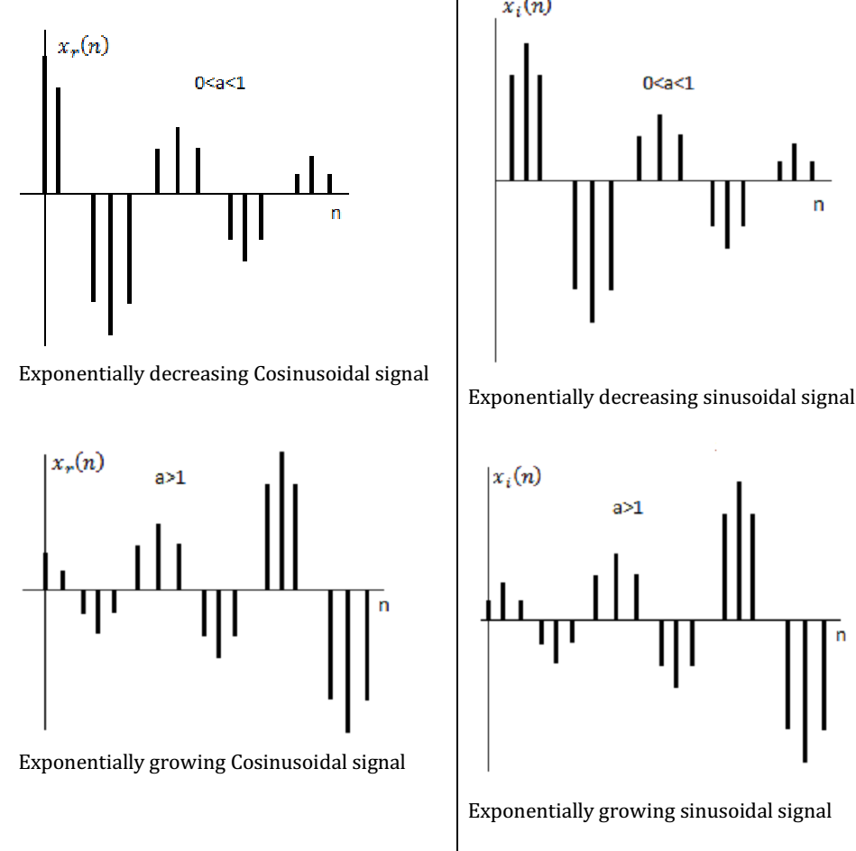

Slide 23
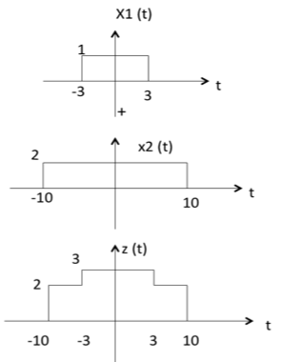
Basic Operations on Signals
Addition
Addition of two signals is nothing but addition of their corresponding amplitudes. This can be best explained by using the following example:

Slide 24
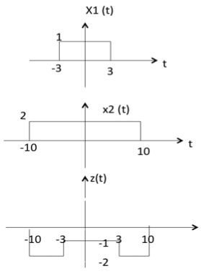
As seen from the diagram above,
-10 < t < -3 amplitude of z(t) = x1(t) + x2(t) = 0 + 2 = 2
-3 < t < 3 amplitude of z(t) = x1(t) + x2(t) = 1 + 2 = 3
3 < t < 10 amplitude of z(t) = x1(t) + x2(t) = 0 + 2 = 2
Subtraction
subtraction of two signals is nothing but subtraction of their corresponding amplitudes. This can be best explained by the following example:

Slide 25
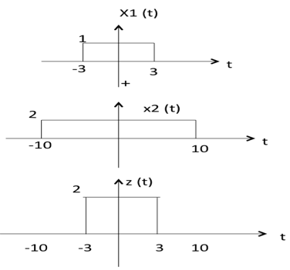
As seen from the diagram above,
-10 < t < -3 amplitude of z (t) = x1(t) - x2(t) = 0 - 2 = -2
-3 < t < 3 amplitude of z (t) = x1(t) - x2(t) = 1 - 2 = -1
3 < t < 10 amplitude of z (t) = x1(t) + x2(t) = 0 - 2 = -2
Multiplication
Multiplication of two signals is nothing but multiplication of their corresponding amplitudes. This can be best explained by the following example:

Slide 26
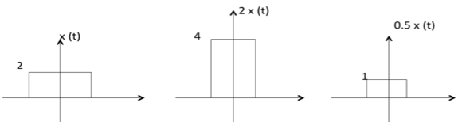
As seen from the diagram above,
-10 < t < -3 amplitude of z (t) = x1(t) ×x2(t) = 0 ×2 = 0
-3 < t < 3 amplitude of z (t) = x1(t) ×x2(t) = 1 ×2 = 2
3 < t < 10 amplitude of z (t) = x1(t) × x2(t) = 0 × 2 = 0
Amplitude Scaling
C x(t) is a amplitude scaled version of x(t) whose amplitude is scaled by a factor C.

Slide 27
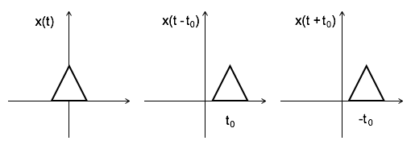
Time Shifting
x(t ± t₀) is time shifted version of the signal x(t).
x (t + t₀) →→ negative shift
x (t - t₀) →→ positive shift
Time Scaling
x(At) is time scaled version of the signal x(t). where A is always positive.
|A| > 1 →→ Compression of the signal
|A| < 1 →→ Expansion of the signal

Slide 28
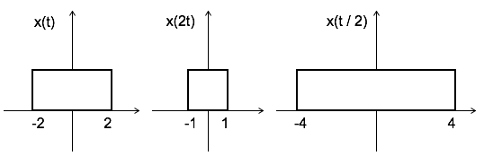
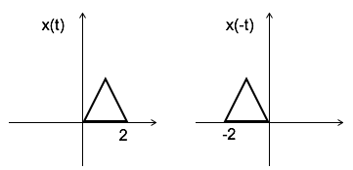
Note: u(at) = u(t) time scaling is not applicable for unit step function.
Time Reversal
x(-t) is the time reversal of the signal x(t).

Slide 29
Analogy between Vectors and Signals
Vectors: A vector is specified by magnitude and direction. The vector is denoted by boldface type and its magnitude is denoted by Lightface type
For Example:
A is a certain vector with magnitude A. Consider two vectors V1 and V2.Let the component of V1 along with V2 is given by C12V2
The component of a vector V1 along with the vector V2 can obtained by taking a perpendicular from the end of V1 to the vector V2 as shown in diagram.
The vector V1 can be expressed in terms of vector V2
𝑉1 = 𝐶12𝑉2 + 𝑉e
But this is not the only way of expressing vector V1 in terms of V2. The alternate possibilities are
𝑉1 = 𝐶1𝑉2 + 𝑉𝑒1
𝑉1 = 𝐶2𝑉2 + 𝑉𝑒2

Slide 30
V1 is represented in terms of V2 plus another vector, which will be called the error vector.
If we asked to approximate the vector V1 by a vector in the direction of V2, then Ve represents the error in this approximation.
The error vector (Ve) is minimum for larger component value (C12) of one vector (V1) along the other vector(V2).
V1.V2=0
If C12=0, then two signals are said to be orthogonal.
Here A and B are two vectors. Dot Product of Two Vectors,
𝐀.𝐁 = AB cos θ
θ = Angle between A and B

Slide 31
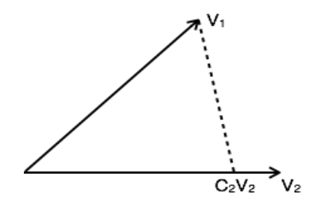
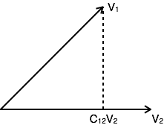
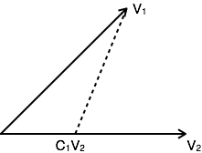
It follows from the definition that
𝐀.𝐁 = 𝐁.𝐀
According to this notation,
- The component of A along B= A cos θ = 𝐀.𝐁/ B &
- The component of B along A= B cos θ = 𝐀.𝐁 /A
Similarly,
The components of V1 along V2= 𝑽𝟏.𝑽𝟐/ V2 = 𝐶12𝑉2

Slide 32
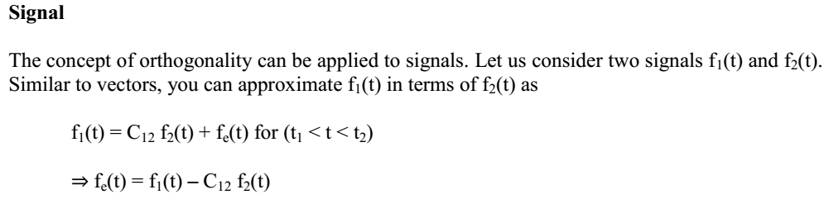
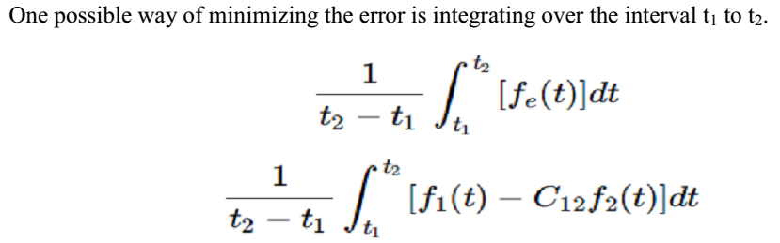

Slide 33
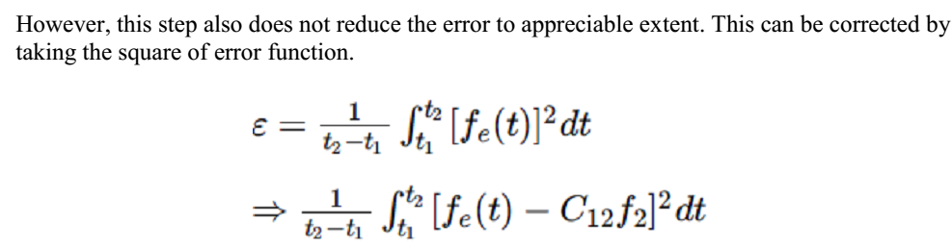
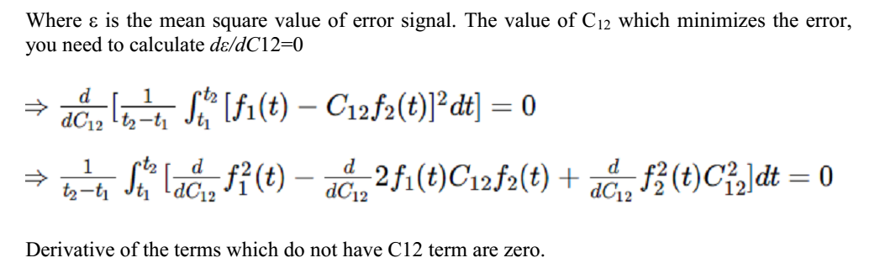

Slide 34
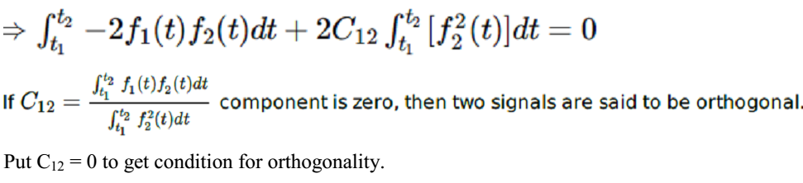


Slide 35


Slide 36




Slide 37



Slide 38



Slide 39


Slide 40


All terms that do not contain Ck is zero. i.e. in summation, r=k term remains and all other terms are zero.

Slide 41


Slide 42

Mean Square Error: The average of square of error function fe(t) is called as mean square error. It is denoted by ε (epsilon)

Slide 43


Closed and Complete Set of Orthogonal Functions: Let us consider a set of n mutually orthogonal functions x1(t), x2(t)...xn(t) over the interval t1 to t2. This is called as closed and complete set when there exist no function f(t) satisfying the condition
If this function is satisfying the equation
For k=1,2,.. then f(t) is said to be orthogonal to each and every function of orthogonal set. This set is incomplete without f(t). It becomes closed and complete set when f(t) is included. f(t) can be approximated with this orthogonal set by adding the components along mutually orthogonal signal i.e.

Slide 44

Orthogonality in Complex Functions:
If f1(t) and f2(t) are two complex functions, then f1(t) can be expressed in terms of f2(t) as f1(t)= C12f2(t).. with negligible error
Where f2*(t) is the complex conjugate of f2(t) If f1(t) and f2(t) are orthogonal then C12 = 0

Slide 45

The above equation represents orthogonality condition in complex functions

Slide 46

PROBLEMS
1. A continuous-time signal x ( t ) is shown in the following figure. Sketch and label each of the following signals

Slide 47



Slide 48


2. Determine whether the following signals are energy signals, power signals, or neither

Slide 49




(d) we know that energy of a signal is
And by using

Slide 50


Slide 51


3. Determine whether or not each of the following signals is periodic. If a signal is periodic, determine its fundamental period.

Slide 52



Slide 53



Slide 54


Slide 55


5. Determine the even and odd components of the following signals:

