Slide 1
8086 Features
It is a 16 bit μp.
It is manufactured with H-MOS technology.
8086 has a 20 bit address bus can access up to 2²⁰ memory
locations ( 1 MB) .
It has multiplexed address and data bus AD0- AD15 and A16 – A19.
It provides fourteen 16-bit registers.
8086 is designed to operate in two modes, Minimum(single processor) and Maximum(multi processor).
It can pre fetches up to 6 instruction bytes from memory and queues them in order to speed up instruction execution.
It can support upto 64K I/O ports.
It requires a +5V power supply
It is enclosed with 40 pins DIP (dual in line package).

Slide 2
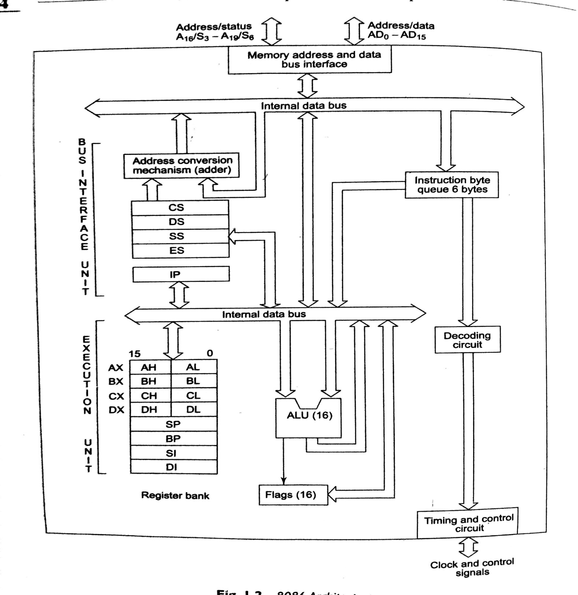

Slide 3
8086 has two blocks BIU and EU
BIU contains Instruction queue, Segment registers,Instruction pointer, Address adder.
EU contains Control circuitry, Instruction decoder, ALU,Pointer and Index register, Flag register.
The BIU performs all bus operations such as instruction fetching, reading and writing operands for memory and calculating the addresses of the memory operands.
EU executes instructions from the instruction system byte queue.

Slide 4
Instruction Queue
To increase the execution speed, BIU fetches as many as six instruction bytes ahead of time from memory.
All six bytes are arranged in first in first out structure in a 6 byte register called instruction queue.
The instructions from the queue are taken sequentially for decoding.
This pre fetching operation of BIU may be in parallel with execution operation of EU, which improves the speed execution of the instruction.
While opcode is fetched by BIU, the EU executes previously decoded instruction concurrently. Thus BIU along with EU forms a pipeline.

Slide 5
Physical address formation
Segment address: 1005 H
Offset address : 5555 H
Segment address: 1005 H: 0001 0000 0000 0101
Shifted left by 4 bit po’s :0001 0000 0000 0101 0000
+
Offset address : 0101 0101 0101 0101
Physical address :0001 0101 0101 1010 0101
1 5 5 A 5 H
Physical address= 10H* Segment address+ Offset address

Slide 6
Execution Unit (EU)
It has 16 bit ALU, able to perform all arithmetic and logical operations.
The 16-bit flag register reflects the results of execution by ALU.
The decoding unit decodes the opcode bytes.
The timing and control unit derives the necessary control signals to execute the instruction.

Slide 7
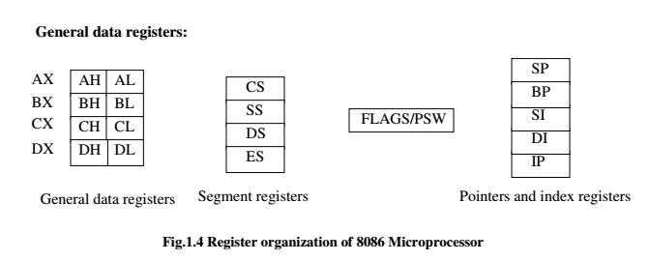
Register organization

Slide 8
General purpose registers
AX: used as 16-bit accumulator, with the lower 8-bits of AX designated as AL and higher 8-bits as AH.
BX: used as offset storage for forming physical addresses in case of certain addressing modes.
CX: used as a default counter in case of string and loop instructions.
DX: used as an implicit operand or destination in case of a few instructions.
used to hold data for MUL & DIV operations

Slide 9
Segment Registers
Code Segment (CS): The CS register is used for addressing a memory location in the Code Segment of the memory, where the executable program is stored.
Data Segment (DS): The DS register is used for addressing the Data Segment of the memory, where the data is stored.
Stack Segment (SS): The SS register is used for addressing the Stack Segment of the memory, i.e. the memory which is used to store stack data.
Extra Segment (ES): ES is additional data segment. The ES register is used for addressing the Extra Segment of the memory, where the data is stored.

Slide 10
Pointers and index registers
The pointers stores offset addresses within the particular segments
IP code segment
BP data segment
SP stack segment
Source Index (SI): It is used for storing offset address of source data in data segment. It is also used for indexed, based indexed and register indirect addressing modes.
Destination Index (DI): It is used for storing offset address of destination data in data or extra segment. It is also used for indexed, based indexed and register indirect addressing modes.

Slide 11
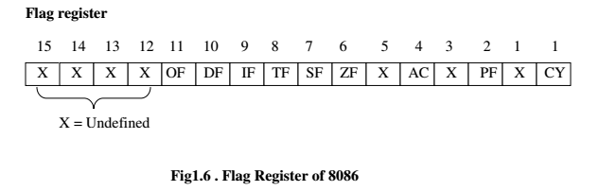
Flag register

Slide 12
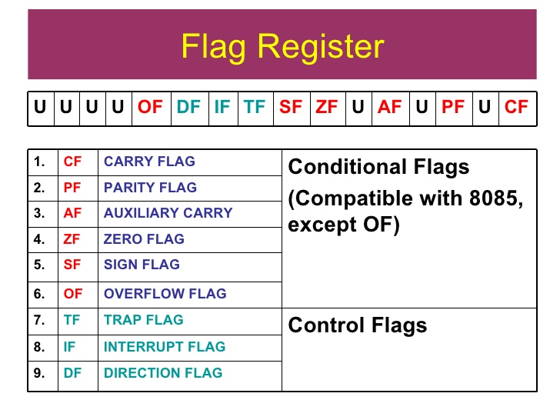

Slide 13
Status/conditional code flags
SF :sign flag is set when the result of operation is negative.
ZF: zero flag is set when the result of operation is zero.
AF: auxiliary carry flag is set when there is a carry from lower nibble or lower four bits of the operation.
PF: parity flag is set if the result has even no.of ones in the lower byte.
CF: carry flag is set when there is a carry from the result.
OF:over flow flag is set when the result of signed operation overflows into the sign bit.

Slide 14
Control flags
TF: When trap flag is set, the processor enters into single step execution mode . i.e. It executes the program instruction by instruction.
IF: It is an interrupt enable/disable flag. If it is set, the maskable interrupts are recognized by the processor otherwise they are ignored.
DF:It is used in string operation.
If it is set, string bytes are accessed from higher memory address to lower memory address. i.e. auto decrementing mode.
When it is reset, the string bytes are accessed from lower memory address to higher memory address. i.e. auto incrementing mode.

Slide 15
Memory segmentation
The size of address bus of8086 is 20 and is able to address 1 Mbytes (2²⁰ ) of physical memory.
The compete 1 Mbytes memory can be divided into 16 segments, each of 64 Kbytes size and is addressed by one of the segment registers.
The addresses of the segment may be assigned as 0000H to F000H respectively.
An offset address is used to address a specific memory location within the segment.
The offset address values are from 0000H to FFFF H so that the physical addresses range from 00000H to FFFFF H.

Slide 16
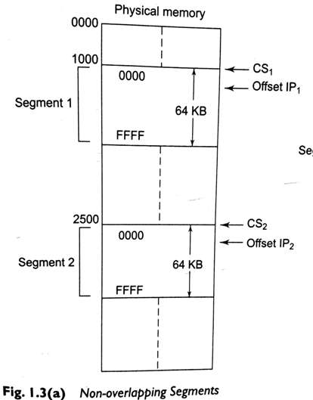
NON OVERLAPPING SEGMENTS

Slide 17
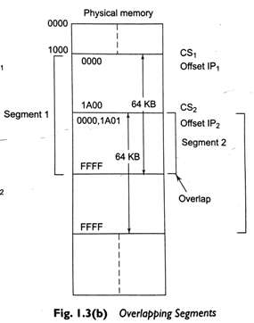
OVERLAPPING SEGMENTS

Slide 18
advantages
Allows the memory capacity to be 1MB although the actual addresses to be handled are of 16 bit size.
Allows the placing of code, data and stack portions of the same program in different parts of memory for protection.

Slide 19
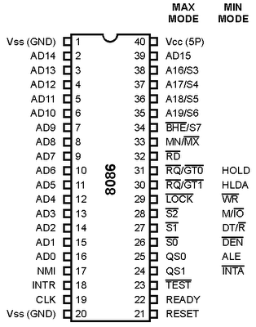
Pin diagram

Slide 20

AD15-AD0 : These are the time multiplexed memory I/O address and data lines. Address remains on the lines during T1 state, while the data is available on the data bus during T2, T3, Tw and T4.
When the memory or I/O device is not able to respond quickly during transfer, wait states (Tw) are inserted between T3 and T4 by disabling the READY input of the 8086. The bus activity during wait state is same as during T3.
A19/S6,A18/S5,A17/S4,A16/S3 : These are the time multiplexed address and status lines.

Slide 21
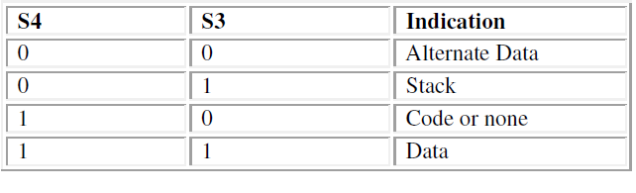
The S4 and S3 combinely indicate which segment register is presently being used for memory accesses .
The status of interrupt enable flag bit is updated at the beginning of each clock cycle and it is displayed on S5
The status line s6 is always low.

Slide 22
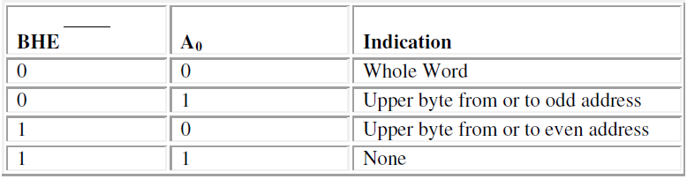
BHE/S7 : The bus high enable is used to indicate the transfer of data over the higher order ( D15-D8 ) data bus .
BHE is low during T1 for read, write and interrupt acknowledge cycles, whenever a byte is to be transferred on higher byte of data bus.
BHE and A0 indicates which byte of data is transferring.

Slide 23
RD – Read : This signal on low indicates the peripheral that the processor is performing memory or I/O read operation.
READY : This is the acknowledgement from the slow device or memory that they have completed the data transfer.
INTR-Interrupt Request : This is a level triggered input. This is sampled during the last clock cycle of each instruction to determine the availability of the request. If any interrupt request is pending, the processor enters the interrupt acknowledge cycle.
TEST : This input is examined by a ‘WAIT’ instruction. If the TEST pin goes low, execution will continue, else the processor remains in wait state.

Slide 24
CLK- Clock Input : The clock input provides the basic timing for processor operation and bus control activity. Its an square wave.
NMI: An edge triggered input, causes a type-2 interrupt. NMI is not maskable internally by software. A transition from a LOW to HIGH on this pin initiates the interrupt at the end of the current instruction.
Reset: Reset causes the processor to terminate the present activity and start execution from FFFF0H. This signal is active high and must be active for at least four clock cycles.
MN/MX = 1 for minimum mode
= 0 for maximum mode

Slide 25
When the Minimum mode operation is selected, the 8086
provides all control signals needed to implement the
memory and I/O interface.
M/IO = 1 for memory operation
= 0 for I/O operation
INTA: Interrupt Acknowledge. It goes low, when the processor has accepted the interrupt. It is active LOW during T2, T3, and T4 of each interrupt acknowledge cycle.
DT/ R :DATA Transmit/Receive
DT/ R = 1 when the processor transmits data
= 0 when the processor receives data

Slide 26
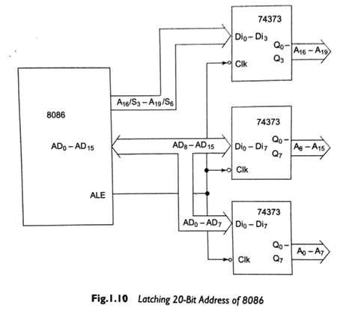
ALE : Address Latch Enable
It indicates the availability of valid address over the address/data lines. It is used to enable the latches to separate the address from the multiplexed address/data signal.

Slide 27
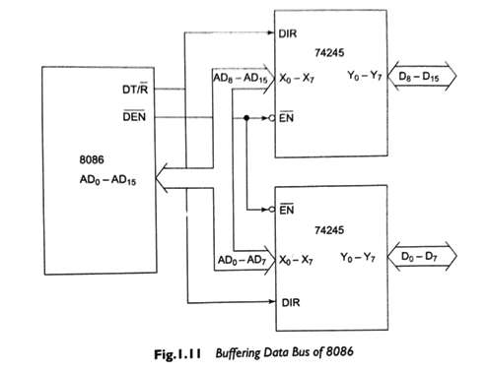
DEN :Data Enable
It indicates the availability of valid data over the address/data lines. It is used to enable the transceivers to separate the data from the multiplexed address/data signal.

Slide 28
HOLD & HLDA: When the HOLD line goes high, it indicates that another master is requesting the bus access. After receiving the HOLD request, it issues HLDA signal in the middle of next clock cycle .
If a DMA request is made while cpu executing a program, it will release the bus during T4 provided
1.the request occur on or before T2 of current cycle
2.the current cycle is not operating over the lower byte of a word.
3.a Lock instruction is not being executed.

Slide 29
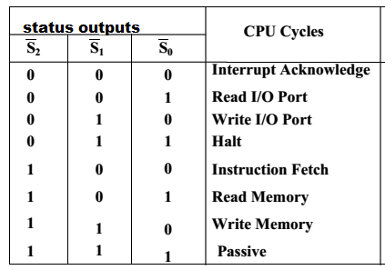
When the 8086 is set for the maximum-mode operation, it provides signals for implementing a multiprocessor / coprocessor system environment.
S2, S1, S0 : these status lines indicate the type of operation being carried out by the processor.
These pins are active during T4, T1 and T2 states and is returned to passive state during T3 or Tw (when ready is inactive).

Slide 30
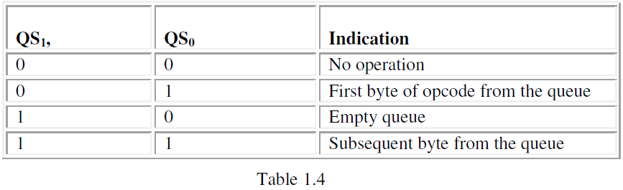
QS0, QS1 : Queue – Status these lines give information about the status of instruction byte queue.

Slide 31
LOCK : it indicates that other system bus master will be prevented from gaining the system bus.
RQ/GT0 and RQ/GT1 (I/O): Request/Grant These pins are used by other processors in a multi processor organization to force the processor to release the Local bus at the end of current cycle.

Slide 32
physical memory organization
In 8086 the 1MB physical memory is organized as odd and even banks, each of 512KB.
A byte data with even address is transferred on D0-D7, while byte data with odd address is transferred on D8-D15.
The processor provides BHE and A0 for the selection of either odd or even or both the banks.
The memory map of 8086 system starts at 00000H to FFFFFH.

Slide 33
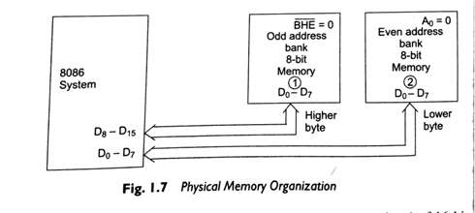



Slide 34
The locations from FFFF0H to FFFFFH are reserved for operations including jump to initialization program and I/O processor initialization .
The locations 00000H to 003FFH are reserved for interrupt vector table.

Slide 35
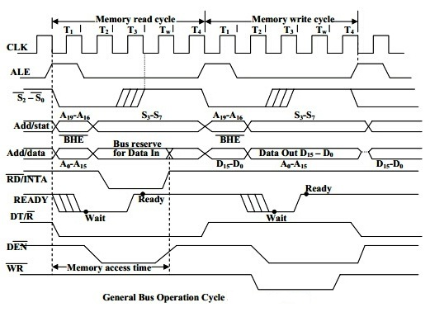
General bus operation

Slide 36
Minimum Mode 8086 System
The microprocessor 8086 is operated in minimum mode by applying MN/MX pin to logic 1.
•In this mode, all the control signals are given out by the microprocessor chip itself. There is a single microprocessor in the minimum mode system.
•The remaining components in the system are latches, transreceivers, clock generator, memory and I/O devices. Some type of chip selection logic may be required for selecting memory or I/O devices, depending upon the address map of the system.

Slide 37
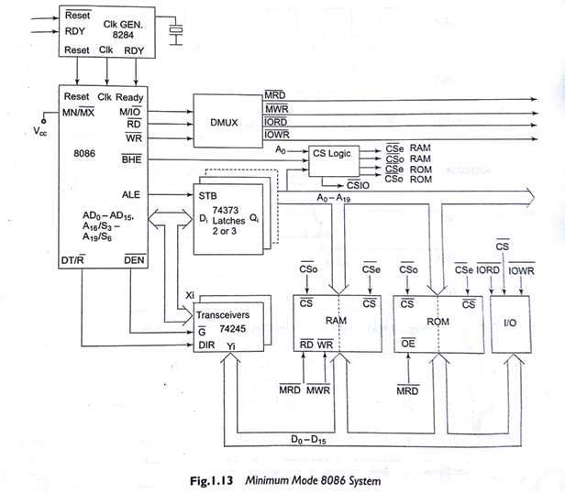

Slide 38
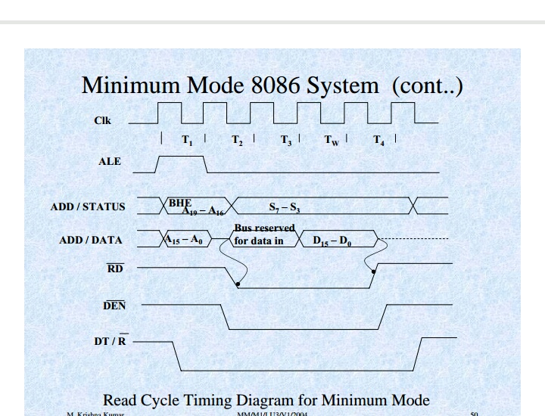

Slide 39
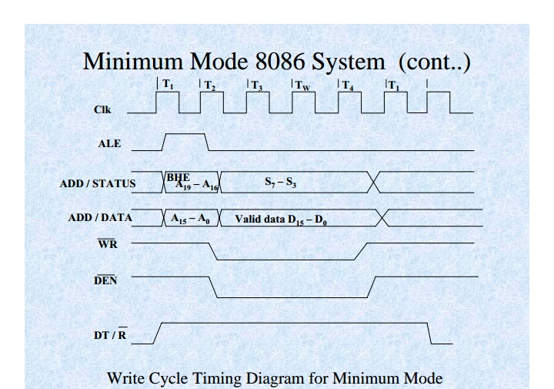
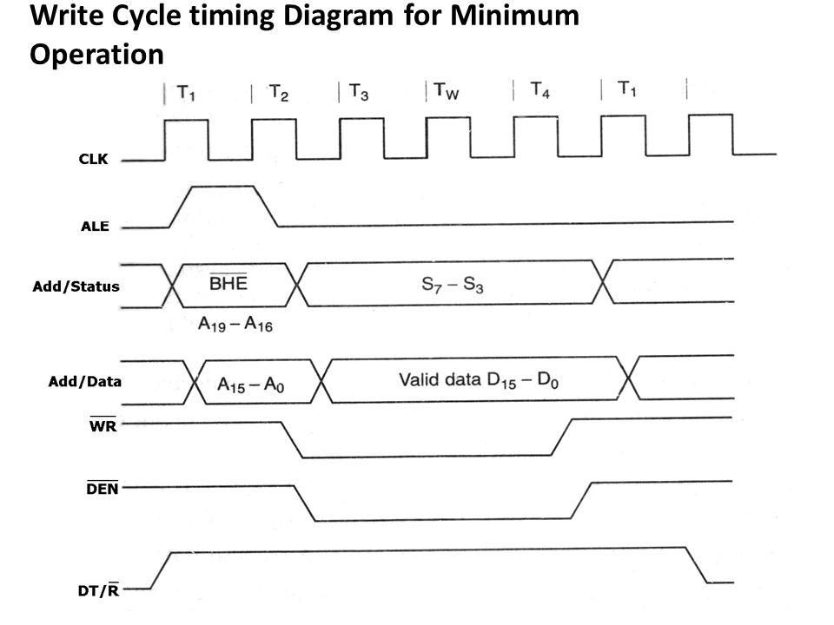

Slide 40
Maximum mode
The microprocessor 8086 is operated in maximum mode by giving MN/MX pin to logic 0.
In the maximum mode, there may be more than one microprocessor in the system configuration.
The components in the system are same as in the minimum mode system.
In this mode, the processor derives the status signal S2, S1, S0. Another chip called bus controller derives the control signal using this status information.

Slide 41
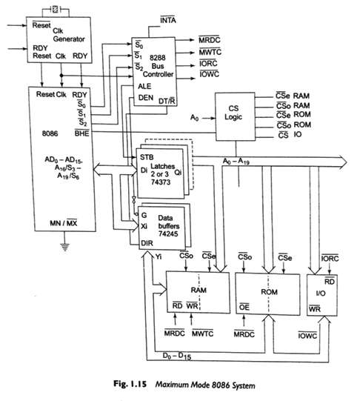

Slide 42
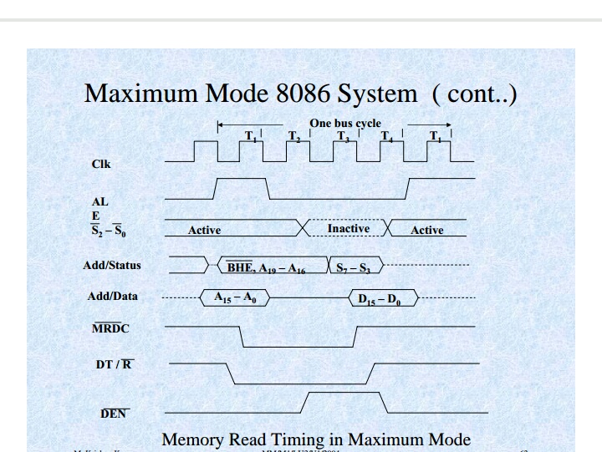

Slide 43
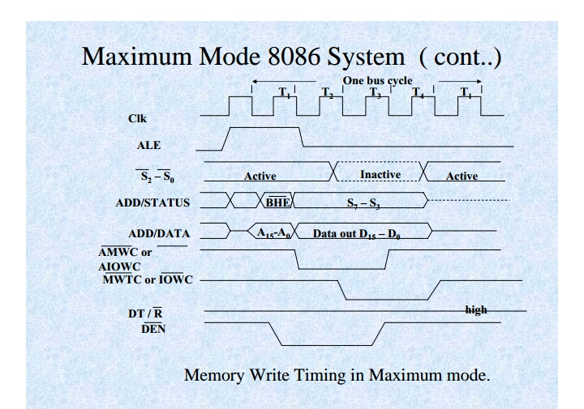

Slide 44
Interrupts
While CPU is executing a program, an interrupt break the normal sequence of execution of instructions,diverts its execution to some other program called Interrupt Service Routine(ISR).
After executing ISR ,the control is transferred back again to the main program.
Whenever a no.of devices interrupt a CPU at a time and if the processor is able to handle them properly,it is said to have multiple interrupt processing capability.
8086 has two interrupt pins NMI and INTR.
NMI :Non Maskable Interrupt
Any interrupt at NMI cannot be masked or disabled.
INTR interrupt may be masked using Interrupt Flag. INTR is of 256 types.
The INTR types may be from 00 to FF H. If more than one type of INTR interrupt occurs at a time,then an external chip called Programmable Interrupt Controller is required to handle them.

Slide 45
Types of Interrupts
External interrupt: due to an external device or a signal interrupts the processor.
ex: keyboard interrupt
Internal interrupt: generated internally by the processor circuit or by execution of an interrupt instruction.
Ex: divide by 0, overflow interrupts and interrupts due to INT instructions.

Slide 46
Interrupt cycle of 8086
When an external device interrupts the CPU at NMI or INTR pin, while executing a program
The CPU first completes the execution of current instruction and IP is incremented to point the next instruction.
The contents of IP and CS are pushed to stack.
The CPU then only acknowledges the requesting device immediately on INTA if it is a NMI,TRAP or divide by 0.
If it is INTR request, the CPU checks the IF flag.
If IF flag is set then it acknowledges the device otherwise the interrupt is ignored.
After acknowledgement the CPU computes the vector address from the type of interrupt. Then the control is transferred to ISR for serving the interrupt device.
The ISR address is available in Interrupt Vector Table.
At the end of ISR last instruction should be IRET.

Slide 47
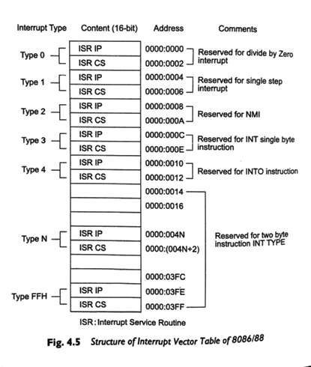
Interrupt Vector Table

Slide 48
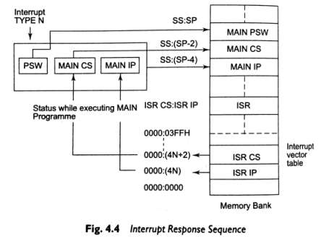
INTERRUPT RESPONSE SEQUENCE

Slide 49
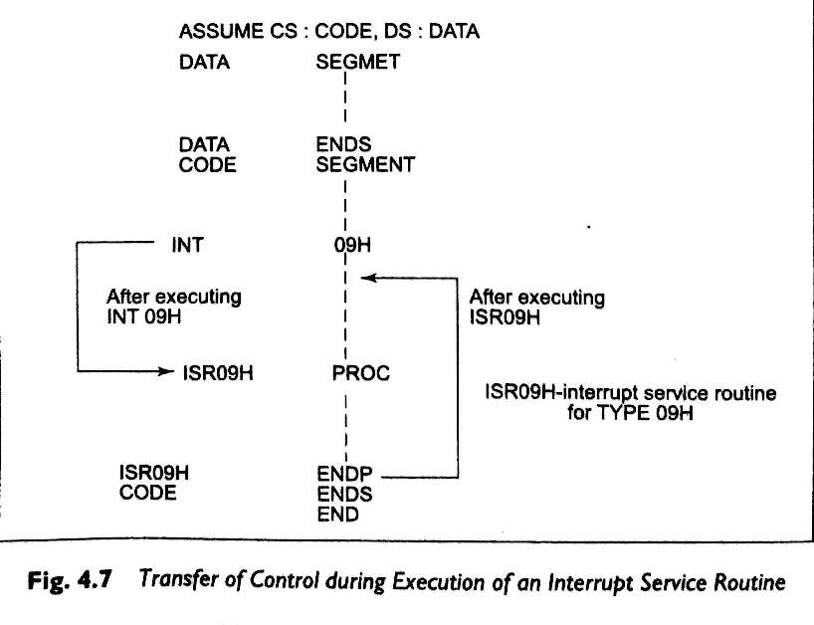

Slide 50
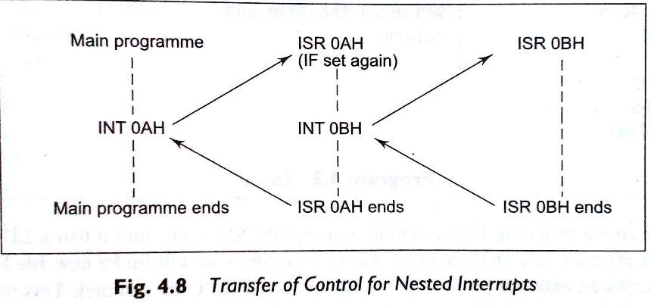
NESTED INTERRUPTS

