Slide 1
Data formats or Instruction formats of 8086:
The instruction format of 8086 has one or more number of fields associated with it.
The first filled is called operation code field or opcode field, which indicates the type of operation.
The instruction format also contains other fields known as operand fields.
There are six general formats of instructions in 8086 instruction set.
One byte Instruction
Register to Register
Register to/from memory with no displacement
Register to/from Memory with Displacement
Immediate operand to register
immediate operand to memory with 16-bit displacement

Slide 2
One byte Instruction: This format is only one byte long and may have the implied data or register operands. The least significant 3 bits of the opcode are used for specifying the register operand, if any. Otherwise, all the eight bits form an opcode and the operands are implied.
For example:
1 1 1 1 1 0 0 0
CLC : clear carry
This is an operation without any operand, which clear the carry flag bit.
Adjust for addition AAA 00110111
Here the operand to this instruction is implicit and it take the contents of register AL.

Slide 3
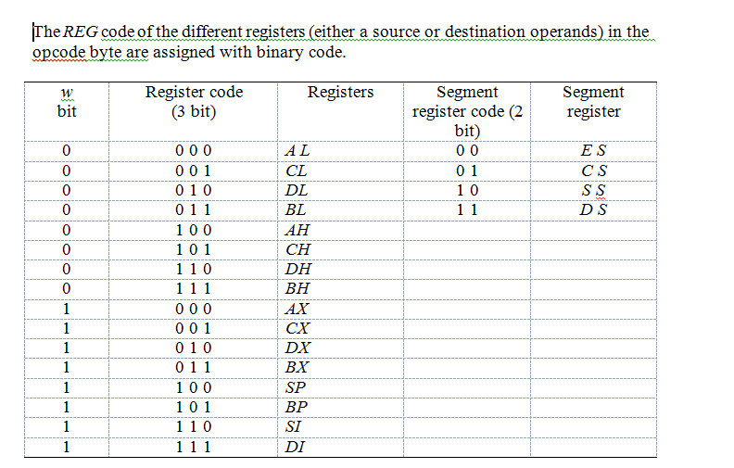

Slide 4
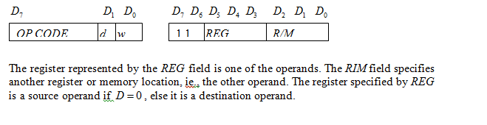
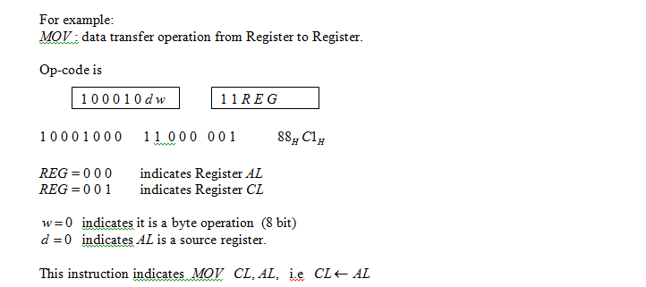
Register to Register : This format is 2 bytes long. The first byte of the code specifies the operation code and the width of the operand specifies by w bit. The second byte of the opcode shows the register operands and RIM field

Slide 5
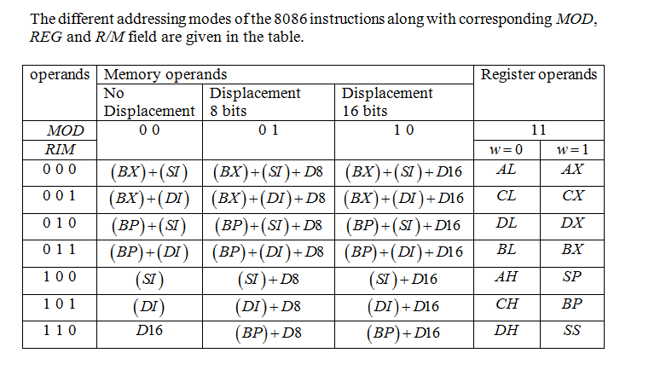

Slide 6
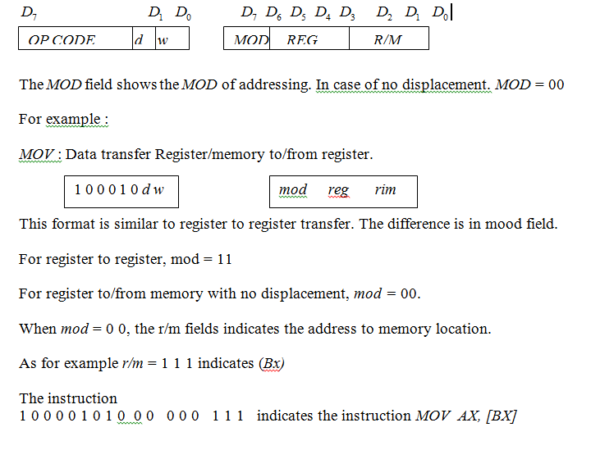
Register to/from memory with no displacement : This format is also 2 bytes long and similar to the register to register format except for the MOD field.

Slide 7
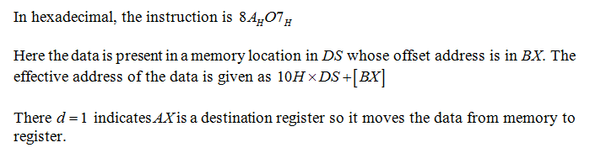

Slide 8
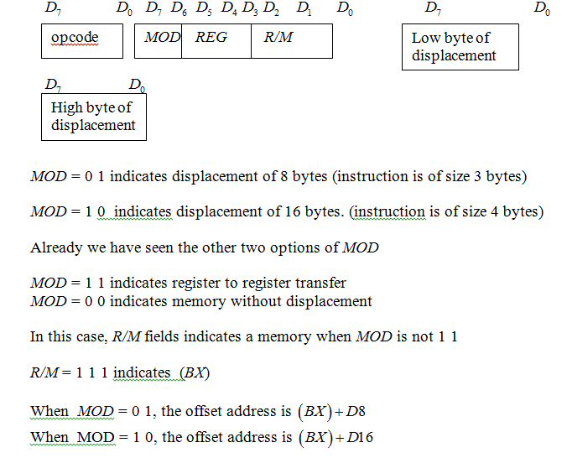
d) Register to/from Memory with Displacement :
This type of instruction format contains one or two additional bytes for displacement along with 2-byte the format of the register to/from memory without displacement.

Slide 9
e) Immediate operand to register

Slide 10
: ADDRESSING MODES OF 8086
The method of specifying data to be operated by an instruction is called as addressing mode.
The different ways that a processor can access the data are referred to as addressing modes.
1. Immediate addressing
2. Direct addressing
3. Register addressing
4. Register Indirect addressing
(a) Based addressing (b) Indexed addressing (c) Based Indexed addressing
5. Register Relative
(a) Relative Based(b) Relative Indexed (c) Relative Based Indexed
6. Implicit addressing
7. Addressing modes for Control transfer / Branch Instructions
(a) Intra segment mode (b) Inter segment mode
8. I/O port addressing

Slide 11
1. Immediate addressing:
The operand (or) data is given in the instruction itself.
Ex: MOV AX, 1234H
ADD AX, 4567H
2. Direct addressing:
The Offset address of operand or data is given in the instruction itself.
Ex: MOV BX,[2000H]
ADD AX,[3000H]
Note: Effective address/ Offset address of data = 3000H
20-bit Physical address = DS * 10 + 3000H
3. Register addressing:
The data is available in any one of the general purpose registers.
Ex: MOV AX, BX
ADD AX, BX

Slide 12
4. Register Indirect addressing:
The Offset address of data is available in any one of the Base / Index registers.
(a) Based addressing: The Offset address of the data is available in any one of the
Base registers BX or BP
Ex: MOV AX,[BX]
Offset address = BX
20-bit physical address = DS*10 + BX
(b) Indexed addressing: The Offset address of data is available in any one of the Index registers SI or DI
Ex: MOV AX, [SI]
Offset address = SI
20-bit physical address = DS*10 + SI

Slide 13
(c) Based Indexed addressing : The Offset address of data is the sum of Base and Index registers
Ex: MOV AX, [BX][SI]
Offset address = BX+SI
20-bit physical address = DS*10 + BX+SI
5. Register Relative addressing:
The Offset address is formed by adding 8-bit (or) 16-bit signed Displacement
to the content of Base / Index registers.
(a) Relative Based addressing: The Offset address is the sum of the content of Base register BX or BP and 8 bit or 16-bit signed Displacement
Ex: 1.MOV AX,25H[BX]
Offset address = BX+25H
20-bit physical address = DS*10 + BX+25
2.MOV AX, 1234H[BX]

Slide 14
(b) Relative Indexed addressing: The Offset address is the sum of the content of Index register SI or DI and 8 bit or16-bit signed Displacement
Ex: MOV AX, 48H[SI]
Offset address = SI+48H
20-bit physical address = DS*10 + SI+48H
(c) Relative Based Indexed addressing : The Offset address of data is the sum of contents of Base register ,Index register and 8 bit or16-bit signed Displacement
Ex: MOV AX, 1000H[BX][SI]
Offset address = BX+SI+1000H
20-bit physical address = DS*10 + BX+SI+1000H

Slide 15
Implicit addressing: The instruction itself specifies the data to be operated.
Ex: DAA - Decimal Adjust Accumulator after addition
AAA - ASCII Adjust Accumulator after addition

Slide 16
7. I/O port addressing: I/O port addressing is used to access the I/O ports.
(a) Fixed port addressing: The 8-bit I/O port address is available in the instruction
IN AL, 80H ; It reads one byte of data from I/O port address 80H to AL
OUT 82H, AL ; It sends one byte of data from AL to I/O port address 82H
(b) Variable port addressing: The 16-bit I/O port address is available in DX register.
Ex: MOV DX,1234H
IN AL, DX
OUT DX, AL
In above instructions, the register DX contains address of I/O port.

Slide 17
Addressing modes for Control transfer / Branch Instructions
2- types : (a) Intra segment mode
(b) Inter segment mode
(a) Intra-segment mode :
In this mode, the destination address lies in the same Code segment. The address appears as an immediate displacement value. This displacement is computed relative to IP.
Here IP is only modified. CS remains the same.
Intra-segment direct:
Ex: JMP SHORT label; label lies between -128 and +127.
Ex: JMP LONG label; label lies between -32768 and +32767.
Intra-segment indirect:
Ex: JMP [BX];

Slide 18
(b) Inter segment mode :
In this mode, the destination address lies in different Code segment.
Here both CS and IP registers will be modified.
Inter segment direct:
JMP 5000H: 2000H
CS:IP
Inter segment indirect:
JMP [3000H];

Slide 19
Instruction set
The 8086 Instruction set is classified as
Data transfer instructions
Arithmetic instructions
Logic & Bit manipulation instructions
Branch / Control transfer instructions
String manipulation instructions
Processor control instructions

Slide 20
Data Transfer Instructions
MOV: Copies data from source to destination.
Source→Immediate/Reg/Mem Dest→ Reg/Mem
Ex: MOV AX, 1234H
MOV AX, BX
MOV AX,[2000H]
MOV AX,[SI]
MOV AX,50H[BX]
PUSH: Pushes the content of source on to the stack. After the execution, SP is decremented by 2 and the source content is stored at stack top.
Ex:PUSH AX
SP ← SP-2
[SP] ← AX

Slide 21
POP: Pop a word from stack top to specified register
The content of stack top is moved to destination & SP is incremented by 2
Ex:POP AX
AX ← [SP]
SP ← SP+2
XCHG : Exchange the contents of source and destination
Ex:XCHG BX,AX
XCHG [5000],AX
IN: Read data from specified input port to Accumulator
Ex: IN AL, 80H ; It reads one byte of data from I/O port address 80H to AL
MOV DX,1234H
IN AL, DX

Slide 22
OUT: Send data from Accumulator to specified output port
Ex: OUT 82H, AL ; It sends one byte of data from AL to I/O port address 82H
MOV DX,1234H
OUT DX, AL
XLAT: Translate
This translate instruction is used for finding out codes in code conversion problems, using lookup table technique.
Ex: XLAT: Translate byte to AL.
LEA: Load Effective Address
Loads of the effective address formed by destination operand into the specified source register.
Ex: LEA BX,ADR
LEA SI,ADR[BX]

Slide 23
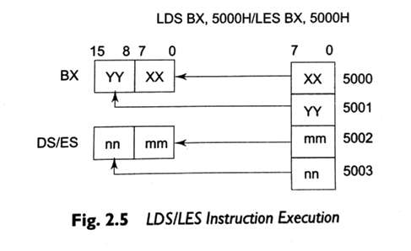
LDS/LES: Load pointer to DS or ES
Load specified register and DS registers with contents of two words from the effective address
Ex: LDS BX,5000H/ LES BX,5000H

Slide 24
LAHF: Load AH from lower byte of Flag
SAHF: Store AH to lower byte of Flag
PUSHF:PUSH Flags to stack
POPF : POP Flags from stack

Slide 25
Arithmetic instructions
ADD: the content of source is added to the destination and result will be stored in destination.
Ex: ADD AX,0100H
ADD AX,BX
ADD AX,[2000H]
ADD AX,[SI]
ADD AX,2000H[BP]
ADC: the content of source along with carry are added to the destination and result will be stored in destination.
SUB:
SBB:
INC: Increases the contents of specified register or memory location by 1.
DEC: Decreases the contents of specified register or memory location by 1.

Slide 26
CMP: it compares destination and source operands.
If the destination < source then CF is set(1).
If the destination > source then CF is reset(0).
If the destination = source then ZF is set(1).
Ex: CMP BX,0100H
CMP [5000H],0100H
NEG: Negate
It forms the 2’s complement of the specified destination in the instruction.

Slide 27
AAA: ASCII Adjust after Addition
It is executed after an ADD instruction that adds two ASCII operands to give byte result in AL.
AAA converts the result in AL into unpacked decimal digits.
AAS : ASCII Adjust after Subtraction
It is executed after SUB instruction that subtracts two ASCII operands to give byte result in AL.
AAS converts the result in AL into unpacked decimal digits.
AAM : ASCII adjust after Multiplication
It is executed after MUL instruction that multiplies two unpacked operands to give byte result in AL.
AAM converts the result in AL into unpacked decimal digits.

Slide 28
AAD : ASCII adjust before Division
It converts two unpacked BCD digits in AH and AL to the equivalent packed binary number in AL.
Ex: AX = 0508
AAD result in AL = 3AH

Slide 29
DAA: Decimal Adjust after Addition
It converts the result of addition of two packed BCD numbers to a valid BCD number. The result has to be in AL.
If the lower nibble of AL>9 then it adds 06.
If the higher nibble of AL>9 then it adds 60.

Slide 30
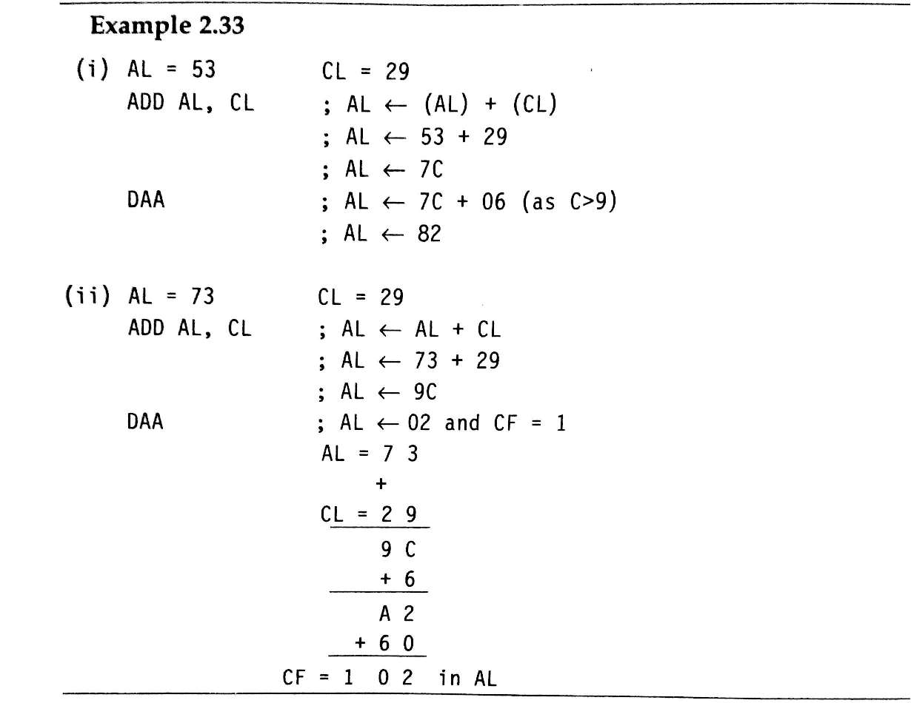
Ex:

Slide 31
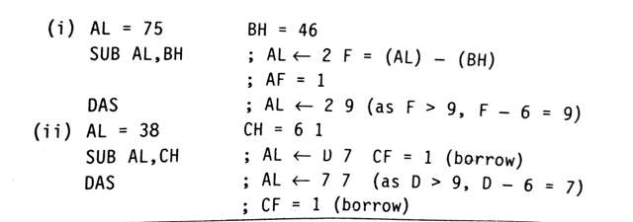
DAS: Decimal Adjust after Subtraction
It converts the result of subtraction of two packed BCD numbers to a valid BCD number. The result has to be in AL.
If the lower nibble of AL>9 then it subtracts 06.
If the higher nibble of AL>9 then it subtracts 60.

Slide 32
MUL: Unsigned Multiplication
Multiplies the contents of AL or AX with an unsigned byte or word .
The most significant word of the result is stored in DX and the least significant word of the result is stored AX.
Ex:
MUL BH; (AX ) (AL)*(BH)
MUL CX; (DX) (AX) (AX)*(CX)
IMUL: Signed Multiplication
Multiplies the contents of AL or AX with an signed byte or word .
The most significant word of the result is stored in DX and the least significant word of the result is stored AX.
Ex:
IMUL BH; (AX ) (AL)*(BH)
IMUL CX; (DX) (AX) (AX)*(CX)

Slide 33
CBW: Convert Byte to Word
It converts a signed byte to a signed word. It copies the sign bit of a byte to all the bits in the higher byte of the result word.
CWD: Convert Word to Double word
It copies sign bit of AX to all the bits of the DX register.
DIV: Unsigned Division:
It divides an unsigned word or double word by a 8 bit or 16 bit operand . The dividend must be in AX for 8-bit operation and in DX:AX pair for 16-bit operation.
The quotient will be in AL or AX and the remainder will be in AH or DX.
Ex: DIV BL AHAL/BL
DIV BX DXAX/BX

Slide 34
IDIV: Signed Division
It divides an signed word or double word by a 8 bit or 16 bit operand . The dividend must be in AX for 8-bit operation and in DX:AX pair for 16-bit operation.
The quotient will be in AL or AX and the remainder will be in AH or DX.
Ex: IDIV BL AHAL/BL
IDIV BX DXAX/BX

Slide 35
LOGICAL INSTRUCTIONS
AND:
It performs bitwise AND operation on Source and Destination operands.
Ex: AND AX, 0008H
AND AX, BX
AND AX,[2000H]
AND [5000H],DX
OR:
It performs bitwise OR operation on Source and Destination operands.
XOR:
It performs bitwise XOR operation on Source and Destination operands.

Slide 36
NOT: Logical invert
It complements the content of a register or a memory location , bit by bit.
Ex : NOT AX
NOT [5000H]
TEST: Logical AND
It performs bit wise logical AND operation on the two operands.
Ex: TEST AX,BX
TEST [0500H],06H

Slide 37
SHL/SAL: Shift left/Shift Arithmetic left
These instructions shift the operand word or byte bit by bit to the left and insert zeros in the newly introduced least significant bits.
SHR: Shift Logical Right
This instruction shift the operand word or byte bit by bit to the right and insert zeros in the newly introduced most significant bits.
SAR: Shift Arithmetic right
This instruction shift the operand word or byte bit by bit to the right and it inserts most significant of the operand in the newly introduced most significant bits.

Slide 38
ROL: Rotate Left without carry
This instruction rotates the contents of destination operand to the left (bit wise) either by one or count specified in CL register, excluding carry
ROR: Rotate Right without carry
This instruction rotates the contents of destination operand to the right (bit wise) either by one or count specified in CL register, excluding carry
RCL: Rotate Left through carry
This instruction rotates the contents of destination operand to the left through carry (bit wise) either by one or count specified in CL register.
RCR: Rotate Right through carry
This instruction rotates the contents of destination operand to the right through carry (bit wise) either by one or count specified in CL register.

Slide 39
String manipulation instructions
MOVSB/MOVSW: move string byte/word
This instruction moves a string of bytes/words pointed by DS:SI pair to the memory location pointed by ES:DI pair.
Each time it is executed, the index registers are automatically updated and CX is decremented.
REP: Repeat Instruction Prefix
It is used as a prefix to other instructions. The instruction to which the REP prefix is provided, is executed repeatedly until the CX register becomes zero.
REPE/REPZ: Repeat operation while equal/zero
REPNE/REPNZ: Repeat operation while not equal/not zero

Slide 40
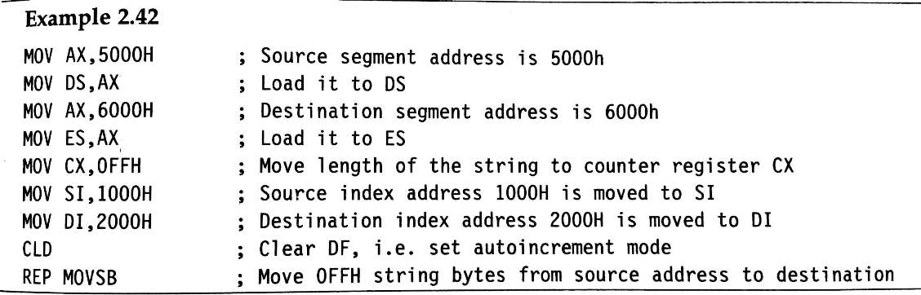

Slide 41
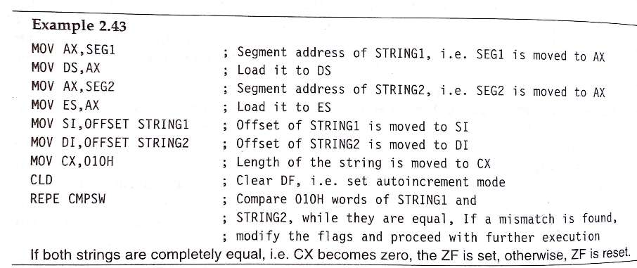
CMPS: Compare String Byte or String Word
It compares two strings stored in DS:SI and ES:DI.
The length of the string must be stored in CX register.
REP instruction prefix is used to repeat the operation till CX becomes zero.

Slide 42
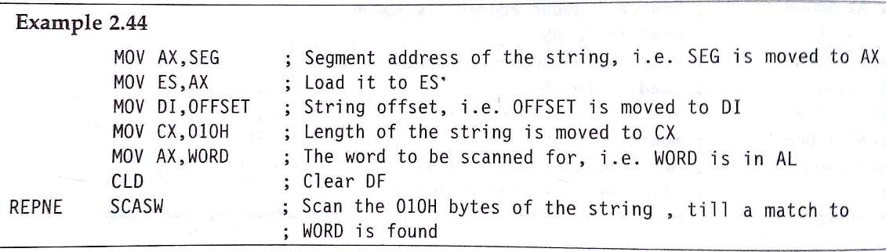
SCAS: Scan String Byte or Word
It scans a string of bytes or words for an operand byte or word specified in the register AL or AX.
The string is pointed by ES:DI register pair.
If a match to the specified operand is found in the string then execution stops and zero flag is set.

Slide 43
LODS: Load String Byte or String Word
It loads AL/AX register by the content of a string pointed by DS:SI register pair.
SI is modified automatically depending upon DF.
STOS: Store String Byte or String Word
It stores the content of AL/AX register to a location in the string pointed by ES:DI register pair.
DI is modified automatically depending upon DF.

Slide 44
Control transfer/branching instructions
CALL: Unconditional Call
It is used to call a subroutine/procedure from a main program.
The address of the procedure may be specified directly or indirectly depending upon the addressing mode.
On execution ,it pushes the incremented IP and CS on to the stack and loads new CS and IP.
NEAR CALL: the procedure lies in the same segment.
FAR CALL: the procedure lies in the other segment.

Slide 45
RET: Return to Main program
It should be the last instruction of a procedure/subroutine.
On execution, the previously stored content of IP and CS along with flags are retrieved and the execution of main program continues further.
INT N: Interrupt Type N
When an INT instruction is executed , the control is transferred to a vector address which is obtained by multiplying Type N with 4.
At this vector address the CS and IP values are stored.

Slide 46
IRET: Return from ISR
It appears at the end of each ISR.
When it is executed ,the values of IP,CS and flags are retrieved from stack to continue the execution of main program.
INTO: INTerrupt on Overflow
It is executed, when the Overflow flag OF is set.
The new contents of CS and IP are taken from 0000:0010 as this is equivalent to Type 4 interrupt.
JMP: Unconditional jump
This instruction unconditionally transfers the control of execution to the specified address using 8-bit or 16-bit displacement or CS:IP.

Slide 47
LOOP: Loop Unconditionally
This instruction executes a part of the program from the label or address specified in the instruction to Loop instruction ,CX number of times.
At each iteration ,CX is decremented automatically.
LOOP: Loop Conditionally
LOOPZ/LOOPE: loop while ZF=1
LOOPNZ/LOOPNE: loop while ZF=0

Slide 48
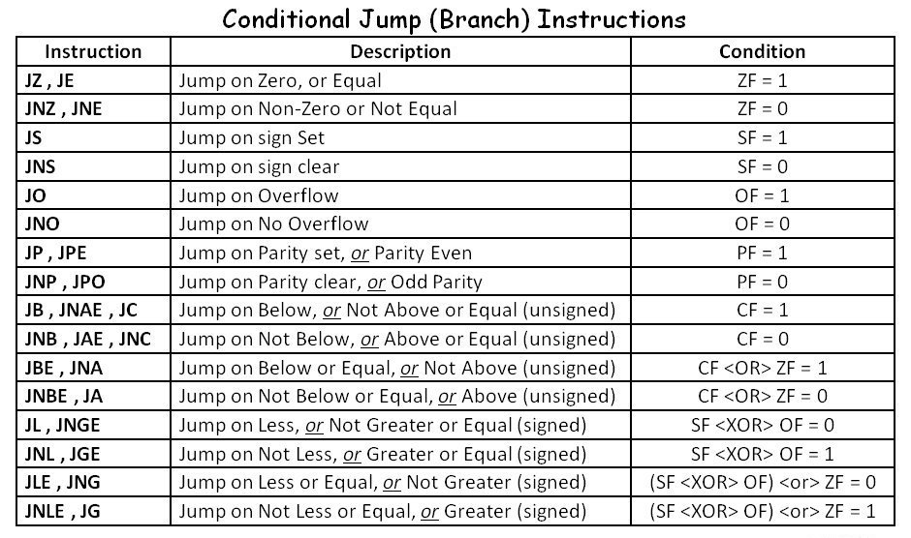
Conditional jumps

Slide 49
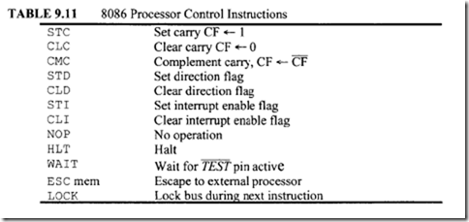
Flag manipulation & machine control instructions

Slide 50
Assembler directives
Assembler directives are hints given to the assembler for correct understanding of assembly language program.
DB - Defined Byte:
It is used to reserve byte or bytes of memory location in the available memory.
Ex:
1.PRICE DB 49h, 98h, 29h ;Declare an array of 3 bytes, named as PRICE and initialize.
2. NAME DB ‘ABCDEF’ ;Declare an array of 6 bytes and initialize with ASCII code for letters
3. ECE DB 58H

Slide 51
DW-Define Word:
It is used to reserve word or words of memory location in the available memory.
Ex: WORDS DW 1234H,4567H,78ABH
DATA DW 5 DUP (6666H)
DQ - Defined Quad Word:
It is used to reserve 4 words or 8 bytes of memory location for the specified variable in the available memory.
DT - Define Ten Bytes:
It is used to reserve 10 bytes of memory location for the specified variable in the available memory.

Slide 52
ASSUME: Assume logical segment name
This directive is used to tell the assembler that consider the name of the logical segment given in the ASSUME statement.
END: End of the program
ENDP: End of the Procedure
ENDS: End of the Segment

Slide 53
EVEN: Align on even memory address
It assign even addresses to a program/ procedure.
EQU: Equate
It is used to assign a label with a value or symbol.
It reduces the recurrence of numerical values or constants in a program.
Ex:
N EQU 69
LABEL EQU 0500H
ADDITION EQU ADD

Slide 54
PUBLIC: Public
It informs the assembler that the names, procedures and labels declared using this directive can be accessed from anywhere.
EXTRN: External
It used to access the names, procedures and labels declared using PUBLIC directive .
Ex: MODULE1 SEGMENT
PUBLIC FACTORIAL FAR
MODULE1 ENDS
MODULE2 SEGMENT
EXTRN FACTORIAL FAR
MODULE2 ENDS

Slide 55
GROUP: Group the related segments
It form a logical groups of segments with similar purpose or type within 64KB. Thus all such segments and labels can be addressed using the same segment base.
Ex: PROGRAM GROUP CODE,DATA,STACK
The above statement group the CODE,DATA and STACK segments and assigns the name PROGRAM. So that assume statement can be written as
ASSUME CS: PROGRAM, DS: PROGRAM, SS: PROGRAM
LABEL:
It is used to assign a name to the current contents of program counter or location counter.

Slide 56
LENGTH: Byte length of a label
It is used to find byte length of a data array or a string.
Ex: MOV CX, LENGTH ‘MPMC$’
LOCAL:
The lables,variables,constants or procedures declared LOCAL in a module are to be used only by that particular module.
Ex: LOCAL a,b,DATA
NAME: Logical name of a module
It is used to assign a name to an assembly language program module.

Slide 57
OFFSET: Offset of a label
It finds offset address of a label .
Ex: CODE SEGMENT
MOV SI,OFFSET LIST
CODE ENDS
DATA SEGMENT
LIST DB 10H
DATA ENDS
ORG:ORIGIN
It is used to start the memory allotment for the particular segment,block or code with the address declared in ORG statement.
Ex: ORG 2000H

Slide 58
PROC: Procedure
It is used to declare a procedure.
Ex: RESULT PROC NEAR
ROUTINE PROC FAR
SEG: Segment of a label
It is used to find segment address of a particular label.
Ex: MOV AX,SEG ARRAY
MOV DS,AX
SEGMENT: Logical segment
It is used to declare a logical segment and it indicates the starting of a segment.
Ex: DATA SEGMENT
.
.
DATA ENDS

Slide 59
PTR:Pointer
It is used to declare the type of a label, variable or memory operand.
It is prefixed by either BYTE or WORD.
Ex: MOV AL,BYTE PTR [SI]
MOV BX, WORD PTR [2000H]
NEAR PTR:
It indicates that the label followed by NEAR PTR is in the same segment.
Ex: JMP NEAR PTR LABEL
FAR PTR:

Slide 60
TYPE:
It is used to decide the data type of the specified label and replaces TYPE label by the decided data type.
Ex: MOV AX, TYPE STRING
SHORT:
It indicates to the assembler that only one byte is required to code the displacement for a jump.
The displacement is within -128 to +128 bytes.
Ex: JMP SHORT LABEL

Slide 61
MACRO:
If a number of instructions are repeating in a program, the listing will be lengthy.
The process of assigning a label or macro name to the string of repeated instructions is called Macro.
This Macro name can be used throughout the program to refer the string of instructions.

Slide 62
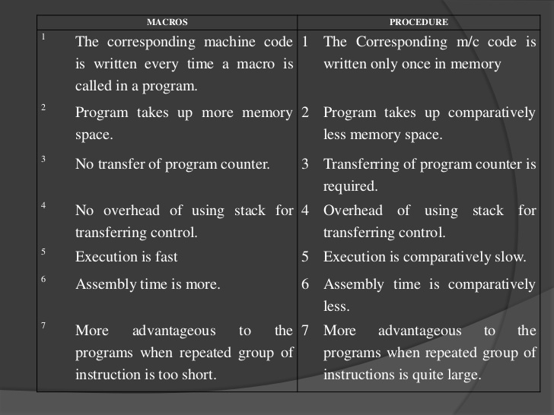
Differences b/w macro& procedure

Slide 63
Defining a macro
A macro can be defined using MACRO and ENDM directives.
DISPLAY MACRO
MOV AX,SEG MSG
MOV DS,AX
MOV DX,OFFSET MSG
MOV AH,09H
INT 21H
ENDM
A macro within a macro is called a nested macro.

Slide 64
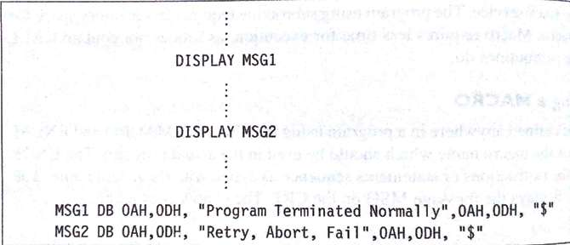
Passing parameters to a macro
The parameters can be passed by calling the name of the MACRO.

