Slide 1

TalentOnCloud
(Unleash Your Talent)

Slide 2
Problem
Many people in this world are talented and they do not have the right platform to showcase their talents to the world.
Most of the passionate people don't have the right training facilities.
Even if they have the right training, most of their time is wasted in traveling.
Talented people are not getting the rewards they deserve.

Slide 3
Need
With this platform, everyone in this world can showcase their talents.
Talented people will get Rewards and Recognition.
People can learn stuff from others.
As it is an online platform, time is not wasted in traveling.
Screen sharing and video sharing features are available for better learning.

Slide 4
Key Features - User
S.no | Module | Description
1 | User Registration | User should be able to register with the application
2 | User Login | User should be able to login with his/her credentials.
3 | Posts by Friends | User should be able to view the posts uploaded by his/her friends.
4 | Posts Worldwide | User should be able to view the posts uploaded across the world.
5 | Live Events | User should be able to host and attend live events across the world. And the host can share the screen to show contents on his screen.
6 | Collab Events | User should be able to view and participate in the collaboration events which involves singing or dancing together.
7 | Post Types | Users should be able to post content such as Music, Dance, Art, Acting, Games, etc.
8 | Learning | Users should be able to Learn skills they like from other users.
9 | Challenges | Users should be able to solve challenges posted by other users. Thereby they can increase the skill points.
10 | Manage Posts | User should be able to edit/delete his/her posts.

Slide 5
Key Features - Admin
S.no | Module | Description
1 | Daily Statistics | Admin should be able to view the daily statistics such as number of different media uploaded per day like Audio, Video, Images, Others.
2 | Overall Statistics | Admin should be able to view the total number of different files uploaded up to now in the form of a pie chart, total storage and number of live/collab events till date.
3 | Manage Users | Admin should be able to edit/delete the users in the platform

Slide 6
Reports and Dashboards
Daily
Overall
Count of files uploaded daily
Overall count of uploaded files
Overall storage space for a particular month
Load on the website for that day
No. of live/collab events till date

Slide 7
Solution Architecture
Client 1
Client 2
Client 3
Products & services
Accounts, Users & Roles
Business Module
Profile Management
Uploads Management
Internal Integration Module
External Integration Module
Posts Management
Authentication Management
Live/Collab Management
Event Notification Management
Components
Crash Analysis
SFTP
Google Analysis
DB Environment
Users DB
Posts DB
File Storage
Live DB
Collab DB

Slide 8
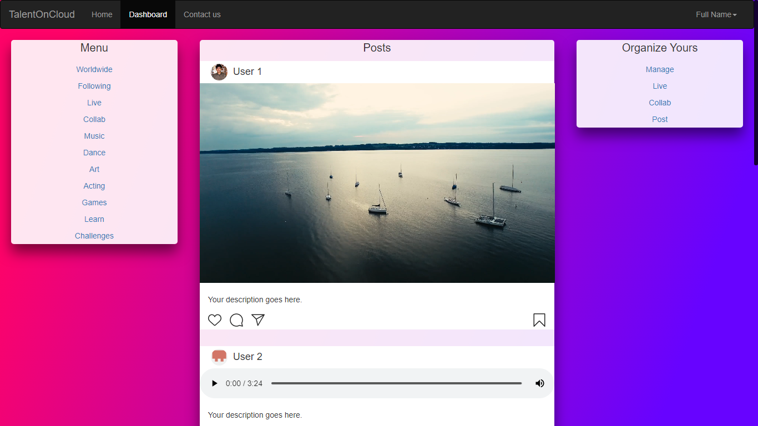
Wireframes for Features
Dashboard, Worldwide, Following, Dance, Acting, Games, Learn & Challenges pages looks similar to this

Slide 9
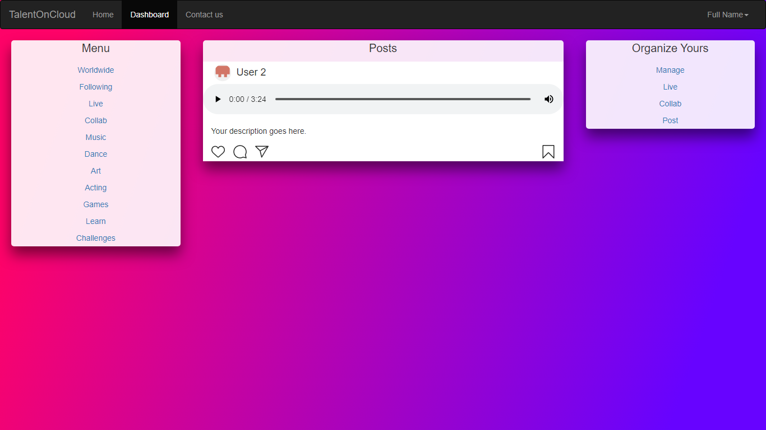
Wireframes for Features
The Music page looks like this

Slide 10
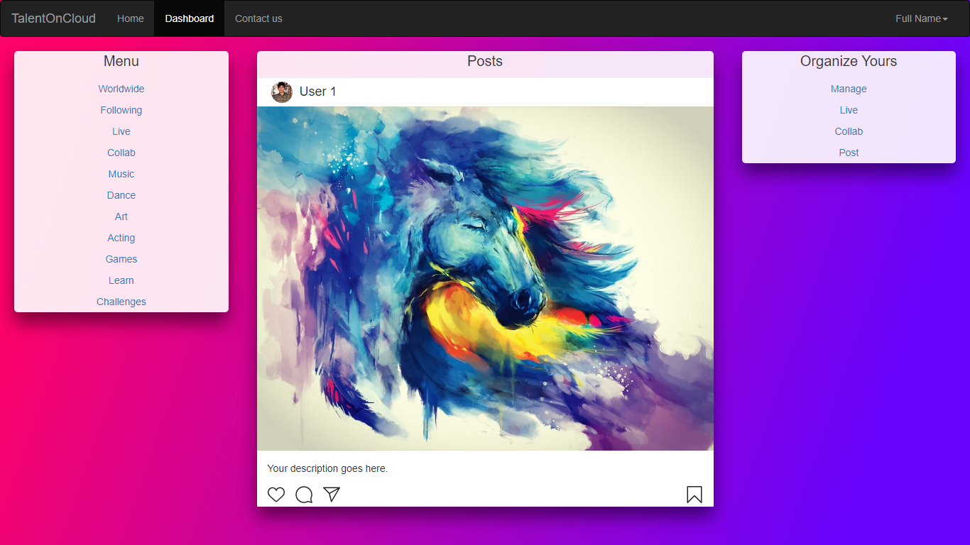
Wireframes for Features
The Art page looks like this

Slide 11
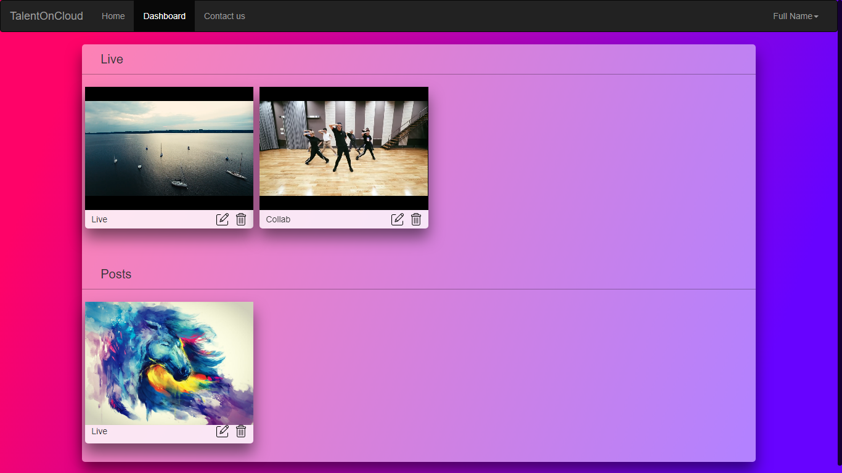
Wireframes for Features
You can manage your Uploaded content in this page

Slide 12
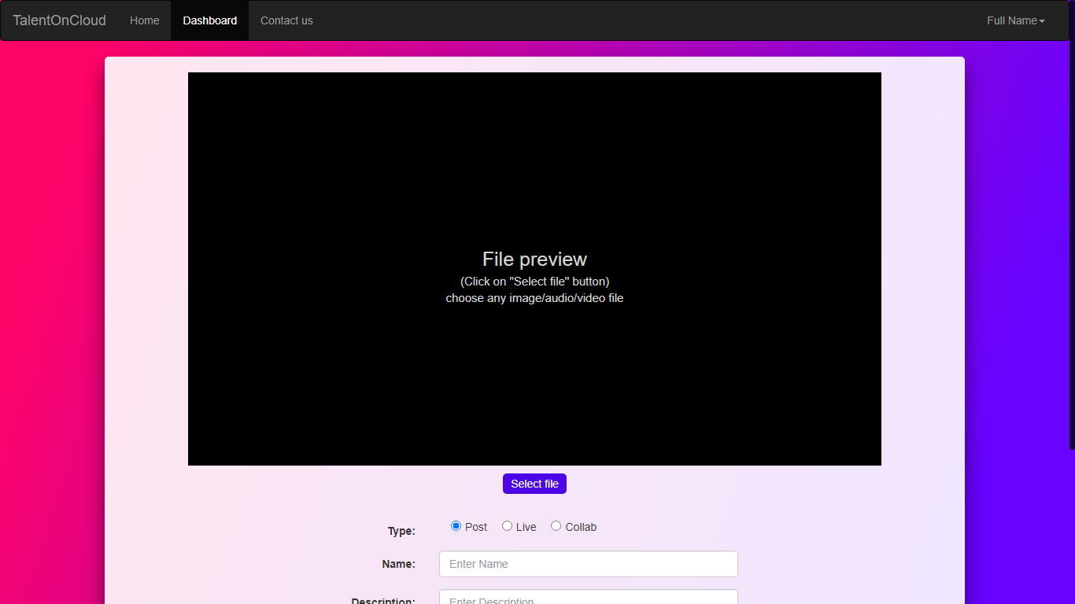
Wireframes for Features
You can upload your talent here

Slide 13
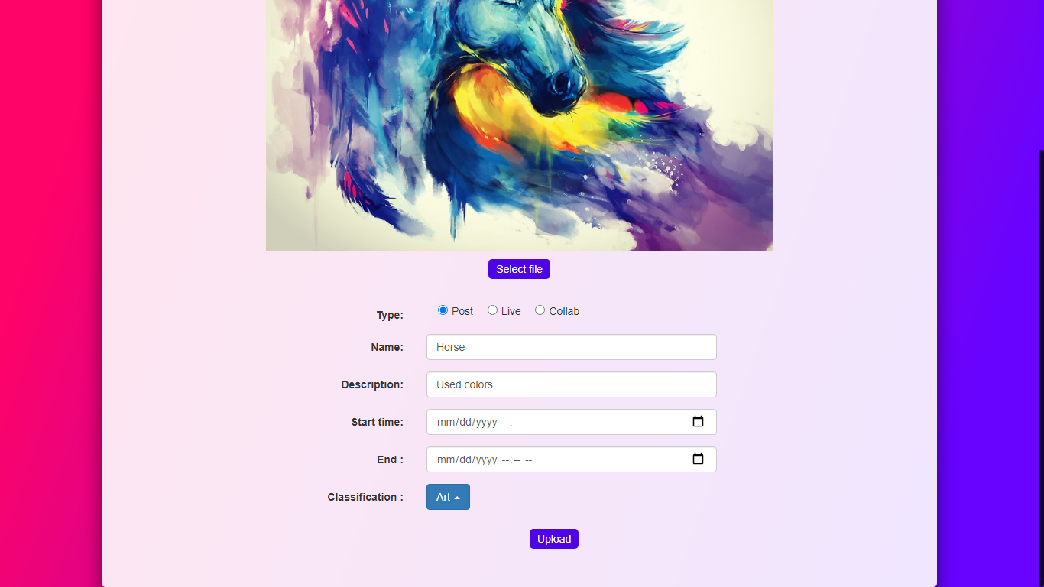
Wireframes for Features
You can upload your talent here

Slide 14
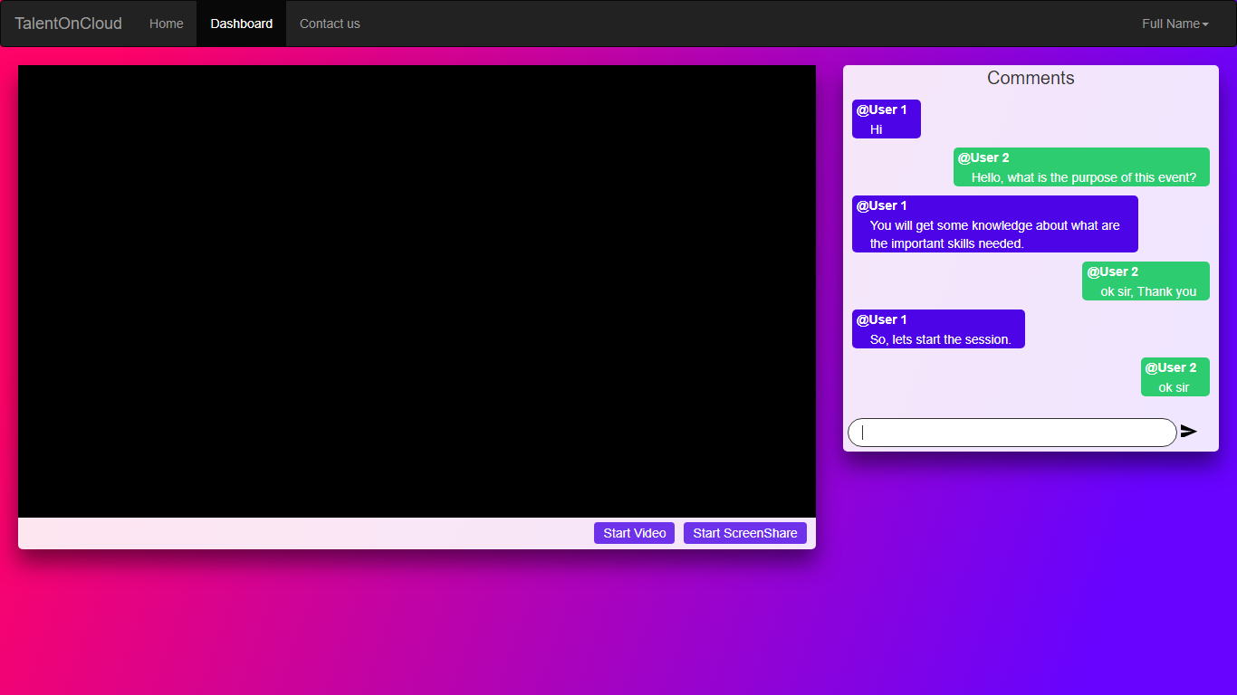
Wireframes for Features
You can organize a live event here (Camera)

Slide 15
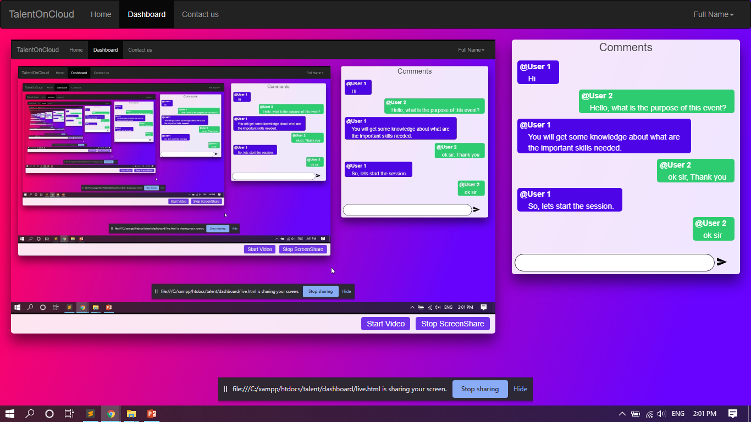
Wireframes for Features
You can organize a live event here (Screenshare)

Slide 16
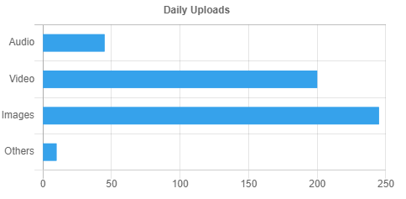
Wireframes for Reports and Dashboard
Count of files uploaded daily

Slide 17
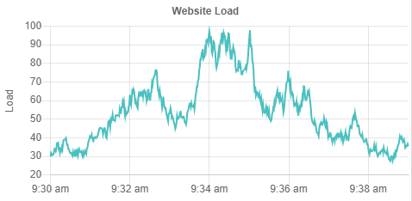
Wireframes for Reports and Dashboard
Load on the website for that day

Slide 18
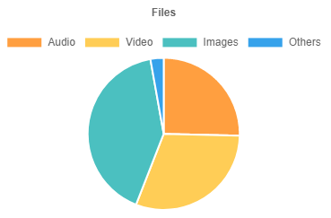
Wireframes for Reports and Dashboard
Overall count of uploaded files

Slide 19
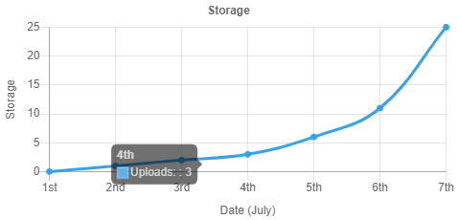
Wireframes for Reports and Dashboard
Overall storage space for a particular month

Slide 20
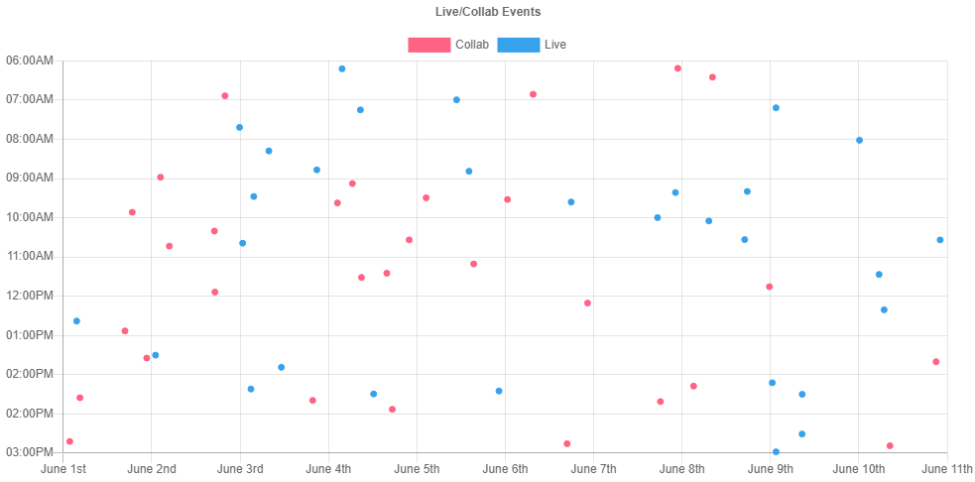
Wireframes for Reports and Dashboard
No. of live/collab events till date

Slide 21
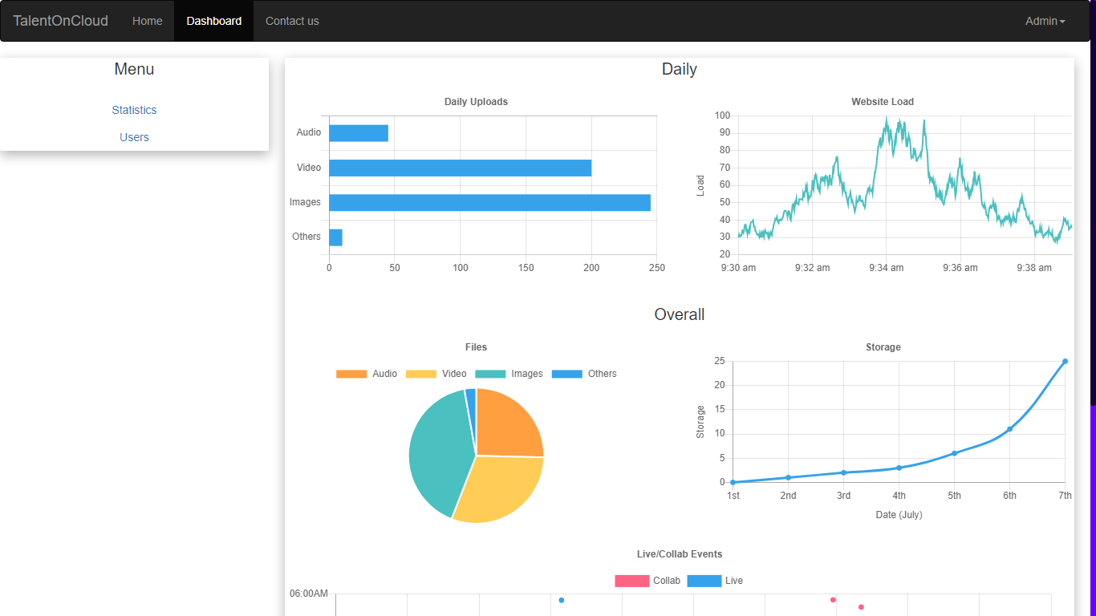
Wireframes for Reports and Dashboard
This is Dashboard page for Admin

Slide 22
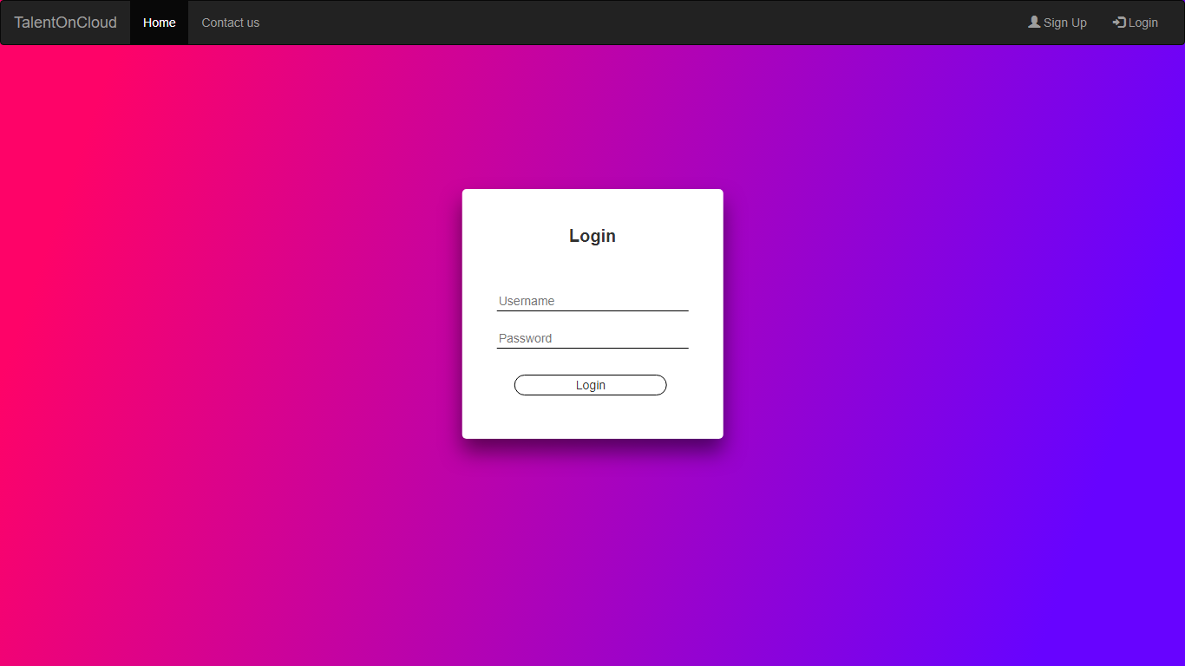
Demo
You can experience the functionality of the website. Click on the below link and give the username and password as follows.
https://dinesh99639.github.io/TalentOnCloud/
User Login :
Username: anything
Password : anything
Admin Login :
Username: admin
Password : anything
Note :
The content in the page is static and there will not be any change in data if you refresh the page

Slide 23
Thank you

