Slide 1

A
ARTIFICIAL INTELIGENCE
Intelligent Agent

Slide 2
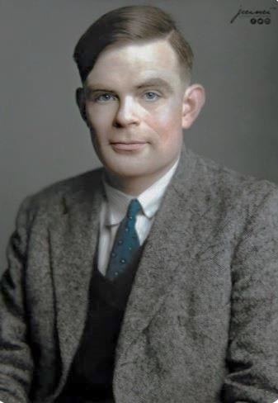
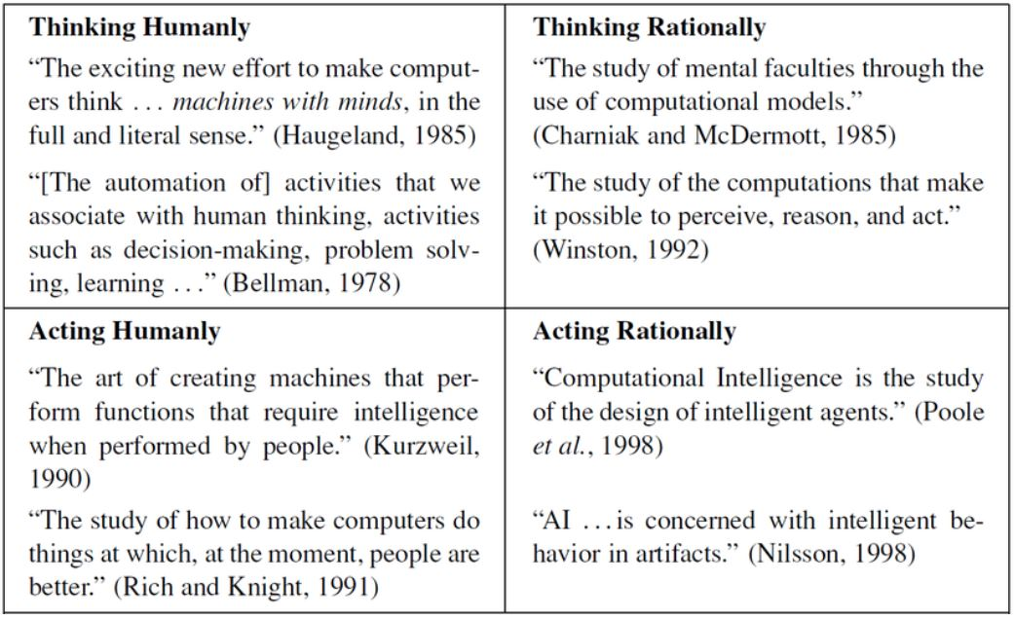
What is AI ? Inception in 1956 Different Approaches have been followed to define Artificial Intelligence.

Slide 3
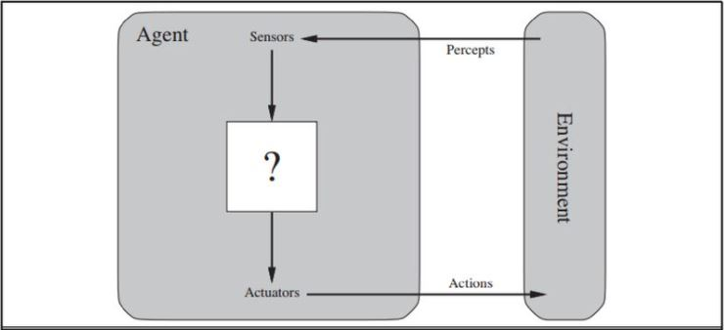

Intelligent Agent
An Agent is anything that can be viewed as perceiving, its environment through sensors and acting upon that environment through actuators.
AI agents must have traits/qualities that demonstrate intelligence, which also allows them to mimic human behavior. E.g. Visual perception, Audio Perception.

Slide 4

Rational Agent
Agent that does the right thing
What is the right thing ? How it is measured ?
Does the desired thing/successful Consequences of the Agent’s
behaviours measured
using Performance measures in
any given sequence of
environment states
ENVIRONEMENT STATE NOT AGENT STATE

Slide 5
STATE TRANSITION DIAGRAM
A diagram that indicates the possible states of a finite-state automation and the allowable transitions between such states. There are several different dialects of State Transition Diagrams. Each one depicts the states, transitions, and event(s) that can cause each transition.
- encyclopedia.com
THE SYNTAX AND CONVENTIONS
- A round-cornered rectangle denoted a state
- Initial State
- Final State
- Transitions from one state to the next
- A choice pseudo-state

Slide 6
ENVIRONMENT STATE
What is environment state ?
Problem to which rational agent is the solution
SPECIFYING ENVIRONMENT STATE
“PEAS”
P- Performance measure
E- Environment
A- Actuators
S- Sensors

Slide 7

THIEF CHASE
LIST OF AGENTS IN THE ARTIFACT:
Thief 01: - Thief 01 evading police after a robbery.
Thief 02:- Thief 02 helps thief 01.
Police Officer: - Arresting the thieves.
Police Car: -Patrolling the street.
Small Child: - this agent tries to locate the thief 01 using his torch light
Police Helicopter: - Police Helicopter hovers in search of the thief 01.

Slide 8

EXPLANATION OF THE SCENES
Scene 01
Instance 01
Thieves Police
02 Instance
Dialogue Box Thief 01 moving forward No Policeman

Slide 9

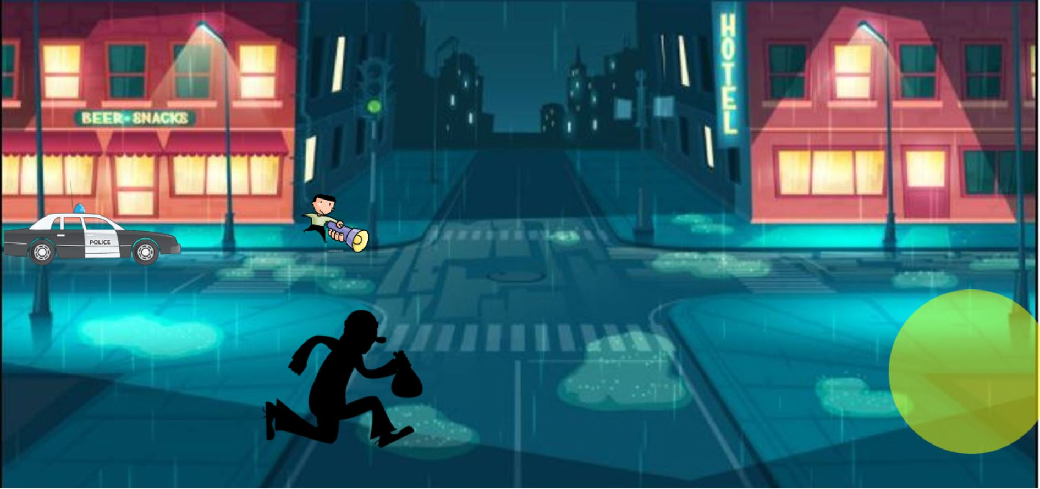
03 Instance
Shooting
SCENE 02
01 Instance
Thief 01 Child with a torch light light

Slide 10
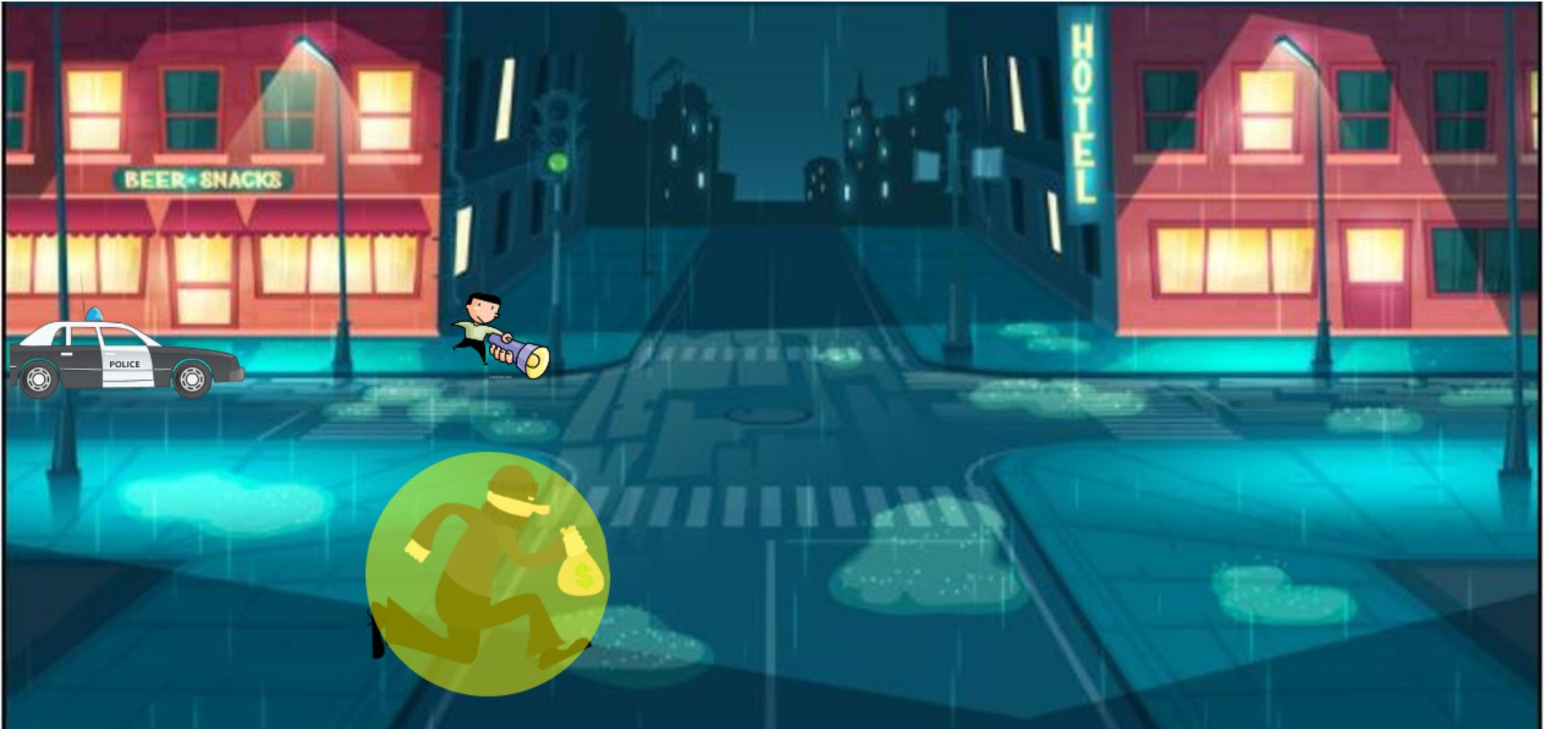

Instance 02
Thief 01 under the light
SCENE 03
Instance 01
T
Thief 01 Search Light

Slide 11


Instance 02
Search Light become red
Instance 03
Thief 01 disguised

Slide 12
“PEAS” FOR THE ARTIFACT’S AGENTS PEAS for thief 01:
Performance | Running away from the police
Environment | City
Actuators | Running (legs)
Sensors | Vision/eyes
PEAS for Police Officer :
Performance | Arresting the thieves
Environment | City
Actuators | Shooting at the Thieves
Sensors | Vision/eyes

Slide 13
PEAS for Thief 02
PEAS for Police Car
Performance | Helping the thief 01 to run away from the police
Environment | City
Actuators | Communicating with the thief 01
Sensors | Vision/eyes
Performance | Patrolling on the streets to locate the thief
Environment | City
Actuators | Moving on the road
Sensors | Infrared

Slide 14
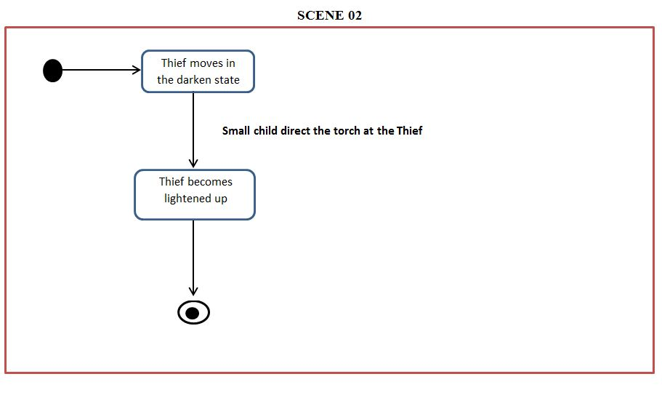
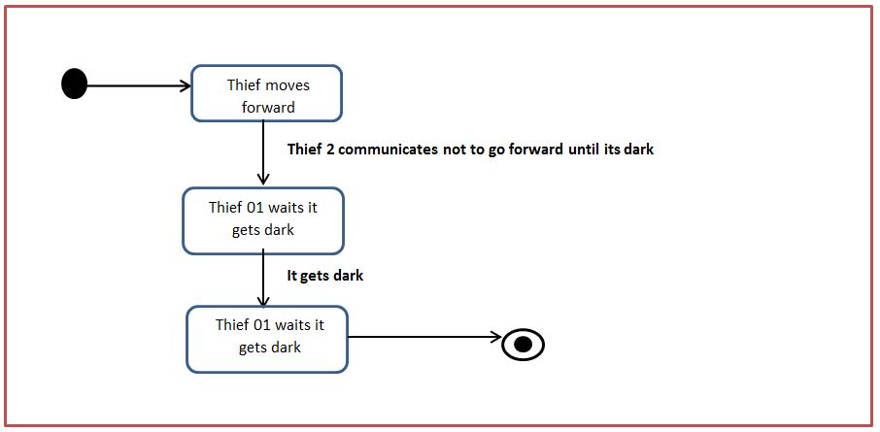
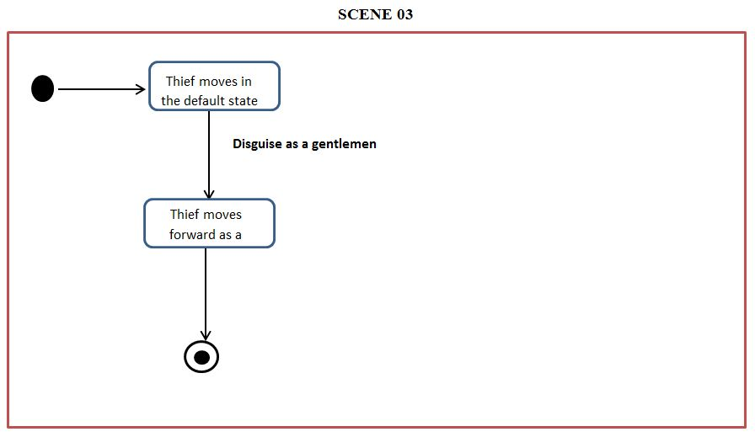
STATE TRANSITION- Thief
SCENE 01

Slide 15
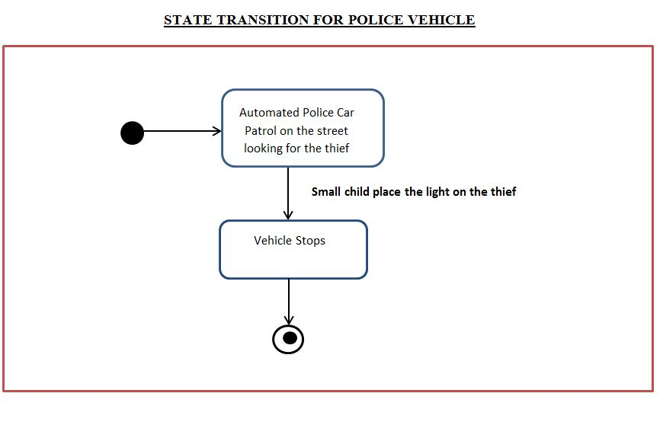
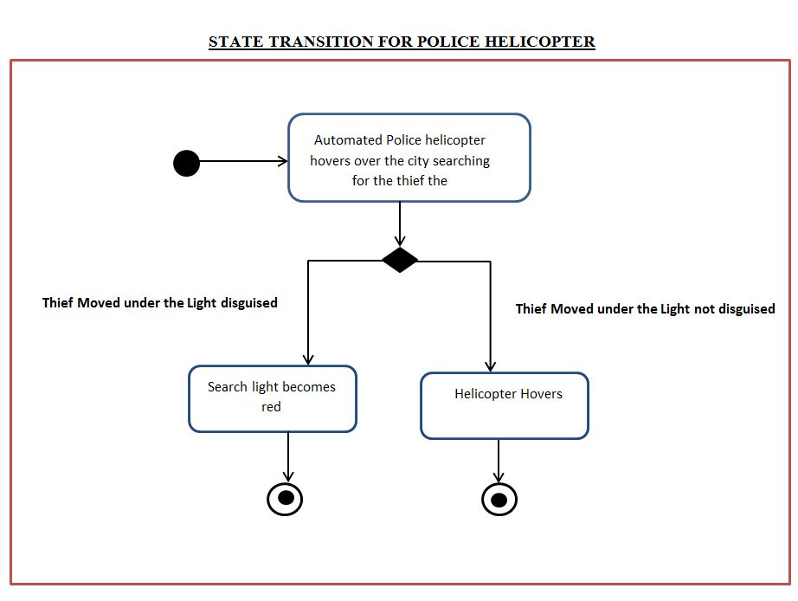

Slide 16
AI TRAINTS IN THE ARTIFACT
Visual Perception- Thief 01,02, small boy and police
Verbal Communication- Thief 01 and 01
Learning – Thief 01 learns fro its experience.

Slide 17
REFERENCE WEBSITES https://sparxsystems.com/resources/tutorials/uml2/statediagram.html accessed on 19th may 2021. https://slideplayer.com/slide/9217442/ accessed on 19th May 2021. https://slidetodoc.com/rational-agents-chapter-2-outline-agent-function-and/ accessed on 18th May 2021. https://www.uml-diagrams.org/state-machine-diagrams.html accessed on 20th May 2021. https://sparxsystems.com/resources/tutorials/uml2/state-diagram.html accessed on 19th May 2021. . BOOKS Russell, Stuart J, Peter. Norvig and Ernest. Davis. Third Edi. Artificial Intelligence: A Modern Approach. Upper Saddle River, NJ: Prentice Hall.

