Slide 1
Quad SPI I/F
8 bit SDRAM
SPI
SDRAM
CTRL
GLOBAL
REG
CLK SKEW ADJUST
CLOCK DOMAIN
WBS_CLK
CARAVEL
WB I/F
WB
HOST
WBM_CLK
WISHBONE INTERCONNECT
RISC CLK
SDRAM CLK
RISCV
CORE
UART
USB
I2C
UART/I2C/USB1.1

Slide 2

SDRAM CTRL
GLBL
REG
SPI
CLK SKEW ADJUST
WB INTERRCONNECT
RISCV
CORE
UART
USB
I2C
WB_HOST

Slide 3
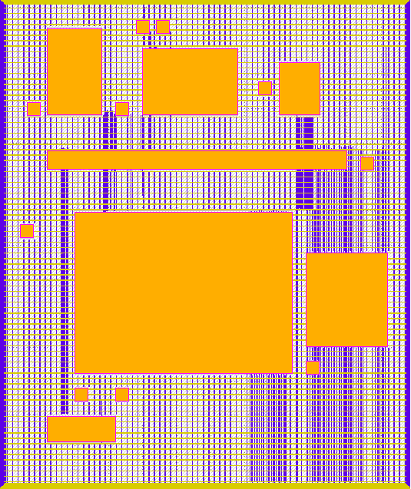

Slide 4
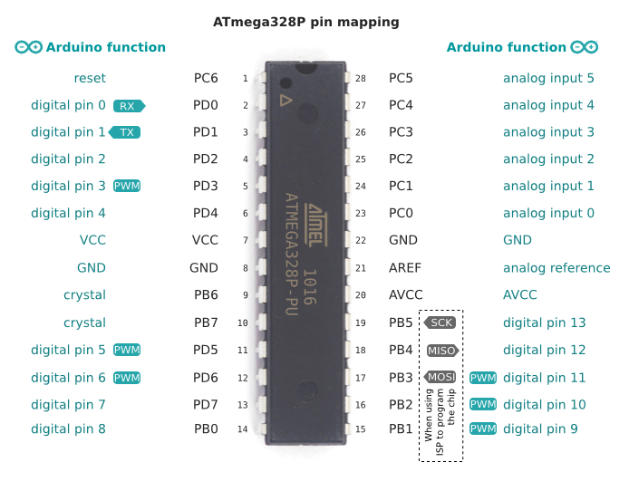

Slide 5
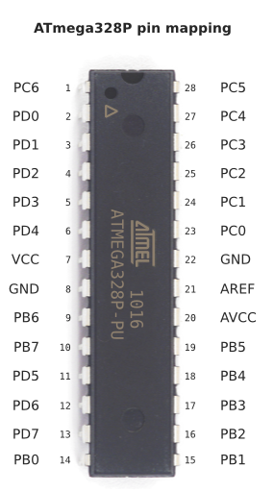
RISCDUINO ADAPTER
3.3v to 1.8V
OSC
CARAVEL
+
RISCDUINO
SOC
CARAVEL SPI FLASH
USER SPI FLASH
USER SPI SRAM

