Slide 1
RISCUDINO (Open Source 32 bit RISCV Based SOC pin compatible to arduino platform)

Slide 2
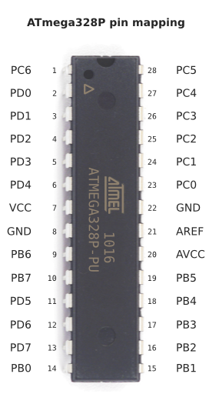
RISCDUINO ADAPTER
3.3v to 1.8V Regulator
OSC
CARAVEL SPI ISP
CARAVEL
+
RISCDUINO
SOC
CARAVEL SPI FLASH
USER SPI FLASH
USER SPI SRAM
28 pin Arduino Pin compatible Adaptor

Slide 3
ATMGA328 Pin No | Functionality | Riscduino Pin Mapping
Pin-1 | PC6/RESET | digital_io[5]
Pin-2 | PD0/RXD[0] | digital_io[6]
Pin-3 | PD1/TXD[0] | digital_io[7]/analog_io[0]
Pin-4 | PD2/RXD[1]/INT0 | digital_io[8]/analog_io[1]
Pin-5 | PD3/INT1/OC2B(PWM0) | digital_io[9]/analog_io[2]
Pin-6 | PD4/TXD[1] | digital_io[10]/analog_io[3]
Pin-7 | VCC | -
Pin-8 | GND | -
Pin-9 | PB6/XTAL1/TOSC1 | digital_io[11]/analog_io[4]
Pin-10 | PB7/XTAL2/TOSC2 | digital_io[12]/analog_io[5]
Pin-11 | PD5/SS[3]/OC0B(PWM1)/T1 | digital_io[13]/analog_io[6]
Pin-12 | PD6/SS[2]/OC0A(PWM2)/AIN0 | digital_io[14]/analog_io[7]
Pin-13 | PD7/A1N1 | digital_io[15]/analog_io[8]
Pin-14 | PB0/CLKO/ICP1 | digital_io[16]/analog_io[9]
Pin-15 | PB1/SS[1]OC1A(PWM3) | digital_io[17]/analog_io[10]
Pin-16 | PB2/SS[0]/OC1B(PWM4) | digital_io[18]/analog_io[11]
Pin-17 | PB3/MOSI/OC2A(PWM5) | digital_io[19]/analog_io[12]
Pin-18 | PB4/MISO | digital_io[20]/analog_io[13]
Pin-19 | PB5/SCK | digital_io[21]/analog_io[14]
Pin-20 | AVCC | -
Pin-21 | AREF | analog_io[23]
Pin-22 | GND | -
Pin-23 | PC0/uartm_rxd/ADC0 | digital_io[22]/analog_io[15]
Pin-24 | PC1/uartm/ADC1 | digital_io[23]/analog_io[16]
Pin-25 | PC2/usb_dp/ADC2 | digital_io[24]/analog_io[17]
Pin-26 | PC3/usb_dn/ADC3 | digital_io[25]/analog_io[18]
Pin-27 | PC4/ADC4/SDA | digital_io[26]/analog_io[19]
Pin-28 | PC5/ADC5/SCL | digital_io[27]/analog_io[20]
RISCDUINO
PIN MAPPING

Slide 4
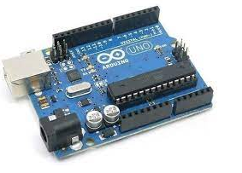
RISCDUINO ADAPTER
3.3v to 1.8V Regulator
OSC
CARAVEL SPI ISP
CARAVEL
+
RISCDUINO
SOC
CARAVEL SPI FLASH
USER SPI FLASH
Replace the ATMEGA328 Chip with
RISCDUINO ADAPTER
USER SPI SRAM

Slide 5
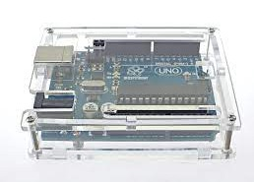
Try to fix this board within this Ardunio Box
Transparent Acrylic Glossy Case Enclosure Box for Arduino UNO R3 - (flyrobo.in)

Slide 6
RISCDUINO PROGRAMMING
RISCDUINO will seamlessly with Arduino-ide through its serial port driver.

Slide 7
BACKUP SLIDE

Slide 8
