Slide 1

Code Refactoring & Bug Fixing Using Flask
-- Dinesh Dasaroju

Slide 2

About me
Hello! I am Dinesh, a B.Sc. Life Science graduate from Osmania University. Despite pursuing a non-technical field during my college days, my curiosity about programming and emerging technologies such as AI and Robotics was insatiable. This curiosity eventually led me towards Data Science, a field I found immensely intriguing.
What captivated me about Data Science is its vast diversity, spanning across various sectors including Finance, Healthcare, Manufacturing, Education, and both Government and Private sectors. This diversity underscores the wide applicability and demand for data-driven insights in today's world.
Motivated by this realization, I made the decision to transition from Life Science to Data Science.
LinkedIn
GitHub

Slide 3

Objective of the Project
Have to debug the code given. The code is about Developing a Note Taking Application using Python, Flask, and HTML. So I have been tasked with fixing the broken code ensuring the application works seamlessly.

Slide 4
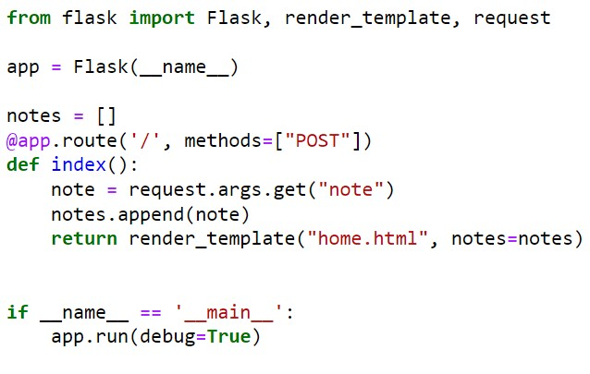
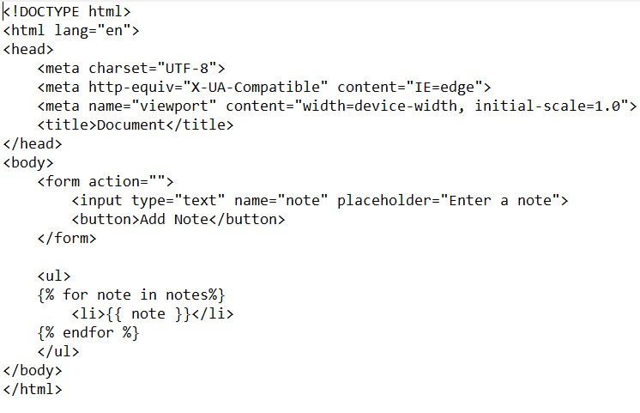
Given Code Snippets

Slide 5
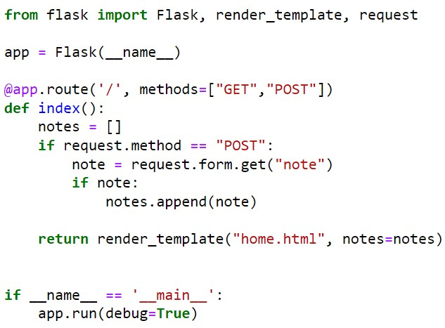
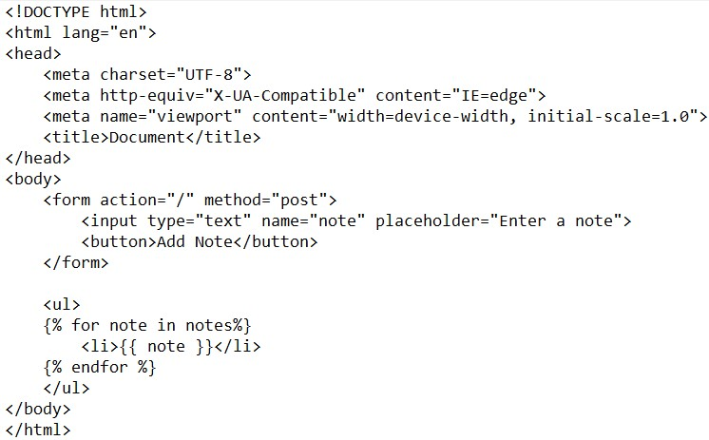
Updated Code Snippets

Slide 6
Changes made In Code Snippets
Handling of HTTP Methods:
In the first version, the route '/' is set up to handle only POST requests: @app.route('/', methods=["POST"]).
In the second version, the route '/' is modified to handle both GET and POST requests: @app.route('/', methods=["GET","POST"]).
Request Parameters Handling:
In the first version, the index() function attempts to retrieve the note from request arguments using request.args.get("note"). However, this is typically used for GET requests.
In the second version, for POST requests, it retrieves the note from form data using request.form.get("note").
Conditional Note Appending:
In the second version, before appending the note to the notes list, it checks if the note exists (if note:) to avoid appending empty notes.
Initialization of notes List:
In the first version, the notes list is initialized globally and persists across requests. This means that notes added by different users will be stored and displayed to all users.
In the second version, the notes list is initialized locally inside the index() function. This means that each time the index() function is called, a new notes list is created, and it only contains notes added during the current request

Slide 7
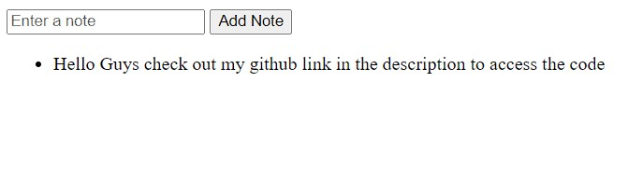
Out Put Of Updated Code

Slide 8

THANK YOU

