Slide 1
Business Scenario – Decision Support System in TELCO

Slide 2
What is Decision Support System?
Decision Support systems is a computer- based information systems intended to help decision makers utilize data in order to identify problems. DSS will help the service provider to analyze data in order to provide useful and explicit information. DSS enables managers in the respective areas within the industry to fully utilize the vast amounts of data available to make projections and decisions in relation to utilization of valuable resources.

Slide 3
What are Dimension & Fact Tables?
Dimension is a data set composed of individual, non-overlapping data elements.
A Fact table contains business facts(or measures) , and foreign keys which refer to (normally primary keys) in dimension tables.
Dimension Tables:
Customer
Time
Rate Plan
Call Type
Region
Fact Table:
Decision Fact

Slide 4
Data Loading Strategy
Load all Dimension and Fact tables data using Files.

Slide 5
Guidelines to load data into Dimension & Facts
Project Name: PROJ_DSS_LOAD_TEAM_B
Job Name: JOB_DSS_LOAD_TEAM_B
Work Flow Name:
(1) WF_DSS_DIMENSION_LOAD_TEAM_B
(2) WF_DSS_DECISION_FACT_LOAD_TEAM_B

Slide 6
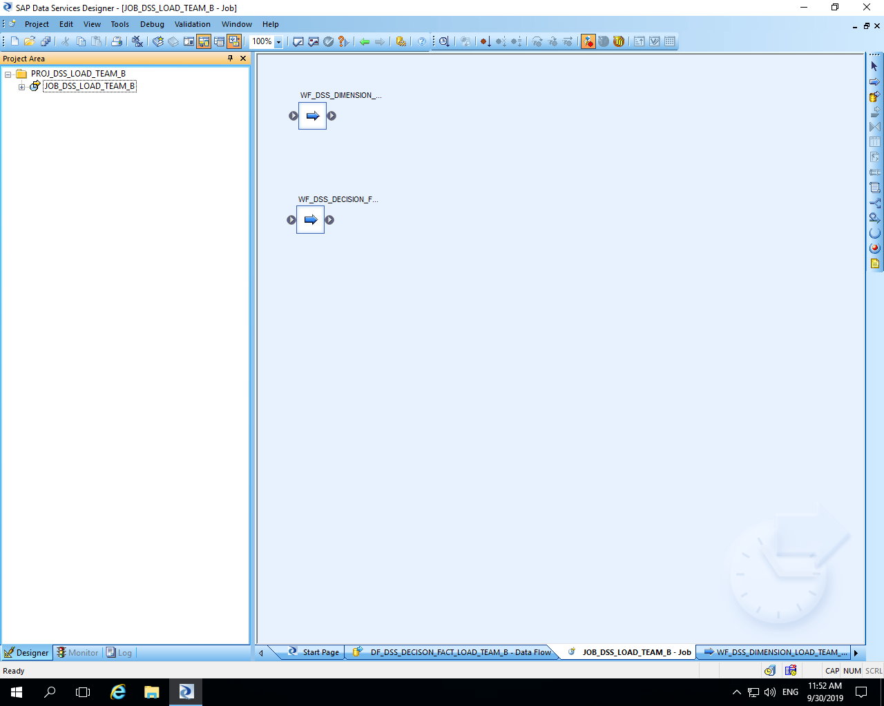

Slide 7
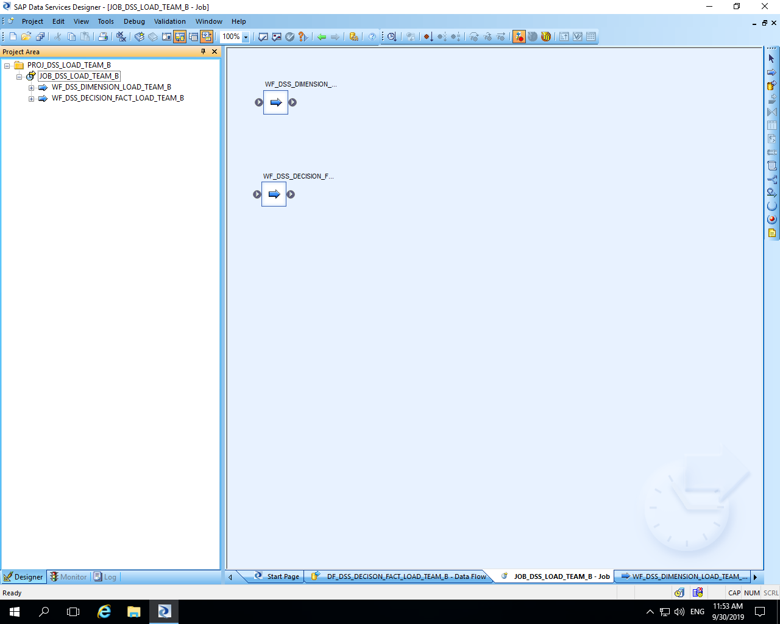

Slide 8
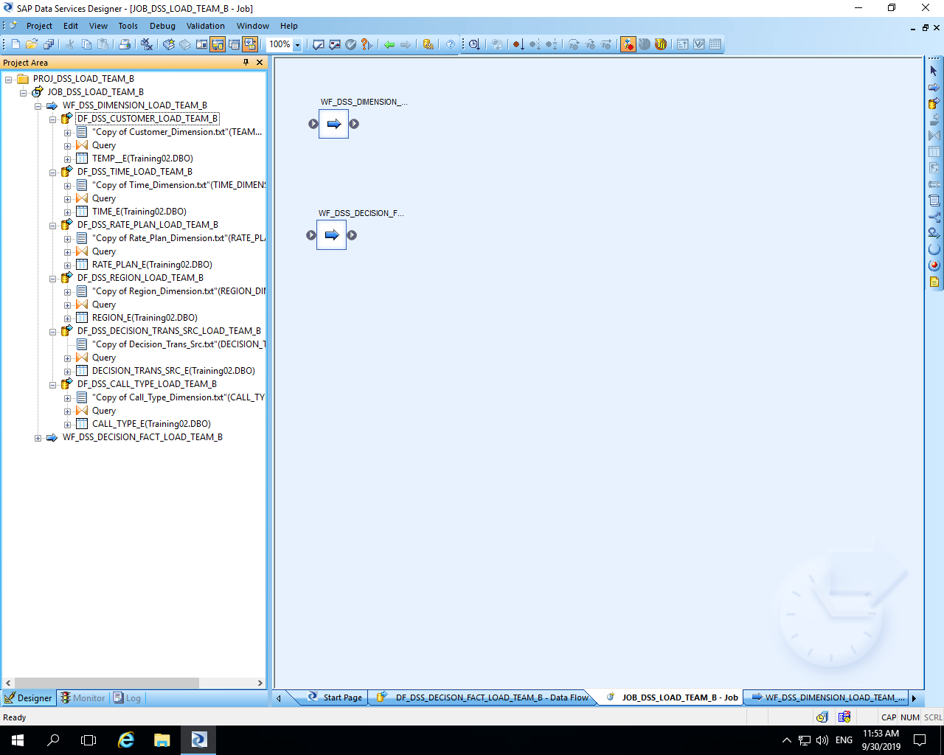

Slide 9
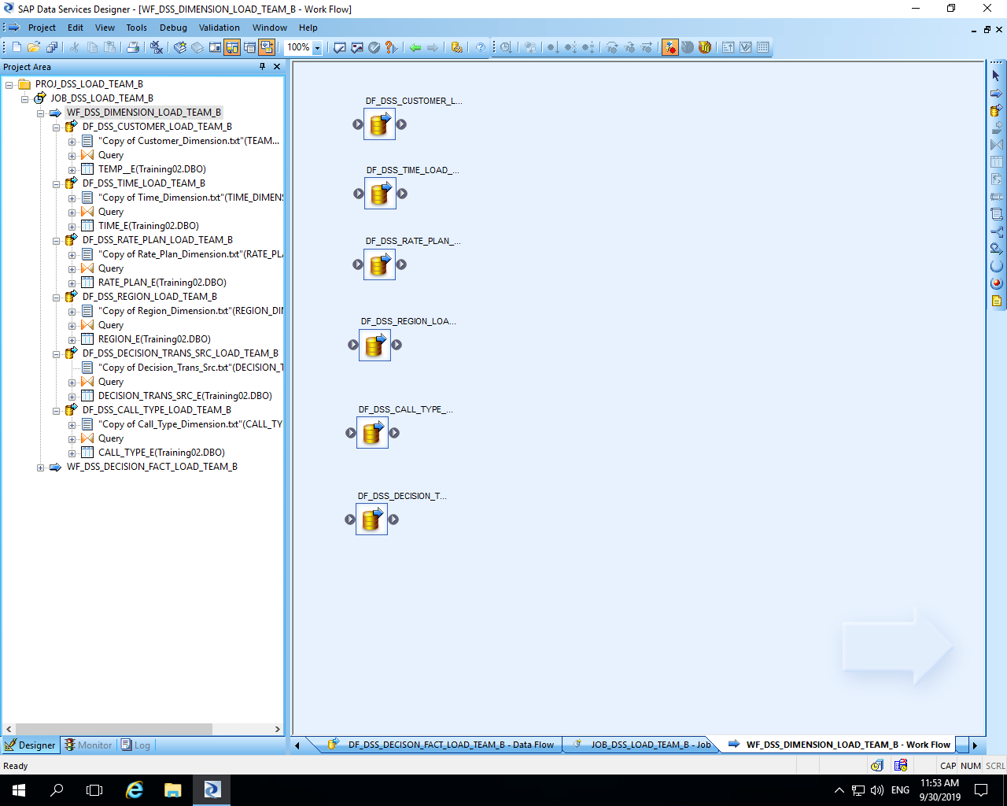

Slide 10
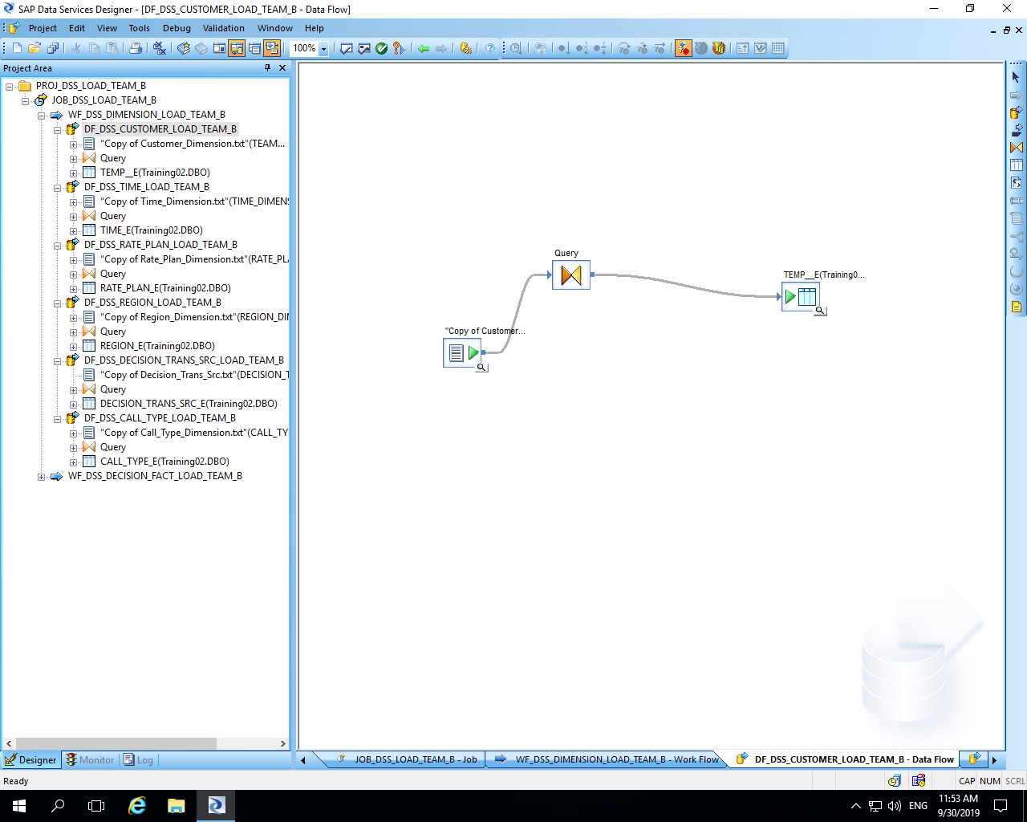

Slide 11
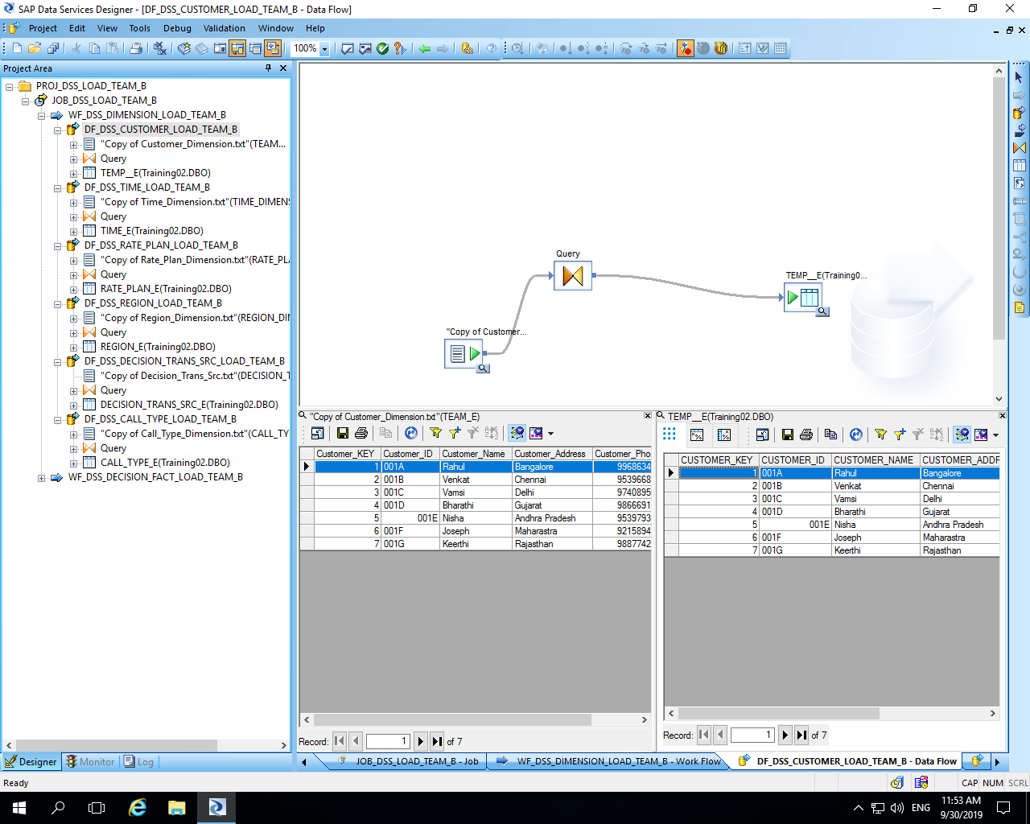

Slide 12
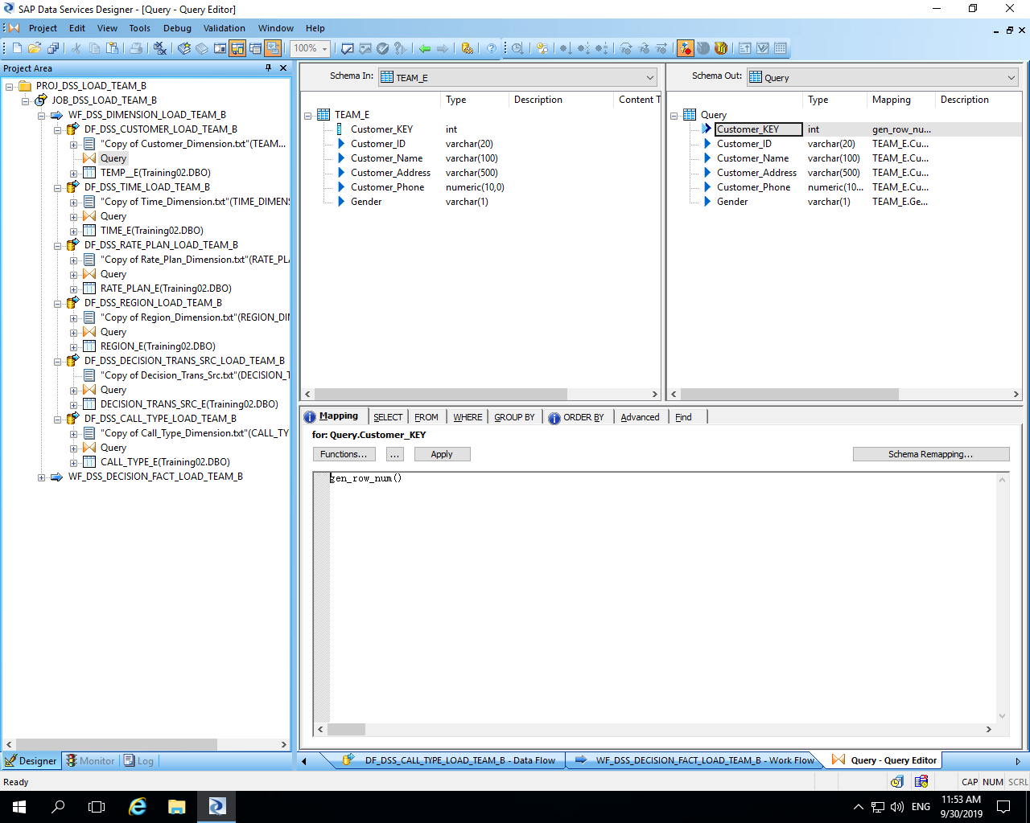

Slide 13
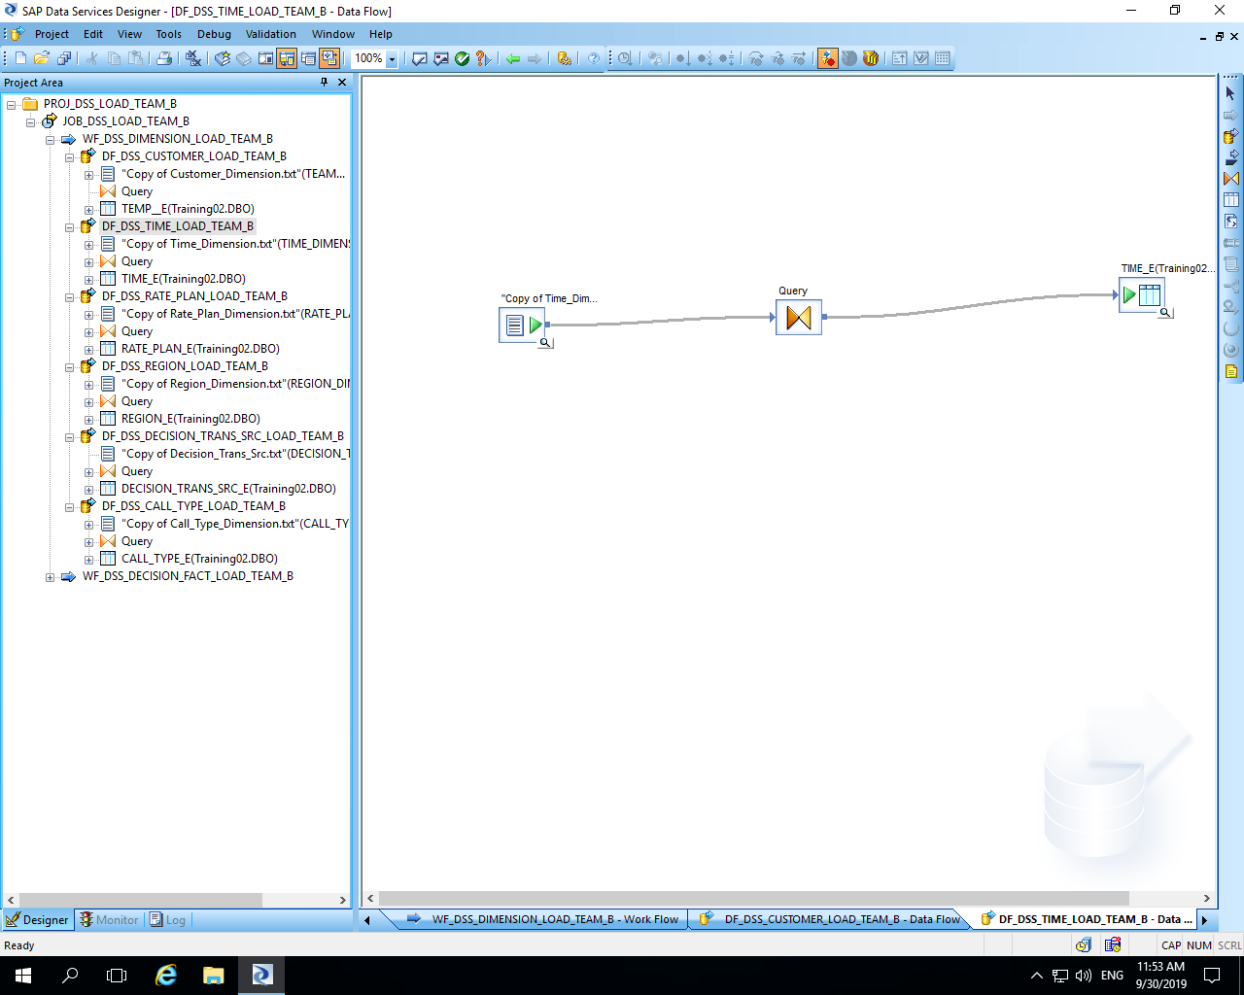

Slide 14
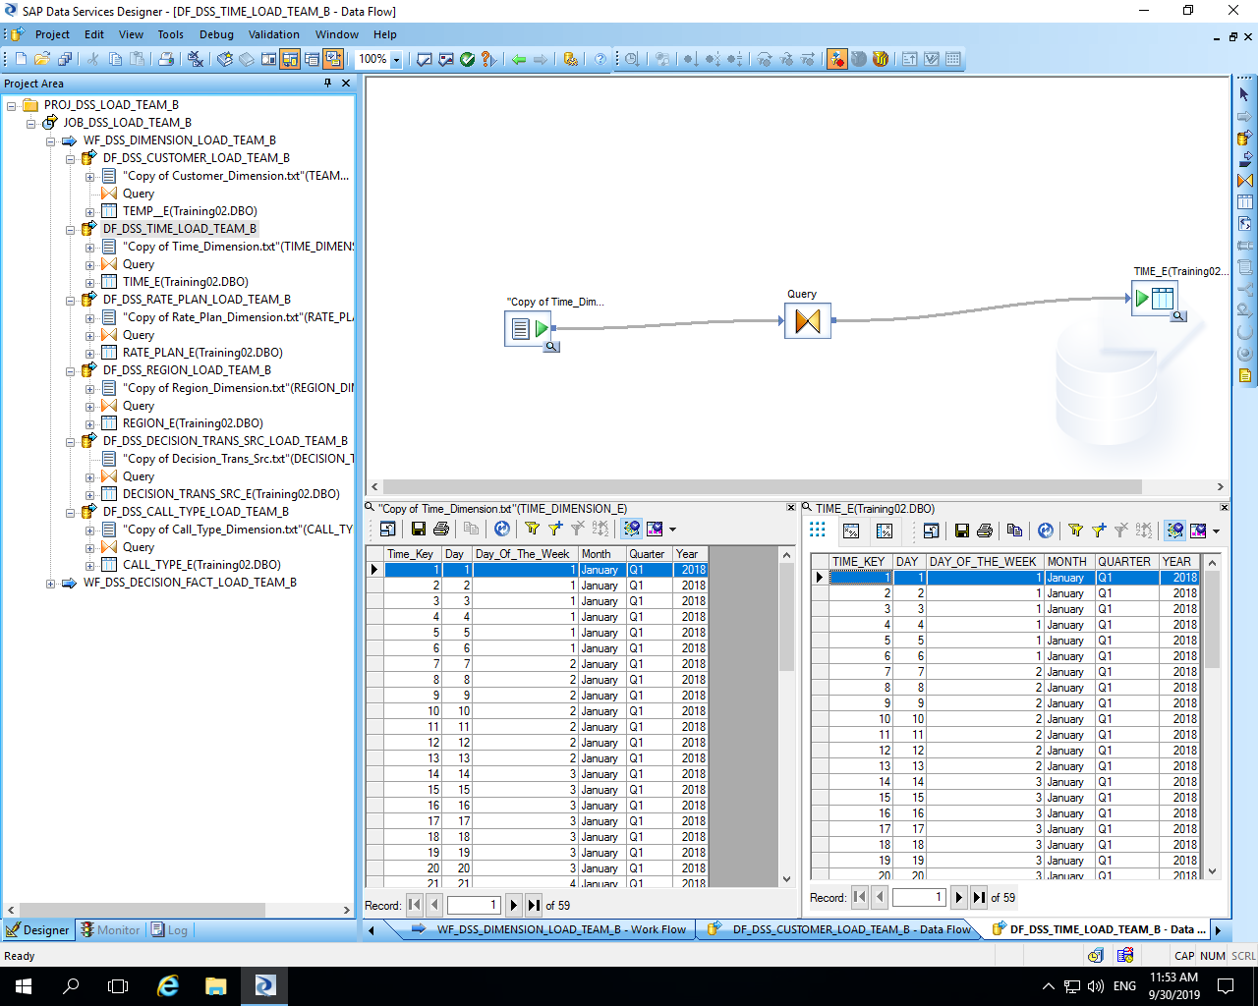

Slide 15
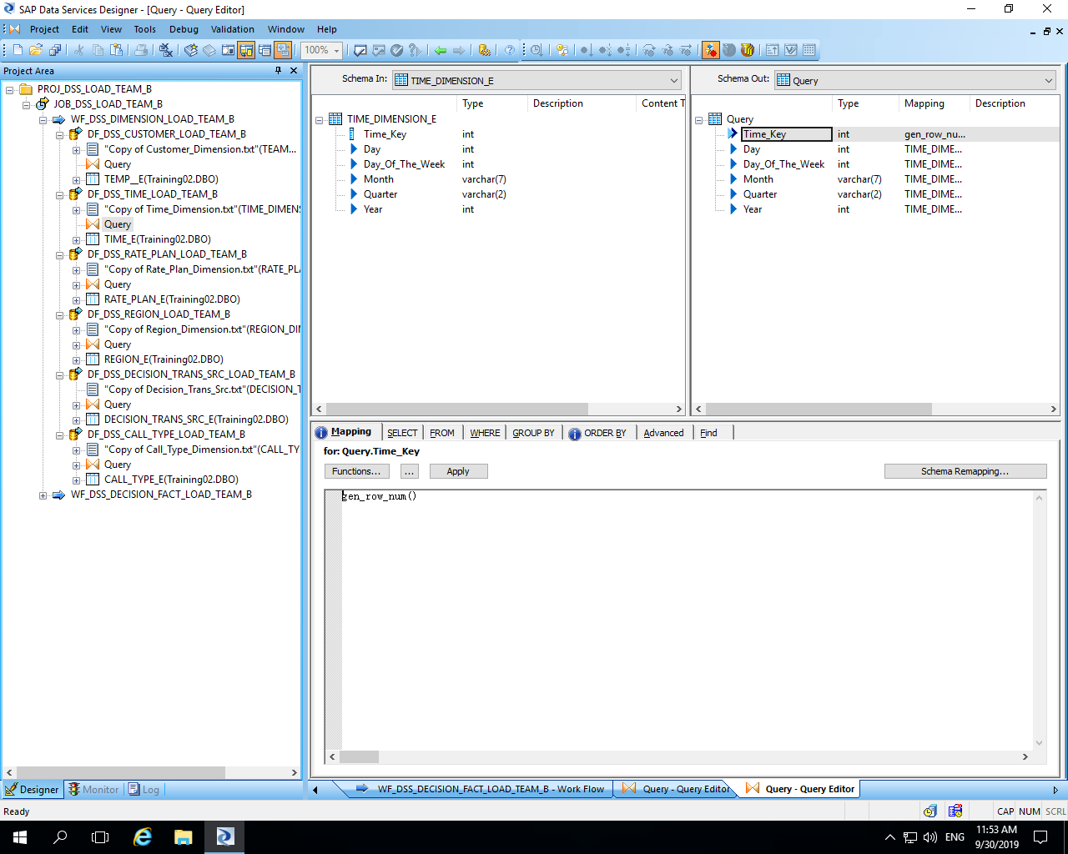

Slide 16
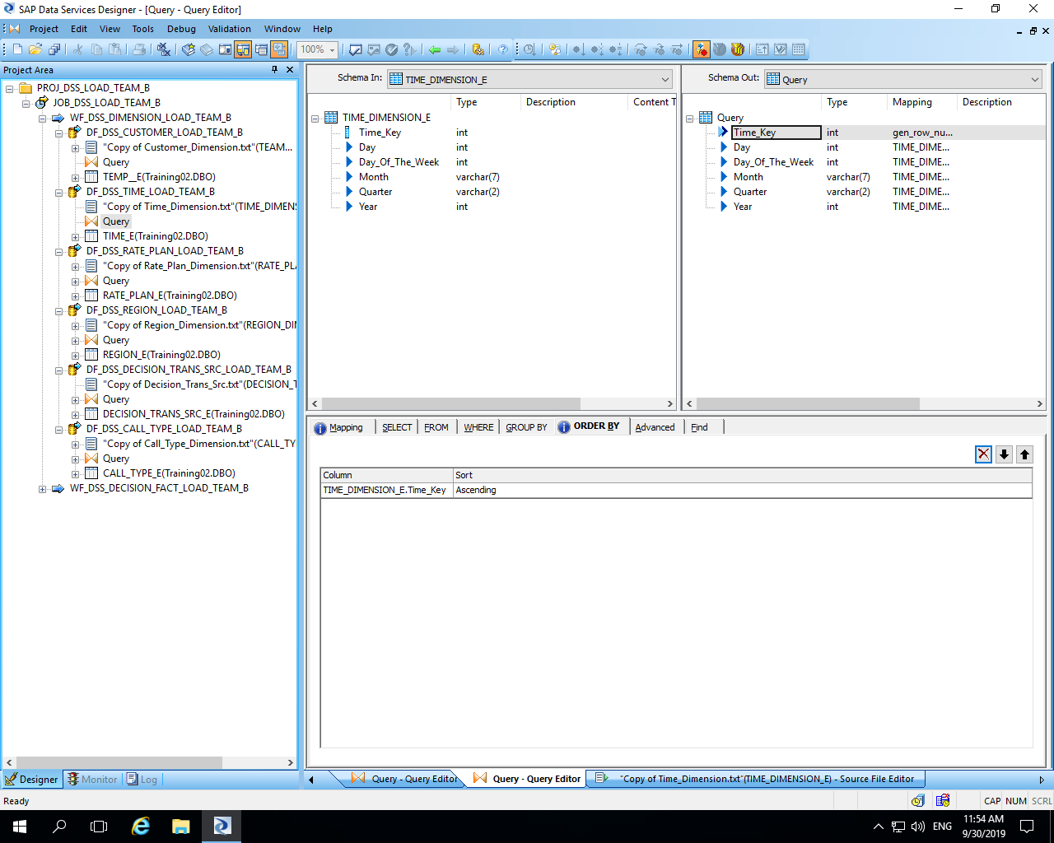

Slide 17
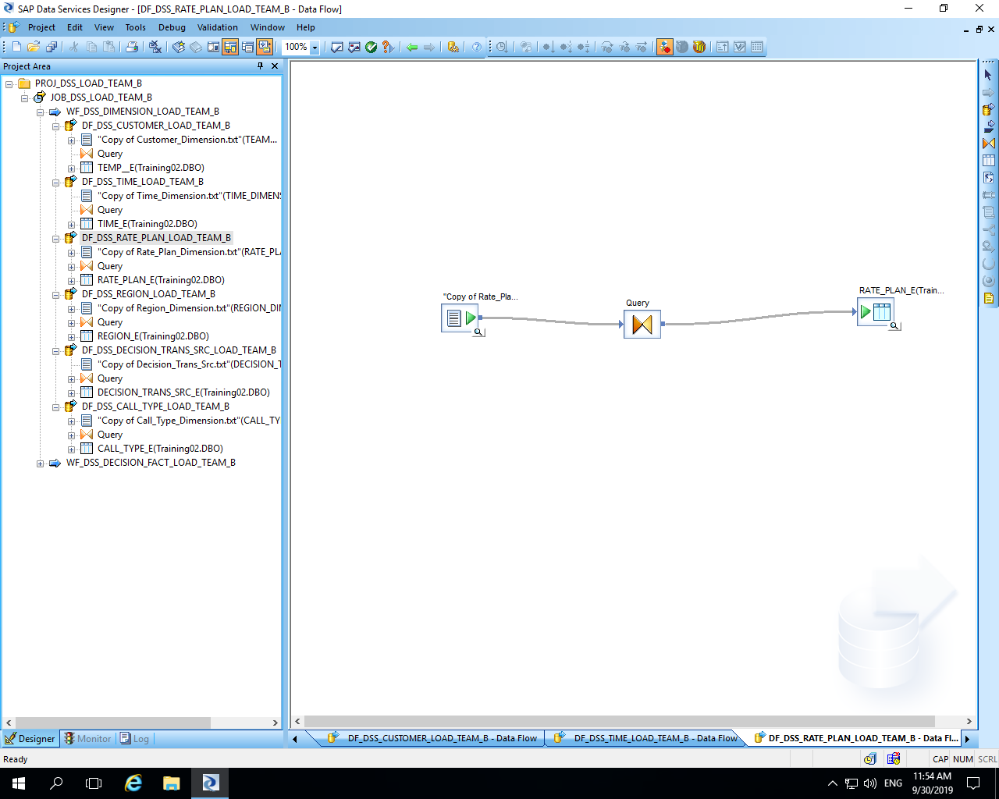

Slide 18
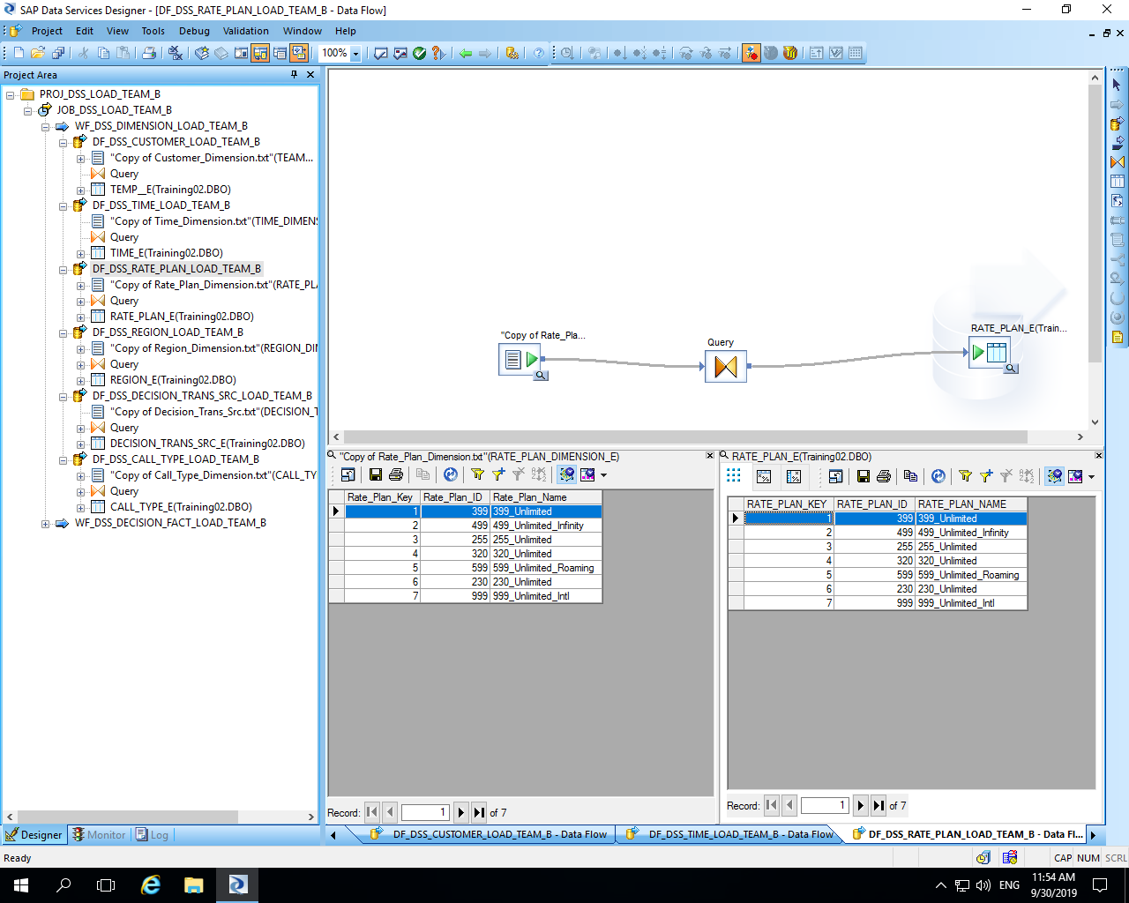

Slide 19
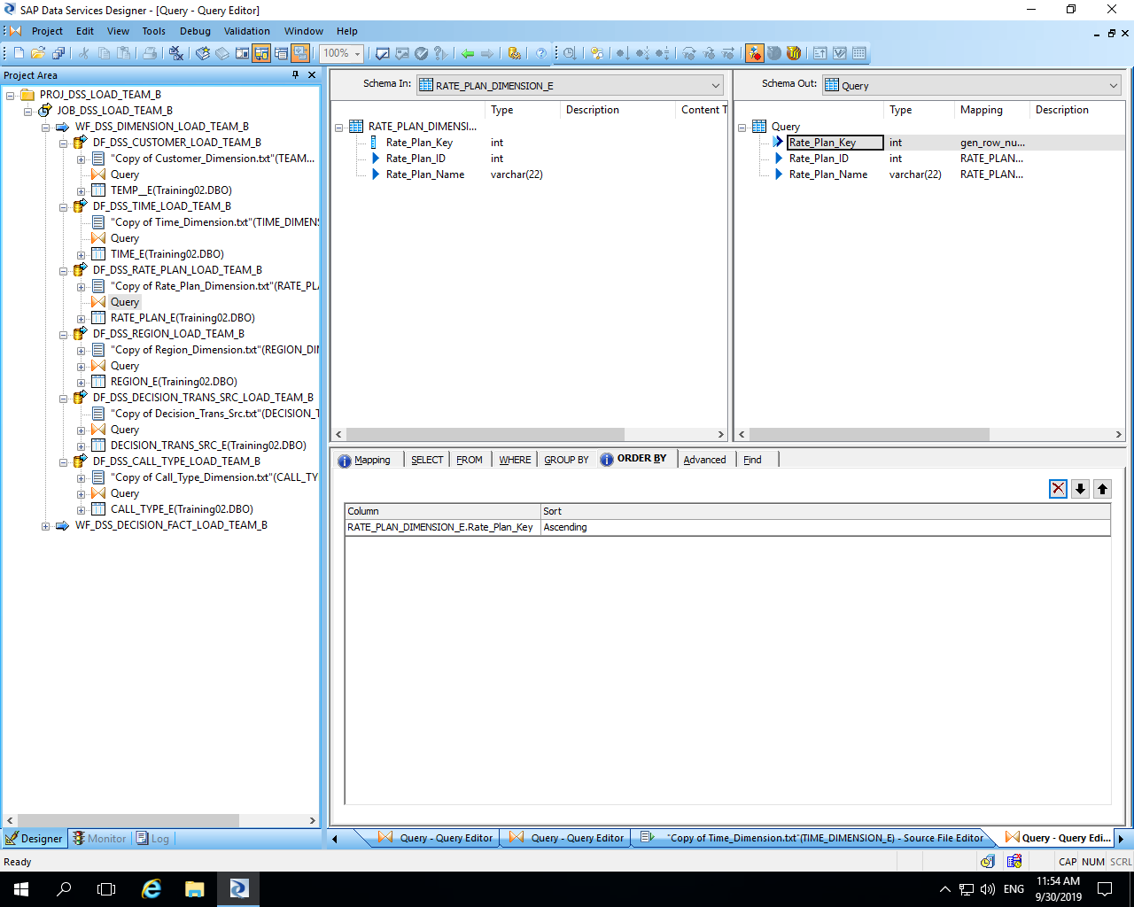

Slide 20
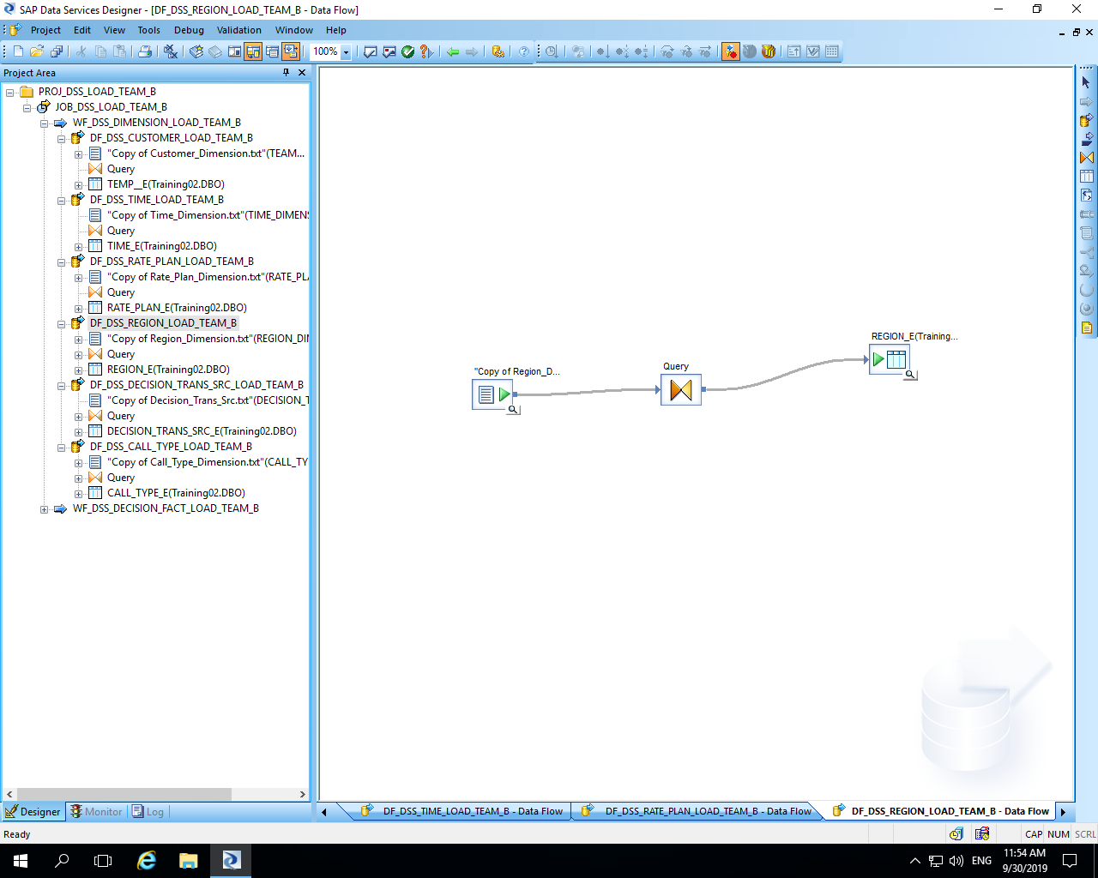

Slide 21
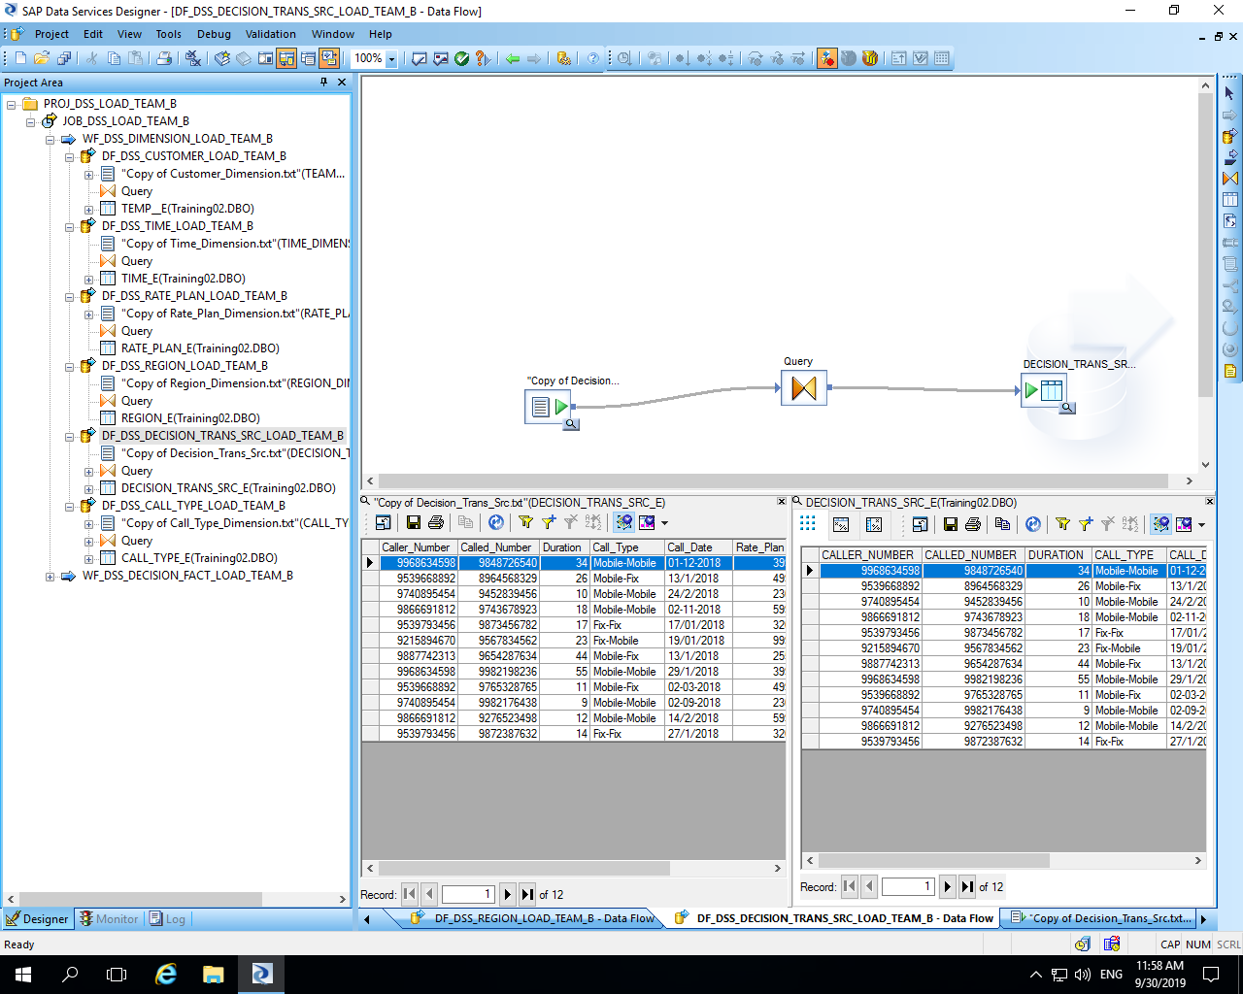

Slide 22
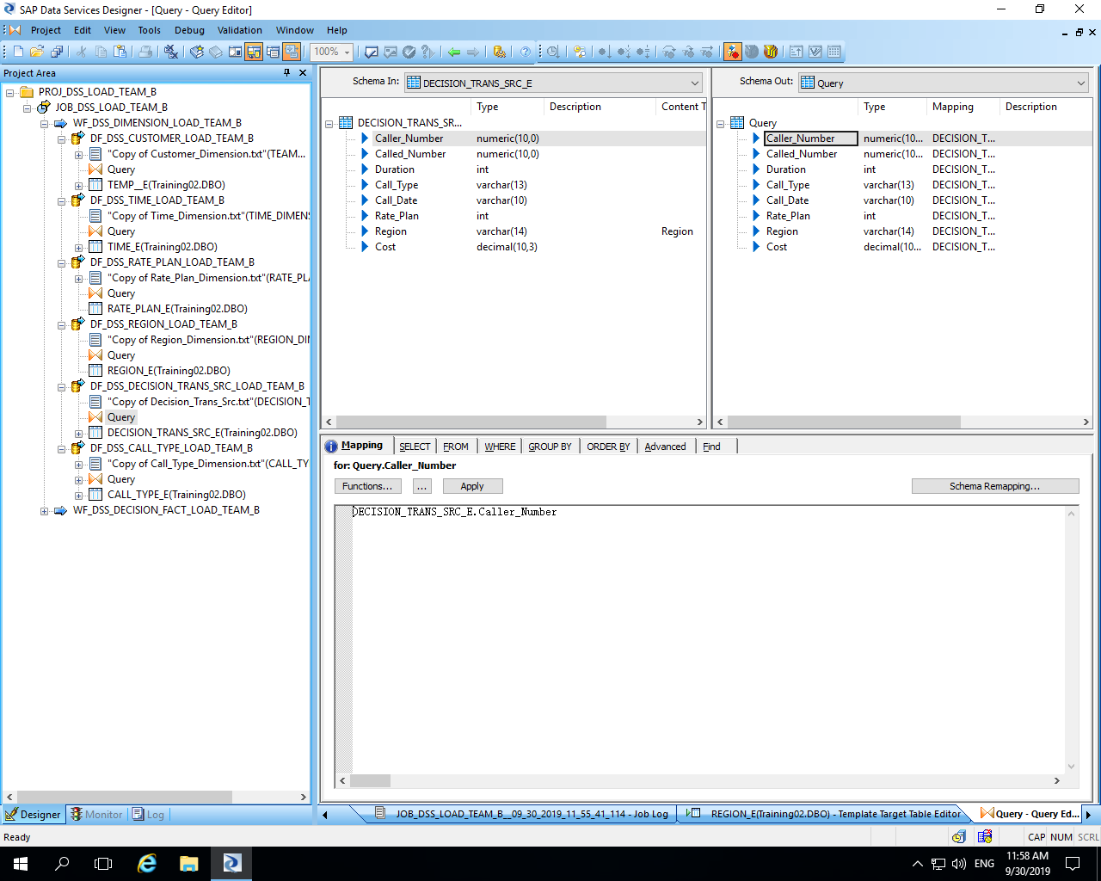

Slide 23
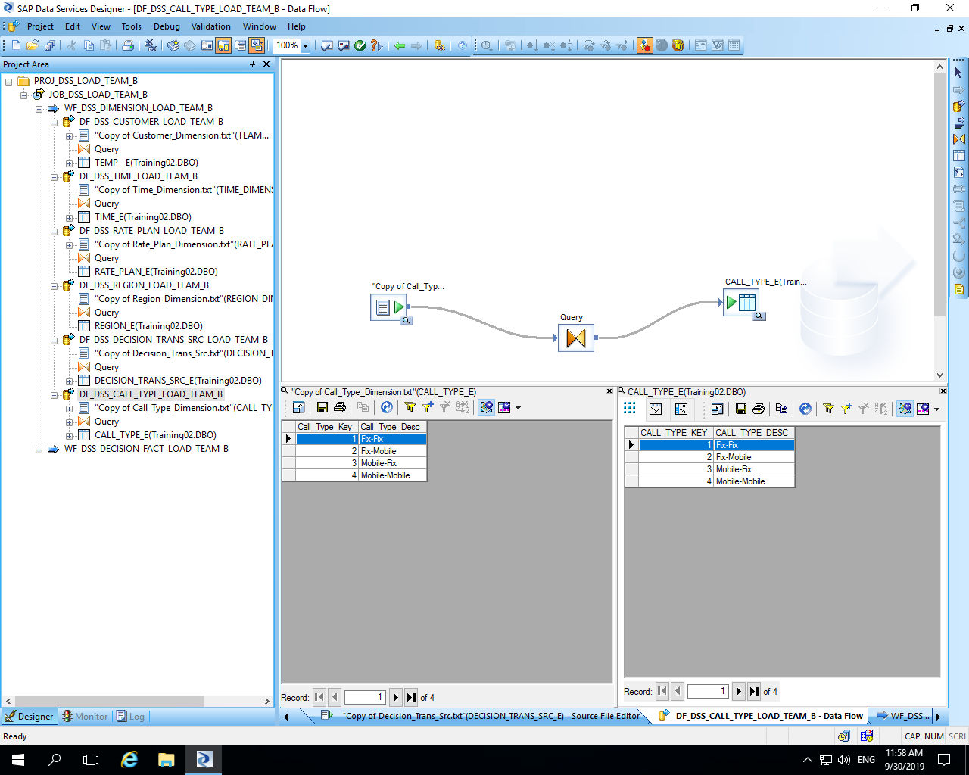

Slide 24
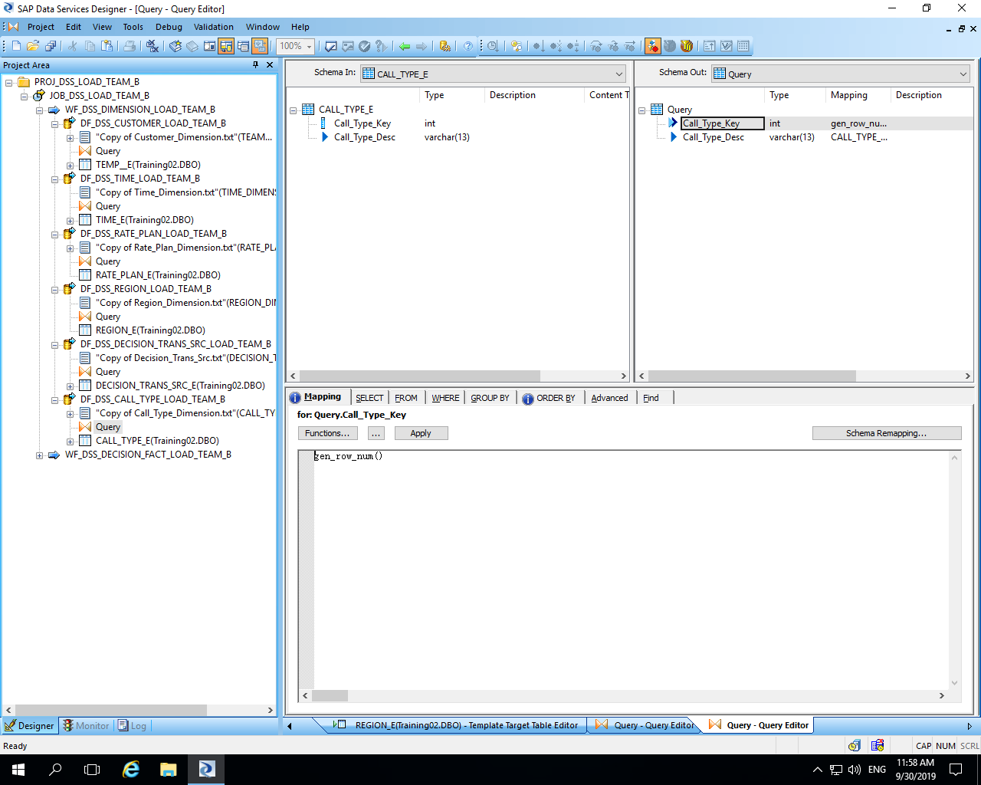

Slide 25
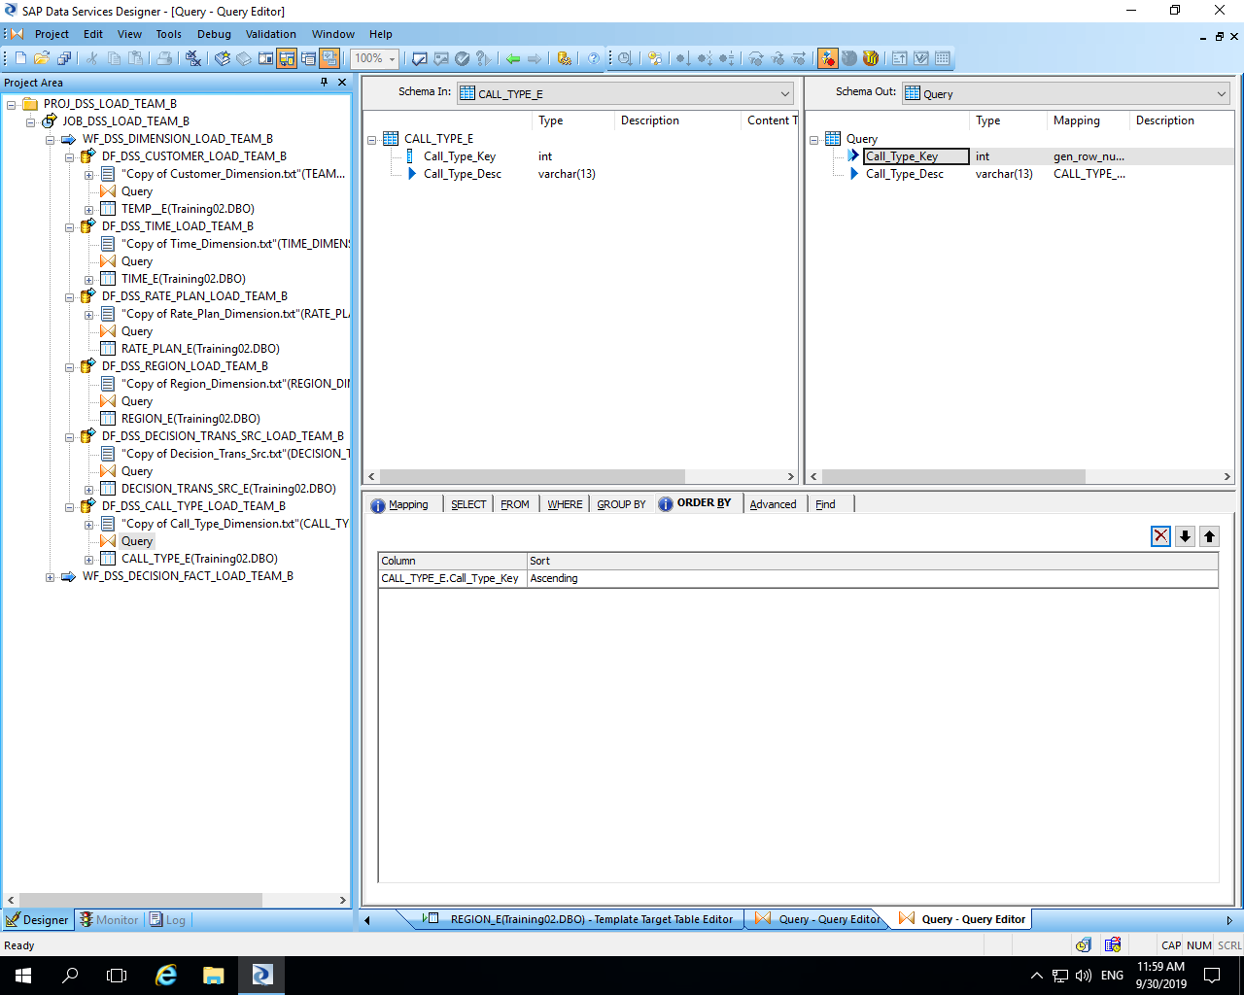

Slide 26
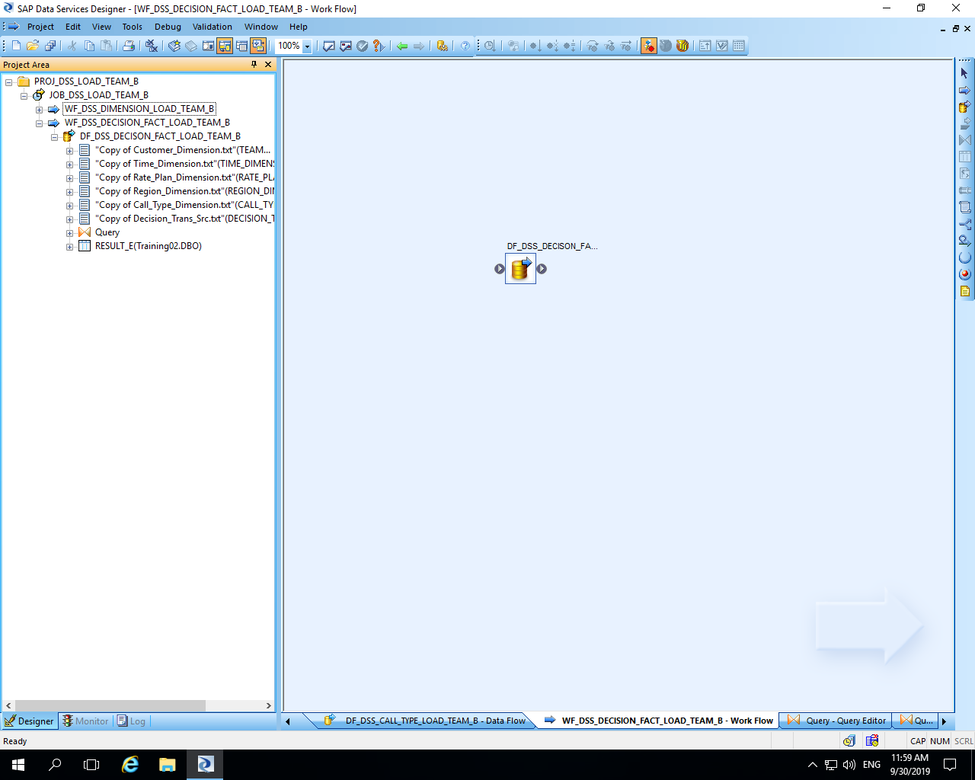

Slide 27
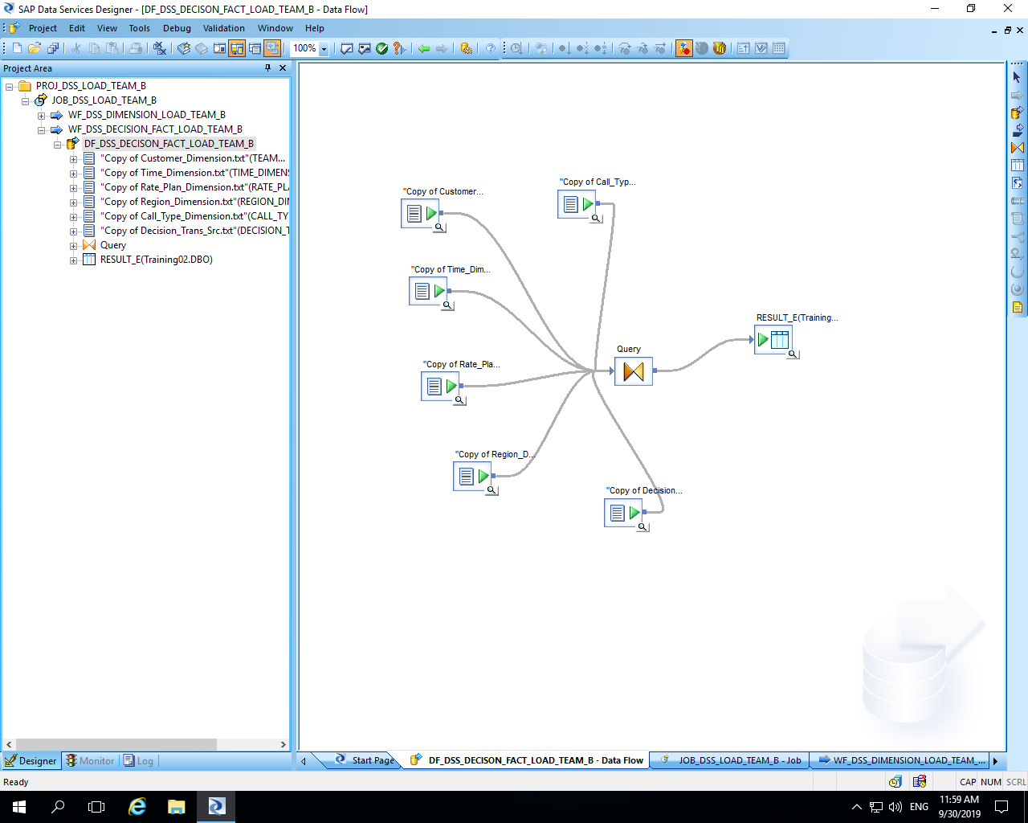

Slide 28
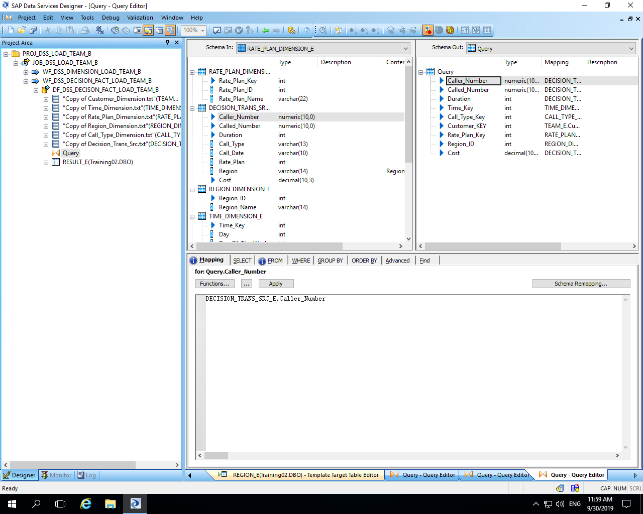

Slide 29
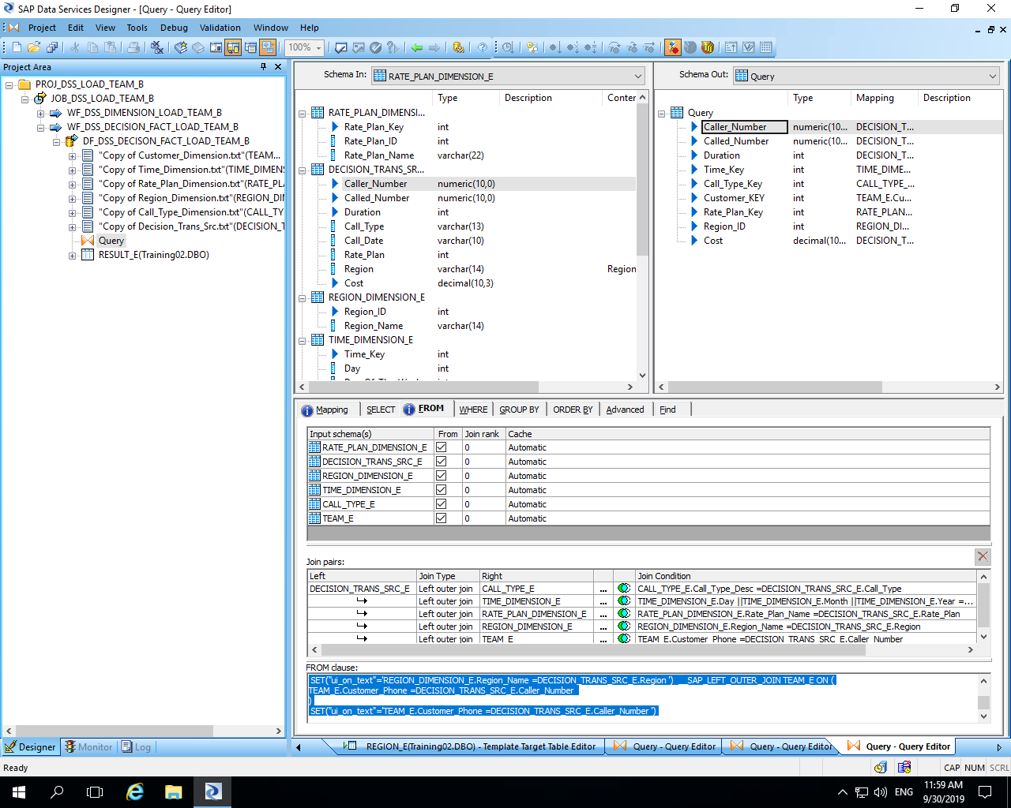

Slide 30
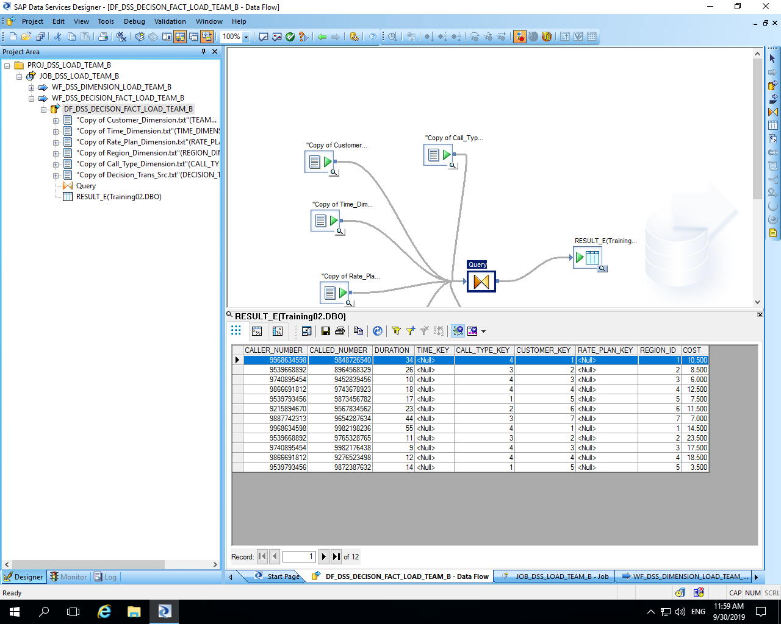

Slide 31


