Slide 1
CLUSTERING
Identifying to which of a set of categories (sub-populations) a new observation belongs, on the basis of a training set of data containing observations (or instances) whose category membership is known

Slide 2
Algorithms
KMeans
DBSCAN

Slide 3
KMeans
Divide into k number of clusters

Slide 4
Algorithm
Choose k random centroids for cluster
For each point
  Find the distance between each clusters
  Assign the point to the nearest cluster
  Recompute new centroid for the cluster
  Iterate until convergence
  Return when all the points are computed.

Slide 5
Advantages
Efficient for small dataset
Simple algorithm
Does not depend upon
Gives exactly k clusters
Final result does not depend upon the order of data

Slide 6
Disadvantages
Calculation heavy
No notion of noise. So includes outliers.

Slide 7
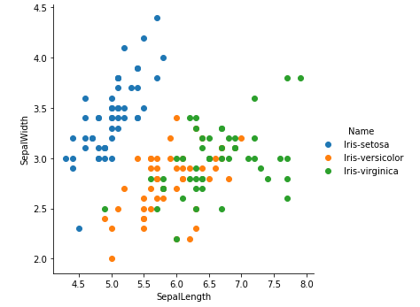
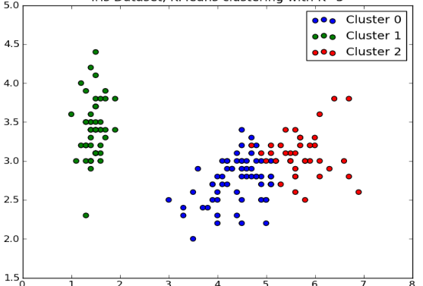
Result

Slide 8
DBSCAN
Density-based spatial clustering of applications with noise
Winner of test of time award 2014

Slide 9
Algorithm
Find the points in the ε (eps) neighborhood of every point, and identify the core points with more than minPts neighbors.
Find the connected components of core points on the neighbor graph, ignoring all non-core points.
Assign each non-core point to a nearby cluster if the cluster is an ε (eps) neighbor, otherwise assign it to noise.

Slide 10
Advantages
No need to specify number of clusters
Can find arbitrarily shaped clusters
Can identify outliers as noise
Mostly insensitive to order points
Eps and minpts can be set by domain experts

Slide 11
Disadvantages
Not deterministic: Border points can switch clusters
Depends on distance measure. Mostly euclidean distance.
W/o understanding data well, choosing eps and minpts is quite daunting.

Slide 12
Dataset
Famous Iris Dataset
Parameters: SepalLength, SepalWidth, PetalLength, PetalWidth, Name
Number of records: 150
minPts ≥ Dimensions + 1 ( at least 5)
Eps: choose small value for better clustering

Slide 13
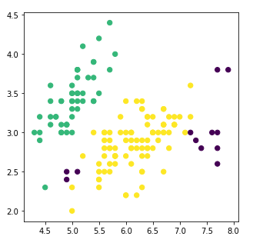
Result

