Slide 1
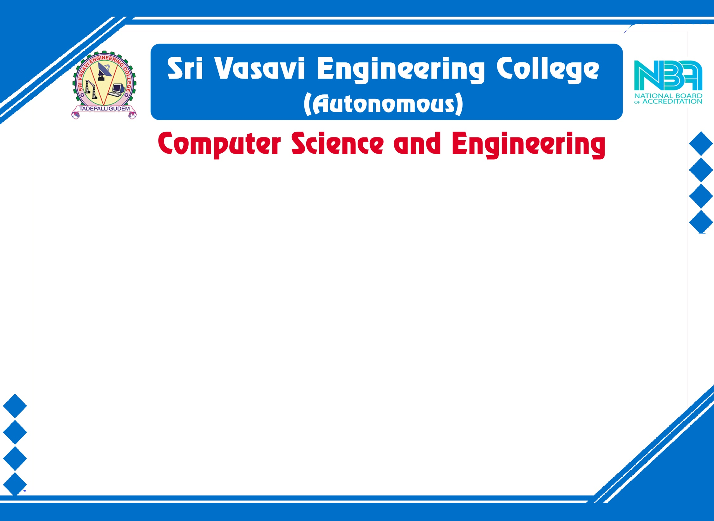



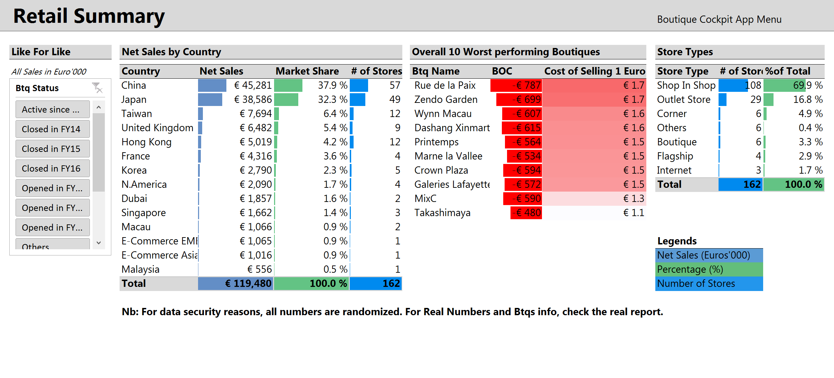
f
Mini Project External Review
PLACEMENTS ANALYTICS
AND DASHBOARD
Batch No: 5
Project Title: PLACEMENTS ANALYTICS AND DASHBOARD
S.No | Regd.No | Student Name
1 | 21A81A0515 | G.Dinesh
2 | 21A81A0511 | D.Harika
3 | 21A81A0504 | A.Sunand
4 | 21A81A0556 | U.Dayanand
5 | 21A81A0503 | A.Naveen
Project Guide:
MRS M N V Surekha,Mtech CSE

Slide 2
CONTENTS
Title
Abstract
Introduction
Literature Survey
Problem Statements in Existing System
Proposed System
Objectives
Requirement Analysis
System Architecture and Design
Methodology
Implementation
Result Analysis
Attainment of objective
Conclusion
Future scope of Project

Slide 3
ABSTRACT
The "Placements Analytics and Dashboard" is a comprehensive web application designed to store and analyze placement data for students who have secured positions in software companies. Now a days there are lot more technologies and opportunities in the software field so in order to get placed in a well established software company we need to find out which are those well established companies and which technologies currently need to be learned that are important.
To be awared about these the system offers powerful analytical features that enable users to enhance statistical reports and visualizations. A pie chart representation showcases the distribution of placements based on the technologies learned by students. This visualization serves as a guide for students to identify the most sought-after skills in the industry, empowering them to make informed decisions regarding their educational and career paths.Furthermore, the project includes a comparative analysis of placement trends year by year, presented through bar graphs and a pie chart representation of hiring companies illustrates the number of students recruited by each organization, providing valuable insights and industry preferences.

Slide 4
INTRODUCTION
Increasing opportunities and technologies in the software field
demand informed career choices for students.
The "Placements Analytics and Dashboard" web application addresses
this need by analyzing placement data for students in software companies.
Empowers students with data-driven insights to identify sought-after
skills in the industry.
Offers powerful analytical features, including pie charts and bar graphs,
for enhanced statistical reports and visualizations.
Facilitates comparative analysis of placement trends year by year and
showcases company preferences for recruitment.
A comprehensive tool to guide students towards successful educational
and career paths in the software industry.

Slide 5
LITERATURE SURVEY
"Placement Analytics Dashboard for Software Engineering Students" by Kumar et al. (2020): Proposes a Dashboard employing data mining and ML to analyze software engineering placement data. Offers insights on popular technologies, sought-after skills, and top companies.
"Web-Based Placement Analytics System for Engineering Colleges" by Rathore et al. (2019): Describes a System collecting and analyzing placement data from engineering colleges. Provides reports on placement trends, popular companies, and in-demand skills.
"Data-Driven Approach to Placement Analytics" by Singh et al. (2018): Presents Framework using data analytics to enhance placement processes. Covers data collection, cleaning, analysis, and visualization.
"Study on Placement Trends in the IT Industry" by Raj et al. (2017): Analysis of IT industry placement trends over five years. Highlights popular technologies (Java, Python, C++) and in-demand skills (problem-solving, communication, teamwork).
"Comparative Analysis of Placement Trends in India and the US" by Sharma et al. (2016): Comparative study of placement trends in India and the US. Identifies popular technologies (Java, Python, C#) and key skills (problem-solving, communication, creativity) in each region.

Slide 6
PROBLEM IN EXISTING SYSTEM
Lack of Data Centralization: In the current system, placement data is likely scattered across various sources, such as spreadsheets, emails, and physical documents. This makes it difficult to have a holistic view of placements, leading to inefficiencies in analysis and decision-making.
Manual Data Analysis: Analyzing placement trends and identifying emerging technologies is labor-intensive and time-consuming. Manual data processing can lead to errors and delays in producing meaningful insights.
Limited Insights: The current system may lack robust visualization and reporting capabilities. This limits the ability to extract meaningful insights from placement data and hampers the ability to identify patterns and trends.
Lack of Student Guidance: Students may not have access to clear information about which technologies are most in demand by employers. This can lead to poor decision-making in terms of skill acquisition and career choices.

Slide 7
PROPOSED SYSTEM
Centralized Data Repository: The "Placements Analytics and Dashboard" application will centralize all placement-related data in a structured database. This ensures that all relevant information is easily accessible, eliminating the need to search through various sources.
Automated Analysis: The system will employ data analysis techniques to automatically process placement data, identifying trends, patterns, and correlations. This will save time and reduce the risk of errors associated with manual analysis.
Interactive Visualizations: The proposed system will offer a range of interactive visualizations, such as pie charts, bar graphs, and trend plots. These visualizations will provide intuitive insights into placement trends, technology preferences, and company hiring patterns.
Technology Distribution Analysis: The pie chart representation showcasing technology distribution will help students understand which technologies are most commonly required by software companies. This empowers students to align their skill development with industry demands.
Comparative Analysis: Year-by-year placement trend analysis through bar graphs will allow stakeholders to identify fluctuations and make informed decisions based on historical data.
Company Recruitment Insights: The pie chart representing the number of students recruited by each organization will shed light on company preferences. This information can guide students in targeting specific companies for job applications.

Slide 8
OBJECTIVES
The objective of the project is to develop a user-friendly web application that stores and analyzes placement data for students who have secured positions in software companies. The application aims to provide insights into well-established companies, trending technologies, and placement patterns over the years. By offering interactive statistical reports and visualizations, including pie charts and bar graphs, the system empowers students to make informed educational and career decisions based on industry preferences and sought-after skills.

Slide 9
FUNCTIONAL REQUIREMENTS
Web Application Interface: A user-friendly web interface for accessing and interacting with the placement data and analytics.
Data Storage and Management: A database system to store, manage, and retrieve placement data efficiently.
Data Visualization: Integration of data visualization libraries to create pie charts, bar graphs, and other visual representations of placement trends.
Statistical Reports Generation: Ability to generate statistical reports based on placement data and technology trends.
Comparative Analysis: Tools for performing year-by-year comparative analysis of placement trends.
Industry Insights: Visualizations that showcase the distribution of placements based on technologies learned, providing insights into industry preferences.

Slide 10
NON FUNCTIONAL REQUIREMENTS
Educational Guidance: Empower students with insights to identify sought-after skills and make informed educational and career decisions.
Career Path Analysis: Provide students with information to align their skillset with industry demands.
Data-Driven Decisions: Enable students to make decisions based on data-backed insights.
User Training and Documentation: Deliver user guides and training sessions to ensure effective utilization of the platform.

Slide 11
SOFTWARE REQUIREMENTS
HTML, CSS, JavaScript:
Integrated Development Environment (IDE) or Code Editor:
Visual Studio Code
Web Browsers:
Google Chrome
Brave Browser
Oracle (Database):
Oracle Database Software:
Oracle Database Express Edition (Oracle XE)
Database Management Tool:
Oracle SQL Developer
Django (Backend Framework):
Python (should be installed):
Download from the official Python website or use a Python distribution like Anaconda.
Django Framework (install using pip):
Use the command: pip install Django
Chart.js (Data Visualization Library for JavaScript):
Text Editor or IDE (for JavaScript coding):
Visual Studio Code
Chart.js Library (add to your HTML file):
Include the Chart.js library using a CDN link in your HTML file.

Slide 12
HARDWARE REQUIREMENTS
Processor: An 11th Gen Intel Core i5-1155G7 processor provides sufficient processing power to run the web application smoothly.
Memory (RAM): With 16.0 GB of installed RAM (15.8 GB usable), your laptop has ample memory to handle both the development environment and the execution of the web application.
Storage: Adequate storage space is required for storing the development environment, database, and any project-related files. Ensure you have enough free space on your laptop's hard drive.
Operating System: laptop is running Windows 11, a modern 64-bit operating system, it is compatible with the latest software and development tools.
Network Connectivity: A stable internet connection is necessary for development, testing, and accessing external resources.

Slide 13
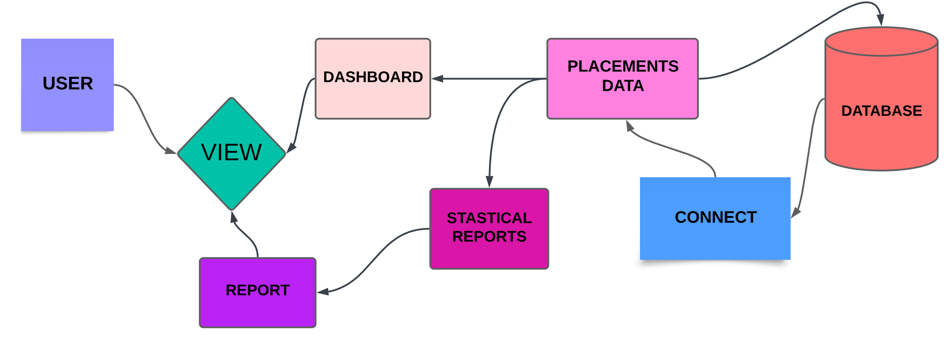
SYSTEM ARCHITECTURE

Slide 14
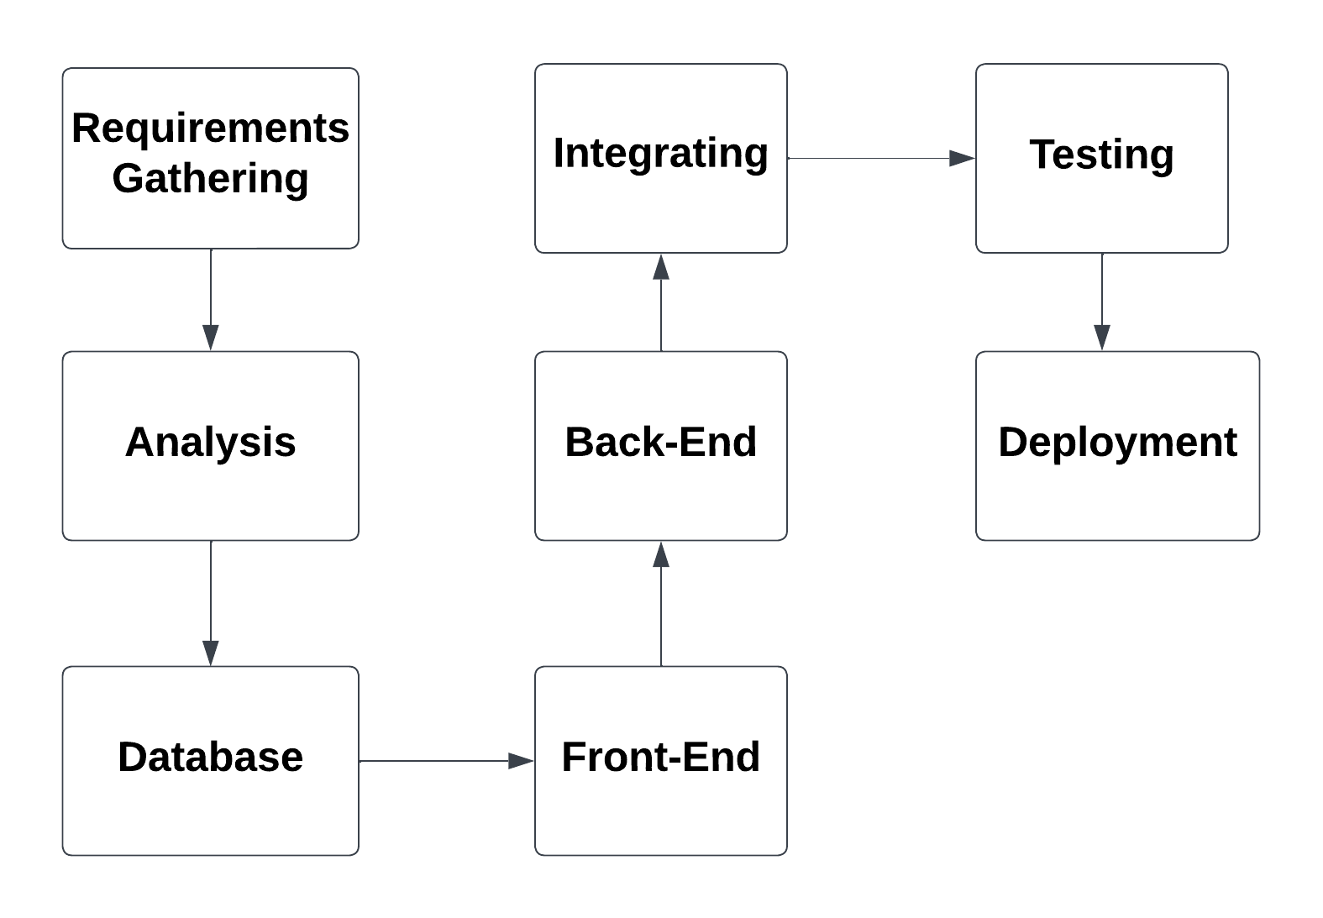
PROJECT PLAN

Slide 15
METHODOLOGY
Data Collection and Analysis: Gather placement data from various sources, including student profiles and company records. Clean and standardize the data by handling missing values and inconsistencies.
Data Storage and Management: Design a database to store student information, company details, and placement records. Establish relationships between entities for efficient data retrieval.
Dashboard Interface Development: Create a web application interface for users to interact with the placement analytics. Design intuitive visuals, including pie charts for technology distribution and hiring companies, and bar graphs for yearly trends.
User Interaction and Customization: Implement user-friendly filters to allow users to customize data views based on years, technologies, and companies.
Visualization Generation: Generate dynamic pie charts and bar graphs using data processed from the analysis. Ensure responsive design for seamless viewing on various devices.

Slide 16
IMPLEMENTATION
1. Requirements Gathering:
Identified the scope of the data: 2016-2020 batch CSE students' placement data.
Defined key features and functionalities for the application.
Selected technologies and tools for development.
2. Database Design and Data Import:
Designed the MySQL database schema to store the placement data.
Imported the gathered placement data into the MySQL database.
3. Frontend Development:
Set up the frontend project structure and included necessary libraries.
Implemented a sidebar with Home, Dashboard, Report, and Contact fields.
Developed the main dashboard interface to display placement data in a table.
Connected the frontend to the Django REST API for dynamic data fetching.

Slide 17
4. Backend Development (Django):
Set up the Django project and configured the database settings.
Created Django models representing entities such as Student, Company, Placement, etc.
Implemented Django views and serializers for data retrieval and manipulation.
Developed Django REST API endpoints for frontend-backend communication.
5. Data Visualization and Analytics (Upcoming Enhancements):
Planning to integrate charting libraries (e.g., Chart.js, D3.js) for interactive visualizations.
Will perform data analysis and generate statistical reports.

Slide 18
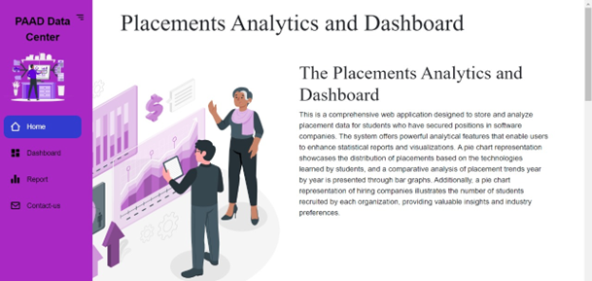
RESULT ANALYSIS
HomePage
Welcome to our homepage! Here, we provide an in-depth overview of our project, detailing how our web application connects students with job opportunities based on their acquired skills. The homepage serves as a comprehensive introduction, explaining the core features that users can access. We prioritize clarity and simplicity, ensuring that visitors easily understand the essence of our platform and the benefits it offers. Explore the project details, learn about the key features, and embark on a journey to discover exciting opportunities for career growth.

Slide 19
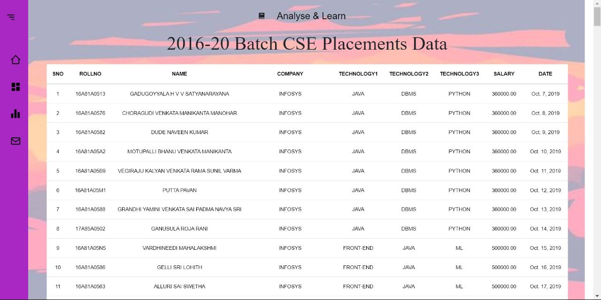
Dashboard
The Placement Analysis and Dashboard is a web-based application, which is my webpage. It contains data about students who secured jobs in various companies. We provide comprehensive information about the students, including the number of technologies they have mastered, the company they joined, their salary, and their date of joining. In this dashboard, we display data containing all the details of the students, such as their names, roll numbers, the companies they work for, the technologies they have expertise in, their salaries, and the date they joined. The primary focus of this dashboard is to showcase information about students who were placed in various companies between 2016 and 2020 in the Computer Science and Engineering (CSE) department.

Slide 20
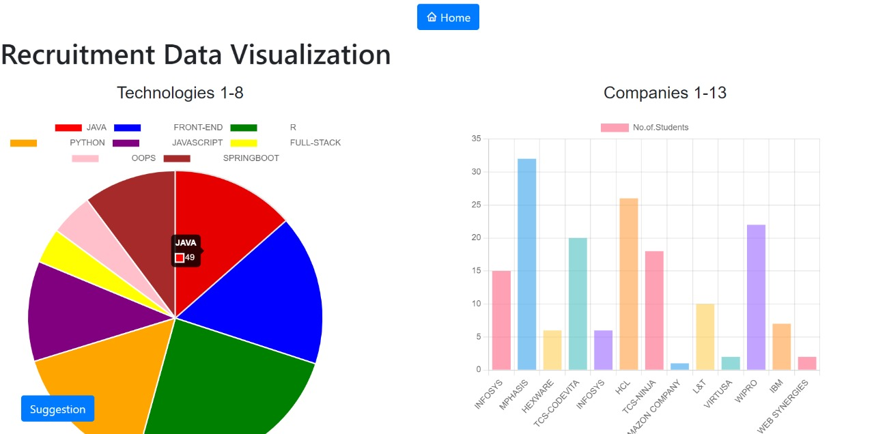
Data Visualizations
In this web application, we provide data about students who have secured jobs in various companies based on the technologies they have learned, all of which we store in a database. For enhanced understanding and visualization, we utilize Chart.js. This tool allows for a clearer and more straightforward comprehension of how many individuals are placed in different companies and the packages they receive. We represent the data through bar graphs and pie charts for better understanding for the user.

Slide 21
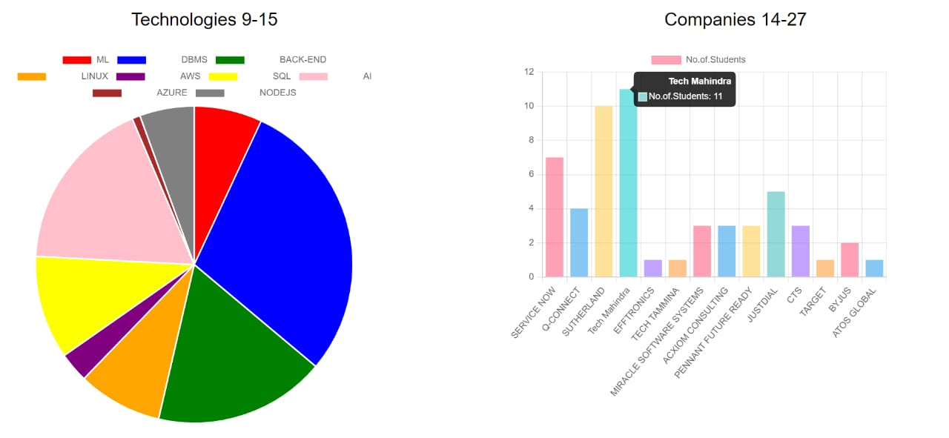

Slide 22
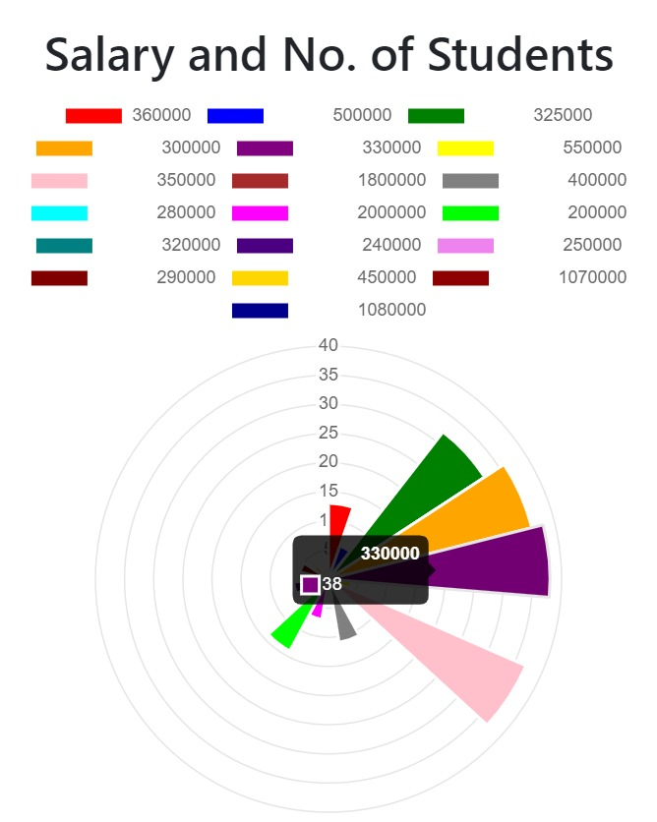
In our comprehensive analysis, we've meticulously gathered data from previous students who secured positions in various companies within the Computer Science and Engineering (CSE) department during the years 2019-2020. Our primary objective is to discern prevailing recruitment trends derived from past on-campus recruitments, shedding light on both the growth and decline in job requirements. To enhance the clarity of our analysis, we utilize Polar Charts specifically designed to showcase salary distributions. This innovative visualization tool provides an insightful depiction of how different factors contribute to overall trends in salaries over time. Users can easily navigate through the Polar Chart to understand the distribution of salaries, gaining valuable insights into the varying compensation levels obtained by different students within our dynamic community. The Polar Chart serves as a convenient and informative tool, offering a unique perspective on the salary dynamics in our job placement landscape.

Slide 23
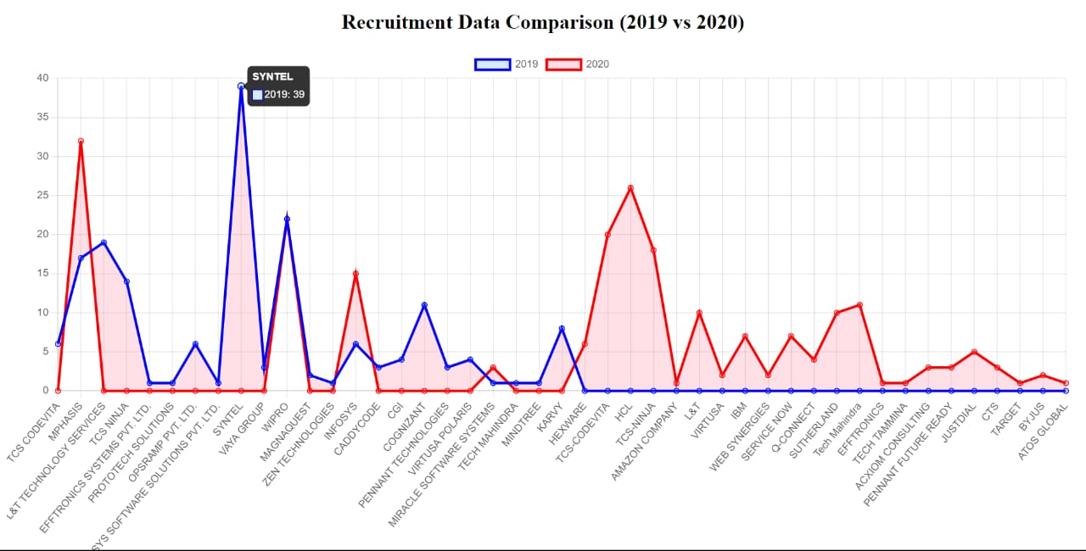
In our analysis, we have gathered data from previous students who secured jobs in various companies within the Computer Science and Engineering (CSE) department between the years 2019-2020. We aim to understand the current recruitment trends based on past on-campus recruitments, shedding light on both growth and declines in job requirements.
To facilitate a clearer comprehension of this analysis, we employ stacked line charts for enhanced visualization. So, users can easily grasp key insights about placements, making it a convenient and informative tool for understanding the dynamics of employment opportunities. Stacked line charts provide a different perspective on the data, showing how different factors contribute to overall trends over time.

Slide 24
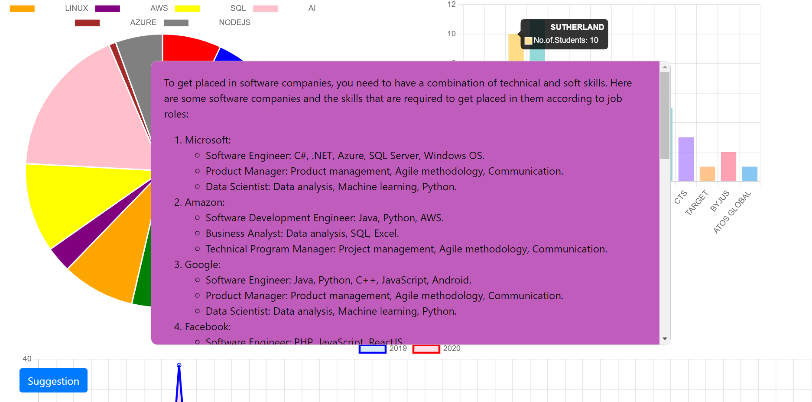
SuggestionBox
Explore our Suggestion Box feature, a valuable resource designed to guide you on the specific technologies required for success in various companies. This interactive tool provides tailored recommendations based on the insights gathered from successful student placements in the Computer Science and Engineering (CSE) department between 2019-2020. Whether you're aiming for a career in a specific company or looking to enhance your skills for broader opportunities, the Suggestion Box offers personalized advice. Input your desired company, and the Suggestion Box will provide a curated list of technologies that have proven beneficial for securing positions in that organization. This feature serves as a roadmap for skill development, empowering you with the knowledge needed to thrive in your chosen career path. Navigate the ever-evolving landscape of technology with confidence, guided by the practical insights shared by those who have successfully navigated similar journeys.

Slide 25
ATTAINMENT OF OBJECTIVE:
Achieving the objective involves transitioning from a decentralized data to a centralized one, facilitated by the utilization of visualization tools and techniques. Where the decentralized data is shown in tables .This centralized approach will enable a more streamlined and efficient analysis of data, improving accessibility and insights through visual representations.The centralized data is displayed using pie charts ,bar graphs ,Polar Area Charts and staked lines.
CONCLUSION:
The completion of the core project tasks, including data collection, cleaning, storage, visualization, and analysis, we have successfully finalized the user-friendly homepage. This serves as the clear and intuitive entry point to access placement data and insights on the dashboard. The Contact or Support feature is also available for users seeking detailed information or clarification of any doubts. This marks a significant milestone in delivering an enhanced and streamlined user experience.

Slide 26
FUTURE SCOPE:
Multi-Year Data Integration:
In the current scenario, the system includes only one year of placement data. In the future, the project could be enhanced to integrate multiple years of placement data. This would allow for a more comprehensive analysis of placement trends over time, enabling students and colleges to make more informed decisions.
Cross-College Data Aggregation:
The future scope of the project could involve aggregating placement data from different colleges. This would provide a broader view of the placement landscape and help identify industry preferences and recruitment trends on a larger scale. Students can then compare the performance of their institution with others and work on areas of improvement.
Advanced Analytics:
With the addition of more data, advanced analytics and machine learning techniques can be incorporated to predict future placement trends. This would involve analyzing historical data to identify patterns and forecast which skills and technologies will be in demand in the future.
Real-Time Data Updates:
The project could be upgraded to include real-time data updates. This would involve integrating the application with college placement systems to fetch data in real-time, ensuring that students and administrators always have access to the most up-to-date information.

Slide 27


