Slide 1
LIA CRM
Release 1 Features
Release 2 Features
Release 3 Features
Web based
Enquiry
Sharing – View/Edit Client access
Chat
Secured/Data Protection
Potential Clients
App + Web
Emails
60 NZD per month
Clients
Invoices
Share form and docs with client
File Notes
Community Posts
Invoicing
Documents
Sync with website
Enquiry Form
Download desktop app
Dashboard
Stay connected with advisers
Timelines

Slide 2
Enquiry Rules
Potential Clients
Enquiry form if linked from website should store data filled by the lead for CRM user
Latest 5 Enquiry should be visible from dashboard
In Enquiry form list view, search should be available
Next to search, few tabs to be provided such as –
Today
This week (Sunday-Saturday night)
Fortnight (2 weeks)
This month
This year
Custom
List view should display with a select check box and button to move to potential client or client. (Differs for potential client and client view)
(can use same as Kiwifern CRM view of enquiry dashboard) – All fields ascending and descending order sorting
Name
Visa type interested in
Phone
Email
In Enquiry form list view, field entry should be clickable
Enquiry form fields should be editable to the CRM user and if any changes are made either auto save or pop up asking to save the changes.
Date and time of last update should be visible on top of page when the user accesses the form next time.
Number of records permitting page and then next and previous page button.

Slide 3
Clients
Client view opens a Kanban view of client stages given below and each client placed as per stages in one view.
When moving to client, there should be a pop up about sharing on/off for client view. If on – it should prompt for all or select from – Client, Stages, Documents, File notes and View or Edit option. The sharing on/off toggle current status should always appear on top of the client file and notification preference should be via web app or link where the user clicks to see the updates and edits if access is provided.
Create new and search option is available
When the user clicks on client view, the clickable stages appear on top to show a clear and organized engagement with the client.
Stages are editable?:
Initial Consultation Agreement Documents Application Lodgement PPI INZ updates Outcome Return of documents Non engagement Completed
The user can move clients to different stages of the process
Each client card displays the following details in Kanban view – Client name, visa type, due date and $ value.
When the client form opens in new or edit view, all the details are organized as per the enquiry or potential client form in sections. The only additions are on the left hand navigation are
1. File notes
2. Documents 3. Invoices
These 3 links keep continuing through the end of the stages so more documents and file notes are added as per the stage the application is in and invoice can be created and reconciled when moving to completed stage.
The completed stage gives a collection of all sections in one view for each client with date/time and hours and $ rate per stage (only admin view)
9. While creating a client, there a new section for invoice where the adviser can enter the following –
- Fixed rate (either fixed rate or per hour rate can be selected)
- Per hour rate
- Estimated hours (when the client moves to completed, there is an additional field for actual hours to be entered and $ value is displayed in Amount Due field.
10. The create invoice button is there through out and displays the list of invoices created under client view – Invoices tab
11. The create new invoice creates the invoice as per image provided.

Slide 4
Files Notes
File notes tab should display a list view of client file notes recently updated
Latest 5 file notes updated should be displayed in dashboard. Under file notes in dashboard, client name will appear and clicking on it will take the user to the client file note section.
In Enquiry form list view, search should be available
Next to search, few tabs to be provided such as –
Today
This week (Sunday-Saturday night)
Fortnight (2 weeks)
This month
This year
Custom
5. File note list view from the tab will have the following with view and sharing toggle on/off. Sharing on will share notes with client in his/her view and alert notification.
1. No 2. Date
3. Time
4. Client Name
5. Visa type
6. File note title
6. View will open the file note form which can be editable.
7. On top of the file note form, there is 2 open text boxes
Add title – Free text (ex Initial consultation, Eligibility Assessment, Follow up)
Enter notes – Free text (editor)
Auto save or save pop up.
8. User can add new or update existing.

Slide 5
Documents
File Name
Upload
or
Add Link
Save
File Name
Upload
or
Add Link
Save
Uploaded Documents
Download All
File Name
View
Download
Upload date.time
File Name
View
Download
Upload date.time
File Name
View
Download
Upload date.time

Slide 6
Invoices - Creation
Fields
To: Client email
Date:
Due Date:
Invoice No:
Reference
GST:
Item Description Price Account GST/Tax rate Amount Currency
1 x
2 x
3 x
Add
Sub total
GST
TOTAL
Save – as draft
Save – download as pdf Save – send to client

Slide 7
Invoices
Dashboard: 1. Display top 5 invoices generated with date, name and amount
2. Display top 5 invoices half of due date set 3. Display top 5 invoices paid
Invoices tab
1. Search option 2. Display all invoices with status or tab of draft, overdue, paid with table of client name, visa type, $ rate. 2. All draft invoices, should have edit and delete option 3. All overdue invoices should have option to mark as paid.
4. Create new button on top to create with option to save and save as template. 5. Saving as template will allow user to create invoice with template every time new invoice is clicked. 6. On top have tabs for today, this week, this fortnight, this month, this year and custom.

Slide 8
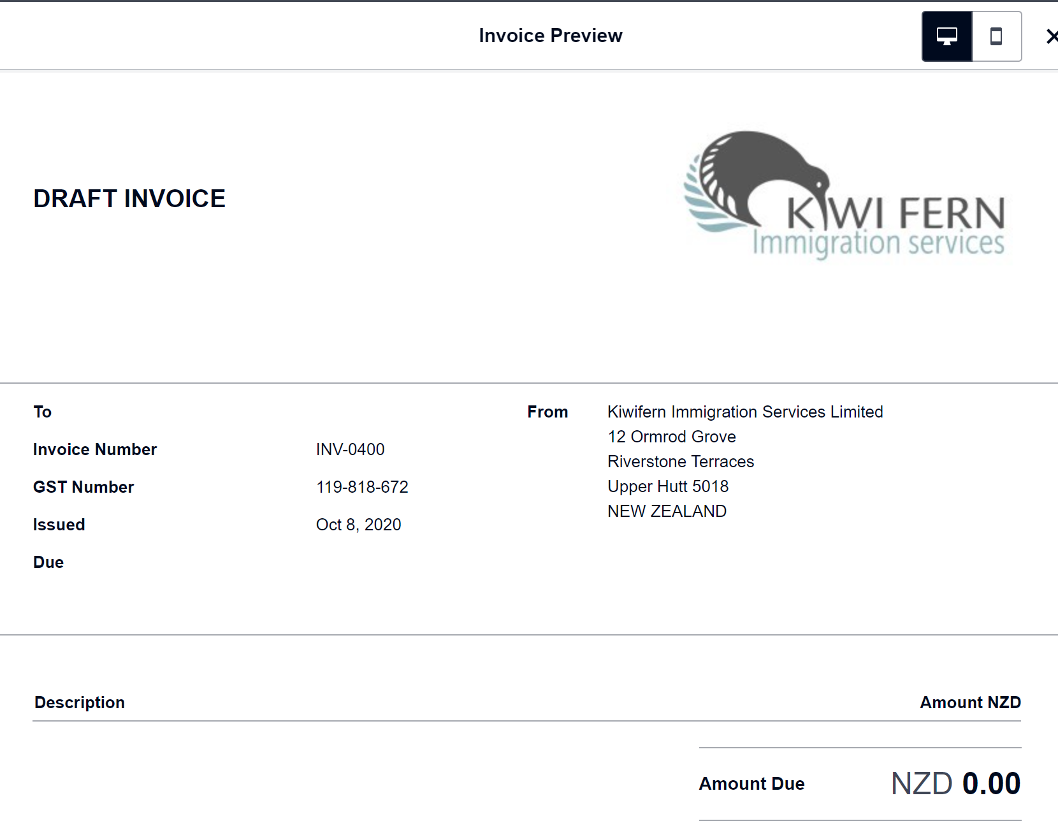
Sample Invoice

