Slide 1
Drone Test Training
June 2019

Slide 2
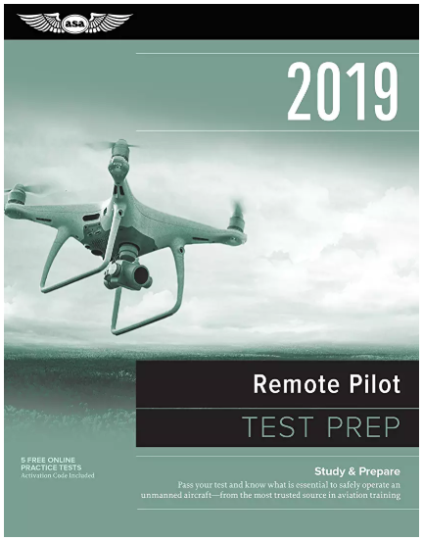
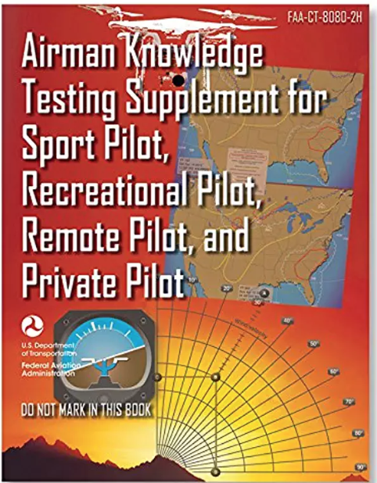
Books
remote_pilot_study_guide.pdf

Slide 3
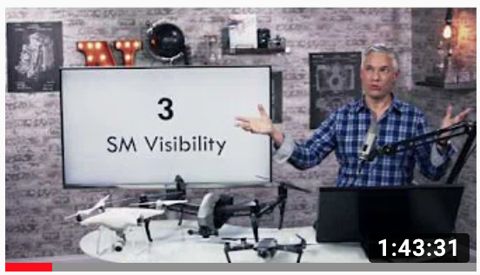
YouTube: search keyword FAA107
https://youtu.be/6_ucCKFJUCU

Slide 4
Online testing examples
Don’t use them before you go through books/videos.

Slide 5
Initial Test
Computer based test.
Testing center in Roanoke airport.
Computer, pencil, calculator, redbook (map etc)
Regulations: 15-25%
Airspace & Requirements 8-15%
Weather 11-16%
Loading and Performance 7-11%
Operations 13-18%
Many questions are about map reading.

Slide 6
Acronyms
sUAS
PIC
VLOS
VO
14 CFR 107
ATC
AGL
MSL
METAR
TAF
UTC
ASOS/AWOS
MOA
MTR
NOTAM
Notes:
sUAS: Small Unmanned Aircraft System
PIC: Pilot in Command
VLOS: Visual Line of Sight
VO: Visual Observer
14 CFR 107: Title 14 of the Code of Federal Regulations Part 107 (Part 107 governs the operation of small unmanned aircraft systems in the United States)
ATC: Air Traffic Control
AGL: Above Ground Level
MSL: Mean Sea Level
METAR: Meteorological Aerodrome Report
TAF: Terminal Aerodrome Forecast
UTC: Universal Time Coordinated
ASOS/AWOS: Automated Surface Observing System/Automated Weather Observing System
MOA: Military Operations Area
MTR: Military Training Route
NOTAM: Notice to Airmen

Slide 7
Some key numbers: 0.55lb and 55lb
sUAS is “less than 55lb” ( < 55lb)
Include everything!
“more than 0.55lb” require registration.
14 CFR 107 is for “civil aircraft” (not military, not public)

Slide 8
13 years old, 16 years old
13 years old : can register aircraft
16 years old: can be licensed to fly
2 year refreshment (email reminder 10 days prior to expiration)

Slide 9
PIC, VO, other crew member
If ask who is responsible, in charge of etc.
The answer is always PIC.
Notes:
Person In Command
VO: Visual Observer

Slide 10
Accident report
$500: damage to property, does not include the cost of the drone.
10 days: report within 10 days.
Serious injury (level 3) or above require report: “hospitalization”

Slide 11
Hazardous materials
Lithium battery is “hazardous material”.
UAS can only carry Lithium battery if the battery is installed on the UAS.

Slide 12
Daylight operation
Civil “twilight”
30 mins before sunrise/after sunset.
Need strong anti collision light (3 miles)
No operation at night

Slide 13
VLOS
Visual Line Of Sight
Must “be able to see” all the time.
Regain VLOS as soon as possible.

Slide 14
Operating Limitations
Max speed: 100 miles per hour / 87 knots.
Max height: 400 feet AGL (above ground level).
Height: 400 feet around structure (tower, building). Tricky question if consider tower inspection in a restricted air space.

Slide 15
Operating Limitations
Visibility: 3 statute miles / SM
Cloud: 2000 feet horizontally
500 feet below
Guy-wire

Slide 16
Right-of-Way
sUAS has no right of way.

Slide 17
No Operation Over People
Except for the people involved in the operation.

Slide 18
Operation from Moving Vehicles or Aircraft
Operation from moving car/boat is allowed in “sparsely populated” or “unpopulated” areas
Operation from aircraft is not allowed (no Avengers)
Cannot drive while operating UAS.

Slide 19
Privacy and drop items from UAS
55 lb include the cargo
Cannot drop items that can harm people
Cannot operate from a moving car/boat
Within boundary of a State
Cannot carry hazardous materials

Slide 20
Alcohol and Drugs
0.04% blood alcohol level
8 hours no drink

Slide 21
Waiver and others
90 days prior to operation
Autopilot: need to be able to take back control anytime.
Flight rules/restrictions: can deviate from the rules to avoid accident. Need report when requested by FAA (Please look this up)

Slide 22
Knowledge of air space system
NOTAMs: notices to airmen
www.1800wxbrief.com
www.skyvector.com (not in the test)

Slide 23
TFR: temporary flight restriction
Protect president and other important public figures.
Emergency response: forest fire etc.
Stadiums for sports events.

Slide 24
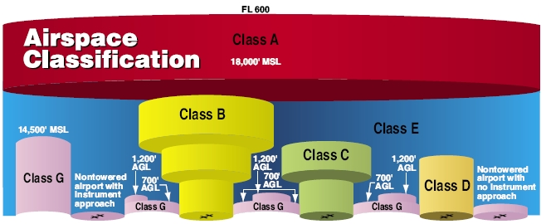
AirSpace classification
Class B,C,D,E,G

Slide 25
Airspace classification
Height of airspaces are provided (no need to remember)
Radius of airspaces are not provided (5NM for C, 4NM for D)
Class G is unregulated
Class E is everything besides A,B,C,D,G
Airport without tower is restricted E space from SFC (surface) up.
Class B,C,D require ATC authorization

Slide 26
Airspace classification
Prohibited Areas
Restricted Areas
Warning Areas
MOA (Military Operation Areas)
Alert Areas
MTR (Military Training Routes), flight height of MTR

Slide 27
Latitude and Longtitude
Latitude is 0 at equator
Longitude increase from east coast (Virginia) to west coast (CA).
Need to be able to read map (degree º, minutes ’, seconds ”)
Example “on map, XX north, YY east, what is the air space”

Slide 28
Airport operations
Upwind Leg: AGAINST WIND DIRECTION
Crosswind Leg: PERPENDICULAR TO RUNWAY AFTER UPWIND
Downwind Leg: PARALLEL TO RUNWAY IN SAME DIRECITO OF WIND
Base Leg: AFTER DOWNWIDND, PERPENDICULAR TO RUNWAY
Short Leg: OR FINAL LEF WHEN AIRCRAFT ALIGHNS WITH RUNWAY FOR LANDING
Example: “hear pilot say xx Leg, yy degree, left/right pattern”
Notes:
Upwind Leg: The leg of the traffic pattern flown parallel to the runway in the direction opposite to landing or takeoff. Aircraft fly upwind to gain altitude and distance from the airport before turning onto the crosswind leg.
Crosswind Leg: The leg of the traffic pattern flown perpendicular to the runway, directly away from or towards the airport. After flying upwind, pilots turn onto the crosswind leg to continue climbing and maintain distance from the airport while maintaining a constant heading.
Downwind Leg: The leg of the traffic pattern flown parallel to the runway in the same direction as landing or takeoff. Pilots on the downwind leg maintain altitude and distance from the airport while preparing for the landing approach.
Base Leg: The leg of the traffic pattern flown perpendicular to the runway, transitioning from the downwind leg to the final approach. Aircraft on the base leg reduce altitude and airspeed in preparation for the final approach and landing.
Final Approach (Short Leg): The final leg of the traffic pattern where the aircraft aligns with the runway for landing. This leg is sometimes referred to as the short leg, especially in situations where the final approach is shortened due to traffic or other factors.
Example phrase: "Hear pilot say 'Turning onto crosswind leg, at 1500 feet, left pattern'." This indicates that the pilot is turning from the upwind leg onto the crosswind leg, flying at an a

Slide 29
Airport marking and signs
On the book but never tested.
Except that runway mark as “xx”: for example “13” means 130 degree from “magnetic north”.

Slide 30
Weather
Thunderstorms
Cumulus stage / mature stage
Weather briefing:
TAF/METAR/ASOS/AWOS
METAR KGGG 161753Z AUTO 14021G26KT 3/4SM +TSRA BR BKN008 OVC012CB 18/17 A2970 RMK PRESFR

Slide 31
Loading and performance
Pitch: Elevator
Yaw: Rudder
Roll: Aileron
Load curve
Stall

Slide 32
Communications
Alpha, Bravo, Charlie, Delta
UNICOM, ASOS, CTAF, MULTICOM:
What are these, and what do they do, and where to find them on the map.

Slide 33
Aeronautical Decision Making
Crew Resource Management (CRM)
Safety Management System (SMS)
Hazardous attitudes:
Anti-authority, Impulsivity, Invulnerability, Machoism, Resignation

Slide 34
Physiology
Hyperventilation
Heatstroke
Hypothermia
Stress
Fatigue
Chronic stress

Slide 35
Maintenance and inspection
Whose duty? Remote PIC
If sUAS manual does not provide a maintenance schedule/procedure?
PIC make a checklist

Slide 36
That’s All

Slide 37
Additional
https://youtu.be/6_ucCKFJUCU
https://a.co/d/fmrC2b1
https://a.co/d/aUY6EB7

