Slide 1


SMART INDIA HACKATHON 2025
AthleteHub: AI-Powered Sports Community & Leaderboard Platform
Problem Statement ID – SIH25073
Problem Statement Title- Al-Powered Mobile Platform for Democratizing Sports Talent Assessment
Theme- Fitness & Sports
PS Category- Software
Team ID-
Team Name- ASHES

Slide 2


AthleteHub: AI-Powered Sports Community & Leaderboard Platform
ASHES
Proposed Solution
Detailed Explanation of the Proposed Solution:
Community-driven platform for athletes.
Profiles to showcase achievements, certificates, and training videos.
Structured like a library, not random like Instagram.
How It Addresses the Problem:
Gives equal visibility to athletes from rural and urban areas.
Removes dependency on physical infrastructure for recognition.
Recognizes diverse athletic styles (e.g., sprinting strategies, stamina levels).
Innovation and Uniqueness of the Solution:
Combination of Reddit-style community + YouTube-like video library.
Library-based categorization instead of random feeds.
AI-powered cheat detection and performance evaluation.

Slide 3
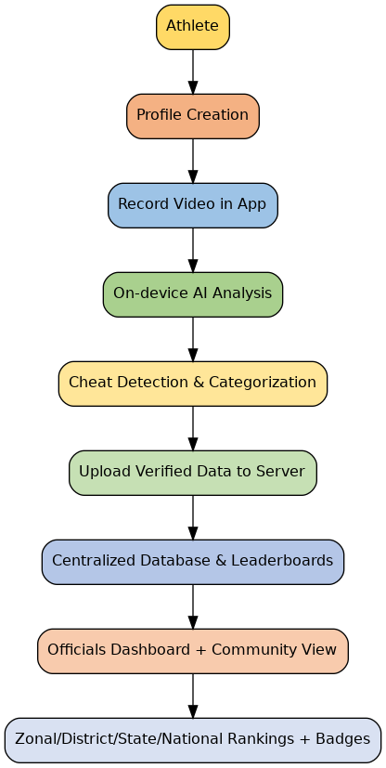
TECHNICAL APPROACH
ASHES
Frontend (Mobile App & Web Dashboard):
Frameworks: Flutter (Android/iOS app), React (for web dashboard)
UI/UX Tools: Figma
Backend & APIs:
Programming Languages: Python, Node.js
Frameworks: Django (Python) or Express.js (Node.js)
Database: PostgreSQL / MongoDB
Cloud: AWS / Google Cloud
AI/ML (Performance Analysis & Leaderboards):
Libraries: TensorFlow Lite, PyTorch Mobile, OpenCV
Models: Pose Estimation (e.g., MediaPipe, OpenPose)
Features: Rep counting, stamina analysis, movement & cheat detection
Authentication & Security:
Firebase Auth / OAuth 2.0
End-to-end encryption for videos & data
Methodology & Process for Implementation:

Slide 4
FEASIBILITY AND VIABILITY
ASHES
Analysis of the Feasibility of the Idea:
Smartphones and internet penetration across India make a mobile-based AI sports assessment platform practical, scalable, and socially impactful nationwide.
Cloud infrastructure with AI/ML enables secure storage, real-time analysis, and performance tracking, ensuring feasibility for large-scale nationwide deployment.
Potential Challenges and Risks:
Limited connectivity and varying device quality in rural regions may restrict participation and cause inconsistent assessment experiences for athletes.
Risks of fake accounts, manipulated videos, and AI misinterpretation could affect leaderboard fairness, data privacy, and overall platform trust.
Strategies for Overcoming These Challenges:
Develop lightweight, offline-capable app with AI optimized for low-end devices, ensuring accessibility in low-bandwidth and resource-constrained environments.
Use diverse datasets for AI training, encryption, and multi-step verification to improve accuracy, detect cheating, and enhance athlete trust.

Slide 5
IMPACT AND BENEFITS
ASHES
Potential Impact on the Target Audience:
Athletes from rural and remote areas gain visibility, bridging gaps in access to national-level opportunities and recognition.
Young athletes receive fair evaluations, motivating consistent training, skill development, and healthy competition across regions and categories.
Coaches and scouts access verified performance data, simplifying talent identification and reducing biases in athlete selection processes.
Government and sports authorities achieve transparent, scalable, and efficient systems for nationwide talent discovery and resource allocation.
Benefits of the Solution:
Social: Encourages inclusivity, youth empowerment, and equal opportunities, strengthening India’s grassroots sports ecosystem.
Economic: Low-cost mobile-first approach reduces infrastructure spending and makes assessments affordable for all participants.
Environmental: Digital evaluations minimize travel and reduce carbon footprint by avoiding centralized physical assessment centers.
Overall: Promotes scalability, transparency, and efficiency in nationwide sports talent management and development.

Slide 6
RESEARCH AND REFERENCES
ASHES
[1] M. B. J. Rodrigues, J. M. F. da Silva, and F. J. R. Fernandes, "Artificial intelligence in sports: Applications and perspectives," Neural Computing and Applications, vol. 33, pp. 10881–10899, 2021.
[2] Google, "MediaPipe: Pose estimation and motion tracking solution," Google AI Developer Solutions, 2023. [Online]. Available: https://developers.google.com/mediapipe/solutions/vision/pose
[3] Sports Authority of India, "Khelo India Talent Identification and Development Programme," Sports Authority of India (SAI), 2024. [Online]. Available: https://sportsauthorityofindia.nic.in/sai/
[4] J. Chen, X. Li, and K. Wang, "Efficient on-device machine learning for mobile applications," in Proc. IEEE Int. Conf. Mobile Computing and Networking (MobiCom), 2020.
[5] A. Koivisto and J. Hamari, "The rise of motivational information systems: A review of gamification research," Computers in Human Behavior, vol. 45, pp. 191–210, 2015.

