Slide 1

Tutorial on “R” Programming Language
Eric A. Suess, Bruce E. Trumbo,
and Carlo Cosenza
CSU East Bay, Department of Statistics and Biostatistics

Slide 2
Outline
Communication with R
R software
R Interfaces
R code
Packages
Graphics
Parallel processing/distributed computing
Commerical R REvolutions

Slide 3
Communication with R
In my opinion, the R/S language has become the most common language for communication in the fields of Statistics and and Data Analysis.
Books are being written now with R presented directly placed within the text.
SV use R, for example
Excellent for teaching.

Slide 4
R Software
To download R
http://www.r-project.org/
CRAN
Manuals
The R Journal
Books

Slide 5
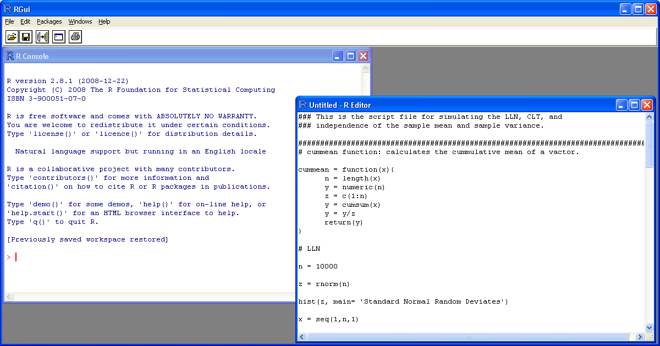
R Software

Slide 6
R Interfaces
RWinEdt
Tinn-R
JGR (Java Gui for R)
Emacs + ESS
Rattle
AKward
Playwith (for graphics)

Slide 7
R code
> 2+2
[1] 4
> 2+2^2
[1] 6
> (2+2)^2
[1] 16
> sqrt(2)
[1] 1.414214
> log(2)
[1] 0.6931472
> x = 5
> y = 10
> z <- x+y
> z
[1] 15

Slide 8
R Code
> seq(1,5, by=.5)
[1] 1.0 1.5 2.0 2.5 3.0 3.5 4.0 4.5 5.0
> v1 = c(6,5,4,3,2,1)
> v1
[1] 6 5 4 3 2 1
> v2 = c(10,9,8,7,6,5)
>
> v3 = v1 + v2
> v3
[1] 16 14 12 10 8 6

Slide 9
R code
> max(v3);min(v3)
[1] 16
[1] 6
> length(v3)
[1] 6
> mean(v3)
[1] 11
> sd(v3)
[1] 3.741657

Slide 10
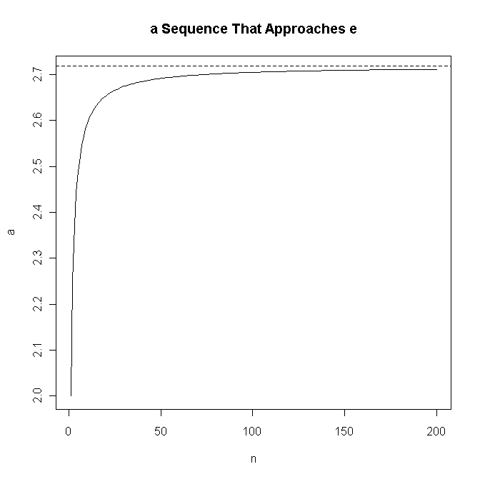
R code
> v4 = v3[v3>10]
> v4
[1] 16 14 12
> n = 1:10000; a = (1 + 1/n)^n
> cbind(n,a)[c(1:5,10^(1:4)),]
n a
[1,] 1 2.000000
[2,] 2 2.250000
[3,] 3 2.370370
[4,] 4 2.441406
[5,] 5 2.488320
[6,] 10 2.593742
[7,] 100 2.704814
[8,] 1000 2.716924
[9,] 10000 2.718146

Slide 11
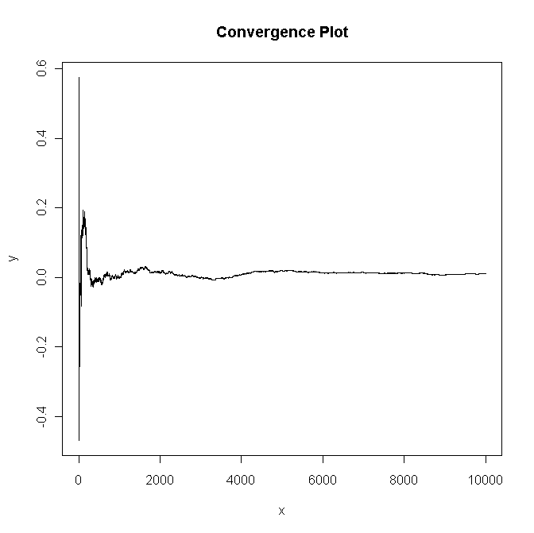
R code
# LLN
cummean = function(x){
n = length(x)
y = numeric(n)
z = c(1:n)
y = cumsum(x)
y = y/z
return(y)
}
n = 10000
z = rnorm(n)
x = seq(1,n,1)
y = cummean(z)
X11()
plot(x,y,type= 'l',main= 'Convergence Plot')

Slide 12
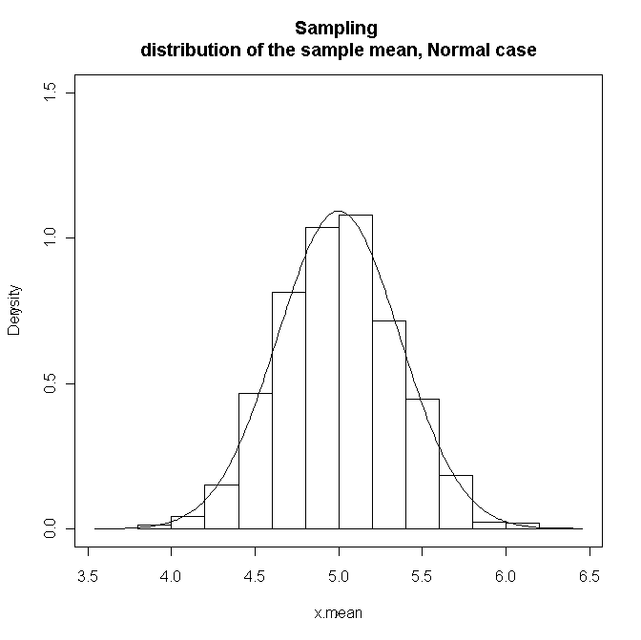
R code
# CLT
n = 30 # sample size
k = 1000 # number of samples
mu = 5; sigma = 2; SEM = sigma/sqrt(n)
x = matrix(rnorm(n*k,mu,sigma),n,k) # This gives a matrix with the samples
# down the columns.
x.mean = apply(x,2,mean)
x.down = mu - 4*SEM; x.up = mu + 4*SEM; y.up = 1.5
hist(x.mean,prob= T,xlim= c(x.down,x.up),ylim= c(0,y.up),main= 'Sampling
distribution of the sample mean, Normal case')
par(new= T)
x = seq(x.down,x.up,0.01)
y = dnorm(x,mu,SEM)
plot(x,y,type= 'l',xlim= c(x.down,x.up),ylim= c(0,y.up))

Slide 13
R code
# Birthday Problem
m = 100000; n = 25 # iterations; people in room
x = numeric(m) # vector for numbers of matches
for (i in 1:m)
{
b = sample(1:365, n, repl=T) # n random birthdays in ith room
x[i] = n - length(unique(b)) # no. of matches in ith room
}
mean(x == 0); mean(x) # approximates P{X=0}; E(X)
cutp = (0:(max(x)+1)) - .5 # break points for histogram
hist(x, breaks=cutp, prob=T) # relative freq. histogram

Slide 14
R help
help.start() Take a look
  An Introduction to R
  R Data Import/Export
  Packages
data()
ls()

Slide 15
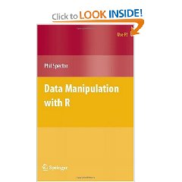
R code
Data Manipulation with R (Use R)
Phil Spector

Slide 16
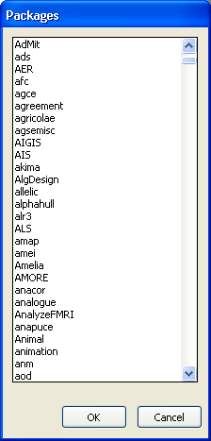
R Packages
There are many contributed packages that can be used to extend R.
These libraries are created and maintained by the authors.

Slide 17
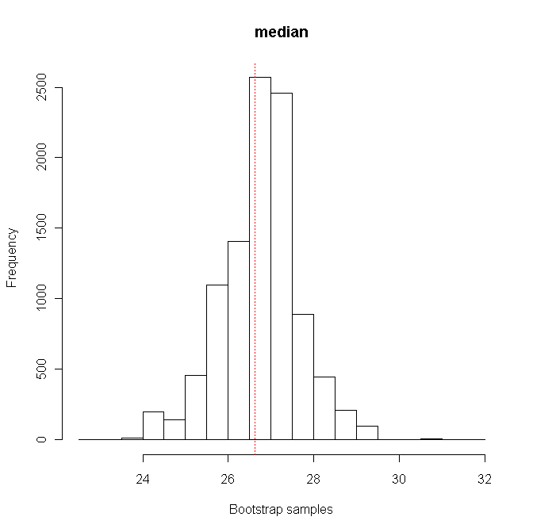
R Package - simpleboot
mu = 25; sigma = 5; n = 30
x = rnorm(n, mu, sigma)
library(simpleboot)
reps = 10000
X11()
median.boot = one.boot(x, median, R = reps)
#print(median.boot)
boot.ci(median.boot)
hist(median.boot,main="median")

Slide 18
R Package – ggplot2
The fundamental building block of a plot is based on aesthetics and facets
Aesthetics are graphical attributes that effect how the data are displayed. Color, Size, Shape
Facets are subdivisions of graphical data.
The graph is realized by adding layers, geoms, and statistics.

Slide 19
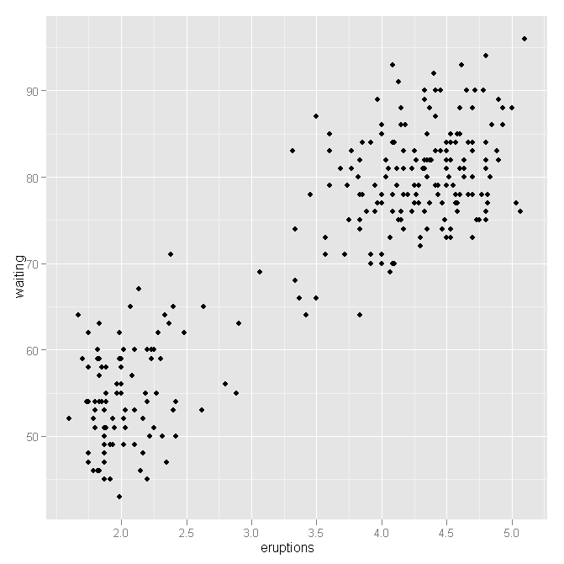
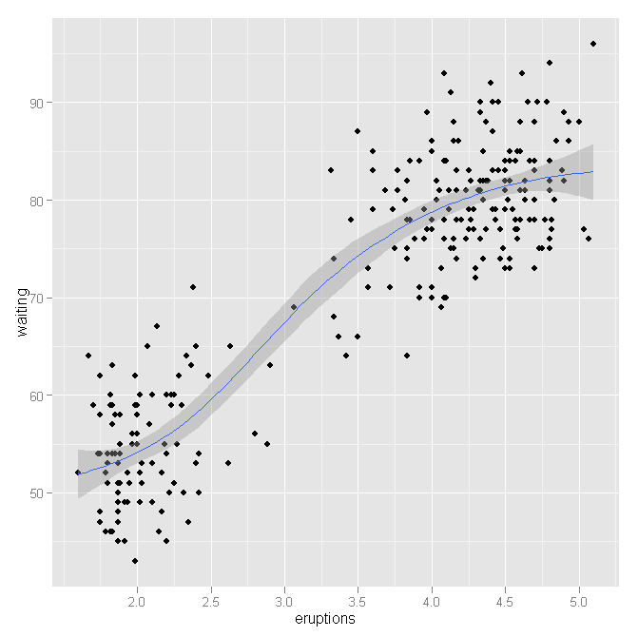
R Package – ggplot2
library(ggplot2)
oldFaithfulPlot = ggplot(faithful, aes(eruptions,waiting))
oldFaithfulPlot + layer(geom="point")
oldFaithfulPlot + layer(geom="point") + layer(geom="smooth")

Slide 20

R Package – ggplot2
Ggplot2: Elegant Graphics for Data Analysis (Use R)
Hadley Wickham

Slide 21
R Package - BioC
BioConductor is an open source and open development software project for the analysis and comprehension of genomic data.
http://www.bioconductor.org
Download > Software > Installation Instructions
source("http://bioconductor.org/biocLite.R")
biocLite()

Slide 22
R Package - affyPara
library(affyPara)
library(affydata)
data(Dilution)
Dilution
cl <- makeCluster(2, type='SOCK')
bgcorrect.methods()
affyBatchBGC <- bgCorrectPara(Dilution, method="rma", verbose=TRUE)

Slide 23
R Package - snow
Parallel processing has become more common within R
snow, multicore, foreach, etc.

Slide 24
R Package - snow
Birthday Problem simulation in parallel
cl <- makeCluster(4, type='SOCK')
birthday <- function(n) {
ntests <- 1000
pop <- 1:365
anydup <- function(i)
any(duplicated(
sample(pop, n,replace=TRUE)))
sum(sapply(seq(ntests), anydup)) / ntests}
x <- foreach(j=1:100) %dopar% birthday (j)
stopCluster(cl)
Ref: http://www.rinfinance.com/RinFinance2009/presentations/UIC-Lewis%204-25-09.pdf

Slide 25
REvolution Computing
REvolution R is an enhanced distribution of R
Optimized, validated and supported
http://www.revolution-computing.com/

