Slide 1

Multiclass Fish Image Classification
Main Title: Multiclass Fish Species Classification
Subtitle: Leveraging Deep Learning and Transfer Learning for Precision Aquaculture
Presenter Name: Jeevarathinam Ranganathan

Slide 2
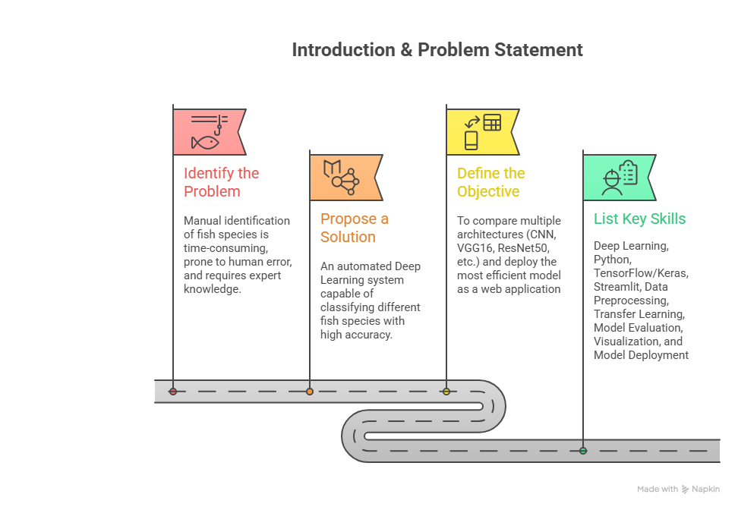

Slide 3
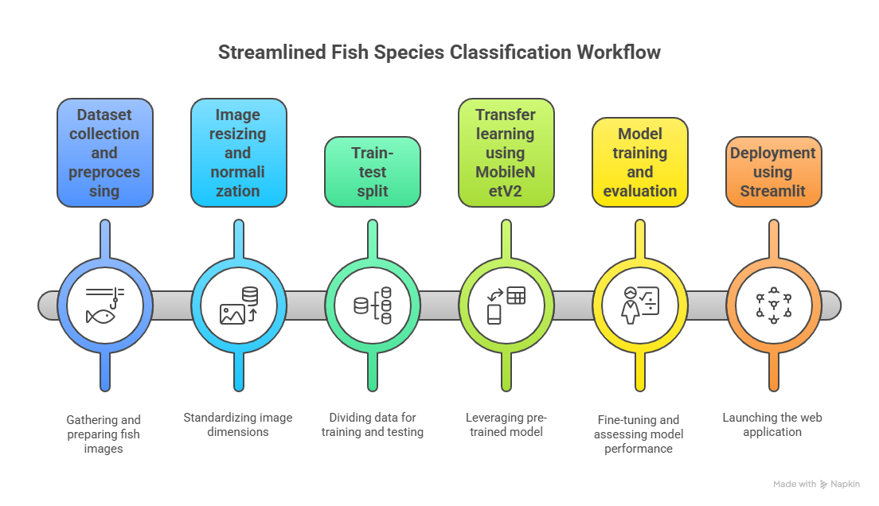

Slide 4
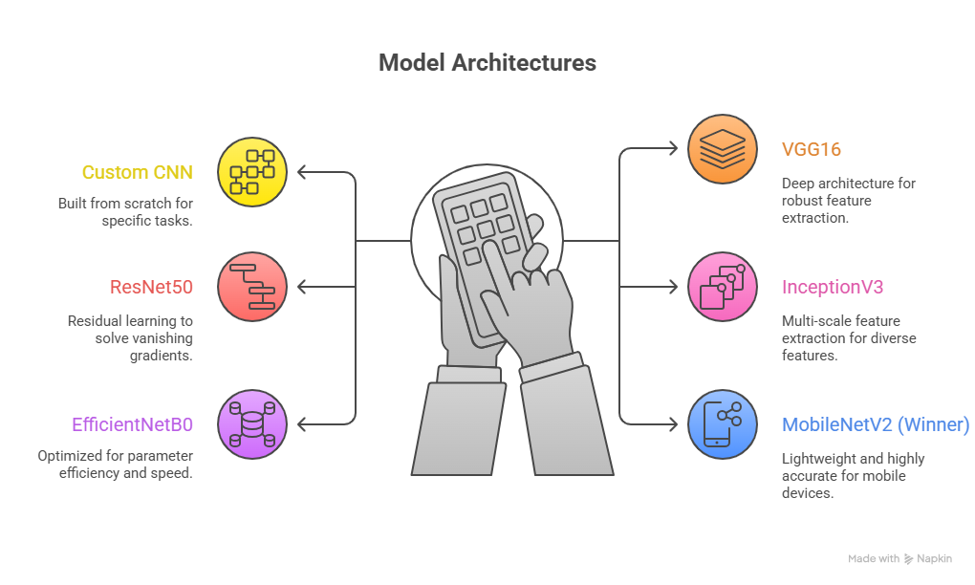

Slide 5
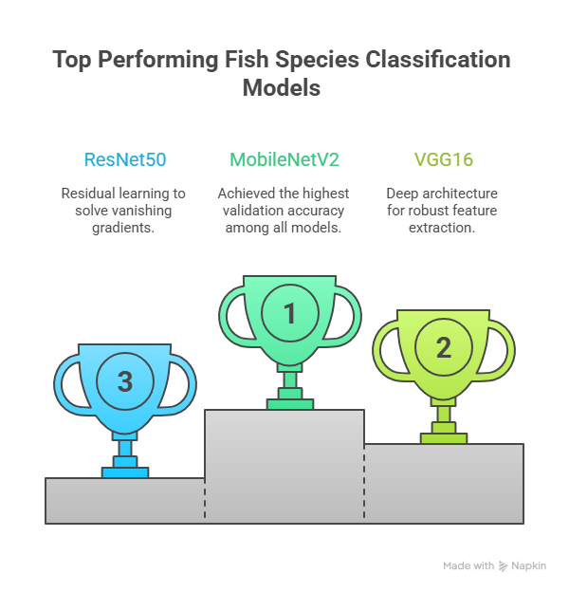

Slide 6
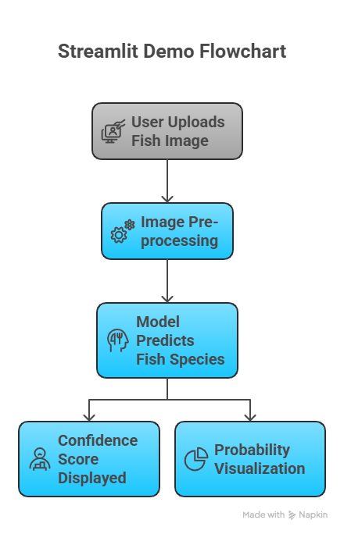

Slide 7
