Slide 1
  Swiggy Restaurant Recommender System
Jeevarathinam R

Slide 2
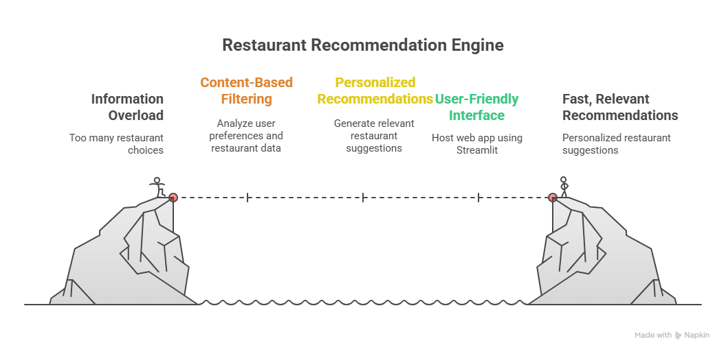
Jeevarathinam R

Slide 3
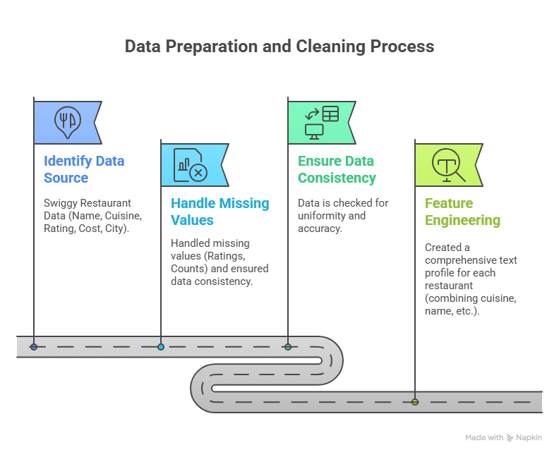
Jeevarathinam R

Slide 4
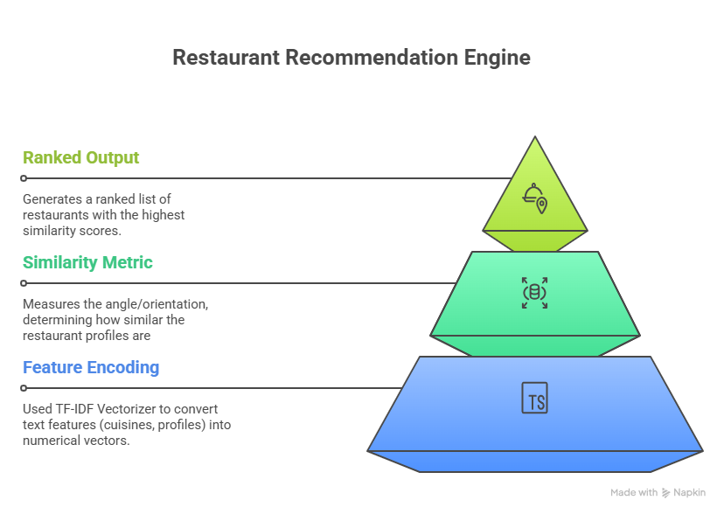
Jeevarathinam R

Slide 5
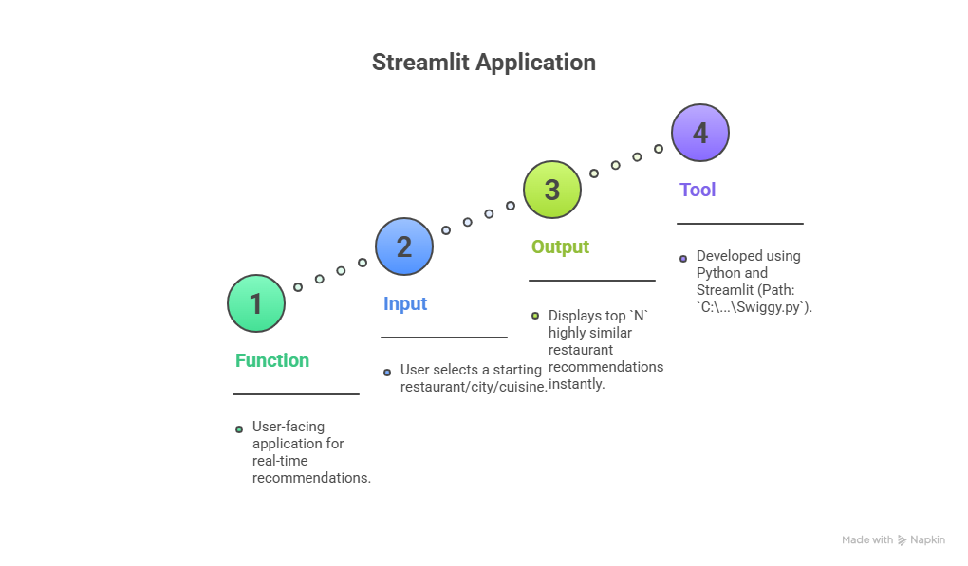
Jeevarathinam R

Slide 6
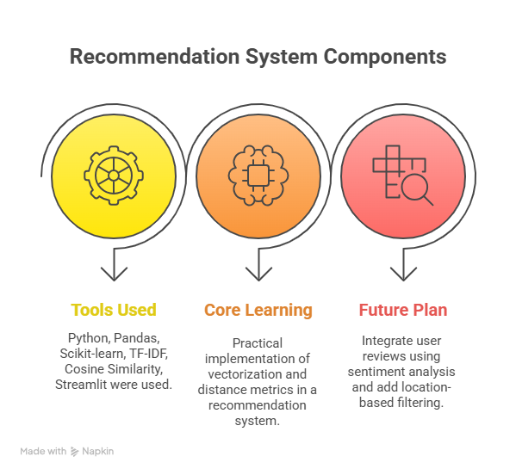
Jeevarathinam R

