Slide 1
A Face Recognition Based Automatic Attendance Management System by Combining LBP and HOG Features
Guide : Mrs.K.Aravinda
Batch No : 18
Team Members :
K.Archana (Y16CS868)
K.Dinesh (Y16CS863)
N.Sowmya (Y16CS907)

Slide 2
Face Detection Algorithms
Har Cascades :
Haar Cascade is a machine learning object detection algorithm where a cascde function is trained from lot of positive and negative images.
The idea of Haar cascade is extracting features from images using a kind of ‘filter’ ,which are called as haar features.
OpenCV offers pre-trained Haar cascade algorithms, organized into categories (faces, eyes and so forth), depending on the images that have been trained on.
Ex: haarcascades_eye.xml
haarcascade_frontalface_alt.xml
haarcascade_smile.xml

Slide 3

OpenCV
Open CV:
OpenCV (Open Source Computer Vision Library) is an open source computer vision and machine learning software library.
CS_868_count.jpg

Slide 4
Basic operations with OpenCV
Loading an image using OpenCV:
Img = cv2.imread (“pic.jpg”,1) # colored images
Img_1 = cv2.imread (“pic.jpg”,0) #Black and White (gray scale)
Displaying the image:
Import cv2
Img = cv2.imread (“Penguins.jpg”,0)
cv2.imshow(“Penguins”, img)
cv2.waitKey(0)
# cv2.waitKey(2000)
cv2.destroyAllWindows()

Slide 5
OpenCV
Imread(): to import the input image.there are 2 parameters to the imread function which is the name of image and to indicate it a color or gray scale image.(0 indicates gray scale and 1 indicates color image)
Imshow(): to display the image by opening a window. There are 2 parameters to the imshow function which is the name of the window and the image object to be displayed.
waitKey(): makes the window static until the user presses a key. The parameter passed to it is the time in milliseconds.
destroyAllWindows(): to close the window based on the waitForKey parameter.
Resize(): function is used to resize an image to the desired shape. The parameter here is the shape of the new resized image.

Slide 6
Face Detection Steps Using OpenCV
Step 1: Considering our prerequisites, we will require an image, to begin with. Later we need to create a cascade classifier which will eventually give us the features of the face.
Step 2: This step involves making use of OpenCV which will read the image and the features file. So at this point, there are NumPy arrays at the primary data points.
All we need to do is to search for the row and column values of the face NumPy ndarray. This is the array with the face rectangle coordinates.
Step 3: This final step involves displaying the image with the rectangular face box.

Slide 7
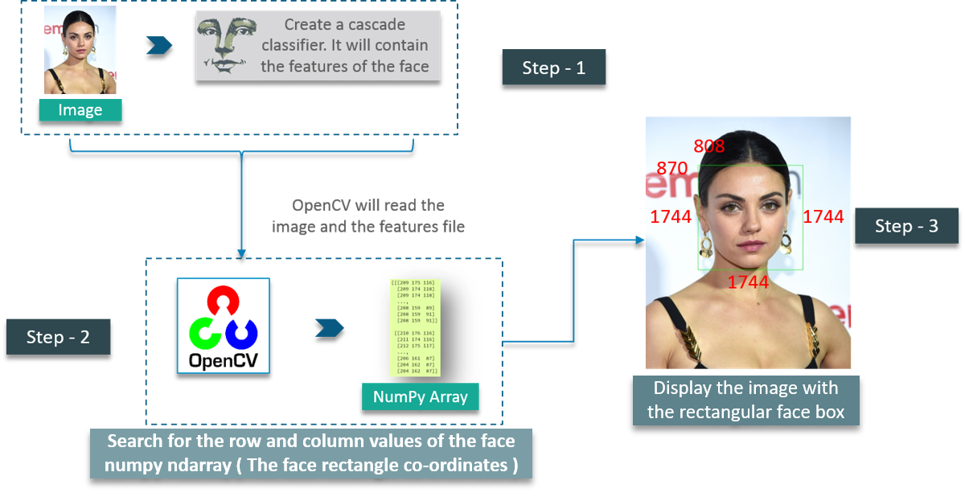

Slide 8
First, we create a CascadeClassifier object to extract the features of the face as explained earlier. The path to the XML file which contains the face features is the parameter here.
The next step would be to read an image with a face on it and convert it into a black and white image using COLOR_BGR2GREY.
Then, search for the coordinates for the image. This is done using detectMultiScale.
The scaleFactor is used to decrease the shape value by 5% until the face is found. So, on the whole – Smaller the value, greater is the accuracy.

Slide 9
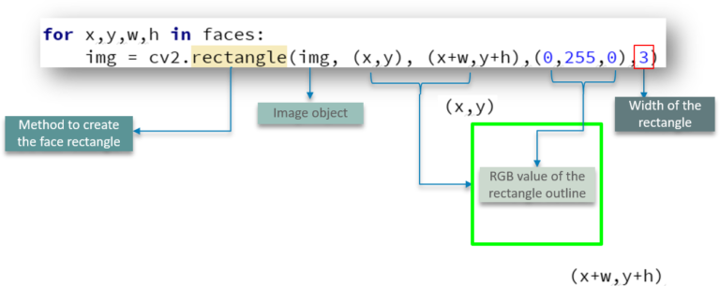
Adding the rectangular face box:
Capturing Video:
vedio=cv2.Vediocapture(0)
vedio.release()
VideoCapture which is used to create the VideoCapture object. This method is used to trigger the camera on the user’s machine. The parameter to this function denotes if the program should make use of the built-in camera or an add-on camera. ‘0’ denotes the built-in camera in this case.

Slide 10
Adding the window:
Adding a window to show the video output is pretty simple and can be compared to the same methods used for images.
vedio=cv2.Vediocapture(0)
Check,frame=vedio.read()
Print(check)
Print(frame)
Time.sleep(3)
vedio.release()
we have defined a NumPy array which we use to represent the first image that the video captures – This is stored in the frame array.
We also have check – This is a boolean datatype which returns True if Python is able to access and read the VideoCapture object.

Slide 11
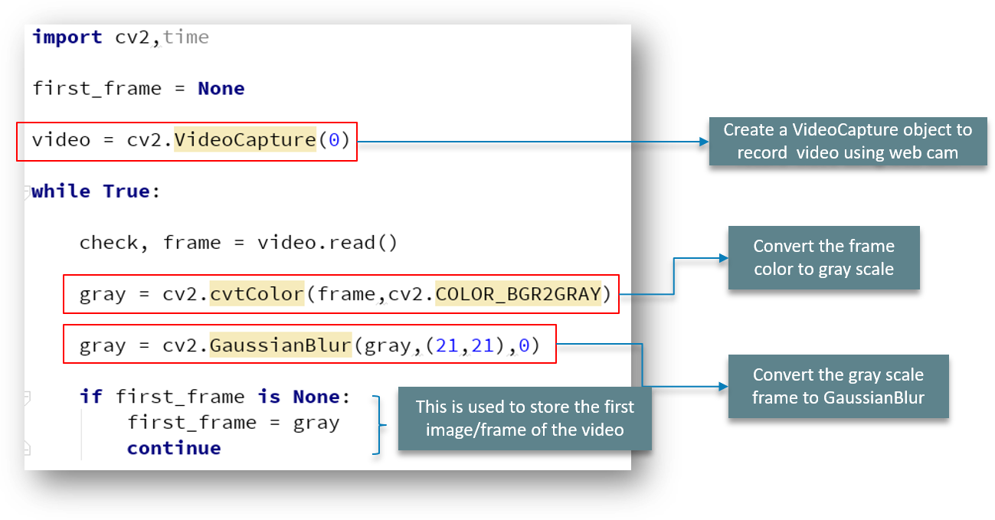

Slide 12
Face Recognition
To import image:
image = face_recognition.load_image_file("your_file.jpg")
Find faces in pictures
face_locations = face_recognition.face_locations(image)

Slide 13
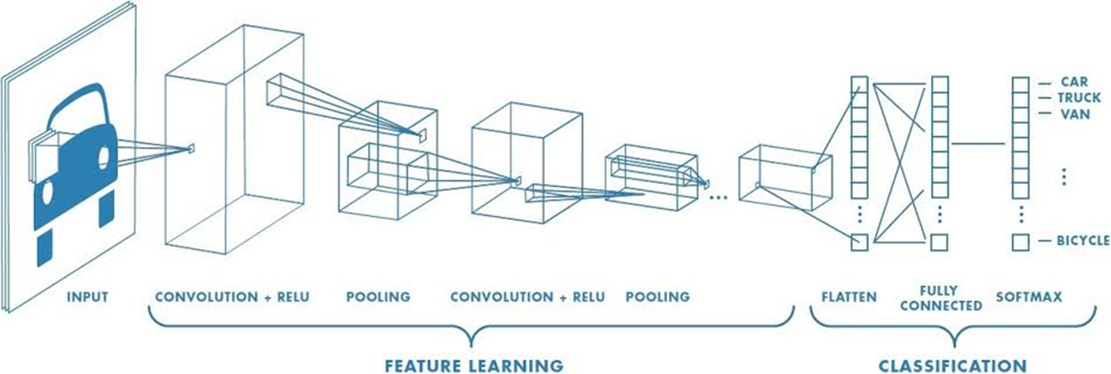
Convolutional Neural Network
A Convolutional Neural Network (ConvNet/CNN) is a Deep Learning algorithm which can take in an input image, assign importance (learnable weights and biases) to various aspects/objects in the image and be able to differentiate one from the other.

Slide 14
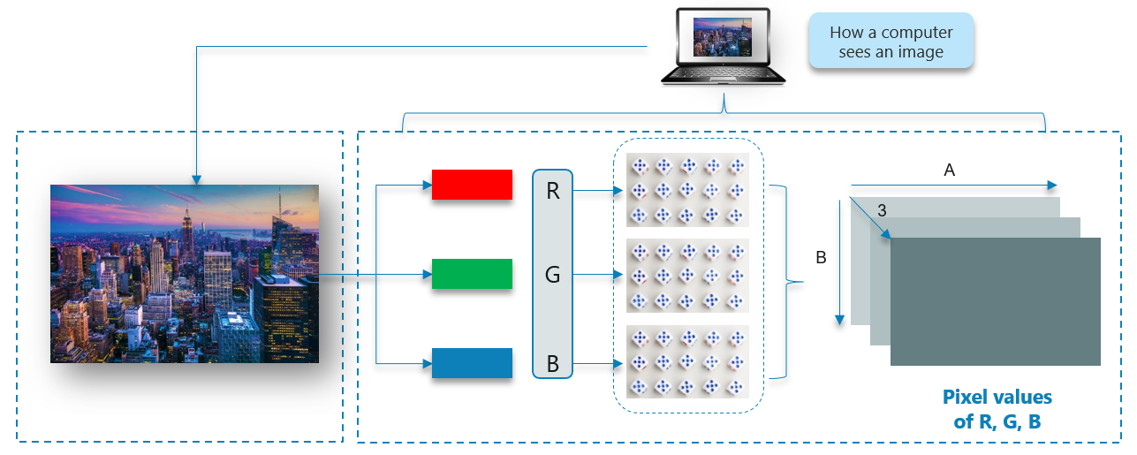
How Does A Computer Read an Image? The image is broken down into 3 color-channels which is Red, Green and Blue. Each of these color channels are mapped to the image’s pixel.
Then, the computer recognizes the value associated with each pixel and determine the size of the image.
However, for black-white images, there is only one channel and the concept is the same.

Slide 15
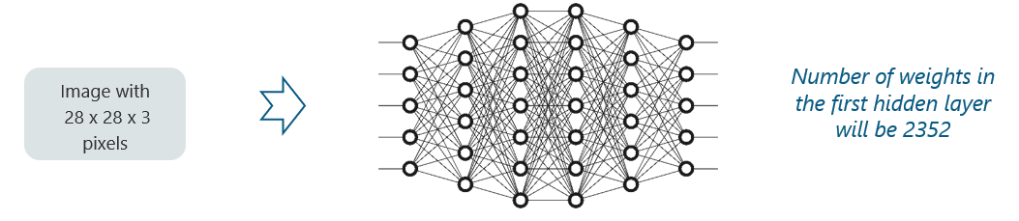
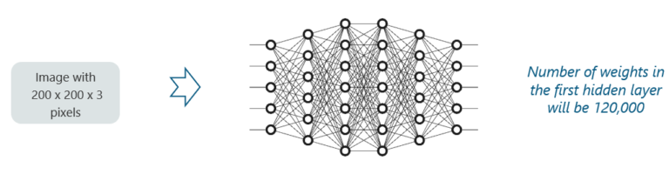
Why Not Fully Connected Networks?

Slide 16
How Do Convolutional Neural Networks Work?
There are four layered concepts we should understand in Convolutional Neural Networks:
1.Convolution
2.ReLu
3.Pooling and
4.Full Connectedness (Fully Connected Layer).

Slide 17
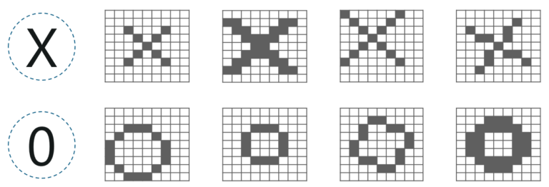
Convoltion:
Consider the image below:
Here, there are multiple renditions of X and O’s. This makes it tricky for the computer to recognize. But the goal is that if the input signal looks like previous images it has seen before, the “image” reference signal will be mixed into, or convolved with, the input signal. The resulting output signal is then passed on to the next layer.

Slide 18
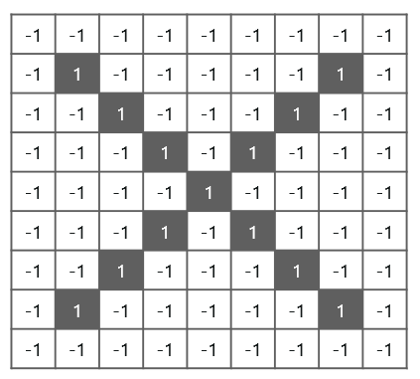
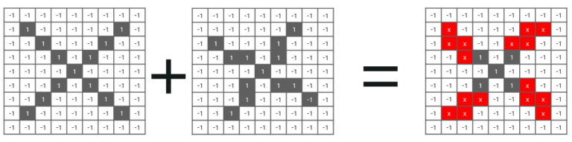

Slide 19
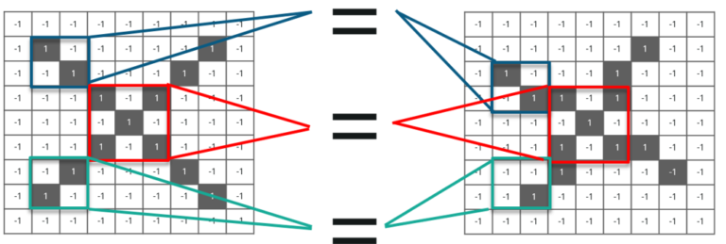
We have 4 steps for convolution:
Line up the feature and the image
Multiply each image pixel by corresponding feature pixel
Add the values and find the sum
Divide the sum by the total number of pixels in the feature

Slide 20
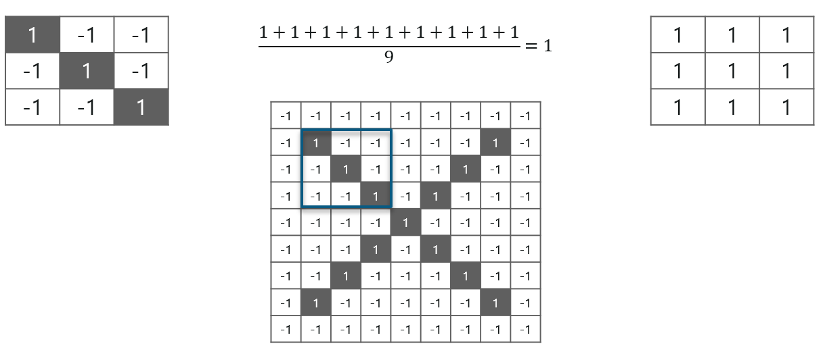
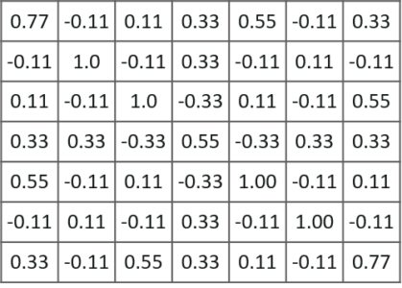

Slide 21
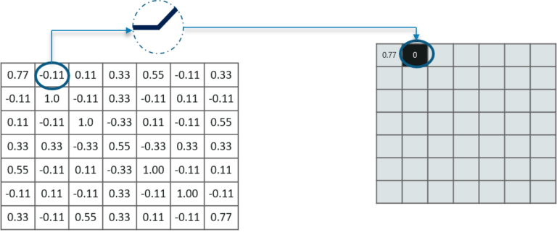
Relu layer:
Rectified Linear Unit (ReLU) transform function only activates a node if the input is above a certain quantity, while the input is below zero, the output is zero, but when the input rises above a certain threshold, it has a linear relationship with the dependent variable.

Slide 22
Pooling layer:
In this layer we shrink the image stack into a smaller size. Pooling is done after passing through the activation layer. We do this by implementing the following 4 steps:
Pick a window size (usually 2 or 3)
Pick a stride (usually 2)
Walk your window across your filtered images
From each window, take the maximum value
Let us understand this with an example. Consider performing pooling with a window size of 2 and stride being 2 as well.

Slide 23
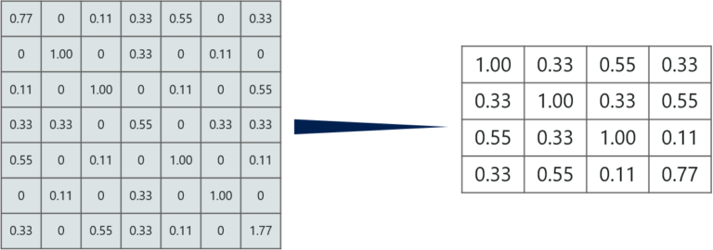
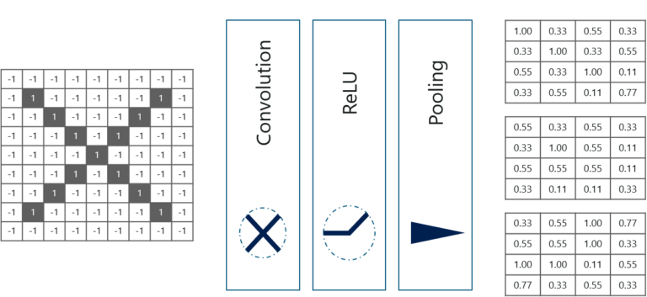

Slide 24
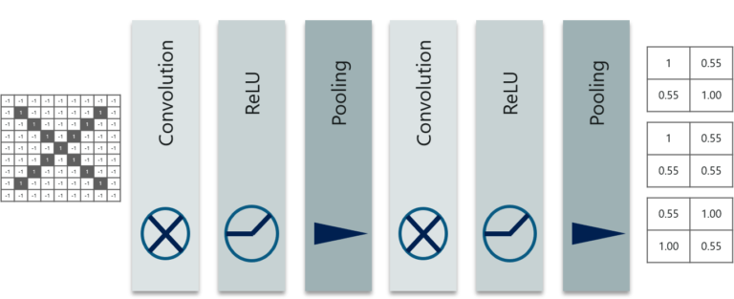
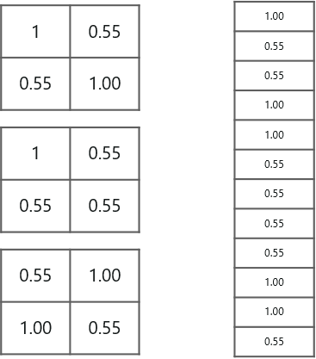
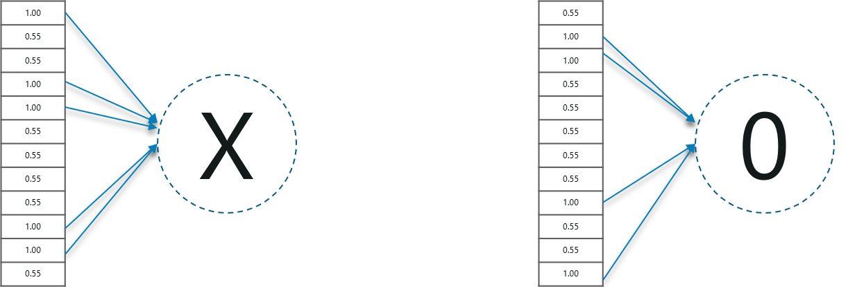
Stacking Up The Layers

Slide 25
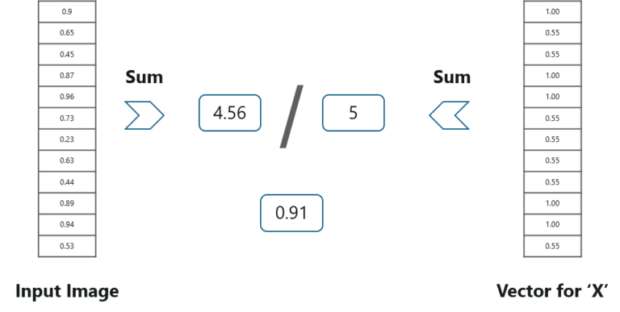

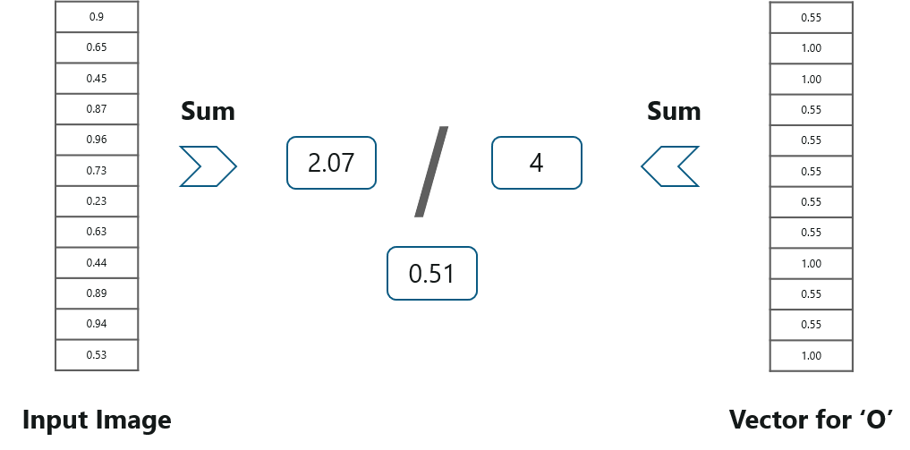
Prediction Of Image Using Convolutional Neural Networks – Fully Connected Layer

Slide 26
Convolutional Neural Networks is a popular deep learning technique for current visual recognition tasks. Like all deep learning techniques, Convolutional Neural Networks are very dependent on the size and quality of the training data.
Given a well-prepared dataset, Convolutional Neural Networks are capable of surpassing humans at visual recognition tasks.

Slide 27
Local Binary Pattern Histograms (LBPH)
Local Binary Pattern (LBP) is a simple yet very efficient texture operator which labels the pixels of an image by thresholding the neighborhood of each pixel and considers the result as a binary number.
It has further been determined that when LBP is combined with histograms of oriented gradients (HOG) descriptor, it improves the detection performance considerably on some datasets.

Slide 28
Steps of LBPH Algorithm
Parameters: the LBPH uses 4 parameters:
1. Radius: the radius is used to build the circular local binary pattern and represents the radius around the central pixel. It is usually set to 1.
2. Neighbors: the number of sample points to build the circular local binary pattern. Keep in mind: the more sample points you include, the higher the computational cost. It is usually set to 8.
3. Grid X: the number of cells in the horizontal direction. The more cells, the finer the grid, the higher the dimensionality of the resulting feature vector. It is usually set to 8.
4. Grid Y: the number of cells in the vertical direction. The more cells, the finer the grid, the higher the dimensionality of the resulting feature vector. It is usually set to 8.

Slide 29
Training the Algorithm: First, we need to train the algorithm. To do so, we need to use a dataset with the facial images of the people we want to recognize. We need to set an ID for each image, so the algorithm will use this information to recognize an input image and give you an output. Images of the same person must have the same ID.
Applying the LBP operation: The first computational step of the LBPH is to create an intermediate image that describes the original image in a better way, by highlighting the facial characteristics. To do so, the algorithm uses a concept of a sliding window, based on the parameters radius and neighbors.

Slide 30
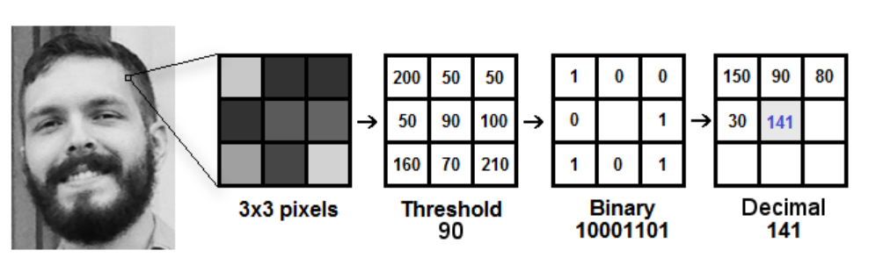

Slide 31
Suppose we have a facial image in grayscale.
Get a part of this image as a window of 3x3 pixels.
It can also be represented as a 3x3 matrix containing the intensity of each pixel (0~255).
Then, Take the central value of the matrix to be used as the threshold.
This value will be used to define the new values from the 8 neighbors.
For each neighbor of the central value (threshold), set a new binary value. They set 1 for values equal or higher than the threshold and 0 for values lower than the threshold.
Now, the matrix will contain only binary values (ignoring the central value). We need to concatenate each binary value from each position from the matrix line by line into a new binary value (e.g. 10001101). Note: some authors use other approaches to concatenate the binary values (e.g. clockwise direction), but the final result will be the same.
Then, we convert this binary value to a decimal value and set it to the central value of the matrix, which is actually a pixel from the original image.
At the end of this procedure (LBP procedure), we have a new image which represents better the characteristics of the original image.

Slide 32
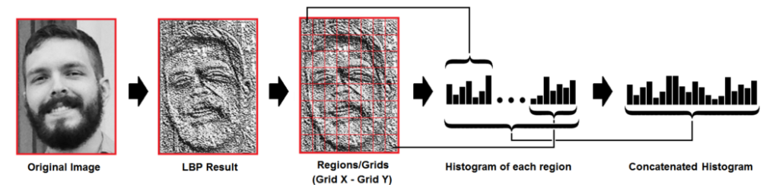
4. Extracting the Histograms: Now, using the image generated in the last step, by use the Grid X and Grid Y parameters to divide the image into multiple grids, as can be seen in the following image:
If an image in grayscale, each histogram (from each grid) will contain only 256 positions (0~255) representing the occurrences of each pixel intensity.
Then, the algorithm concatenate each histogram to create a new and bigger histogram. Supposing we have 8x8 grids, we will have 8x8x256=16,384 positions in the final histogram. The final histogram represents the characteristics of the image original image.

Slide 33
Performing the face recognition: In this step, the algorithm is already trained. Each histogram created is used to represent each image from the training dataset. So, given an input image, we perform the steps again for this new image and creates a histogram which represents the image.
So to find the image that matches the input image we just need to compare two histograms and return the image with the closest histogram.
We can use various approaches to compare the histograms (calculate the distance between two histograms) example: euclidean distance, chi-square, absolute value, etc.
So the algorithm output is the ID from the image with the closest histogram. The algorithm should also return the calculated distance, which can be used as a ‘confidence’ measurement.
As lower confidences are better because it means the distance between the two histograms is closer.

Slide 34
Conclusion
LBPH is one of the easiest face recognition algorithms.
It can represent local features in the images.
It is possible to get great results (mainly in a controlled environment).
It is robust against monotonic gray scale transformations.
It is provided by the OpenCV library (Open Source Computer Vision Library).
The OpenCV library can be used by many programming languages (e.g. C++, Python, Ruby, Matlab).

Slide 35
Thank You

