Slide 1
Project 2026
IMAGE‑BASED CROP DISEASE DETECTION WITH FEDERATED LEARNING
Under the Guidance of
Dr. Barathram Ramkumar
Associate Professor
School of Electrical and Computer Sciences (SECS)
Indian Institute of Technology Bhubaneswar
Presented By
Angajala Dinesh Kartheek
Roll No: 23cs01005
Summer Research Internship
Indian Institute of Technology Bhubaneswar

Slide 2
PROBLEM & PROJECT APPROACH
Project 2026
Problem
  Crop diseases can significantly reduce crop productivity and quality.
  Image-based deep learning can automatically identify disease patterns from plant leaf images.
  However, a centralized approach requires collecting and transferring large amounts of image data to a central location.
  This creates challenges related to data privacy, data availability, security, and data-transfer costs.
Project Approach
  Federated Learning (FL) provides a distributed alternative where training data remains within its assigned client.
  Instead of sending raw images to a central server, clients train locally and send model parameters/updates to the server.
  The server aggregates these updates using FedAvg to create an improved global model.
  The motivation of this internship was to implement this complete federated pipeline and investigate whether CNN models can achieve high disease-classification performance under repeated federated aggregation.

Slide 3
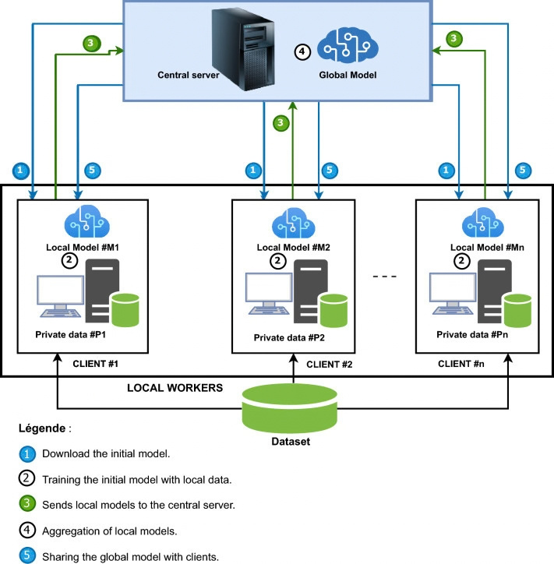
Project 2026
WORK METHODOLOGY
1. Initialize → Initialize the global model
2. Distribute → Send the global model to clients
3. Local Training → Train locally using private data
4. Parameter Transfer → Send updated model parameters to the server
5. FedAvg Aggregation → Aggregate client models into a new global model
6. Global Model Update → Distribute the updated global model
7. Repeat → Continue for multiple communication rounds

Slide 4
DATASET, MODELS & EXPERIMENTAL DESIGN
Project 2026
Dataset & Disease Classification
Models & Experimental Design
The PlantVillage dataset was used with four crop subsets: Grape, Apple, Corn, and Tomato, containing 4, 4, 4, and 10 disease classes, respectively. Images were resized to 224 × 224 and normalized before classification.
Three pretrained CNN models ResNet50, VGG16 and MobileNetV2 were evaluated across the four datasets, resulting in 12 experiments. Each experiment used 3 simulated clients, 1 local epoch, and 30 communication rounds with weighted FedAvg.

Slide 5
IMPLEMENTATION WORKFLOW
Project 2026
01
04
Dataset Selection
Model Initialization
Select crop dataset and disease classes.
Load pretrained CNN model.
02
Image Preprocessing
05
Local Training
07
Evaluation & Iteration
Resize and normalize images.
Train each model on local client data.
Measure Accuracy/F1 and repeat for 30 rounds.
03
Client Partitioning
06
FedAvg Aggregation
Split training data among 3 clients.
Combine client updates into a global model.

Slide 6
Project 2026
FEDERATED TRAINING: COMMUNICATION ROUNDS
One Complete Communication Round
The global model is distributed to the 3 clients. Each client performs local training for 1 epoch using its local data and sends the updated model parameters to the server. The server combines these updates using weighted FedAvg to create the next global model, which is then evaluated.
Why Repeat the Rounds?
Each communication round combines the learning from all clients into the global model. Repeating the cycle allows the model to learn progressively, with performance generally improving during the early rounds before reaching a high-performance plateau.

Slide 7
Project 2026
EVALUATION METHODOLOGY
After each communication round, the global model was evaluated on the validation dataset. Its performance was measured using Accuracy and weighted F1-score. These metrics were recorded for all 30 communication rounds and used to compare the performance of the three CNN models across the four crop datasets.

Slide 8
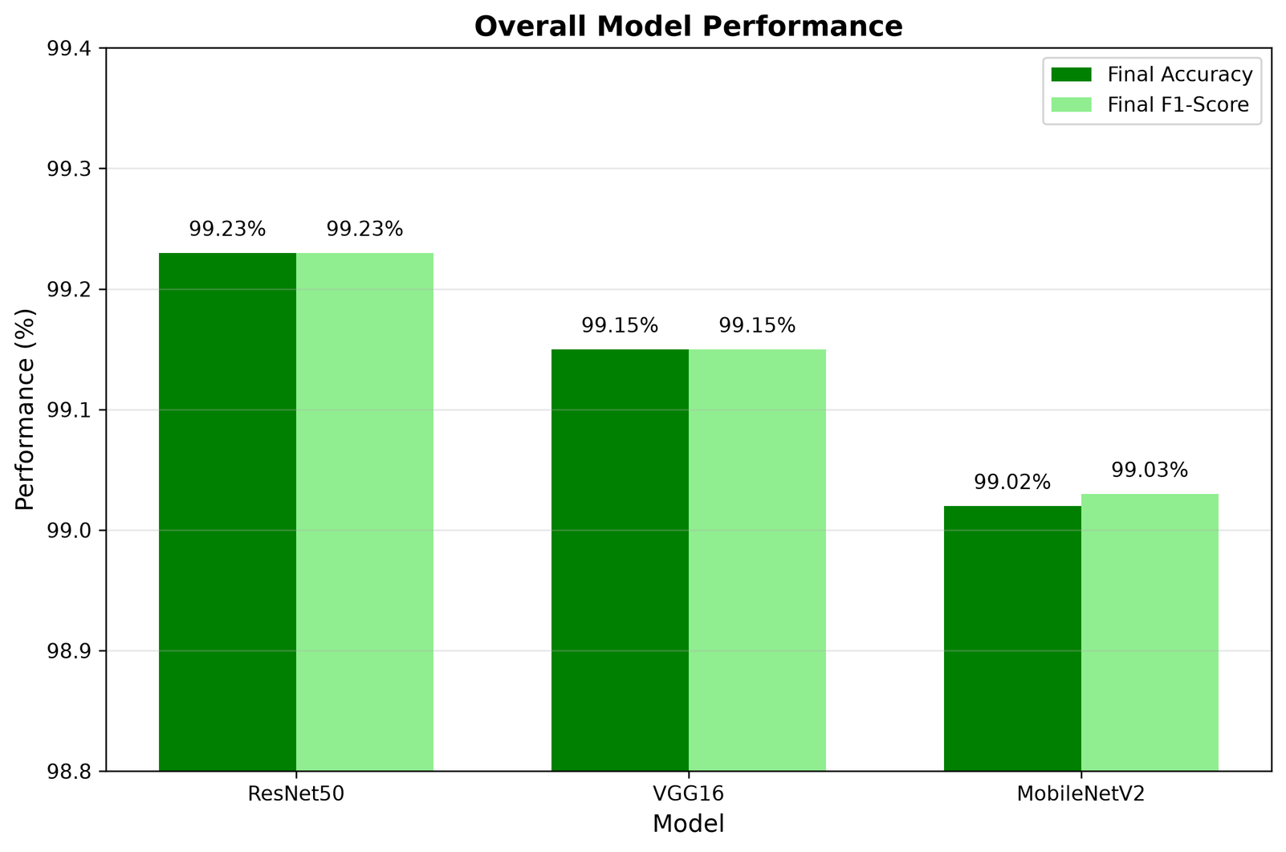
IMPLEMENTATION RESULTS
Project 2026

Slide 9
Project 2026
CONCLUSION
  The implemented system demonstrates that crop disease classification can be performed effectively using Federated Learning without sending the clients’ raw leaf images to the central server.
  The clients train the models locally on their own images and send only the model updates to the server.
  The server uses FedAvg to aggregate these updates and creates an improved global model.
  After 30 communication rounds, the models achieved very high validation performance, reaching approximately 97–100% Accuracy across the four crop datasets.
  ResNet50 achieved the best overall performance with 99.23% mean final validation Accuracy.
  Therefore, in this experimental setup, the results show that highly accurate crop-disease prediction is possible even when the central server does not directly access the clients’ leaf images.

Slide 10
Project 2026
REFERENCES
Kabala, D. M., et al. (2023). Image-based crop disease detection with federated learning. Scientific Reports, 13, 18448. DOI: 10.1038/s41598-023-46218-5
Mohanty, S. P., Hughes, D. P., & Salathé, M. (2016). Using Deep Learning for Image-Based Plant Disease Detection. Frontiers in Plant Science, 7, 1419. Source of the PlantVillage dataset.
McMahan, B., et al. (2017). Communication-Efficient Learning of Deep Networks from Decentralized Data. Proceedings of AISTATS 2017. Foundational work introducing Federated Averaging (FedAvg).
He, K., Zhang, X., Ren, S., & Sun, J. (2016). Deep Residual Learning for Image Recognition. Proceedings of CVPR 2016. Reference for the ResNet architecture.
Simonyan, K., & Zisserman, A. (2015). Very Deep Convolutional Networks for Large-Scale Image Recognition. ICLR 2015. Reference for the VGG16 architecture.
Sandler, M., et al. (2018). MobileNetV2: Inverted Residuals and Linear Bottlenecks. Proceedings of CVPR 2018. Reference for the MobileNetV2 architecture.
THANK YOU

