Slide 1
DEVELOPMENT OF MECHANICAL OPERATED MULTIPURPOSE AGRICULTURE CUTTER
Under the guidance of
Dr.R.Senthil., M.E., Ph.d
Professor & Head,
Department of Mechanical Engineering,
UCE-Villupuram.
Crew Members,
ANANDH S (422516114003)
DINESH KARTHIK K (422516114016)
ARUTSELVAN M (422516114007)
SEENUVASAN A (422516114047)

Slide 2
ABSTRACT:
  The main purpose of our Project is to design a Multipurpose cutter to harvest different types of crops economically.
  Our project work will focus on easy harvesting various types of crop in less time and at low cost by considering different factors such as cost of equipment, and time of operation.
  The blades used in Multipurpose Cutter is scissoring type operation which can cut up to two rows of crop.
  This Multipurpose Cutter might be the best solution for the problems faced by small scale farmers relating with availability of labours and cost of harvesting.

Slide 3
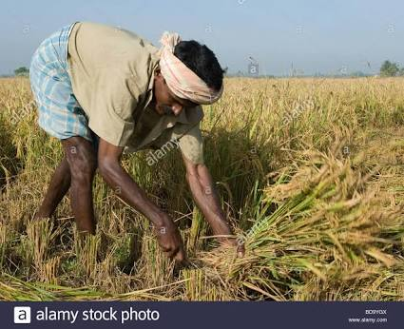
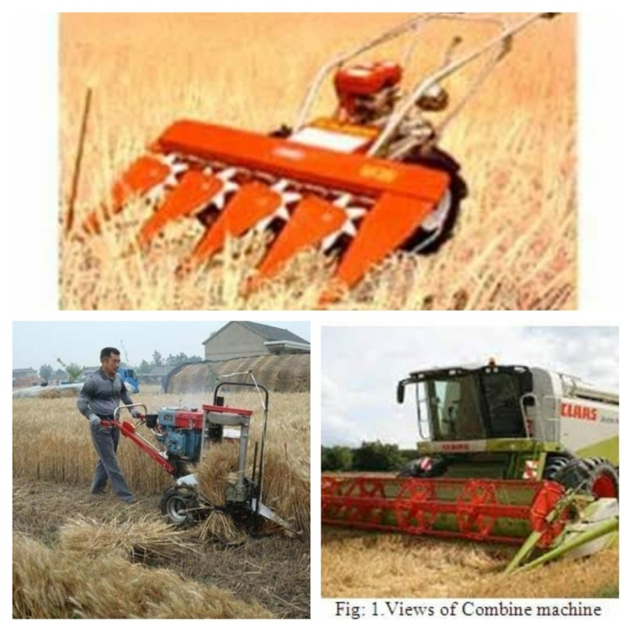
INTRODUCTION:
People in the olden age used to harvest the grains with the help of the Sickles.
It takes much more time to complete the harvest and needs large man power to complete the harvesting.
The harvestings are available for purchase but because of their high costs, they are not affordable.
In the modern age people uses different types of multicrop cutter to harvest the various types of grains.
This type of harvesting reduces the time of harvesting and also reduces the use of man power.
But due to the cutting of various crops it requires various cutters, which requires high cost and this can be resolved by using the Multipurpose cutter.

Slide 4
SURVEY:
S.NO | PAPER TITLE | INFERENCE
1. | Design and Fabrication of Multi Crop Cutter by Mayank Kumar Gupta, Pradeep Tyagi, Shubham Chauhan-RBS Engineering Technical Campus, Agra, India. | Design and analysis of small field crop cutter machine for small height and small steam crop. Keywords: Manual Method, Mechanized Method, crop cutting.
2. | Design and Fabrication of Harvesting Machine by Amar B.Mule, Kapil R.Bhiwapurkar-KDK Umred, Maharastra, India. | A Machine which is cheap and will reduce the labour required to harvest corps. This machine has the capability and the eonomic value for fulfilling the needs of farmers haveing smallland holdings.

Slide 5
Continued...
3. | Fabrication of Multicrop Cutter by Dr. U.V.Kongre(Associate Professor)-Mechanical Engineering, JDIET Yavatmal,India. | Fabrication of cutting of multiple types of crop during harvesting which possesses four criterion ease in manufacturing, ease in handling, low cost and light weight. Keywords: Harvesting, Rotary Motion.
4. | Multipurpose Farm Machine by Dr. C.N.Sakhale(Associate prof.), Prof. S.N.Waghmare(Associate prof.)-Priyadharshini College of Engineering, Nagpur, India. | Concept to Design a machine in which muliti funtions can be performed with cheap costs as compared to other agriculture machines.
5. | Development of Multipurpose Agriculture Cutter by Lakshmipathi Yerra, K Sandeep Kumar, M Anil Kumar- JNT University, Hyderabad, India. | In the modern world as time for caarrying out many things has redued drastically so as to be done the removal of grass involving use of a machine. This mahine can be railed as multipurpose cutter which is mostly depends on the type of bladess that we use to cut the corps.

Slide 6
STUDY FROM SURVEY:
Crop cutting machine is more important and also it is should be economically low.
There are different types of agricultural cutter is available for different crop.
To overcome the ease the problems of workers, a new manually operator cutter is fabricated for cutting of multiple types of crop during harvesting “MULTIPURPOSE CUTTER” is used.
From this Literature Survey, It is decide to Develop a Mechanical Operated Multipurpose Agriculture Cutter to Cut the various types of crops in the field such as Green leaf, Corn, paddy and Tall grass (Which was used as feedstock for cow).
The Scissoring type blade is operated by means of the Bevel gear mechanism which is connected with the shaft.

Slide 7
OBJECTIVE:
  The Main Objective of our project is to create a portable, user-friendly and low cost mini Multipurpose cutter machine.
  Our proposed model is the special purpose cutter which can harvest various types of crops in a single cutter called “Multipurpose cutter”.
  Cutting operation is achieved by Sliding motion of a steel blades attached to the rotating front axle which results in the removal grains from the field.
  The machine is simple, less bulky and the ergonomic considerations in the design allows for comfortable use and easily be operated by either male or female.

Slide 8
DESIGN AND WORKING:
The crop cutter was designed on keeping small scale farmers in mind. This crop cutter which was deigned is having good harvesting capacity for small farms.
The cutting action is transmitted to the blades by bevel gear mechanism which is driven by the eletric motor.
The design of Multipurpose cutter can be extended for cutting paddy, weeds, and lawn grass etc..by using the DC motor.
Its have been carefully designed for user comfort by considering ergonomics aesthetics. Particlular attention has been given to avoid pollution and worker tiredness.

Slide 9
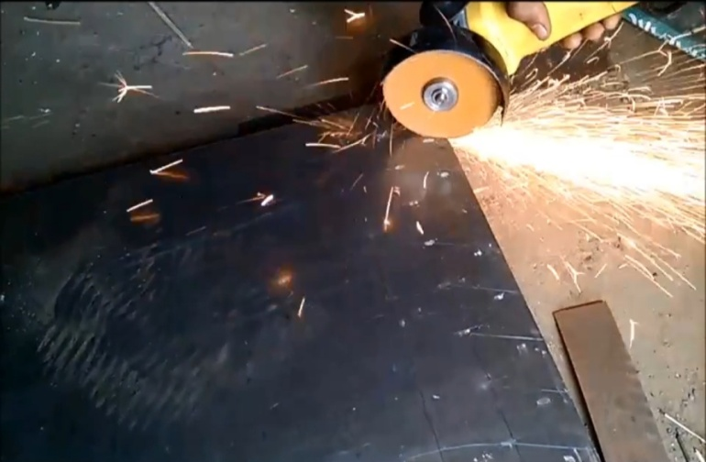
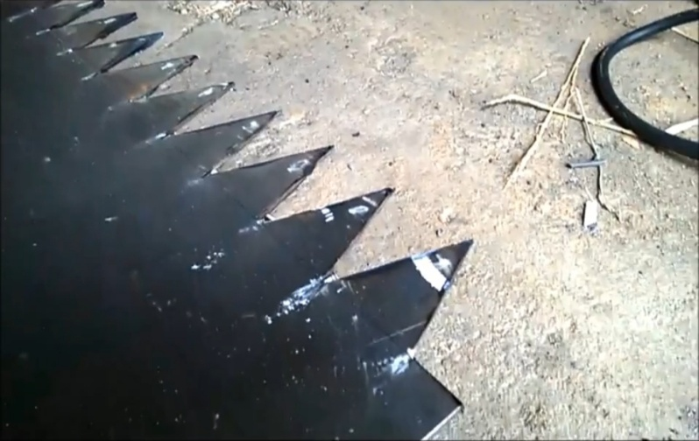
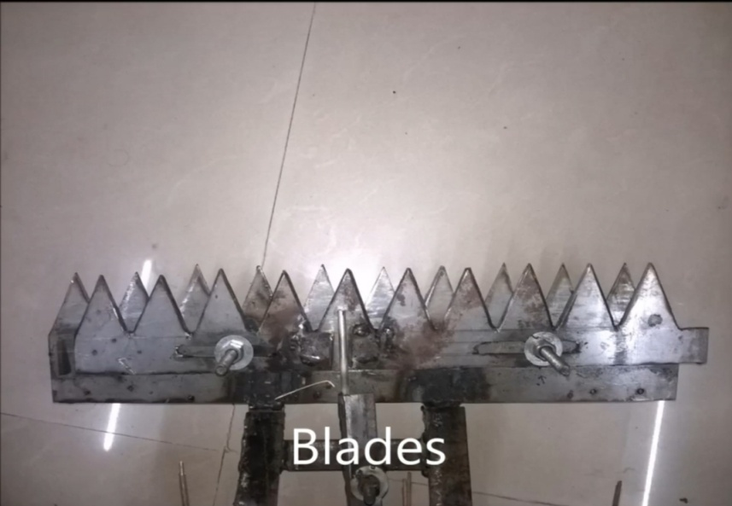
WORKING PROCESS:
(i)Cutting of Sheetmetal (ii)Cutted Sheetmetal
(iii)Finished Cutter

Slide 10
MATERIAL REQUIRED:
Electric Motor
Sheet Metals
Bolts and Nuts
Roll wheelers
Steel Frames
Gears

Slide 11
ADVANTAGES:
The machine have compact design lead to requirement of less workspace because of which operator an control easily control over the machine handling.
The machine is suitable for small farms due to its less weight and higher work efficiency.
It's maintainene cost is very low.
Reduced man power.

Slide 12
APPLICATIONS:
It is used in Agriculture field for Multipurpose cropping.
It is used to crop the Paddy of rice, wheat and soyabin etc.

Slide 13
Thank You

