Slide 1

Basic Details of the Team and Problem Statement
Ministry/Organization Name/ Student Innovation:
Government of NCT of Delhi
PS Code:SIH1615
Problem Statement Title:
Learning path dashboard for enhancing skills
Team Name: code crafters
Team Leader Name: K.Dhanunjaya
Institute Code(AISHE): ANIL
Institute Name: Anil neerukonda institution of technology and sciences
Theme Name: Navigate Your Learning Journey

Slide 2
Idea/Approach Details
IDEA :
A comprehensive learning dashboard that enables customized learning paths, real-time progress tracking, analytics, and adaptive recommendations for educational and professional training environments.
SOLUTION :
Handle multiple record and resource formats (e.g., .bibtex, Excel, PDF, Word, links, videos).
Show reading stats, completion percentages, and offer filters.
Monitor learner progress and engagement with notifications
Allow instructors to build and adjust learning paths easily.

Slide 3
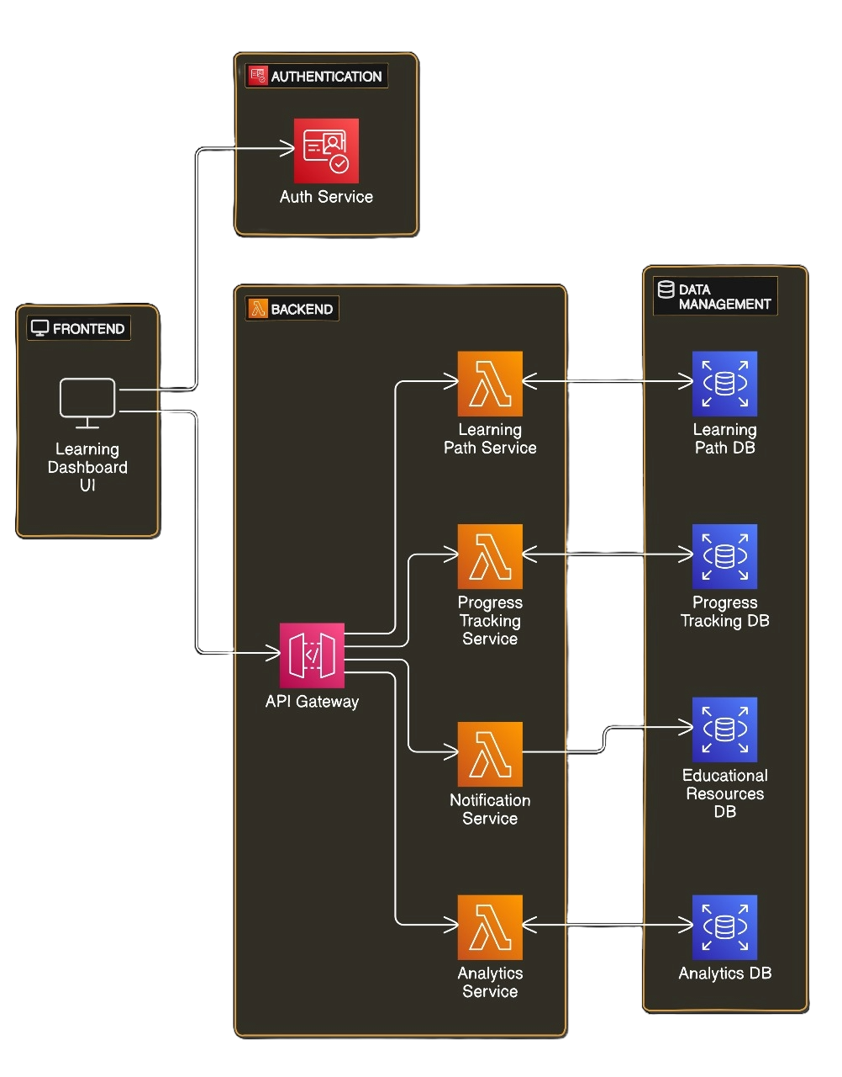
TECHNICAL APPROACH
TECHNOLOGY STACK:
React.js: For front-end development.
Node.js with Express.js: For back-end development.
PostgreSQL or MySQL: For database management
Amazon S3 or Google Cloud Storage: For data storage.
Auth0 or Firebase Authentication: For user authentication.
Elasticsearch and Kibana: For powerful search, analysis, and visualization of large datasets.
ARCHITECTURE

Slide 4
Idea/Approach Details
USE CASES:
SHOW STOPPERS:
User Authentication: Secure registration and profile management for learners and instructors.
Learning Path Management: Customizable paths with diverse resources and prerequisites.
Resource Access: Easy access and interaction with learning materials.
Progress Tracking: Real-time updates on learner progress and performance.
Analytics and Reporting: Detailed insights on engagement, completion rates, and resource effectiveness.
Data Integration: Challenges with handling various formats and ensuring data availability.
Real-Time Updates: Issues with syncing progress and data inconsistencies.
Scalability: Risks of performance degradation under high load.
Security and Privacy: Ensuring data protection and compliance.
Content Management: Keeping resources current and managing versions
CHANNELS: Govt. portals, Industries, organizations etc.
Revenue Streams: Service based model

Slide 5
Team Member Details
Team Leader Name: K.Dhanunjaya
Branch : B.Tech Stream : CSE (AI & ML) Year : |||
Team Member Name: K.Kishore
Branch : B.Tech Stream : CSE (AI & ML) Year : |||
Team Member Name: K.Satya Laxmi Narasimha Murthy
Branch : B.Tech Stream : CSE (AI & ML) Year : |||
Team Member Name: N.Varalakshmi
Branch : B.Tech Stream : CSE (AI & ML) Year : |||
Team Member Name: K.Yamini
Branch : B.Tech Stream : CSE (AI & ML) Year : |||
Team Member Name: G.Varsha priya
Branch : B.Tech Stream : CSE (AI & ML) Year : |||
Team Member Name: K.Jithin Sai Kamal
Branch : B.Tech Stream : CSE (AI & ML) Year : |||

