Slide 1
A Large-Scale Empirical Study on Software Reuse in
Mobile Apps
By:
Israel J. Mojica, McAfee
Bram Adams, École Polytechnique de Montréal
Meiyappan Nagappan, Queen’s University
Steffen Dienst, University of Leipzig
Thorsten Berger, University of Waterloo
Ahmed E. Hassan , Queen’s University
Presenters:
Dinesh Bandam kumar
Nagi Reddy Sollapuram
Vilas Mamidyala
Sree Ravi Kishore, Lellapalli

Slide 2
Introduction:
A study of hundreds of thousands of Android apps found substantial software reuse, indicating that while these apps benefited from increased productivity, they’re also more dependent on the quality of the apps and libraries that they reuse.

Slide 3
What are Mobile Applications ?
Application developed to run on devices such as smart phones or Tablets
These applications can be accessed from
Google Play
Black-Berry World
Apple App Store
Windows Phone marketplace.
The number of available products is staggering, with Google Play alone offering 700,000 apps at the end of 2012

Slide 4
Mobile Market Revenue:
The huge market combined with standardized app stores and feature-packed mobile platforms such as Android or iOS, has attracted thousands of developers.
A survey of 352 app developers showed that
• 40 percent develop apps outside of their main job
• 21 percent work on apps part time
• 39 percent made their living through app development.
Billions of downloaded apps, with projected revenue of more than US$22 billion by 2016

Slide 5
Educational Background
Many of these developers are highly educated (for instance, 33 percent had some graduate school experience), but their schooling isn’t necessarily in software engineering.
Thus, the survey concluded that app developers often lack expertise in all the aspects of app development
needed to be successful.
Although half of those surveyed earned less than $15,000 per year, the average income was still $45,000.

Slide 6
we found 48 clusters of 217 apps that were identical, often consisting of fake apps cobbled together by unscrupulous app developers from existing.
We also found that some of these developers
• replace advertisement libraries to steal revenue from the original app developers.
• add malicious functions to steal information from the
app users (for example, contact list numbers).
• automatically charge app users without their knowledge(for example, by sending text messages to premium numbers)
To analyze whether these phenomena are just specific to the apps in our previous study or to mobile apps in general, we extended our study to more than 200,000 free Android apps across all 30 app categories from Google Play.

Slide 7
Study Design
Software Reuse has been analysed since 1968 when Douglas McIlroy proposed to mass produce software with the help of reusable components.
How can we implement the reusable components?
To analyse these different forms of reuse, they generated a signature for each Java class of a mobile app, then tracked the signature across all apps.
In 2011, two authors started gathering information from the official Google Play app store to obtain two datasets.

Slide 8
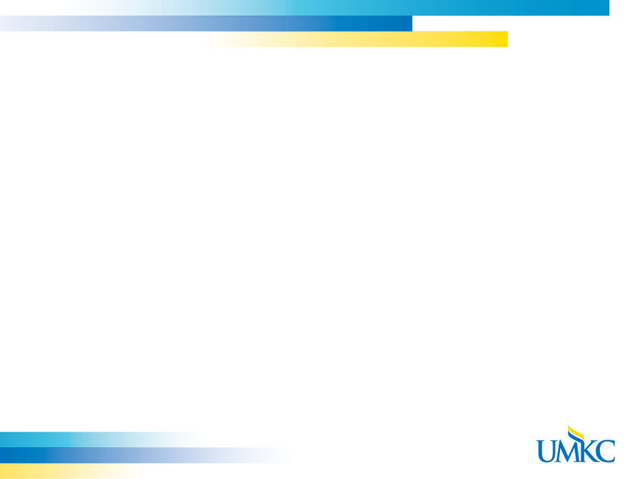
Obtained info of the binary android apps in the official Android Package (APK) and the apps metadata.
They studied only information collected from free to download Android apps as they required access to source code
From gathered data they concluded that Google Play considers 27 different app categories and eight game subcategories
They didn’t find the data related two categories Live Wallpapers and Widgets but found two identically named subcategories under Games.

Slide 9
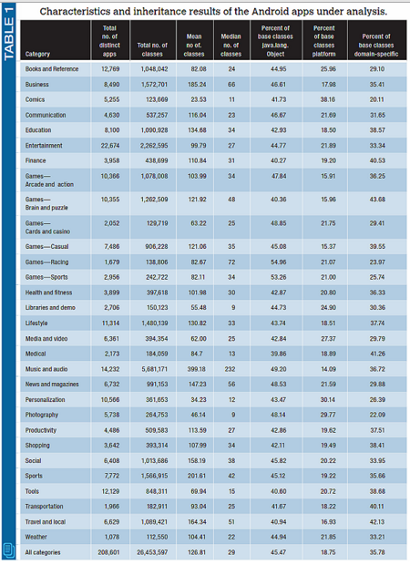

Slide 10
Class Signature Extraction
Used the Software Bertillonage technique, which compares the interface of Java classes, to analyse the mobile apps for software reuse.
Avoided the traditional methods like code clone detection and hashing-based techniques.
Bertillonage only analyses the interface of classes (that is, the class name and method prototypes), which can readily be extracted from byte code.
Followed five steps for analysing the data

Slide 11
Extract byte code from the APKs: Used dex2jar tool (http://code.google.com/p/dex2jar) to extract the JAR
Extract classes and methods: Extracted its fully qualified name (name of the class along with the package) and names of the methods
Remove obfuscation: Obfuscated classes have names consisting of one or two letters (for example, “ab”)
Generate class signatures: A Bertillonage signature consists of the fully qualified class name followed by an alphabetical list of the method prototypes
Compare signatures across JAR archive

Slide 12
Case Study:
Under this ,extracted signatures were used to analyze inheritance and code reuse, as well as framework reuse of whole apps
Inheritance Reuse
Code Reuse
Framework reuse of whole apps

Slide 13
Inheritance Reuse
In Java E.g: public class com.google.ads.AdView extends android.widget.RelativeLayout
On average, 54.53 percent of the classes in each category inherit from a base class, while only 18.75 percent of all classes inherit from the Android platform base classes.
The Activity class in the Android API is the most popular, with approximately 8.4 percent of the class signatures inheriting from it.
Another E.g. The TwitterResponseImpl class in the twitter4j package is from the twitter4j-core library

Slide 14
Inheritance Reuse…
Further in the case study,
Mobile apps inherit from platform classes (which developers therefore reuse) such as Activity
In the examined top 10 inherited domain-specific base classes, ranks of this group are ranged from 7 to 26.
Among these top 10 ,we found classes to
Interface with Twitter
Handle JSON data
interpret the Kawa scheme implementation
interpret JavaScript, HTML5, and CSS3
display advertisements

Slide 15
Code Reuse
Proportion of Class Signatures Reused (PCSR)
total number of unique class signatures
PCSR = 1
total number of class signatures
A high PCSR value indicates that the reuse of class signatures is high in that category.

Slide 16
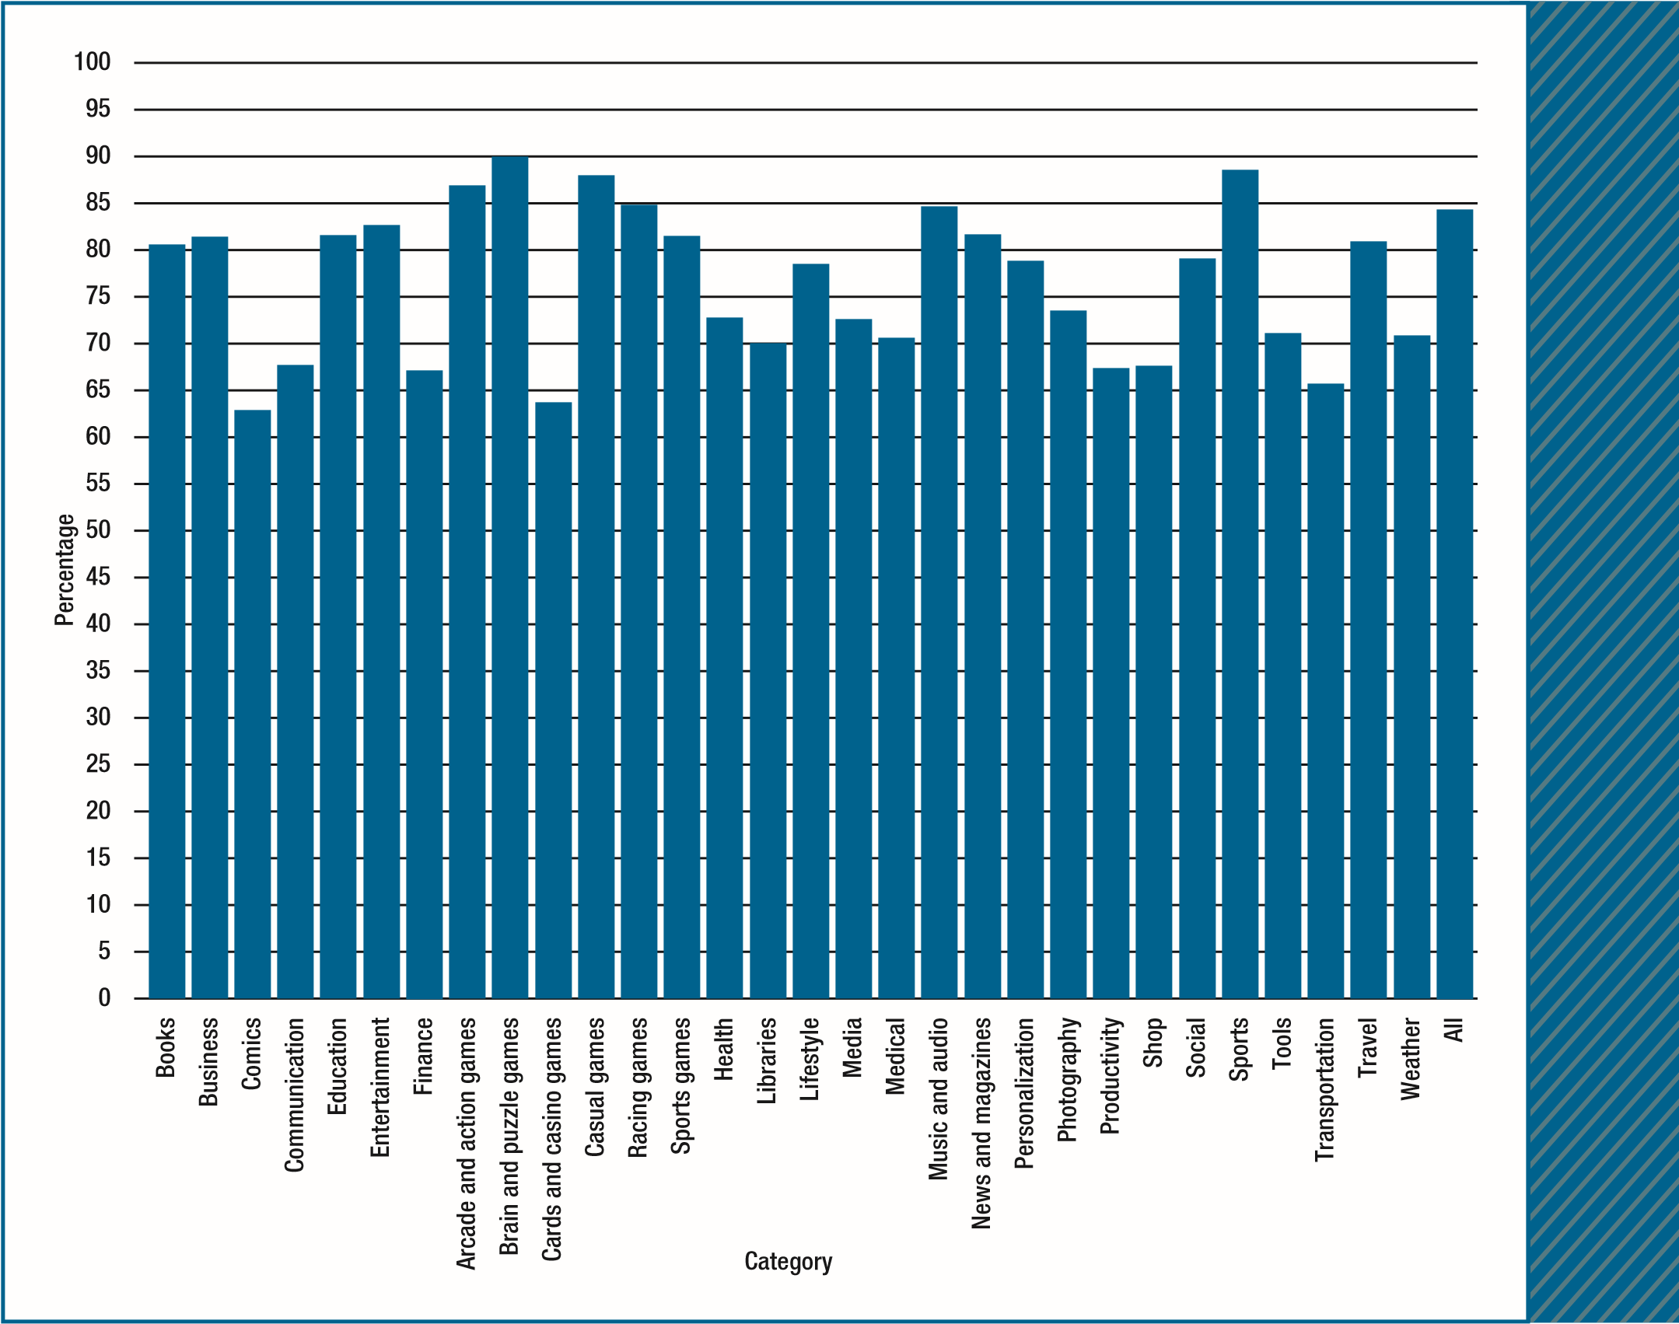
Code Reuse..
Proportion of class signatures reused per category.

Slide 17
Framework reuse of whole apps
In framework reuse, all classes of an app are reused by another app, or multiple apps have identical sets of classes.
For this analysis, we introduce the local reuse of a mobile app, denoted as local(A,B). For a pair of mobile apps A and B, local reuse is the proportion of class signatures found in A that also occur in B:
s(A) s (B)
Local( A, B) =
s (A)
,s (X) is set of signatures in app X
A high value of local reuse means that a high number of class signatures are reused in another app.

Slide 18
Framework reuse of whole apps ..
Local Reuse 1 means that both mobile apps have the same number of classes and each class signature in one mobile app is identical to a signature in the other mobile app.
It is found that 1,811 sets of mobile apps had the same set of class signatures, comprising 17,109 individual mobile apps (8.2 percent of all studied mobile apps), and 30 out of the 1,811 sets comprise apps from different categories
The number of classes (app sizes) across the 1,811 different sets of apps where local reuse=1 is true varies from one to 1,903 classes.
The top three largest clusters consist of 473 apps with one reused class, 339 apps with eight reused classes, and 334 apps with 20 reused classes.

Slide 19
Mobile apps that are identical to other mobile apps seem to belong to one of the following four types of framework reuse: reuse of private closed source classes owned by companies for their own purposes; reuse of private closed source classes owned by companies to develop solutions for their clients; reuse of a public, open source collection of libraries; or use of automatic mobile app builders.
When considering clusters with 100 or more classes and at least 100 apps, we found the following seven clusters:
174 apps with 124 classes, distributed across 20 different categories, especially News and magazines (27 apps), Business (24), Communication (22), and Music and audio (22), created by 18 different app developers.
154 apps with 161 classes, all under the Books and reference category and created by Chinese developer Lexun
178 apps with 170 classes, all under the Books and reference category and were created by another Chinese
developer, 3GQA Dev Team

Slide 20
Conclusion
Benefits:
improved productivity
higher-quality software
faster time to market
No deep formal training in software engineering
Interesting thing is that mobile platforms encourage reuse by making frequently reused apps and libraries a part of the mobile platform itself.

Slide 21
Some disadvantages of reuse:
Increased dependencies on the reused classes
Potentially large amount of effort needed to integrate a reused class in the mobile app.
Risk of Bugs
harm to Quality and Reliability
More research is needed to analyze this negative impact on mobile apps in the long term, as well as to analyze other forms of reuse such as the general case of framework reuse.

Slide 22
Thank you & Any questions ☺

