Slide 1

TRAVELLA
TEAM No. A10
PRESENTED BY,
DINESH J – 714023104022
DINESH KUMAR S – 714023104023
HAMANTH A – 714023104032
KATHIR S – 714023104046
IV– CSE A
SIET.
GUIDED BY,
Mr. Subramanian E
Assistant Professor – CSE
SIET
DATE : 10/10/2026

Slide 2

AGENDA
Objective
Abstract
Introduction
Existing System and Proposed System
Literature Survey
Flowchart
Modules
Outcomes
Result and Analysis
Reference
Conclusion

Slide 3
OBJECTIVE
Automate Trip Planning: Generate fully customized, day-by-day travel itineraries within seconds using generative AI.
Natural Language Processing: Allow users to describe trips using free-form text prompts instead of rigid forms.
Eliminate Hallucinations: Ground AI generation with verified real-world places, ratings, and photos via Google Places API.
Optimize Travel Routes: Compute real-time driving routes, distances, and transit durations using Google Routes API.
Dynamic Itinerary Modification: Enable conversational, in-place adjustments (e.g., "Make Day 2 cheaper") without regenerating the entire plan.

Slide 4
ABSTRACT
Traditional travel planning requires navigating across multiple websites (reviews, maps, flight/hotel booking, blogs), consuming hours and frequently leading to unrealistic transit schedules.TravelMind AI resolves this fragmentation by combining Large Language Models (LLMs) with Geospatial APIs.The system extracts trip parameters, queries verified Points of Interest (POIs), calculates precise driving routes and durations and constructs day-by-day time-slotted itineraries with budget breakdowns.Experimental testing demonstrates a 90%+ reduction in trip planning time while eliminating fabricated venues through real-time API grounding.

Slide 5
INTRODUCTION
Digital Transformation in Tourism: Modern travelers demand personalized, flexible, and budget-friendly travel experiences.
The Planning Bottleneck: Traditional trip planning takes 10–20 hours across multiple disjointed websites (blogs, maps, booking portals).
Limitations of Generic AI: Standard chatbots often suggest closed venues, non-existent locations, and geographically impractical schedules.
Proposed Solution (TravelMind AI): A full-stack MERN web application combining Large Language Models with live Geospatial APIs.
Key Innovation: Bridges generative AI reasoning with real-world map data to produce accurate, executable, and visual travel plans.

Slide 6
EXISTING AND PROPOSED SYSTEM
EXISTING SYSTEM
Manual Effort: Requires cross-referencing multiple sites for hotels, attractions, and routes.
Static Packages: Travel agency packages are rigid and not personalized.
High Hallucination Risk: Generic AI outputs fake places or outdated operational hours.
Poor Geospatial Awareness: Places far apart are often grouped into unrealistic time slots.
PROPOSED SYSTEM
Single-Prompt Generation: Generates comprehensive multi-day plans from one simple prompt.
100% Real-World Grounding: Every destination is validated through Google Places API (New).
Interactive Map Visualization: Displays day-wise color-coded markers and routes directly on the map.

Slide 7
LITERATURE SURVEY
YEAR | AUTHOR | TITLE | TECHNOLOGY USED | LIMITATION
2020 | Lewis et al. | Retrieval-Augmented Generation for Knowledge Tasks | RAG, Pre-trained Seq2Seq, Dense Retrieval | Does not support live geospatial coordinate routing
2022 | Yao et al. | ReAct: Synergizing Reasoning and Acting in Language Models | ReAct Agent, LLM Prompting, External APIs | Lacks budget allocation and interactive map UI

Slide 8
LITERATURE SURVEY
YEAR | AUTHOR | TITLE | TECHNOLOGY USED | LIMITATION
2023 | Schick et al. | Toolformer: Language Models Using External Tools | Tool-augmented LLMs, API Integration | High latency and unverified place hallucinations
2024 | Xie et al. | TravelPlanner: Tool-Use Agents for Travel Planning | Autonomous LLM Agents, Multi-Constraint Optimization | Benchmark framework only; lacks fullstack web interface

Slide 9
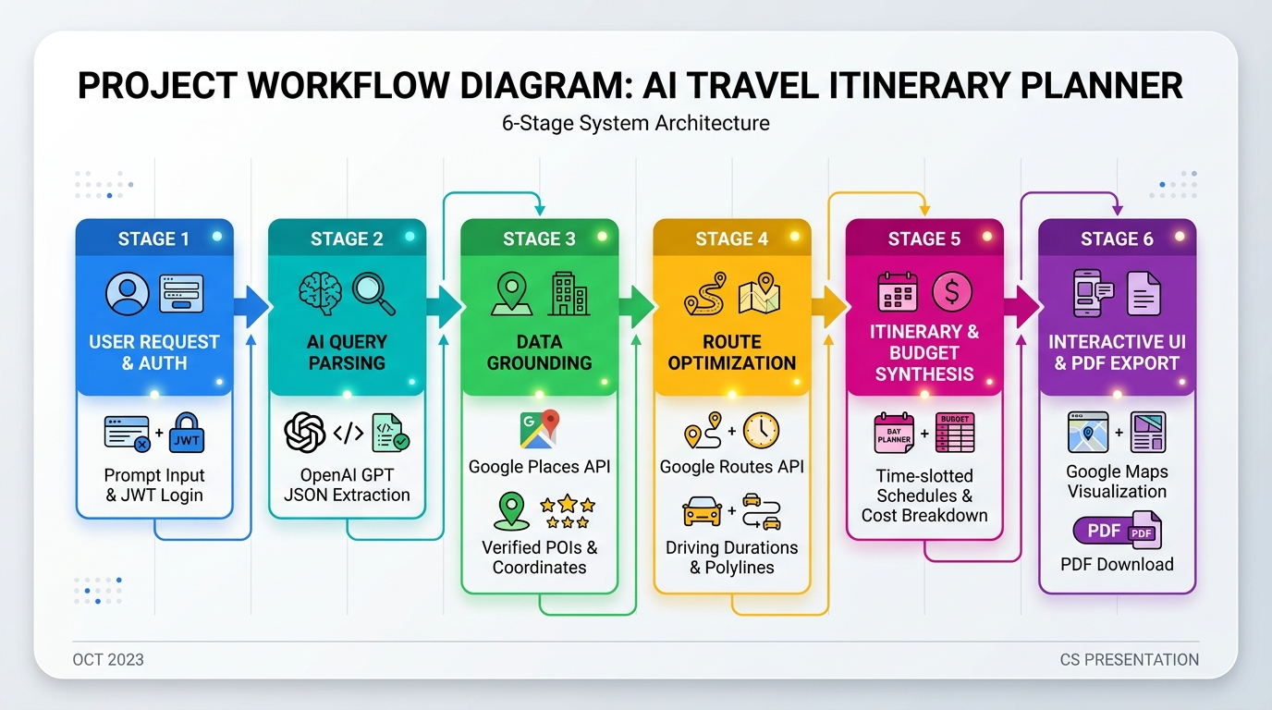
FLOWCHART

Slide 10
MODULES
1. User Authentication & Profile Module:
  Secure user sign-up and sign-in using JWT and bcryptjs (12 salt rounds).
  Protected routes, profile dashboard, and saved trip history.
2. Natural Language AI Parser:
  Parses free-form user prompts into structured JSON parameters (Destination, Duration, Budget, Group, Interests).
  Validates and sanitizes trip inputs before processing.

Slide 11
MODULES
3. Geospatial & Map Integration Module:
  Google Places API (New): Fetches verified attractions, hotels, restaurants, ratings, and photos.
  Google Routes API v2: Computes route polylines, travel distances, and step-by-step driving durations.
  Google Maps JS API: Renders interactive maps with custom markers and transit routes.
4. Budget & Itinerary Engine:
  Categorizes daily activities into structured time slots (Morning, Afternoon, Evening).
  Automatically calculates and allocates budget across accommodations, dining, and activities.
5. Dynamic Modifier & Export Module:
  Conversational itinerary refinement through targeted AI prompt updates.
  Instant PDF export with complete day-by-day schedules and expenditure breakdown.

Slide 12
REFERENCE
Bao, Y., He, T., Zhang, Y., & Chen, X. (2023). Planning with Large Language Models for Personalized Tour Recommendation and Itinerary Generation. https://arxiv.org/abs/2305.08848
Lewis, P., Perez, E., Piktus, A., et al. (2020). Retrieval-Augmented Generation for Knowledge-Intensive NLP Tasks. https://arxiv.org/abs/2005.11401
Schick, T., Dwivedi-Yu, J., Dessì, R., et al. (2023). Toolformer: Language Models Can Teach Themselves to Use Tools. https://arxiv.org/abs/2302.04761
Wang, L., Ma, C., Feng, X., et al. (2024). A Survey on Large Language Model based Autonomous Agents. https://arxiv.org/abs/2308.11432
Xie, J., Zhang, K., Chen, J., et al. (2024). TravelPlanner: A Benchmark for Tool-Use Agents in Complex Travel Planning. https://arxiv.org/abs/2402.01622

Slide 13
CONCLUSION
Successful Integration: Effectively bridges Large Language Models (OpenAI GPT) with real-world geospatial intelligence (Google Places & Routes APIs).
Elimination of Hallucinations: Ensures 100% verified locations, accurate operating hours, ratings, and real photos across all itineraries.
Significant Time Optimization: Reduces comprehensive trip planning time from 10–12 hours to under 10 seconds.
Realistic Route Feasibility: Solves impractical transit schedules by computing precise driving durations, distances, and waypoint polylines.
Granular AI Customization: Supports conversational, in-place itinerary edits without resetting or regenerating the entire plan.

Slide 14
THANK YOU !!!

