Slide 1

EDUSTART NOW WELCOMES
YOU

Slide 2

CONTENT FOR THE DAY
COMPANY INTRODUCTION
TRAINEER PROFILE
FAQ'S
INTRODUCTION TO DATA SCIENCE
DIFFERENCE BETWEEN AI/ML/DL/DS
COMPLETE COURSE CURRICULUM
Follow @edustartnow

Slide 3
Frequently Asked Questions
PREREQUISITES TO THE COURSE
NEW TO PROGRAMMING?
QUALIFICATION?
Follow @edustartnow

Slide 4
WHAT IS DATA SCIENCE?
Data science is a multi-disciplinary field that uses
scientific methods, processes, algorithms and
systems to extract knowledge and insights from
structured and unstructured data
Application: YouTube Recommendation
Follow @edustartnow

Slide 5
DIFFERENCE BETWEEN DATA SCIENCE/AI/ML/DL
AI
ML
DL
DATA SCIENCE
Follow @edustartnow

Slide 6
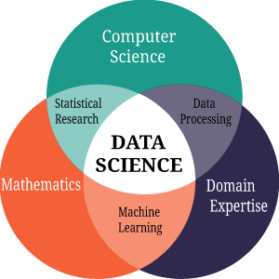
DATA SCIENCE OVER VIEW
Follow @edustartnow

Slide 7
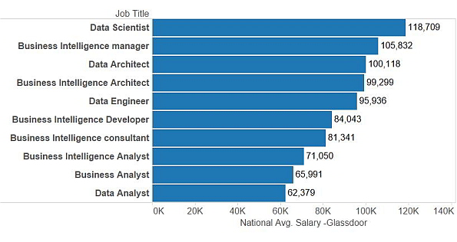
SALARY TRENDS FOR DATA SCIENTIST
Follow @edustartnow

Slide 8
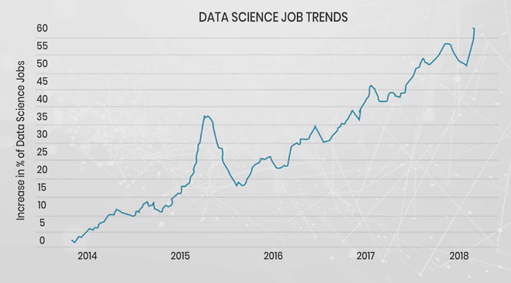
DEMAND OF DATA SCIENCE
Follow @edustartnow

Slide 9
COURSE CURRICULUM
Python Programming
Data Analysis
Data Visualization
Statistics
Machine Learning
Supervised
Unsupervised
Deep Learning
NLP
Computer vision
Classification+Project
Regression+Project
Clustering+Project
Follow @edustartnow

Slide 10
THANK YOU
Follow @edustartnow

