Slide 1
Managing Agile Projects Using Scrum
Tommy Norman
Systems Architect / Certified Scrum Master
tommy.norman@compuware.com

Slide 2
Agenda
Introductions
Overview of Agile Ideals
Scrum Process
Project Management in Scrum
Q & A

Slide 3
Introductions

Slide 4
Tommy Norman
Systems Architect, Compuware Corporation
Certified Scrum Master, Agile Alliance
MVP Team System, Microsoft
Email: tommy.norman@compuware.com
Blog: www.tommynorman.com

Slide 5
Agile Software Development

Slide 6

What is Agile Software development?

Slide 7






Traditional “Waterfall” Approach
Analysis
Design
Develop
Test
Deploy

Slide 8
Agile Approach
Analysis
Design
Develop
Test
Deploy

Slide 9
Agile Approach
Analysis
Develop
Develop
Design
Test
Deploy
Analysis
Design
Test
Analysis
Develop
Deploy
Design
Test
Deploy
!
?
?
!

Slide 10
Agile Manifesto
Individuals and Interactions
Processes and Tools
Working Software
Comprehensive Documentation
Customer Collaboration
Contract Negotiation
Responding to Change
Following a Plan

Slide 11
Most Agile methodologies have similar concepts.

Slide 12

Iterative Development

Slide 13

Working from Lists
Create Customer
Class
Add GetCustomer
Service Method
Refactor Customer
List UI

Slide 14

Develop One Small Feature at a Time

Slide 15

Sustainable Pace

Slide 16



Lean Management Hierarchy

Slide 17
Cross Functional Self Organizing Teams

Slide 18

Trusting your Team

Slide 19

Production Ready Deliverables

Slide 20

Automated testing and builds (Continuous Integration).

Slide 21




Embracing Change

Slide 22

Inspect and Adapt

Slide 23
Agile “Methodologies”
Scrum
XP
Lean
(*)DD

Slide 25
Scrum Overview

Slide 26






Roles
Scrum Master
Scrum Team
Product Owner
Stakeholders & Users

Slide 27





Artifacts
Product Vision
Product Backlog
Release Plan
Sprint Backlog
Sprint Burndown
Impediment List

Slide 28



Sprint
Project Initiation
Sprint
Review
Product Increment
Sprint
Planning
Sprint
Retrospective

Slide 29
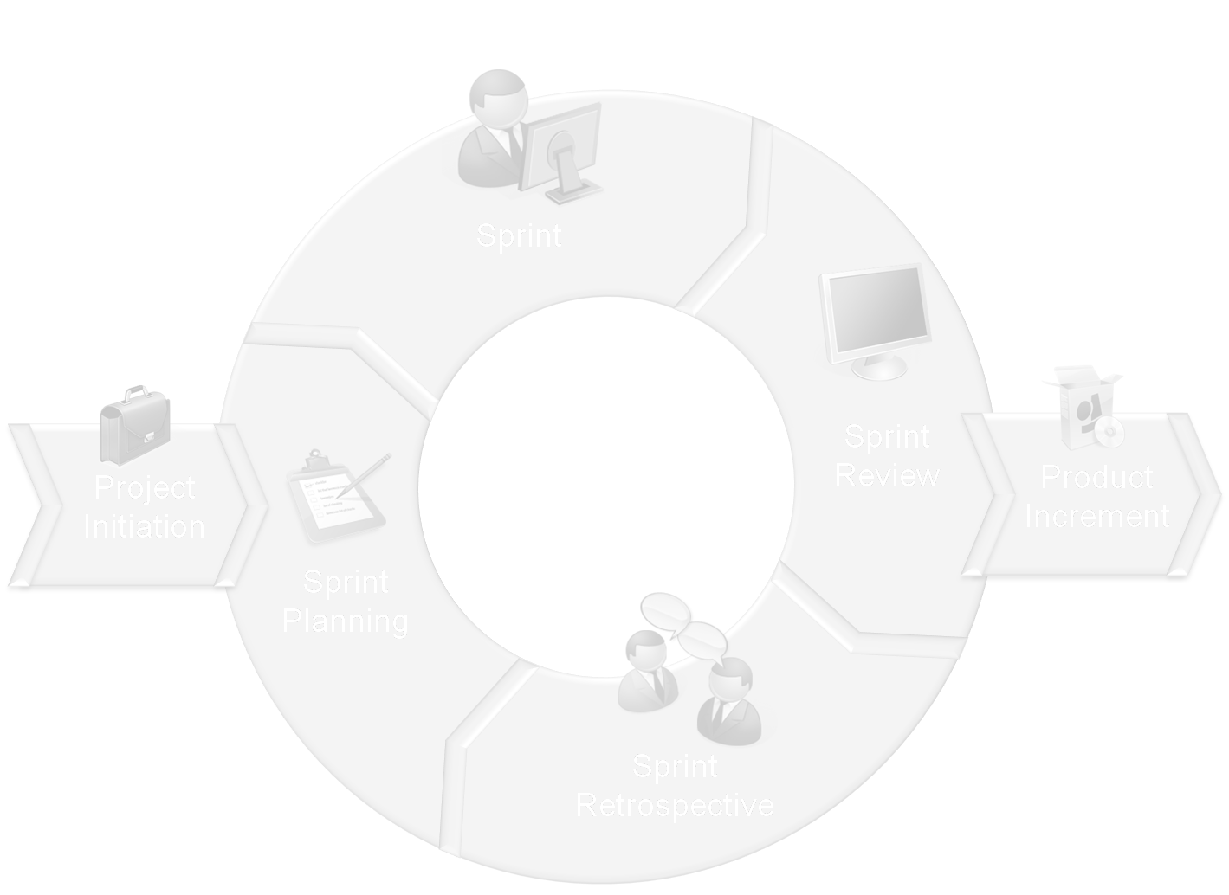
Project
Initiation

Slide 30
Project Initiation
Business Case
Product Vision
Product Backlog
Scrum Team
Release Plan

Slide 31
Sprint Planning

Slide 32
Sprint Planning
Product Owner
Product Backlog
Scrum Team
Sprint Backlog

Slide 33
Sprint

Slide 34
Sprint (Daily Scrum)
Scrum Master
Scrum Team
Sprint Backlog
Sprint Burndown
Impediment List

Slide 35


Sprint (Development)
Source Control
Continuous Integration
Developer
Unit Testing
Feature Testing

Slide 36
Product Backlog Maintenance
Product Owner
Product Backlog
Scrum Team
Stakeholders & Users

Slide 37
Sprint Review

Slide 38
Sprint Review
Product Owner
Finished Product
Scrum Master
Scrum Team
Stakeholders & Users

Slide 39
Sprint Retrospective

Slide 40
Sprint Retrospective
Product Owner
Scrum Master
Scrum Team
Stakeholders & Users

Slide 41
Rinse and Repeat

Slide 42
Sprint
Project Initiation
Sprint
Review
Product Increment
Sprint
Planning
Sprint
Retrospective

Slide 43
Project Management in Scrum

Slide 44
PMBOK

Slide 45
Process Groups
Initiation
Planning
Executing
Controlling
Monitoring
Closing

Slide 46
Knowledge Areas
Integration
Scope
Time
Cost
Quality
Resources
Communication
Risk
Procurement

Slide 47

Executing
Planning
Monitoring
Initiation
Sprint
Project Initiation
Sprint
Review
Product Increment
Sprint
Planning
Closing
Sprint
Retrospective
Controlling

Slide 48


Business Analyst
Project Manager
Product Owner
Scrum Master
Developer
Architect
Scrum Team
Stakeholders & Users
Project Director
Tester

Slide 49
Scope, Risk, Cost
Scope, Resources
Product Backlog
Sprint
Backlog
Sprint Burndown
Time, Communication

Slide 50




Slide 51
Muscle Memory

Slide 52
Muscle Memory

Slide 53
Scope
Quality
Cost
Time

Slide 54
Scope

Slide 55
Product Backlog
Product Owner

Slide 56
Epic
Theme
Feature
User Story

Slide 57
User Stories
As a (role) I want (something) so that (benefit).
Conditions of Acceptance or How to Demo

Slide 58
Estimating User Stories
Search Catalog
As a Registered User I want to search the online catalog to find items to purchase.
Business Value: 800
Story Points: 4
Stakeholders & Users
Scrum Team

Slide 59
Sprint Zero
Product Backlog
Release Plan
Architecture & Design
Continuous Integration
Feature(s)

Slide 60
Sprint Backlog
Scrum Team

Slide 61

Time

Slide 62
Project Planning
Product Backlog
3
Sprint 1
3
Product Backlog
1
Release 1
3
Sprint 2
1
3
3
Sprint 3
2
Release Plan
3
3
Release 2
Sprint 4
5
Sprint 5
8

Slide 63
Daily Scrum
Sprint Burndown

Slide 64


Sprint Task Board
User Stories
Not Done
In Progress
Done
Deferred
As a user I want this to do that.
Do this and that.
Do this and that.
Do this and that.
Do this and that.
As a user I want this to do that.
Do this and that.
Do this and that.
As a user I want this to do that.
Do this and that.
Do this and that.
Do this and that.

Slide 65
350 hrs.
Work Hours Remaining
0 hrs.
Time

Slide 66

Cost

Slide 67


Resources
Infrastructure
Software

Slide 68


More Resources = More Velocity?
8
16
12
24
16

Slide 69
Scrum of Scrums

Slide 70

Development
QA
Staging
Production

Slide 71
Quality

Slide 72
Continuous Integration
Frequent Reviews
Impediment List
Software
Craftsmanship

Slide 73
Scope
Quality
Cost
Time

Slide 74
Questions?

Slide 75
THANK YOU!

Slide 76

© 2008 Compuware Corporation — All Rights Reserved

