Slide 1

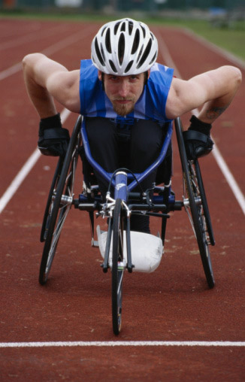
GNOME
Accessibility
Overview
Willie Walker
Sun Microsystems, Inc.
william.walker@sun.com
GNOME.Asia
October 2008

Slide 2
Topics
Why do we do accessibility?
Who benefits from accessibility?
Users and solutions
Future work
Additional thoughts
Learn more and participate

Slide 3
Why do we do accessibility?
It is the right thing to do
It is the law (e.g., Section 508)

Slide 4
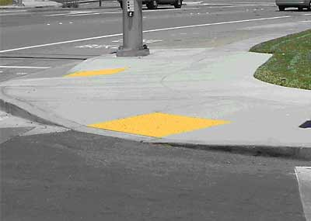
Who Benefits from Accessibility?
Everyone!
“Curb Cuts”
  Wheelchairs
  Strollers
Computer accessibility creates “Electronic
Curb Cuts”

Slide 5

Users and Solutions
Online screencasts available at:
http://master.gnome.org/~wwalker/demos/

Slide 6
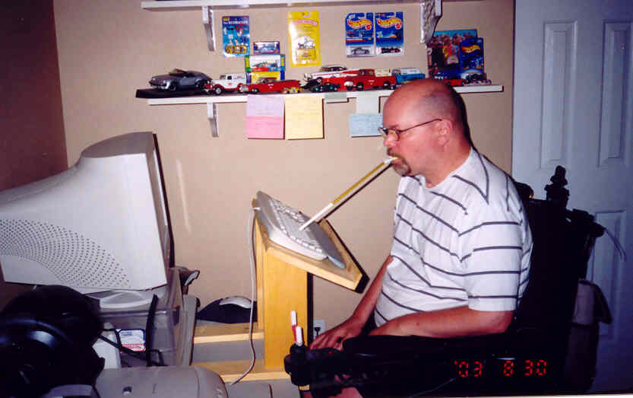
Users – keyboard only
http://www.aboutgbs.com/Tools_and%20Equipment.htm

Slide 7
Solutions – keyboard only
Cannot use mouse
  GNOME provides full keyboard access
  You can do everything from keyboard
Keyboard Enhancements
  StickyKeys
  SlowKeys
  BounceKeys
  RepeatKeys
  MouseKeys

Slide 8
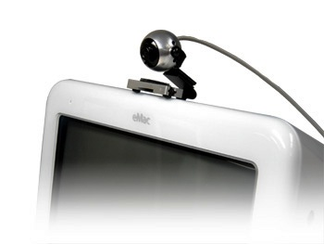
Users – mouse only

Slide 9
Solutions – mouse only
Users cannot use keyboard
May or may not be able to click mouse
MouseTweaks
  Dwell clicking
    “Hover” to click
  Clicking by gesture
    “Hover” and then move
MouseTrap
  Emerging, low cost head tracking

Slide 10
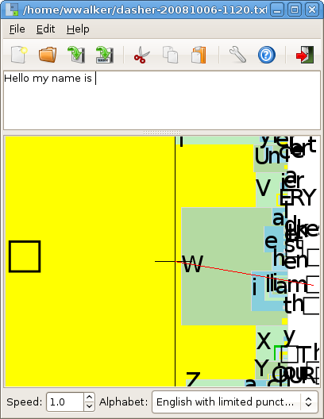
Solutions – mouse only
Dasher
  Predictive text entry
  “Typing” speed of 35+ words per minute

Slide 11
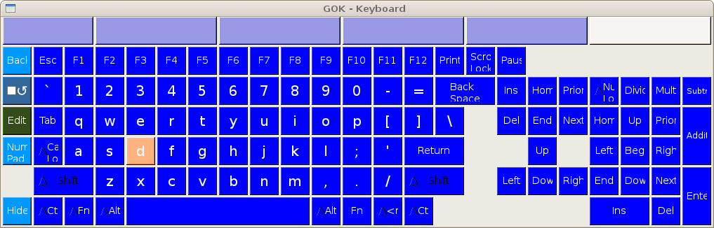
Solutions – mouse only
GOK
  GNOME Onscreen Keyboard
  Move mouse and hover or click to type
  “UI Grab” and word completion

Slide 12
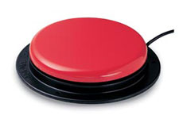
Users – switch only

Slide 13
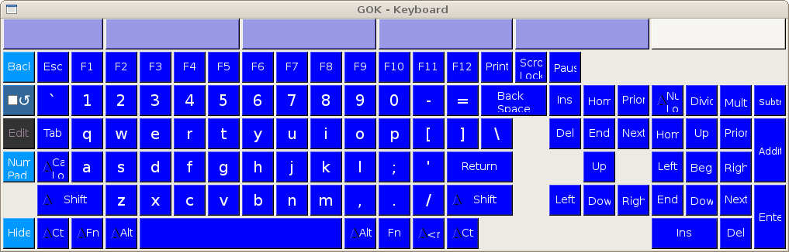
Solutions – switch only
GOK
  GNOME Onscreen Keyboard
  “Scanning Mode”

Slide 14
Solutions – switch only
Click switch to start vertical scan

Slide 15
Solutions – switch only
Wait to get to the row you want

Slide 16
Solutions – switch only
Click switch to scan horizontally

Slide 17
Solutions – switch only
Wait to get to the key you want

Slide 18
Solutions – switch only
Wait to get to the key you want

Slide 19
Solutions – switch only
Wait to get to the key you want

Slide 20
Solutions – switch only
Wait to get to the key you want

Slide 21
Solutions – switch only
Click to select the key

Slide 22
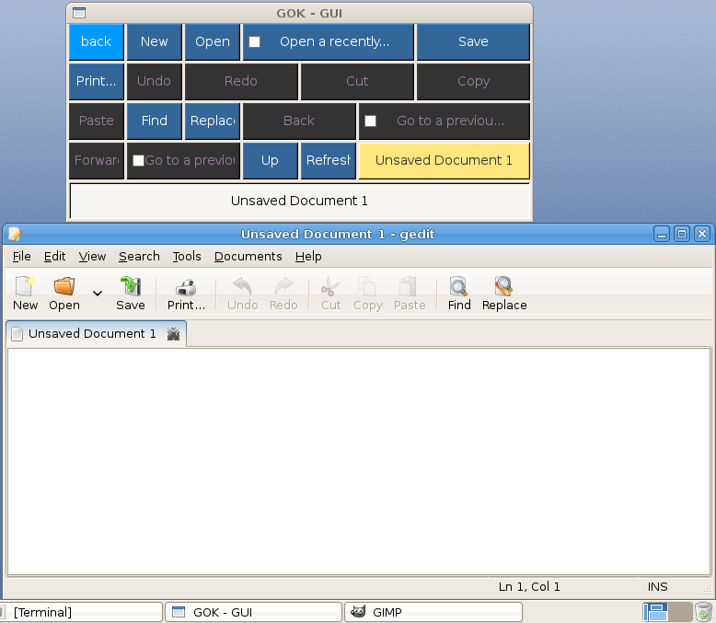
More on GOK - “UI Grab”

Slide 23
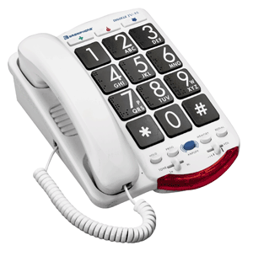
Users – low vision
High contrast
Large print
Inverse

Slide 24
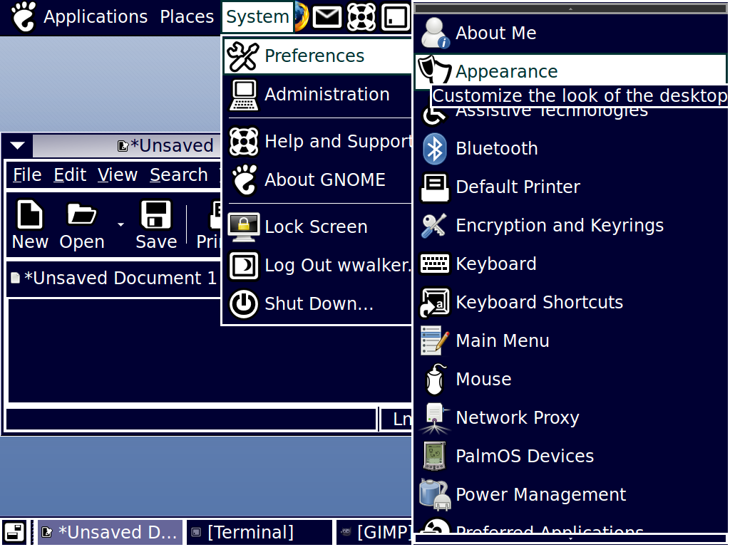
Solutions – low vision (theming)

Slide 25
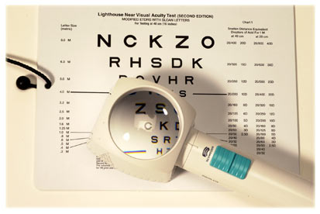
Users – low vision

Slide 26
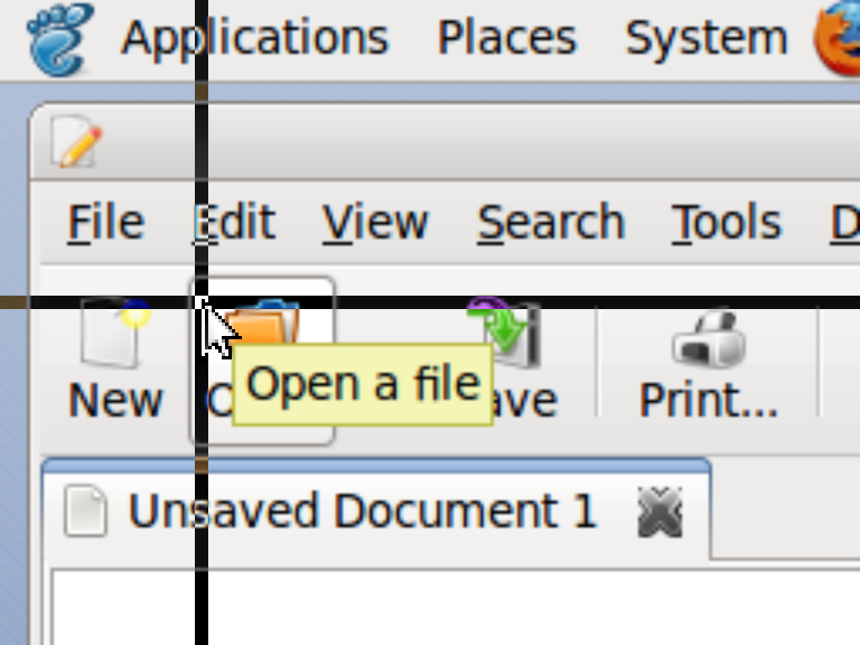
Solutions – low vision (Orca w/mag)

Slide 27
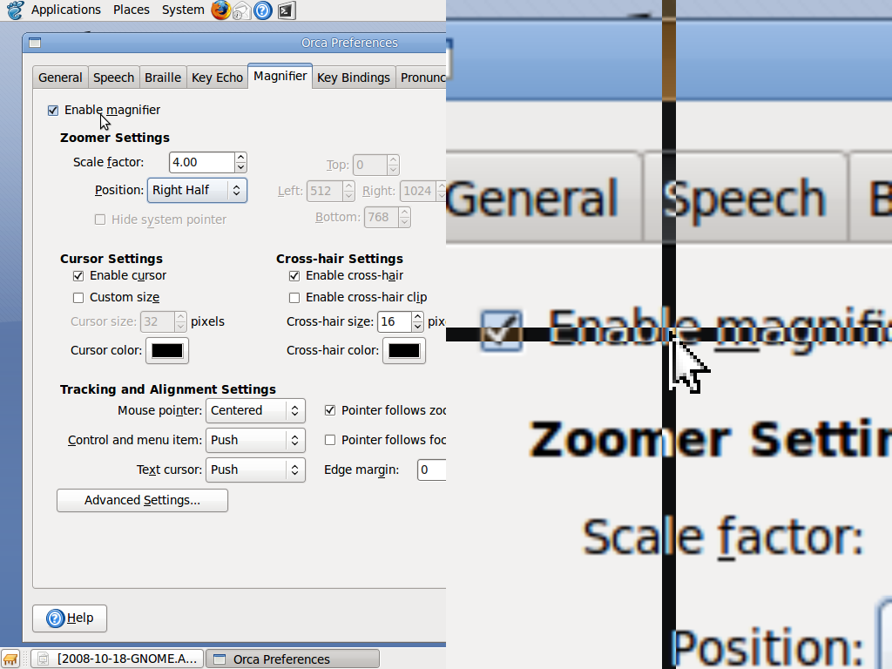
Solutions – low vision (Orca w/mag)

Slide 28

Users - blind

Slide 29
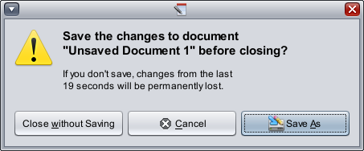

Solutions – blind (Orca w/speech)
“... if you don't save, changes from the last 19 seconds will be permanently lost ...”

Slide 30
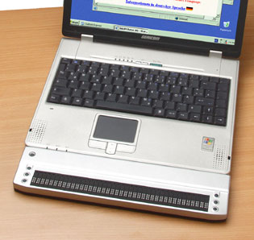
Solutions – blind (Orca w/braille)

Slide 31
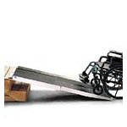
How does it work?
AT-SPI
  Assistive Technology
  Service Provider Interface
  “Built-in, not bolted on”

Slide 32
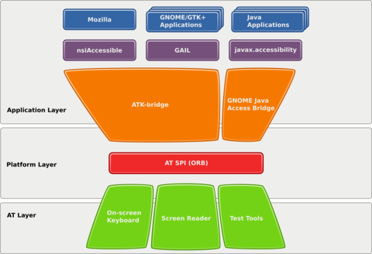
How does it work?

Slide 33
How does it work?
OpenOffice

Slide 34
How does it work?
GTK+

Slide 35
How does it work?
Firefox

Slide 36
How does it work?
Java

Slide 37
How does it work?
KDE/Qt (future)

Slide 38
How does it work?
AT-SPI

Slide 39
How does it work?
Orca

Slide 40
How does it work?
GOK

Slide 41
How does it work?
Dasher

Slide 42
How does it work?
Events

Slide 43
How does it work?
Queries

Slide 44
How does it work?
Presentation

Slide 45
Future Work
Espeak languages and voices
Cognitive impairments
  Dyslexia
  Learning disabilities
  ...
Hearing impairments
  Closed captioning
  ...
Infrastructure changes
  AT-SPI move from CORBA to D-Bus
    Access for GNOME, KDE, Mobile...

Slide 46


Additional thoughts
Accessibility in GNOME is built-in, powerful, free
  Covers a range of disabilities
  Basic accessibility equal to other desktops
  Orca rivals commercial products
  GOK & Dasher superior to Windows/Mac options
  Being used world wide
+ a11y =
“GNOME with accessibility provides universal access”

Slide 47
Learn more and participate
URLs
  http://live.gnome.org/Accessibility
  http://mail.gnome.org/mailman/listinfo/gnome-accessibility-list
  http://master.gnome.org/~wwalker/demos/
Room #2 today:
  16:00-17:00 – Accessibility Internals
Room #3 tomorrow:
  14:00-15:00 – Orca
  15:00-16:00 – Accessibility Testing

Slide 48
GNOME
Accessibility
Overview
Willie Walker
Sun Microsystems, Inc.
william.walker@sun.com
GNOME.Asia
October 2008

