Slide 1

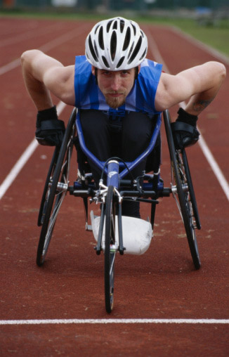
Orca:
Screen Reading and Magnification for GNOME
Willie Walker
Sun Microsystems, Inc.
william.walker@sun.com
GNOME.Asia
October 2008

Slide 2
Agenda
What is Orca?
Demo
Why is Orca important?
How does Orca work?
Closing thoughts

Slide 3

What is Orca?
Screen Reader
  Speech
  Braille
  Magnification
Open Source
  Thriving community
  of happy users and developers

Slide 4
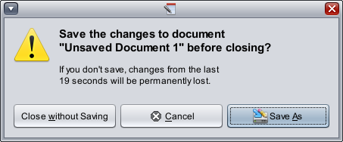
What is Orca?
“... if you don't save, changes from the last 19 seconds will be permanently lost ...”
Screen Reader
  Speech
  Braille
  Magnification
Open Source
  Thriving community
  of happy users and developers

Slide 5
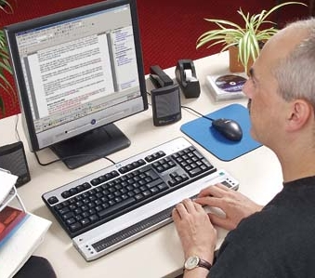
What is Orca?
Screen Reader
  Speech
  Braille
  Magnification
Open Source
  Thriving community
  of happy users and developers

Slide 6

What is Orca?
Screen Reader
  Speech
  Braille
  Magnification
Open Source
  Thriving community
  of happy users and developers

Slide 7
Compelling accessibility!
“I am ... the beneficiary of this wonderful work. FF3 is the application I use most frequently on the desktop, and it's helping meet my needs where I no longer have good alternative options.”
Screen Reader
  Speech
  Braille
  Magnification
Open Source
  Thriving community
  of happy users and developers
-- Orca User
http://live.gnome.org/Orca

Slide 8
Compelling accessibility!
Let the user requirements drive the architecture, not the other way around.

Slide 9

Demo

Slide 10
Why is Orca important?
  Free Open Source Software
Those that need it the most are often those who cannot afford it.
Contributions and ideas come directly from end users.
Source code changes are used and tested immediately.

Slide 11
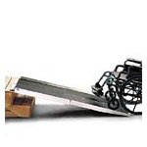
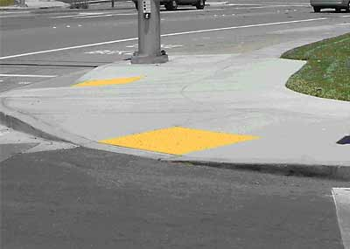
How does Orca work?
AT-SPI
  Assistive Technology
  Service Provider Interface
  “Built-in, not bolted on”

Slide 12
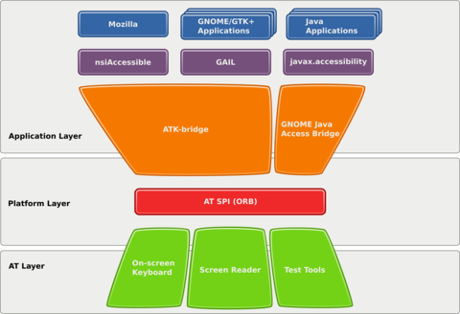
How does Orca work?

Slide 13





How does Orca work?
Apps and Toolkits
Accessibility Infrastructure (AT-SPI)
Orca

Slide 14
How does Orca work?
Apps and Toolkits
Accessibility Infrastructure (AT-SPI)
FOCUS!
Orca

Slide 15
How does Orca work?
Apps and Toolkits
Accessibility Infrastructure (AT-SPI)
FOCUS!
Name?
Orca

Slide 16
How does Orca work?
Apps and Toolkits
Accessibility Infrastructure (AT-SPI)
FOCUS!
Name?
“OK”
Orca

Slide 17
How does Orca work?
Apps and Toolkits
Accessibility Infrastructure (AT-SPI)
FOCUS!
Name?
“OK”
Orca
OK Button

Slide 18

How does Orca work? (Scripting)
Apps and Toolkits
Accessibility Infrastructure (AT-SPI)
Orca

Slide 19

Closing thoughts
Accessibility in GNOME is built-in, powerful, free
Orca rivals commercial products
Being used world wide
+ a11y =
“GNOME with accessibility provides universal access”

Slide 20
Orca:
Screen Reading and Magnification for GNOME
Willie Walker
Sun Microsystems, Inc.
william.walker@sun.com
GNOME.Asia
October 2008

