Slide 1

Deliver a rich,
plugin-less audio
experience
on the web!
With buzz.js and
knockout.js!
Mike Hodnick
github.com/kindohm
@kindohm

Slide 2

“Yo, why HTML5 audio?”

Slide 3
“We code for HTML5 audio so that we don't have to use plug-ins for
audio in web browsers.”

Slide 4
“But plug-ins aren’t so bad! I like Flash!”

Slide 5
“No, you don’t like Flash.”
“r u n00b?”

Slide 6
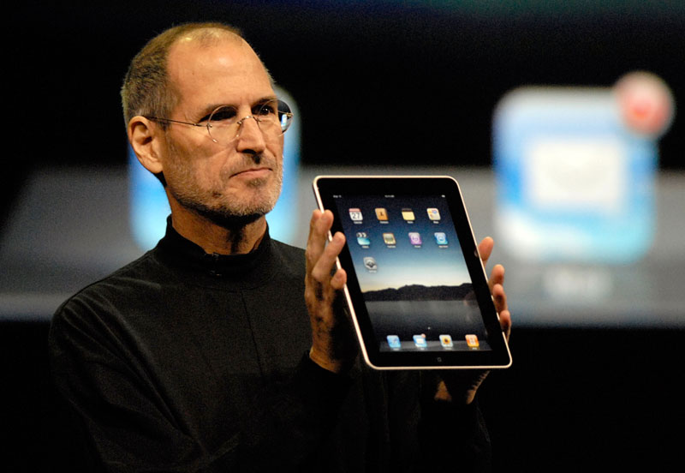
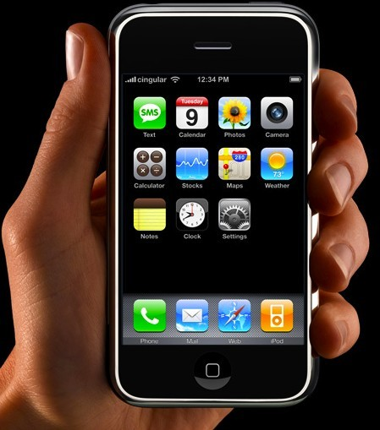
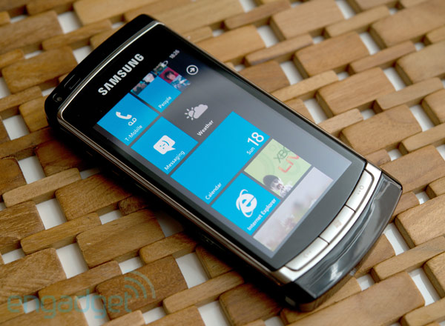
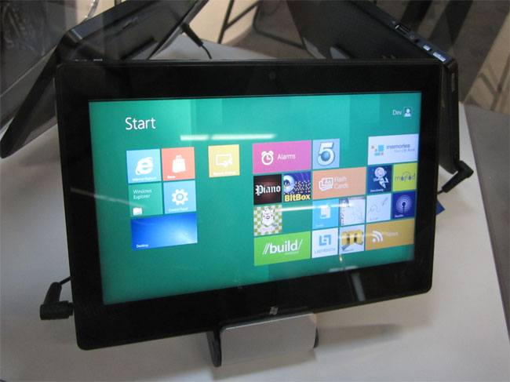
Adobe: “Chrome for Android does not Support Flash”

Slide 7
“How about raw mp3 files for downloading?”

Slide 8
“mp3 files? Lame. What about rich browser features? You have a blank canvas! The sky is the limit!”

Slide 9
“Are you telling me to compete with Pandora and Spotify?”

Slide 10
“Garage production, podcasts, voice recordings, interviews...
they can all benefit from HTML5 audio.”

Slide 11
“You can even do this stuff inside your own company if you want!”

Slide 12
“Ok, so what is buzz.js?”

Slide 13
“Buzz.js levels the HTML5 audio playing field.”

Slide 14
var basePath = ‘path/to/audio/file’;
var sound = new buzz.sound(
basePath,
{ formats : [‘mp3’, ‘ogg’, ‘wav’] } );
sound.play();
sound.stop();

Slide 15
“Ok, so what is knockout.js?”

Slide 16
“Use it to create simple, dynamic JavaScript UI's with the MVVM pattern. It isn't even an HTML5 thing!”

Slide 17
<span data-bind=“text: title”></span>
<input data-bind=“value: author”></input>
var viewModel = {
title: ‘The Art of Llamas’,
author: ko.observable(‘Llarry’)
};
ko.applyBindings(viewModel);
// change the name…
viewModel.author(‘Llarry Llindstrom’);

Slide 18
“I’m down with that. Let’s build!”

Slide 19

@kindohm
github.com/kindohm
buzz.jaysalvat.com
knockoutjs.com

Slide 20
Llama images used respectfully under their Creative Commons licenses:
http://flic.kr/p/aYkcVv
http://flic.kr/p/68qNUM
http://flic.kr/p/5a1A2E

