Slide 1
LEVEL-UP YOUR WIN7 KINECT APP
approaching an exceptional natural user interface
mike hodnick
kindohm.com
github.com/kindohm

Slide 2
ABOUT MIKE
i like to:
write code
play hockey
write music
make and eat pancakes

Slide 3
MAIN THEMES
kinect in your wpf architecture
background noise
cursor control sucks
a few helpful tools
this is not a 100-level session

Slide 4
KINECT IN YOUR WPF ARCHITECTURE
heard of model-view-viewmodel?
kinect as a service

Slide 5
DEMO
implement the kinect runtime as a service using the model-view-viewmodel pattern

Slide 6
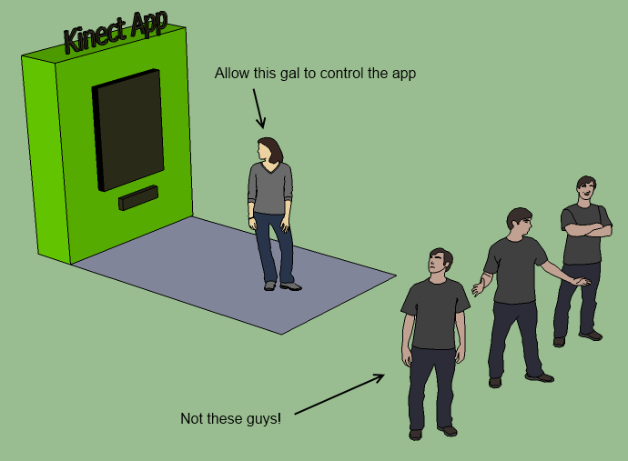
BACKGROUND NOISE
who should be in control?
who should not be in control?
where is control allowed?

Slide 7
CONSTRAIN CONTROL
unique user id
first-in-first-out, or your own rules
location

Slide 8
DEMO
implement a first-in-first-out bounding box with a configurable user interface

Slide 9
BOUNDING BOX BONUS
try implementing “UserEntered” and “UserExited” events to enable awareness of user presence.

Slide 10

SAFETY TIP #1
include a kinect debug view to diagnose sensor problems such as lighting, camera distance, or device failure

Slide 11
VIDEO AND DEPTH FEEDS
use coding4fun kinect tools to easily render video and depth video images

Slide 12
SAFETY TIP #2
use a timer or background worker to throttle speed of depth and video image rendering

Slide 13
DEMO
enhance the bounding box user interface with visual debugging information

Slide 14
WHAT IS KINECT CURSOR CONTROL?
translate hand joint to cursor position on screen
user32.dll call
use skeleton smoothing to eliminate jitter
selection gesture such as hover or push

Slide 15
WHY KINECT CURSOR CONTROL IS GOOD
somewhat intuitive for users
easy to implement and you can be lazy

Slide 16
WHY KINECT CURSOR CONTROL IS BAD
different body sizes == different experiences
cross-body problems
cursor precision is problematic
an old metaphor in a NUI world

Slide 17
ALTERNATIVE #1 TO CURSOR CONTROL
gestures
creative use of motion tracking and math

Slide 18
GESTURE THEORY
out of scope for today
not easy to get the right design
worth it for the users

Slide 19
DEMO
implement your own swipe

Slide 20
DEMO
gesture recording and tracking

Slide 21
DEMO
“dance central” style menu
creatively use math and motion tracking

Slide 22
ALTERNATIVE #2 TO CURSOR CONTROL
speech recognition
limited success
quiet or controlled environment required
open or public environments will fail

Slide 23
DEMO
basic speech recognition

Slide 24
go forth and write code for other people’s body joints
(and listen to them speak)
mike hodnick
kindohm.com
github.com/kindohm

