Slide 1
Digital Portfolio
STUDENT NAME: DINESH V
REGISTER NO AND NMID: 222402699 asunm163u24cs127
DEPARTMENT : BSC Computer science
COLLEGE: COLLEGE/ UNIVERSITY: Hindustan college of arts and sciences/University of Madras

Slide 2
PROJECT TITLE
Academic and Skill Development Portfolio

Slide 3


AGENDA
Problem Statement
Project Overview
End Users
Tools and Technologies
Portfolio design and Layout
Features and Functionality
Results and Screenshots
Conclusion
Github Link
3/21/2024 Annual Review

Slide 4

PROBLEM STATEMENT
Students face challenges in organizing and presenting their academic achievements, projects, and skills in one place. Many students struggle to create a professional portfolio that reflects their capabilities and progress effectively.

Slide 5

PROJECT OVERVIEW
This digital portfolio helps students document their coursework, projects, certifications, and extracurricular activities. It provides a structured way to showcase achievements, track progress, and share information with faculty and potential employers.

Slide 6

WHO ARE THE END USERS?
Students looking to present their academic profileFaculty members who need to track student performanceRecruiters and employers searching for skilled candidatesEducational institutions aiming for better documentation

Slide 7
TOOLS AND TECHNIQUES
Languages: HTML, CSS, JavaScriptFrameworks: Bootstrap for responsive designVersion Control: GitHub for collaboration and trackingDesign Tools: Figma / Canva for UI mockupsTesting: Chrome DevTools for debugging and responsiveness checks

Slide 8
POTFOLIO DESIGN AND LAYOUT
The portfolio is designed with simplicity and clarity in mind:Clean navigation barSections for academic achievements, projects, certifications, and contact detailsMobile-friendly layout for accessibilityUse of consistent colors and typography for professional appearance
8

Slide 9
FEATURES AND FUNCTIONALITY
Upload and manage academic projectsAdd certifications and training recordsFilter and search for specific achievementsResponsive design for mobile and desktopEasy sharing through GitHub and email links

Slide 10
RESULTS AND SCREENSHOTS
Portfolio successfully created and tested✔ Projects, certificates, and achievements are displayed clearly✔ Responsive layout works on both desktop and mobile devices✔ Students can easily update and manage content(Insert screenshots of the portfolio homepage, project section, and mobile
3/21/2024 Annual Review
10

Slide 11
CONCLUSION
This portfolio provides a professional platform for students to present their skills and achievements effectively. It helps build confidence, enhances job prospects, and provides a structured way to document academic progress.
11

Slide 12
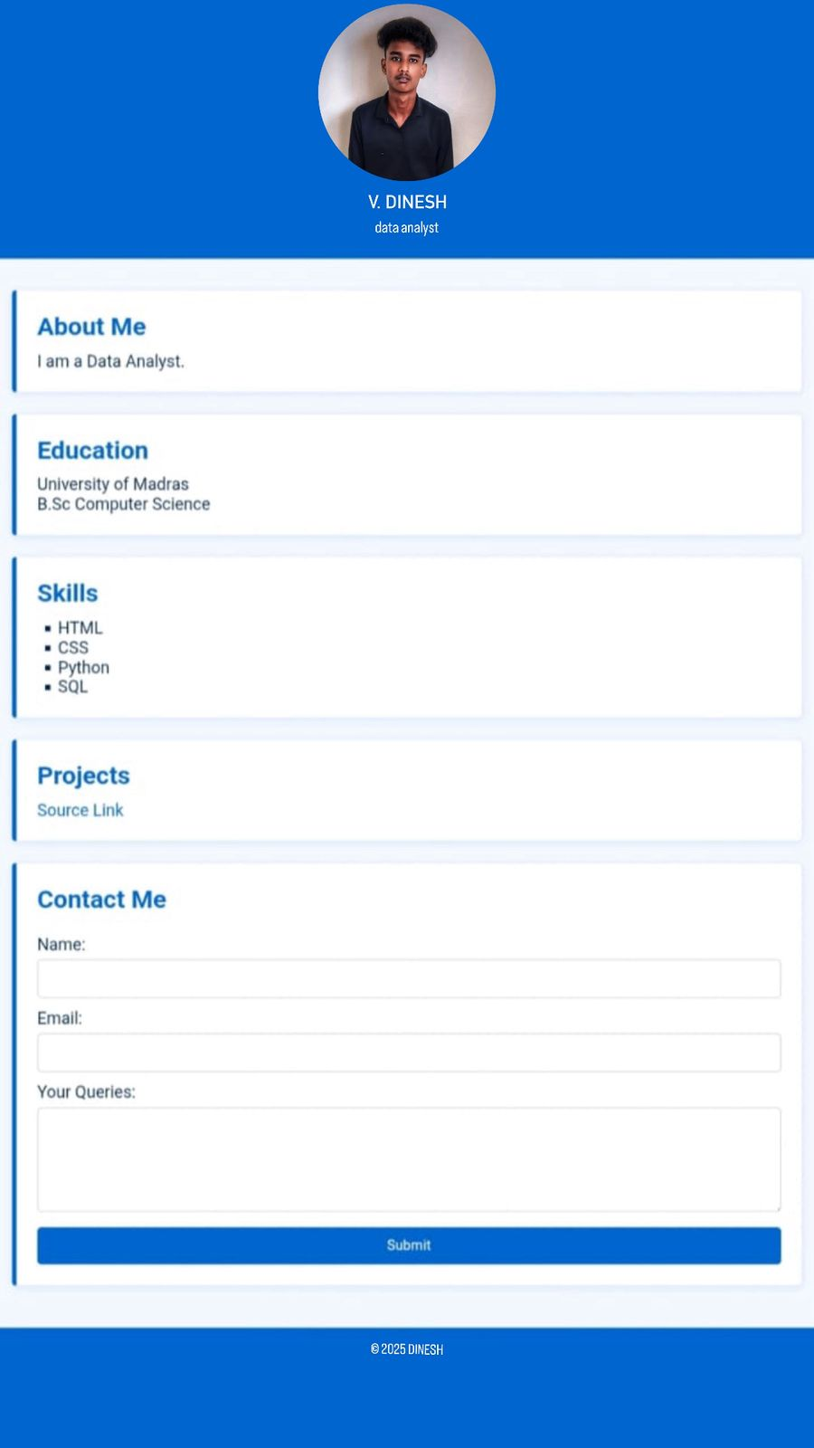
Screenshot

